Slide 1
Please submit your questions in the Q&A Box at the end of the session,
Thank you
Welcome!
You will be muted upon entry

Slide 2
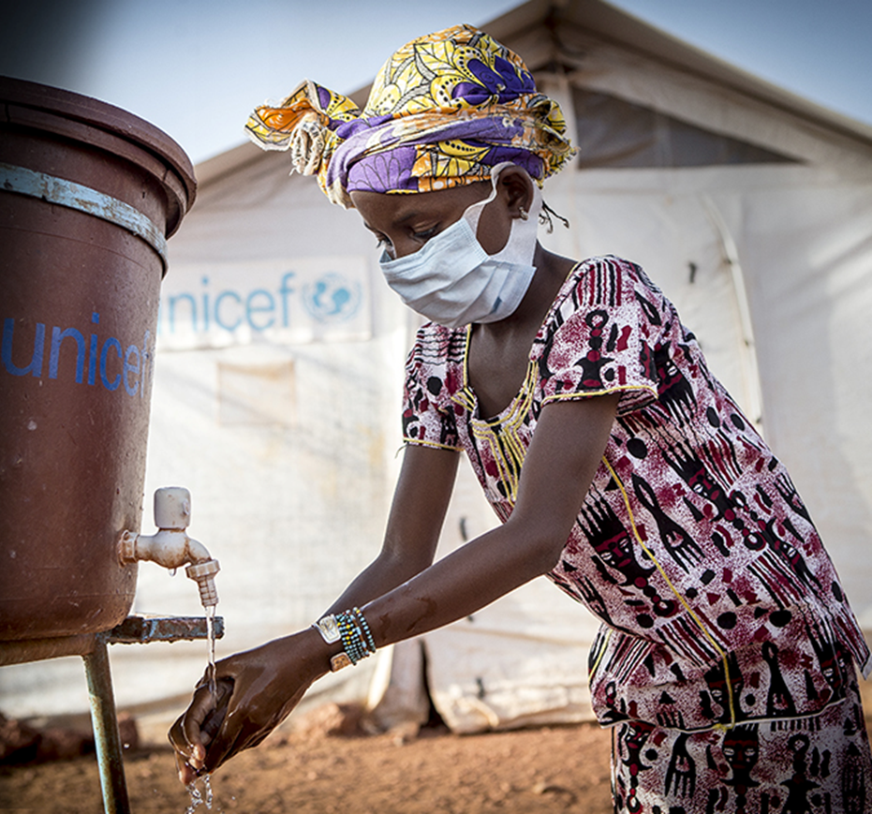
WASH Pledge Intro for Preferred Suppliers
Sept 2020
Xylem global procurement

Slide 3
Agenda
Overview of Xylem SC 2025 Sustainability Goals
WASH Pledge
Q&A

Slide 4
Xylem Sustainability 2025 Framework
At Xylem, we define sustainability broadly, as responsible practices that strengthen the environment, global economy and society, creating a safer and more equitable world.
Serving Our Customers
We provide innovative technologies, solutions and expertise that help our customers solve major water challenges like water affordability, scarcity and resilience. We are harnessing the power of data and analytics to transform water management and deliver powerful water, energy and cost savings for our customers and the communities they serve.
Building a Sustainable Company
We know that in order to be a
company that advances sustainability,
we have to be a company with a
strong financial foundation that executes with discipline today while also focusing
on the future. We adhere to and
champion responsible business
practices, including promoting
diversity and inclusion, and look to
be a standard-setter. We still have much to do but we are fully committed to this purpose.
Affordability
Operations
Scarcity
Culture/
Talent
Creating a
Water-Secure
World
Supply
Chain
Resilience
Empowering Communities
As part of our commitment to create both economic and social value, we strive every day to deliver social impact by solving water for communities globally, including those impacted by water-related disasters, recognizing that water challenges dramatically affect the quality of life and economic prospects for millions of people around the globe.
Living
the Mission
Disaster
Response
Education
& Awareness

Slide 5
Building a Sustainable Supply Chain
Operations
  Goals
  2025
Culture/
Talent
1
  Engage Preferred suppliers in sustainability initiatives through audit program and corrective action plans
  100% of Sustainability critical & preferred suppliers
Creating a
Water-Secure
World
2
  Preferred Suppliers will provide Scope 1 & 2 GHG emissions and water usage via CDP Supply Chain
  To Be Defined in 2021
Supply
Chain
3
  Preferred suppliers will disclose sustainability information via EcoVadis (or equivalent) system
  60% of Preferred Suppliers
4
  Preferred Suppliers will take the WASH Pledge for the Workplace
  100% - Mandatory condition to be Preferred Supplier
5
  Implement a supplier diversity program in the US and increase diverse supplier spend
  12% of spend

Slide 6
Agenda
Overview of Xylem SC 2025 Sustainability Goals
WASH Pledge
Q&A
What is WASH and what is the WASH Pledge?
Why should we sign up?
How do we sign up?
We signed the WASH Pledge, what’s next?

Slide 7
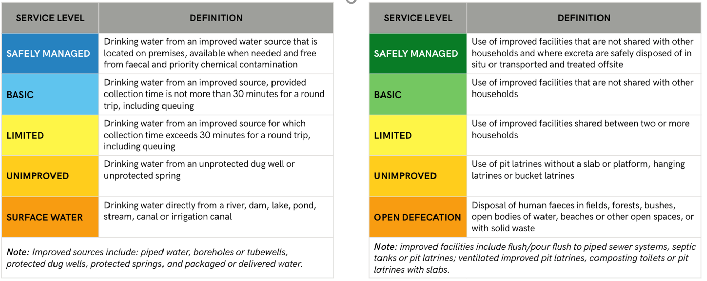

Universality: Basic for all AND moving up the ladder
WASH: Water, Sanitation & Hygiene
WATER
SANITATION
Notes:
This slide shows a bit more about the differences between the levels of service – for example, the difference between a basic and safely managed water service is a difference of proximity and availability: safely managed water service must be on premises and available when needed, whereas basic water service can be within a 30-minute round trip from home.

Slide 8
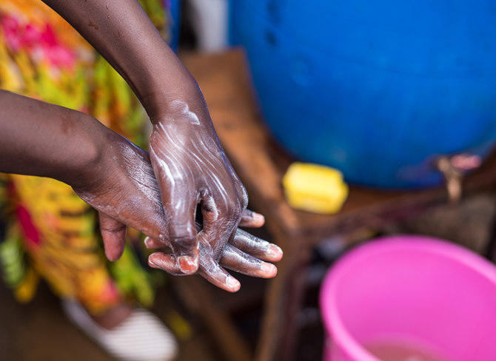

WASH Pledge at the Workplace
The WBCSD Pledge for access to safe water, sanitation and hygiene (WASH) is an opportunity for companies to contribute concretely to the implementation of SDG 6, while at the same time ensuring that they provide international best practice on WASH.
By signing the WASH Pledge, companies commit to implementing access to safe water, sanitation and hygiene at the workplace at an appropriate level of standard for all employees in all premises, under their control within three years of signature. Under the Pledge, companies are also encouraged to address WASH across their value chain, including among their suppliers, as well as in the communities that surround their workplaces and/or where their workers live.
Source: https://www.wbcsd.org/Programs/Food-and-Nature/Water/Water-stewardship/WASH-access-to-water-sanitation-and-hygiene/The-WASH-Pledge

Slide 9
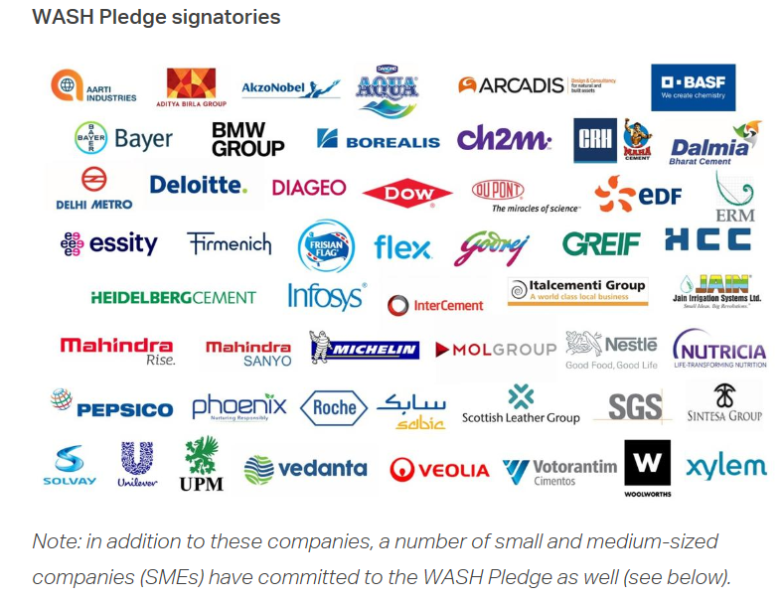
Why should my company sign the WBCSD Pledge?
To Demonstrate leadership by joining WBCSD members in setting a higher standard for the health and safety of company employees, value chains and communities.
To Join Xylem and the WBCSD in setting a higher standard for the health and safety of company employees.
To Generate impact by contributing to the implementation of the SDGs
To Reap business benefits by investing in a healthier and more productive workforce and strengthening their social license to operate
Notes:
To demonstrate leadership:
Join Xylem and the WBCSD in setting a higher standard for the health and safety of company employees.
Sign the first business-led initiative that directly tackles WASH at the workplace.
Demonstrate that businesses can have a direct positive impact.
“Walk the Talk” by ensuring you are in line with international best practice on WASH.
To generate impact:
Lead the global business momentum toward the achievement of universal access to safe WASH and contribute to the implementation of the United Nations Sustainable Development Goals and the Human Rights to Water and Sanitation.
To reap business benefits:
Invest in a healthier and more productive workforce.
Generate reputational benefits from your adherence to internationally recognized standards and demonstrate them to a wide audience.
Strengthen your social license to operate and lower your reputational risks.
The business case for investing in WASH is clear. While every dollar invested returns USD $5 in benefits for sanitation and USD $2 for water, one in every three people still goes without access to safe sanitary facilities and one in every ten does not have access to clean and safe water when needed. The impact potential for WASH investments is immense.

Slide 10
How can my company sign up?
The process is quite straightforward: A representative in a position to commit their business can sign the Pledge and submit a statement (see sample below) to the WBCSD Water team.
In addition, we request that you cc: Xylem on your commitment email to the WBCSD at our sustainability email address xylem.sustainability@xyleminc.com so we can track completion.
Example statement:
This email confirms that <Name of the Company> has committed to signing the WBCSD Pledge for Access to Safe Water, Sanitation and Hygiene. We recognize that by signing this Pledge, <Name of the Company> commits to implementing access to safe water, sanitation and hygiene at an appropriate level of standard for all employees in all premises under our direct control, and supporting partners across our value chains and communities that surround our workplaces within three years of signature.
Source: https://www.wbcsd.org/Programs/Food-and-Nature/Water/Water-stewardship/WASH-access-to-water-sanitation-and-hygiene/The-WASH-Pledge

Slide 11
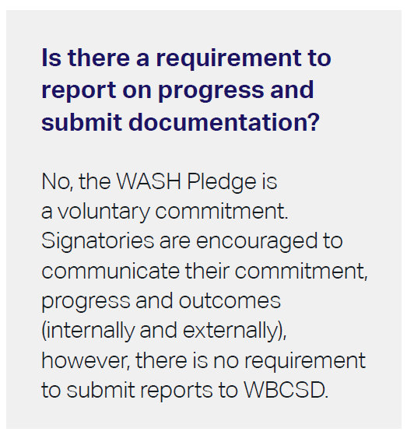
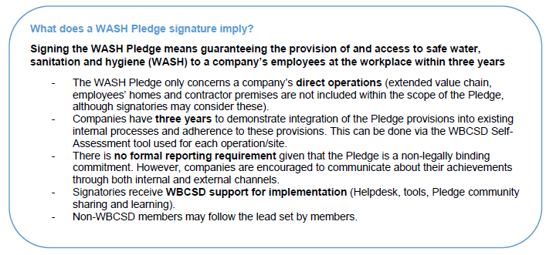
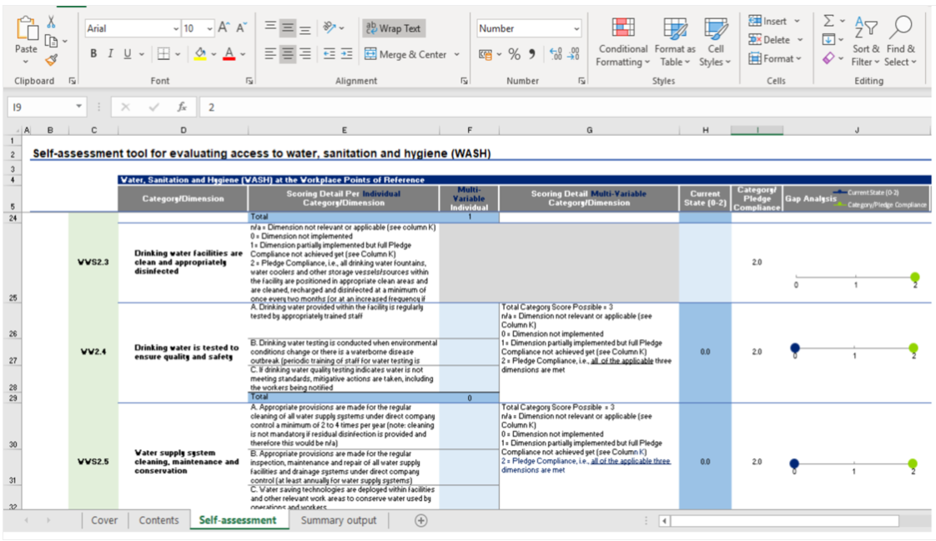
My company signed the WASH Pledge, what‘s next?
WASH Pledge frequently asked questions
WASH Pledge implementation case studies e.g. Nestle implementation
Other useful resources:
WASH Pledge guiding principles
WASH Pledge impact report
WASH Pledge self-assessment tool for business
Notes:
Other Useful Resources:
WASH Pledge guiding principles
WASH Pledge impact report

Slide 12
Agenda
Overview of Xylem SC 2025 Sustainability Goals
WASH Pledge
Q&A
Thank you!
Any Questions?

Slide 13
Thank you!
We look forward to you All joining us in making an impact on WASH.
We kindly ask you to address this ask within your organization in the coming days, aiming to sign the WASH Pledge by the 30th of September!
We will be sharing the slides and the recording with all of you at the conclusion of these sessions.

Slide 14

Please type your questions in the Q&A Box

