Slide 1
Water Quality Data Processing

Slide 2
Objectives of this session
1
HYPACK Environment
What software tools are included
Changes to streamline the workflow
2
Processing WQ Sensor Data
New WQS Editor
Selecting Sensor Data
Saving Contours from WQS Editor
Saving Sorted data from WQS Editor
3
Processing ADCP In situ Data
Displaying the profile information
Viewing individual Ensembles
Notes:
Stressed Water Supply
Issue
Maintain the health of traditional water sources and execute a water source diversification strategy
Solution
Xylem’s leading-edge technologies monitor, pump and treat water from all sources and enable water reuse
Aging Infrastructure
Issue
Utilities have to effectively assess and identify high-risk areas for repair/replacement before problems occur
Solution
Xylem’s intelligent pipeline and critical infrastructure services perform condition assessment, identify defective assets, provide bypass services and replacement technologies, reduce or eliminate combined sewer overflows and leaks/non-revenue water
Stormwater & Flooding
Issue
Significant increase in severe weather patterns is causing flooding and related damages to communities
Solution
Xylem’s flood management solutions include sensors for early warnings, dewatering for disaster response, communications for recovery and submersible pumping for resilient infrastructure
Regulatory Compliance
Issue
Utilities must successfully comply with a growing body of compliance regulations
Solution
Xylem’s analytics and sensors evaluate a broad range of water quality parameters, and our technologies treat water and wastewater to meet regulatory standards
Non-Revenue Water
Issue
Utilities have an important opportunity to reduce persistent and costly water losses from leaks and faulty meter readings
Solution
Xylem’s broad portfolio of solutions monitors for, and identifies, water leaks, as well as faulty meters. Our communications network enables point-to-multipoint communications throughout the system
Operating Strategy Reducing Costs
Issue
Utilities want to lower operating and energy costs, and leverage new revenue opportunities
Solution
Xylem offers industry-leading pumping and treatment solutions for energy efficiency, and software-enabled solutions to optimize operations and identify revenue opportunities

Slide 3
HYPACK Environment

Slide 4
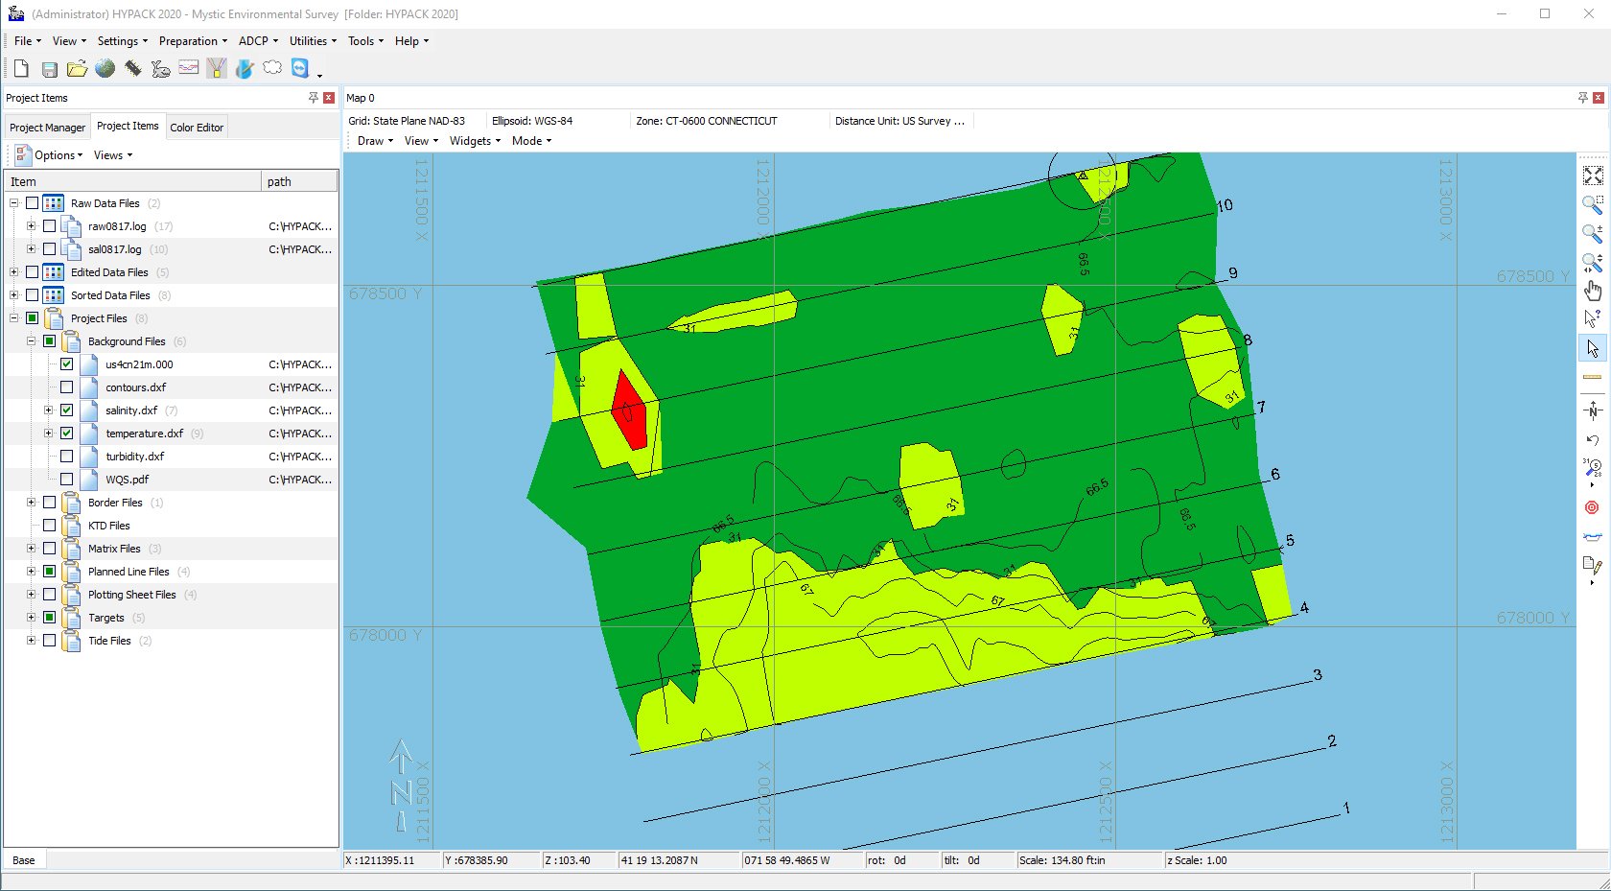
HYPACK Shell
Icon and Menu Area
1 2 3 4 5 6 7 8
Geodesy Bar
Geodetic Parameters
Hardware Settings
Survey Program
ADCP Processing
ADCP In Situ Processing
WQ Editor
Point Cloud Viewer
Remote Assistance
Map Tools
Project Files

Slide 5
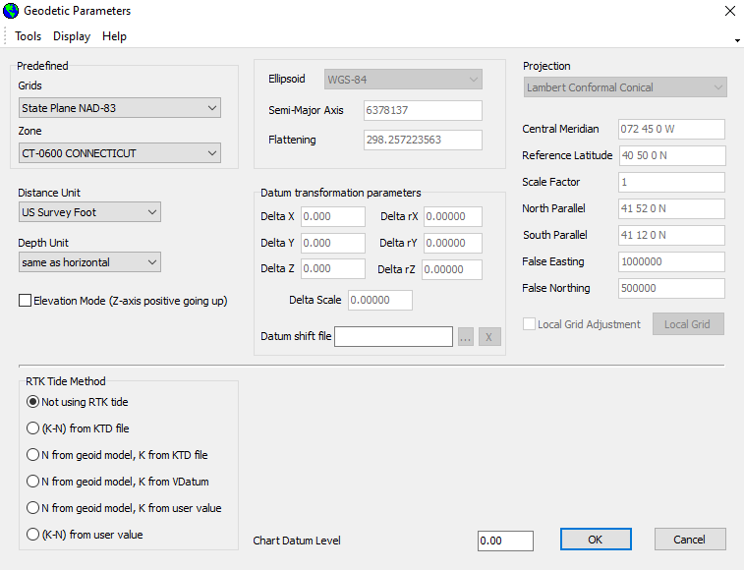
Geodetic Parameters
The Geodetic Parameter options within HYPACK allows the user to choose from pre-defined geodesy settings world wide.
The user has the ability to create their own geodetic parameters if required or work on a local grid.
HYPACK will convert from WGS-84 to any projection coordinates.

Slide 6
Environmental Editor

Slide 7
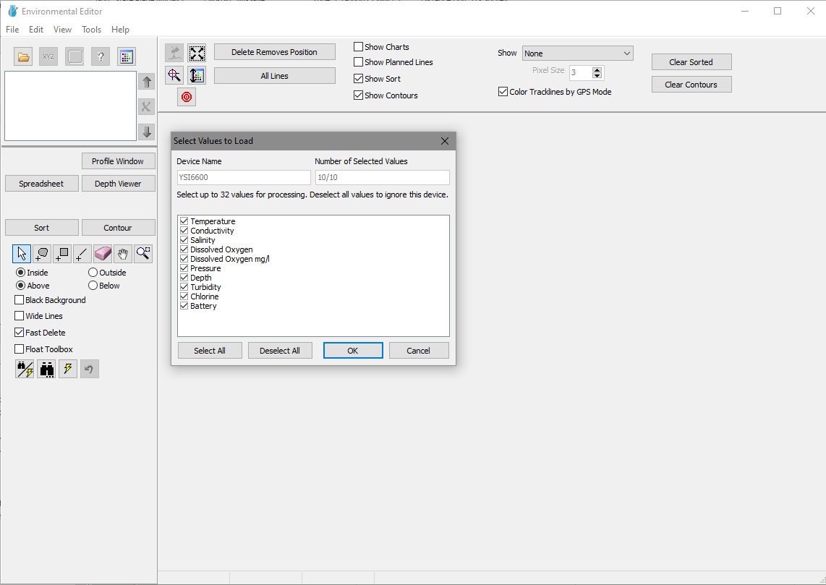
Environmental Editor
The Environmental Editor program can load both Raw data collected as well as processed session data.
Data collected by HYPACK is recorded in an SMI record.
During the Read Parameter phase of loading data the user can choose which sensor data to process
Environmental Editor saves to a binary *.smi session format as well as XYZ and HYPACK Edited All Files
Up to 32 sensor readings per sample time can be processed

Slide 8
Input Data
HYPACK Survey (*.raw & *.log) files with SMI records
  Example Drivers:
    YSI-6000
    YSI EXO
    Generic Input Parser
Edited *.smi files saved from HYPACK’s Environmental and Magnetometer Editors
i3XO EcoMapper *.log files
EXO *.bin files

Slide 9
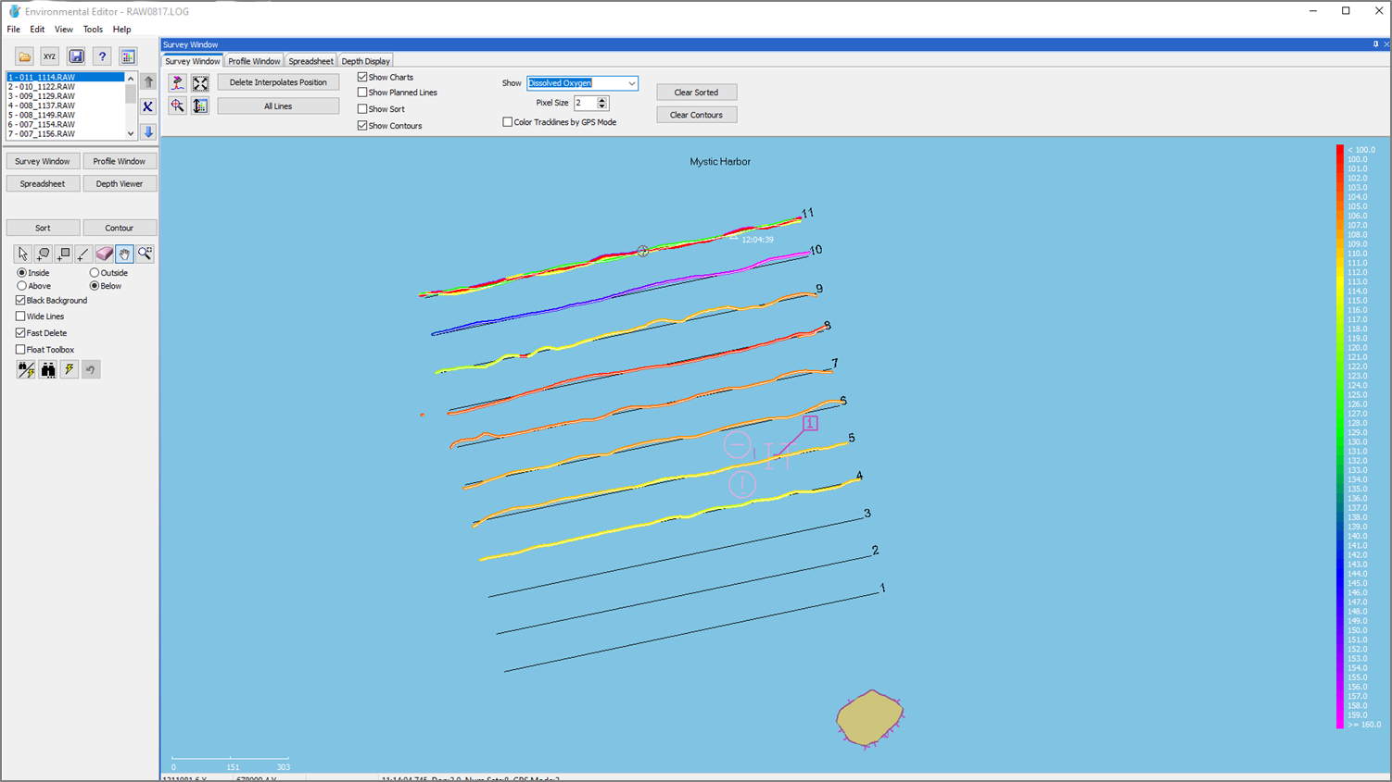
Environmental Editor – Survey Window
File selection
Display Windows
Final Products
Editing Tools

Slide 10
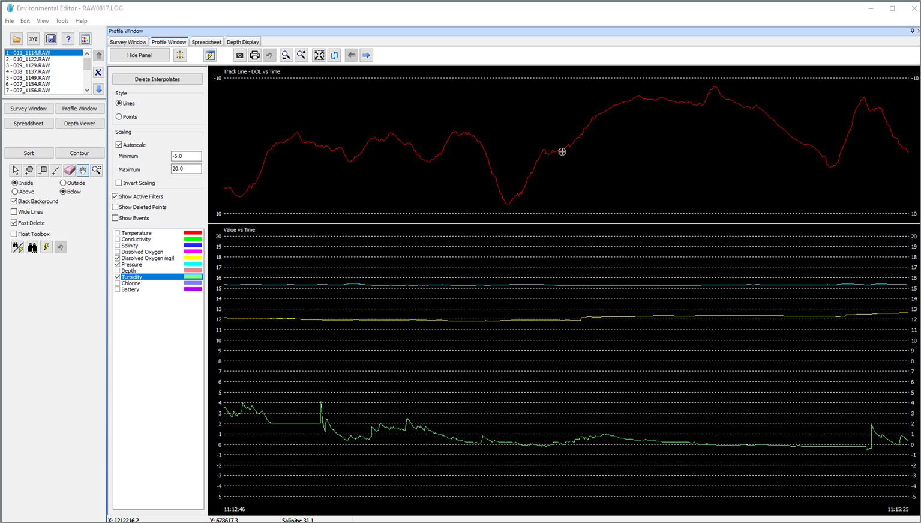
Environmental Editor – Profile Window
Editing Tools
Sensor Selection
Profile Window

Slide 11
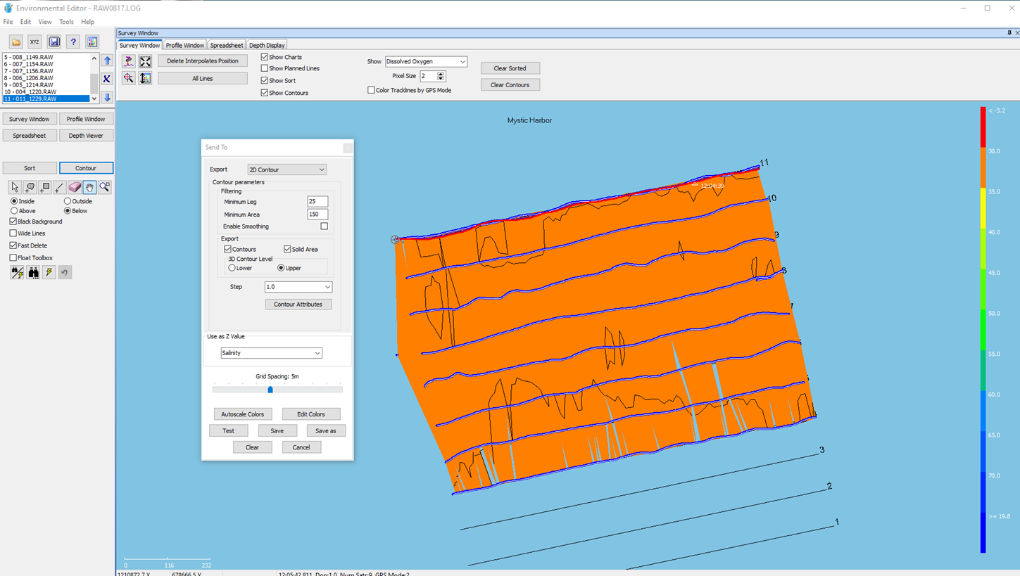
Environmental Editor – Contour Option
Contouring has been embedded in the WQS Editor
The same options as are available in the TIN MODEL program
Contours can be generated from any sensor without reloading the data

Slide 12
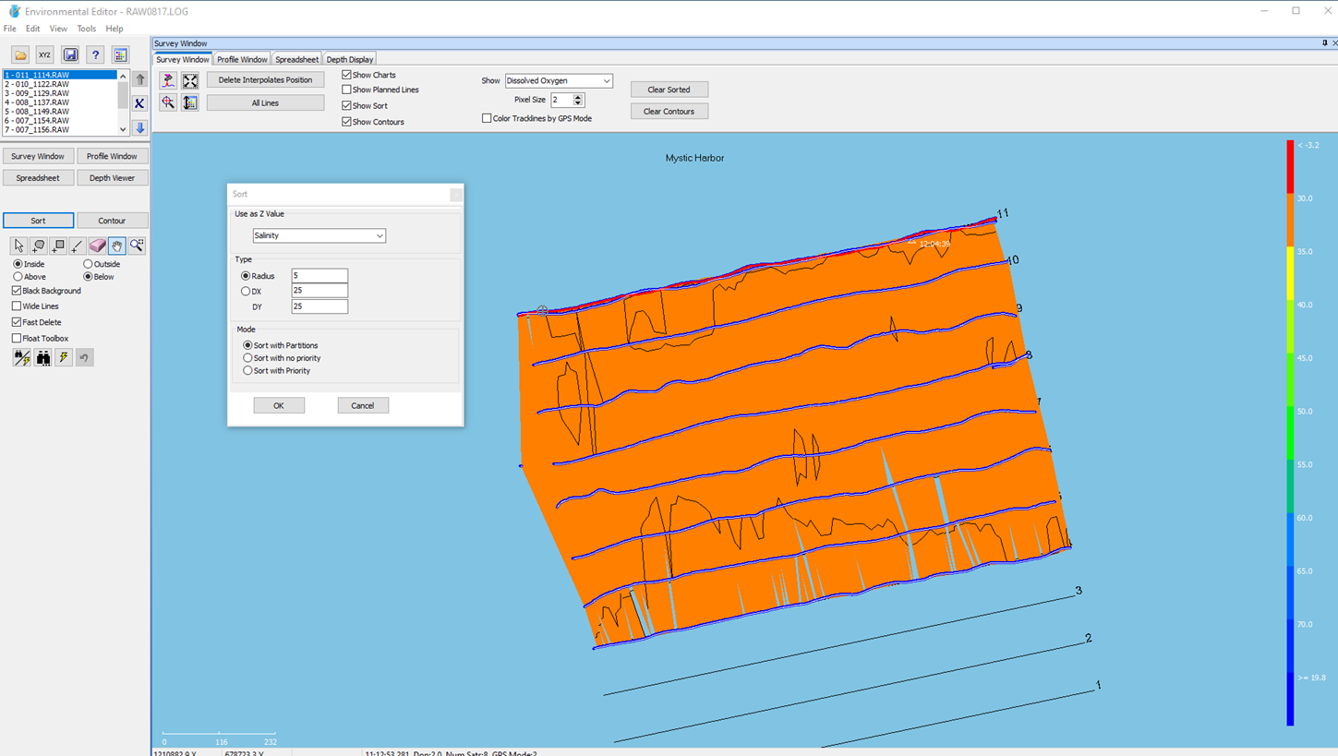
Environmental Editor – Sort Option
Data Sorting has been embedded in the WQS Editor
The same options as are available in the SORT program

