Slide 1
Water Quality - ADCP

Slide 2
Objectives of this session
1
Collecting ADCP Data
Displaying the profile information
Viewing individual Ensembles
2
Processing ADCP Data
Displaying the profile information
Viewing individual Ensembles
3
Processing ADCP In Situ Data
Displaying the profile information

Slide 3
ADCP Data Collection

Slide 4
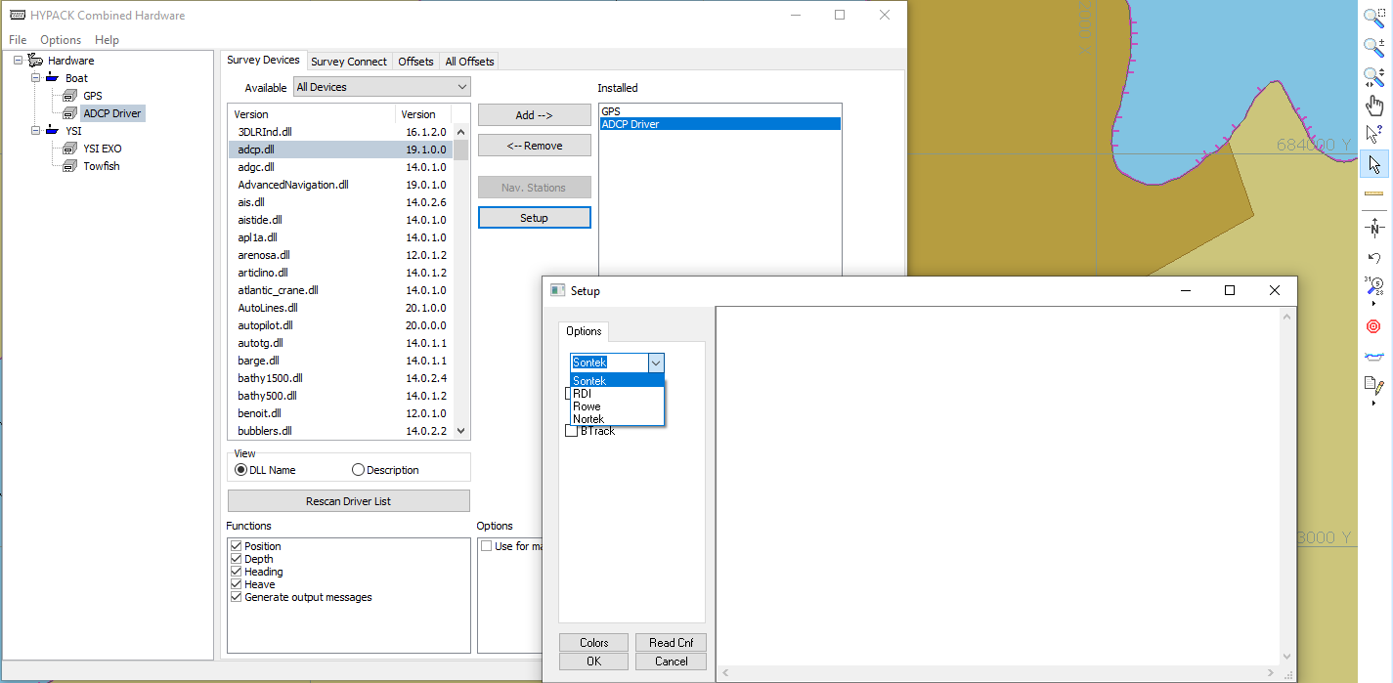
ADCP Hardware
A common ADCP driver is used to read multiple manufacturers hardware to ensure a standard display is used.

Slide 5
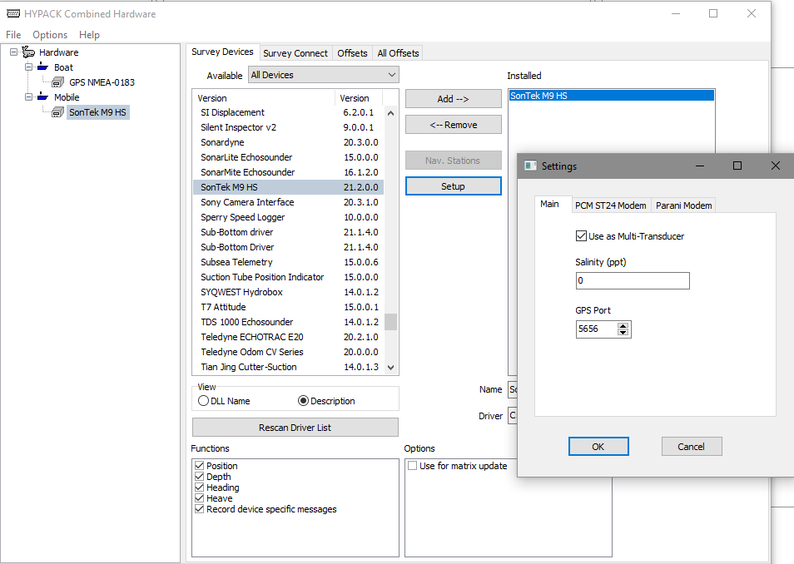
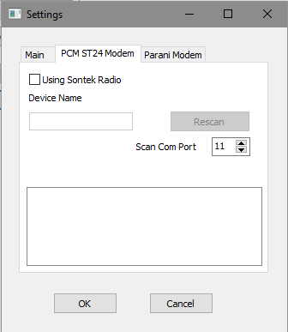
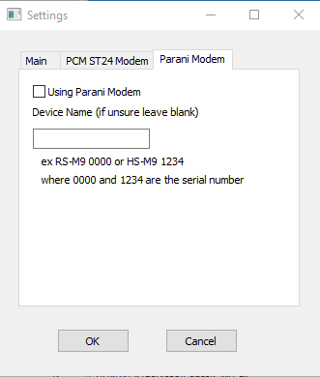
SonTek HydroSurveyor Hardware
For use with the SonTek M9 HydroSurveyor

Slide 6
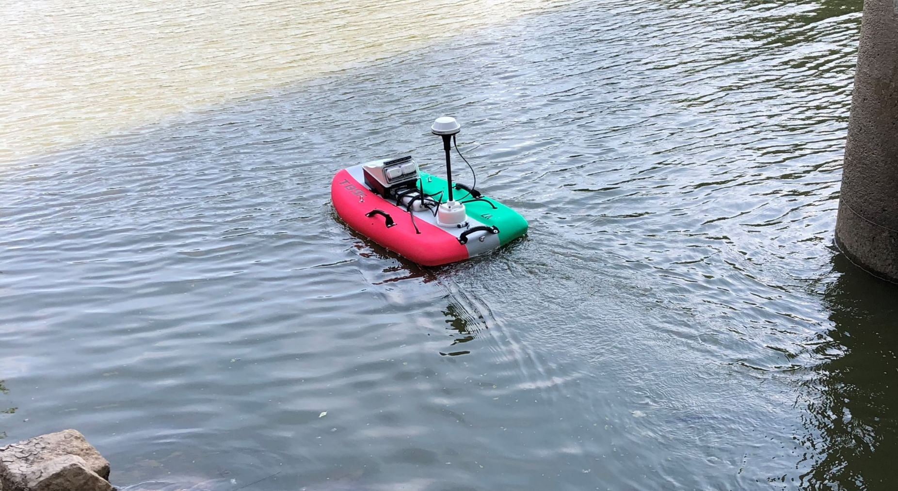
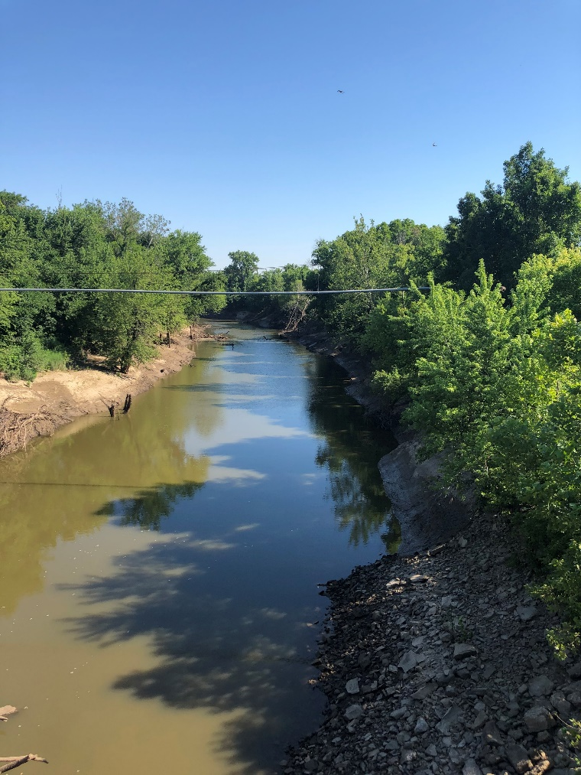
Shallow Water - ADCP
Many projects involve remote data collection in challenging environments

Slide 7
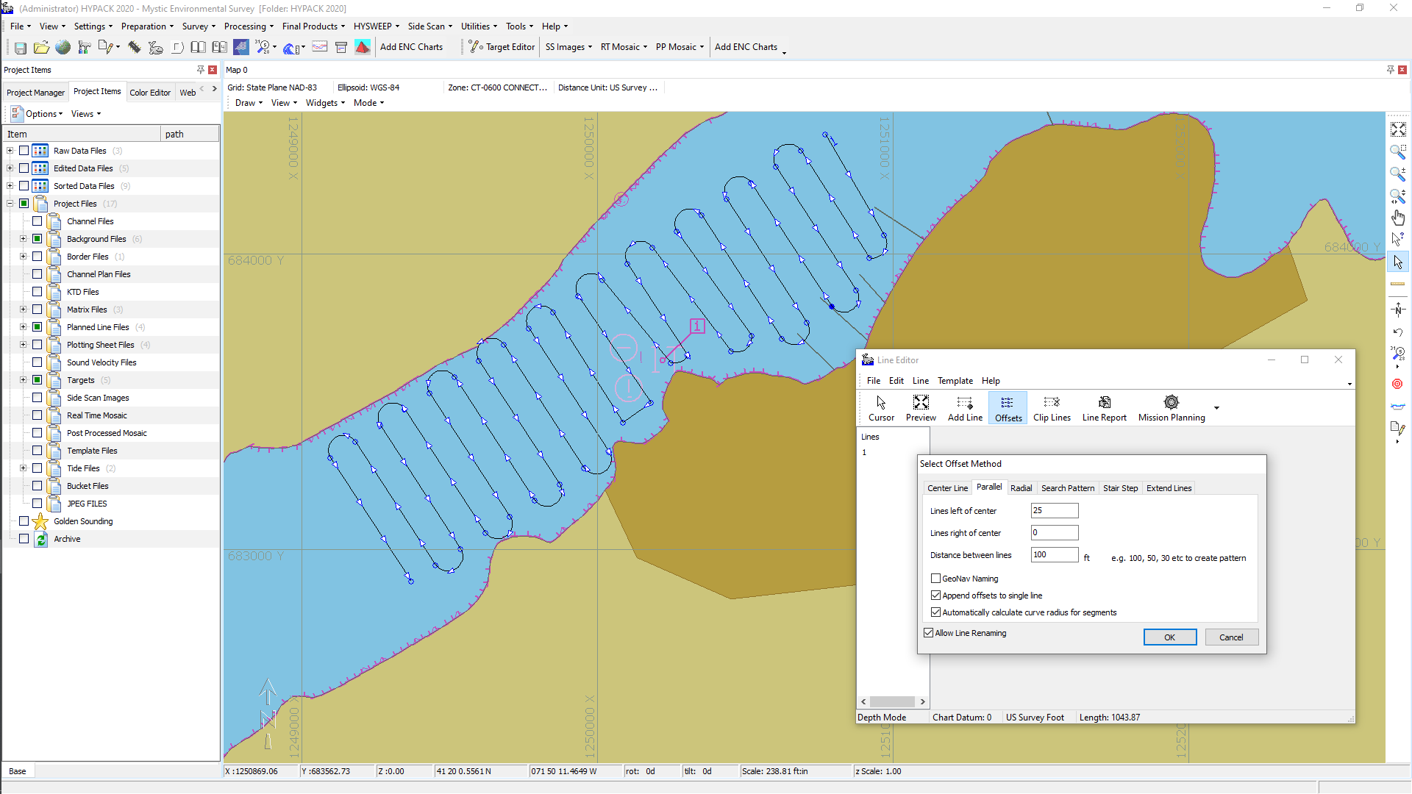
ADCP Planned Lines
Planned Lines can be created and exported to a MAVLINK file for autonomous survey.

Slide 8
ADCP Processing

Slide 9
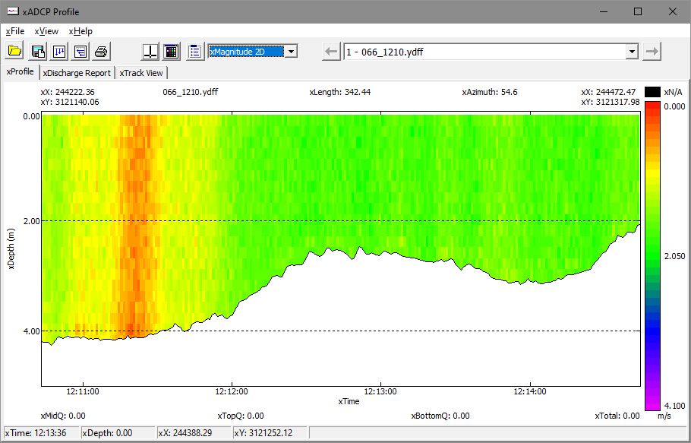
ADCP Profile
Display Settings
File Selection
ADCP profile has been designed to show each profile cross section.
The colors can be adjusted using the Color Dialog in Display Settings.

Slide 10
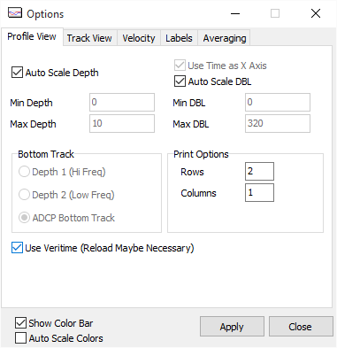
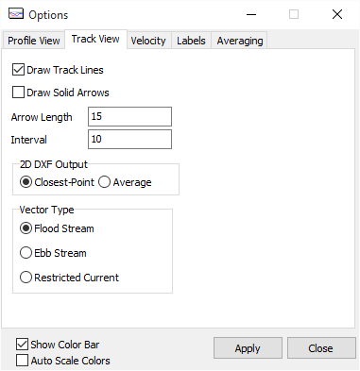
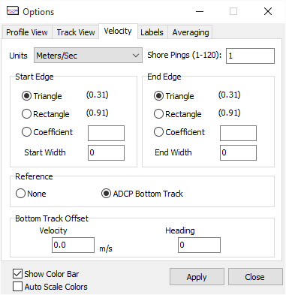
ADCP PROFILE Settings
Profile View Tab:
Controls:
  Scaling of Chart
  Bottom Track
  Print Layout
Track view Tab:
Controls:
  Arrow Length
  Spacing
  Vector Type
Velocity Tab:
Controls:
  Units
  Visible Pings
  Flow Options

Slide 11
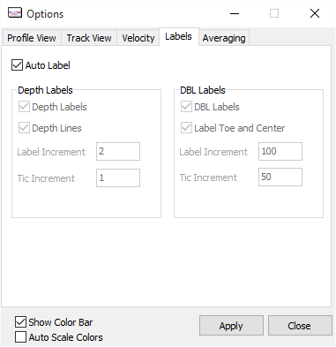
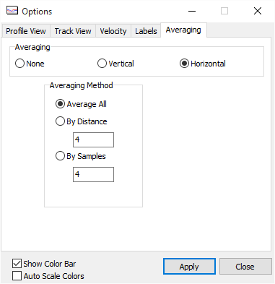
ADCP PROFILE Settings
Labels Tab:
Controls:
Labeling for Chart and for DXF Output.
Averaging Tab:
Apply averaging by:
Vertical or Horizontal
Number of bins or Distance

Slide 12
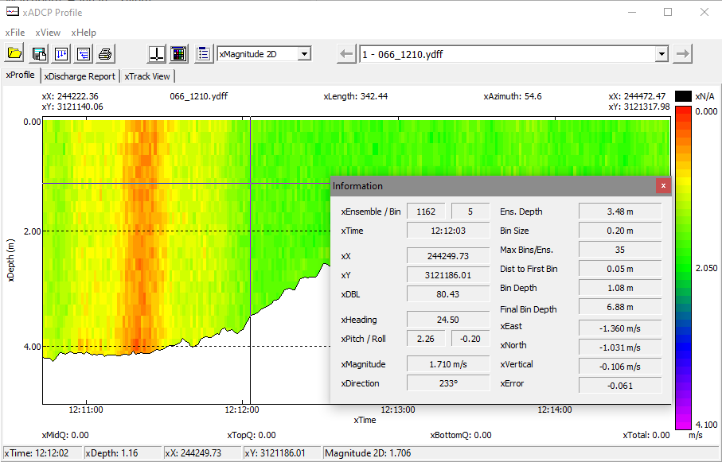
ADCP Profile
Ensemble Information can be displayed at the cursor location

Slide 13
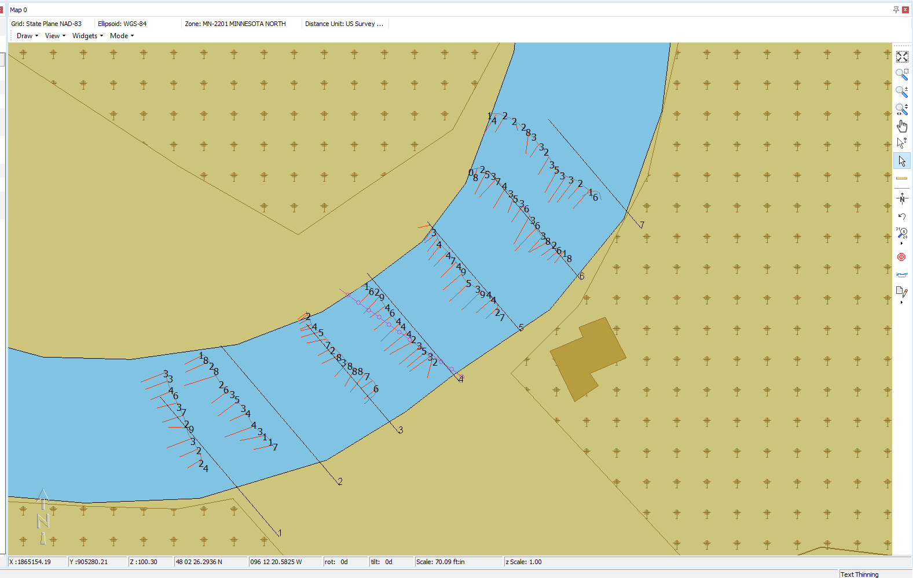
ADCP Profile – DXF output
ADCP Profile has the ability to output DXF Vectors

Slide 14

HYPACK ADCP Future work
Water Quality is at the heart of what Xylem stands for.
The future of ADCP work within the HYPACK software will include the adaptation of the USGS QRev discharge calculation.
Working closely with Sontek, YSI, and other hardware manufacturers on the water quality market, the software will be improved over the course of the next year by adding many features currently requested by you, our users.
Please send in suggestions so we can tailor the tools to better fit your needs.

Slide 15
ADCP – In Situ

Slide 16
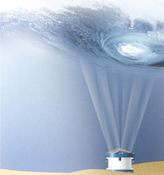
ADCP IN SITU Features
ADCP IN SITU is used to process data produced by profiling current meters:
- Instantaneous pressure measurements (on certain instruments).
- Instantaneous temperature measurements.
- Heading, roll and pitch measurements.
- Current measurements integrated over a period (integration period).
- Measurement of the back-scattered echo or of the amplitude of the received signal according to the instrument in question.
ADCP = Acoustic Doppler Current Profiler.

Slide 17
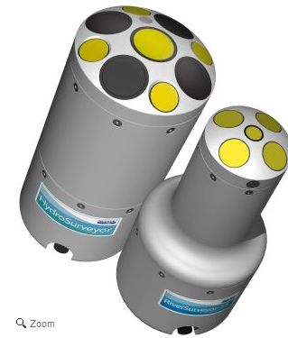
Input Data
Reads the raw data coming from SonTek, Nortek, and RDI equipment.
  SonTek
    *.adp format
  Nortek NDP
    *.adp format
  Nortek AquaPro
    *.prf format
  Nortek Aquadopp (single point current meter)
    *.aqd format
  Nortek AWAC
    *.wpr format
  Nortek Continental
    *.cpr format
  Teledyne RDI
    *.000 format

Slide 18
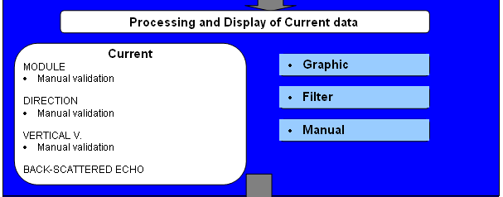
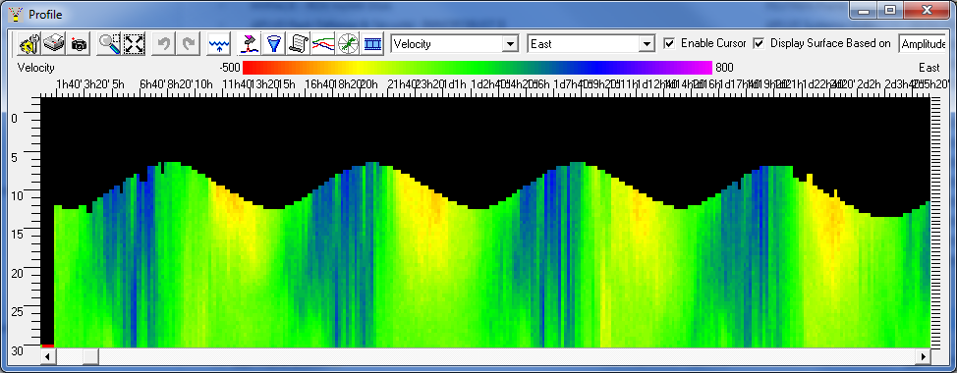
Profile Display
Operating data is displayed by clicking on the Profile icon.

Slide 19
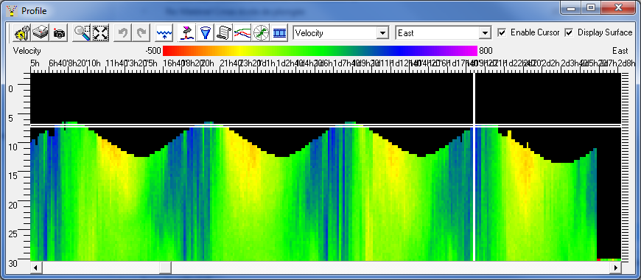
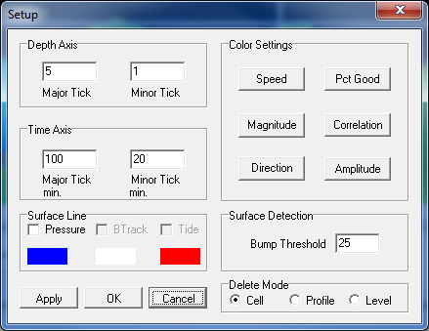
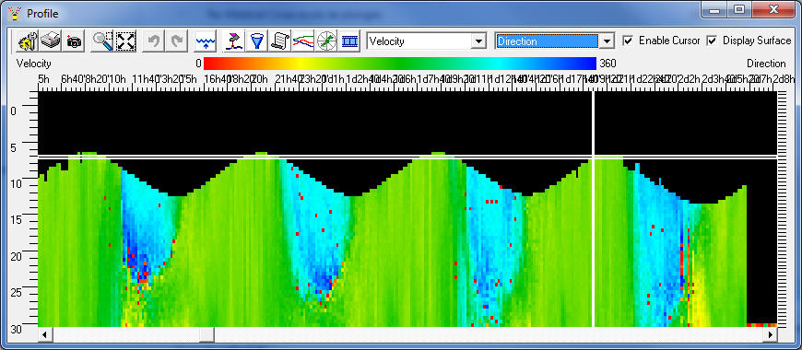
Profile Color Settings
Independent color settings for each component.

Slide 20

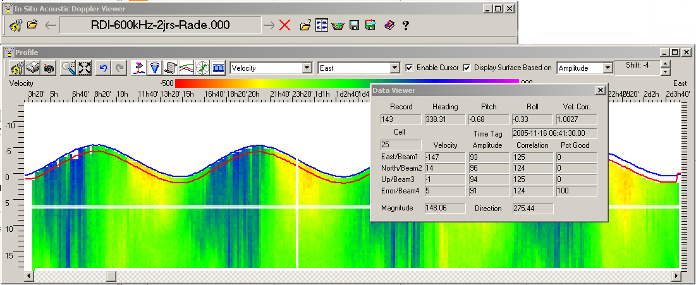
Data Viewer
Data Viewer displays the data indicated by the cursor.

Slide 21
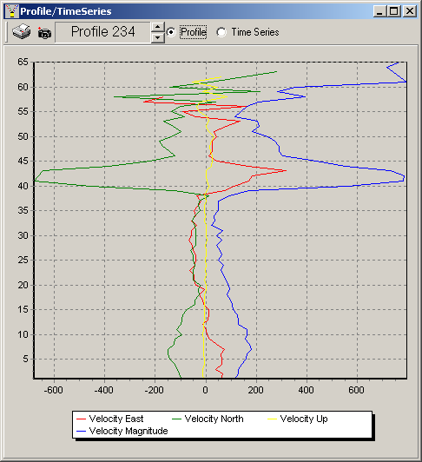
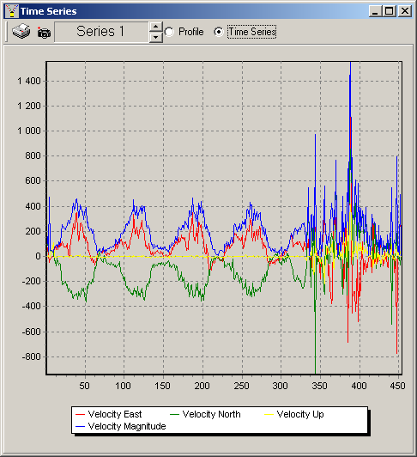
Profile and Time Series View
Display of graphic data by profile or time series

Slide 22
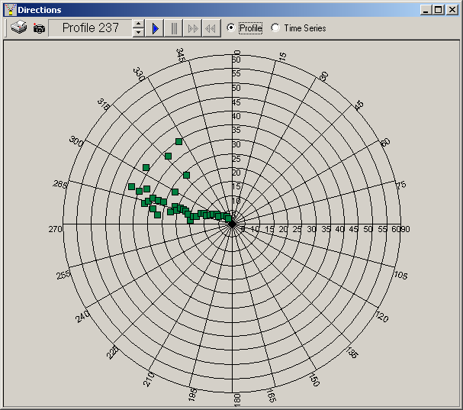
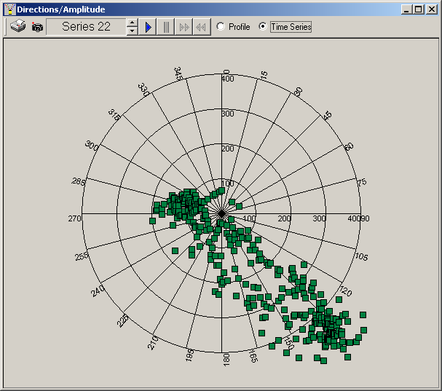
Profile and Time Series View
Display of data by direction by profile or time series.

Slide 23
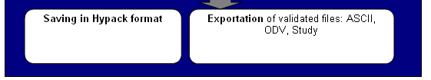
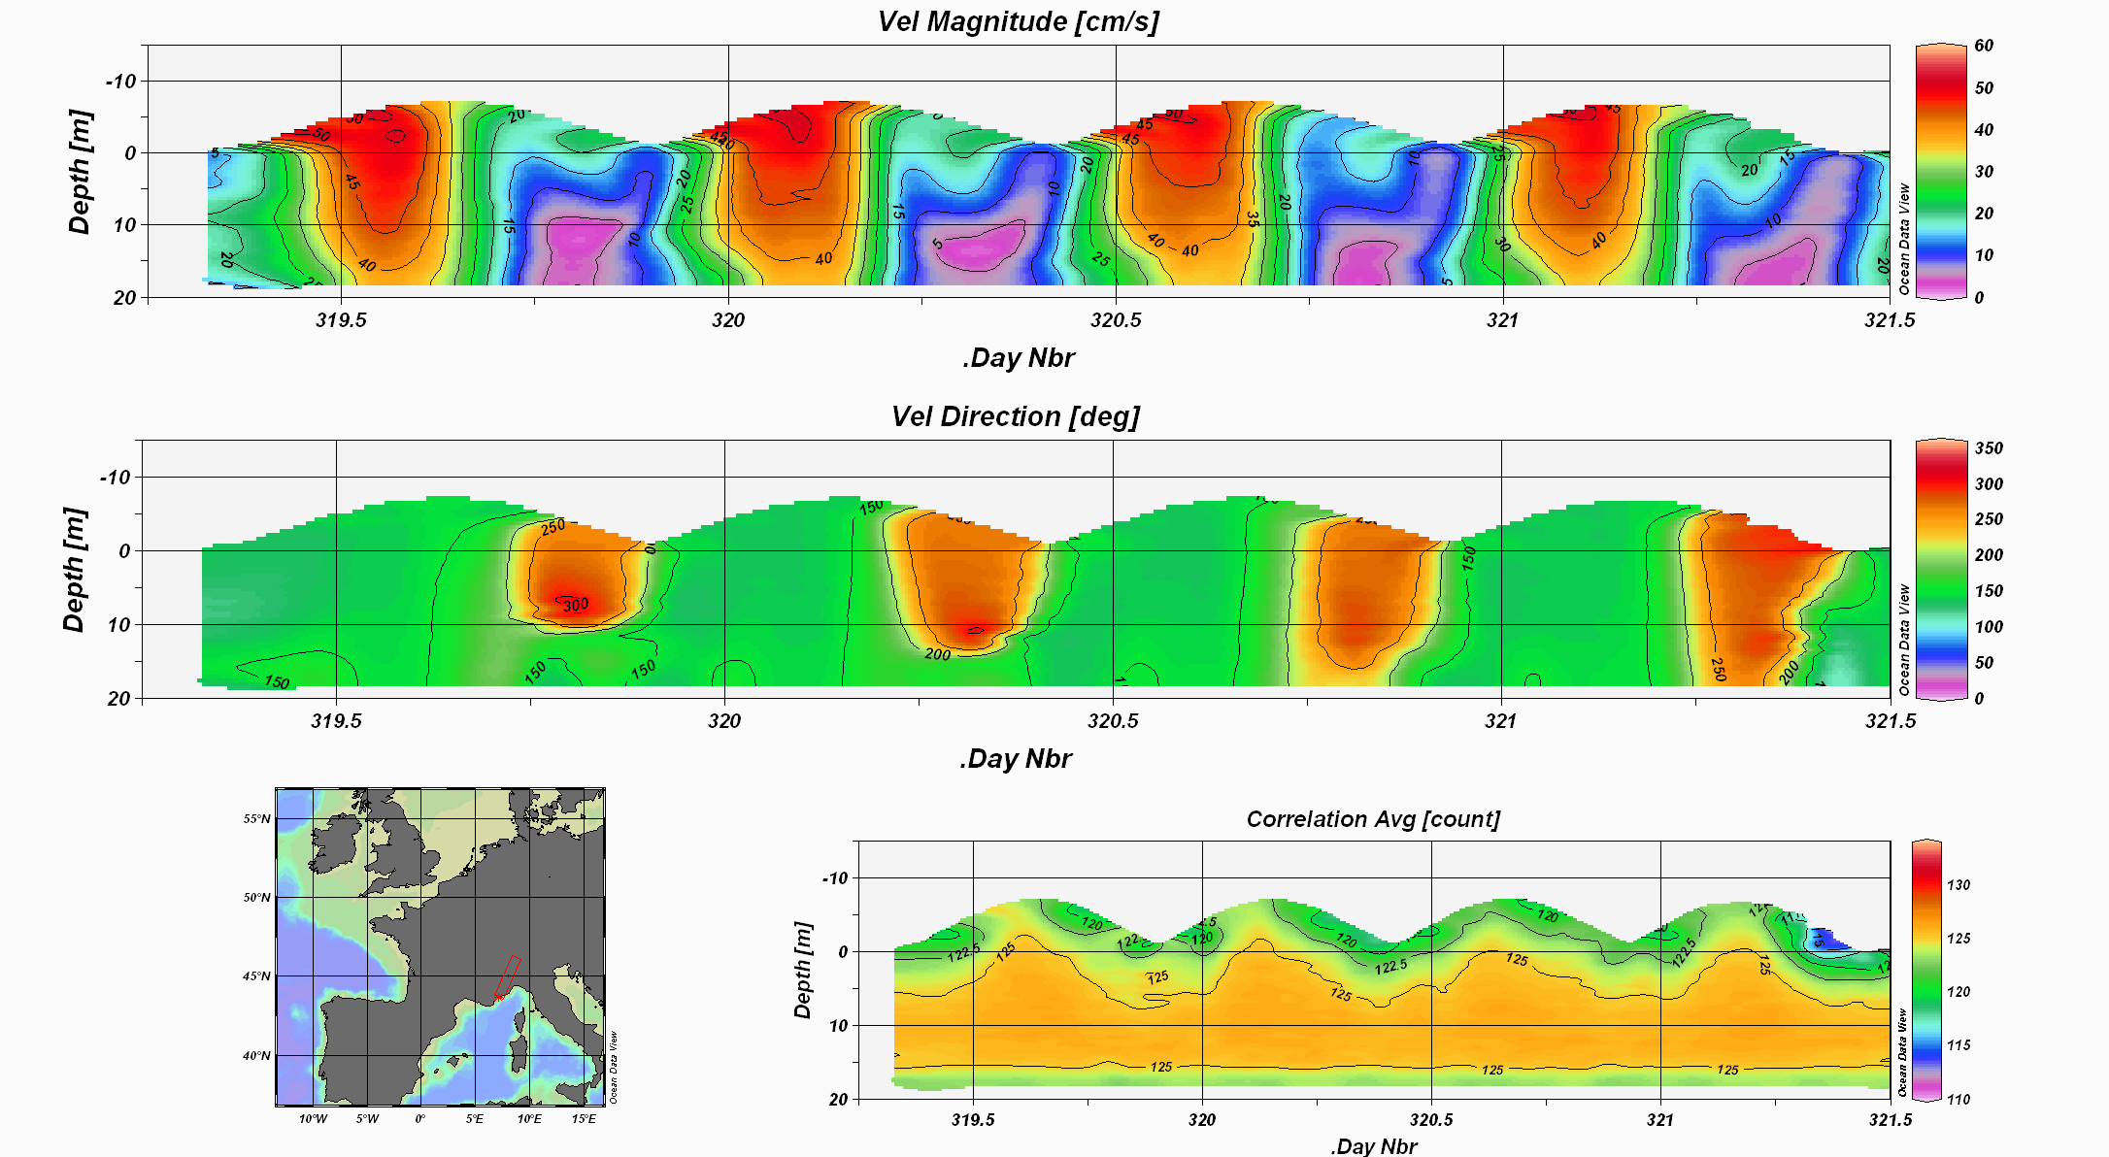
ODV Export
Export in ODV format from the ASCII export by loading the previously created configuration file odv.ini, available in HYPACK 20XX/ADCP.
The ODV software configuration file for importing the HYPACK export is also available in HYPACK 20XX/ADCP. It is the Config_type_odv.cfg file.

