Slide 1
LiDAR Training

Slide 2
Objectives of this session
1
2
3
LiDAR Background
Beam Divergence
LiDAR Footprint
Accuracy Specifications
Point Density and Spacing
HARDWARE
LiDAR Sensors
Return Modes
Data Rates
Physical Mounting
Data Collection
Proper speed considerations
4
5
Final Deliverables
Data Processing

Slide 3
LiDAR Background

Slide 4
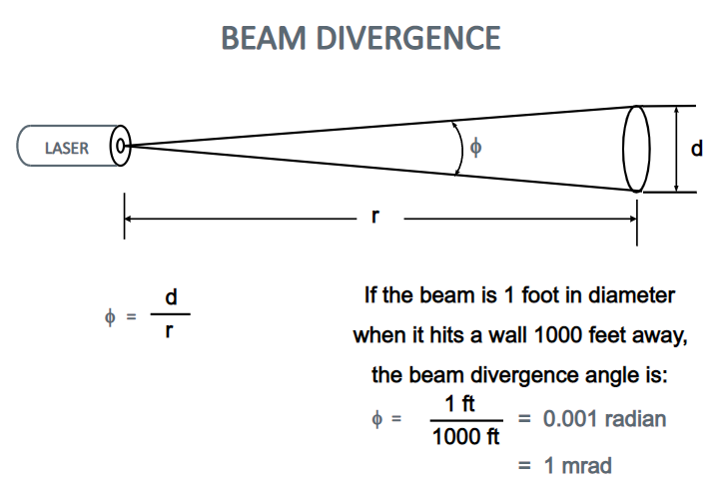
Beam Divergence – LiDAR Systems
Beam Divergence describes the change in diameter of each IR pulse that the LIDAR emits as it travels away from the source
(i.e. The pulse gets wider the further away from the LIDAR gun it travels).
This change is typically measured in milliradians (mrad), radians are standard units of measuring the ratio between the length of an arc (two points on the outer edge of a circle) and its radius (center point of the circle).
Notes:
This is important to understand because the divergence of the beam has multiple effects. A

Slide 5
LiDAR Footprint
300 Ft
The LiDAR system’s beam divergence is a critical part of understanding realistic results based upon the sensor being employed.
There are three LiDAR systems compared here over the maximum distance of the VLP-16 measured in feet.
At 300 feet from the sensor, the footprint of the VLP-16 is 0.9 feet in diameter. The Applanix LandMARK is 5% of the VLP-16 footprint, at 0.045 feet.
The cost difference between the VLP-16 and the Applanix system is significant.
250 Ft
200 Ft
150 Ft
100 Ft
50 Ft
Riegl
LMS-Z420i
0.25 mRad
Applanix
LANDMark
0.15 mRad
VLP-16
3 mRad
Notes:
Do not think of these as round objects they are not spherical. Each point represents a flat circle as it projects away from the emitter. Imagine the discs as a coin in your pocket.

Slide 6
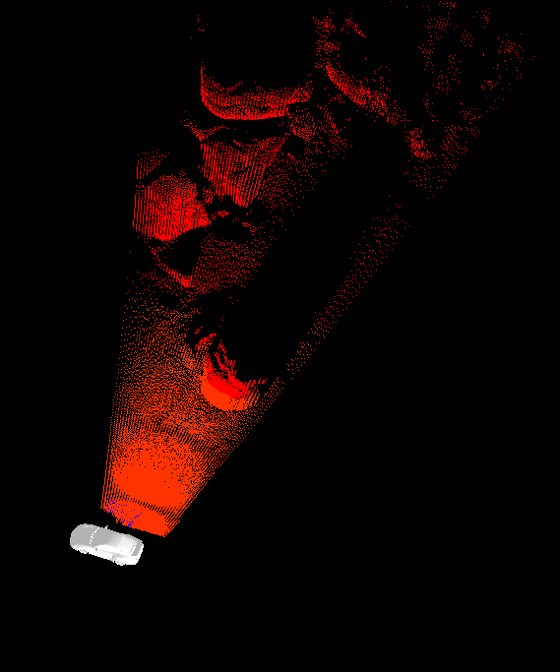
Large Footprint versus Small Footprint
Now that you know what factors contribute to the resulting factor – why would you care? Depending on your mission, being aware of the size of your LiDAR footprint will help determine the required specifications and parameters.
A large LiDAR footprint can be beneficial if we want to be sure to detect small or thin objects like for example power lines. A larger illuminated area will also help to ensure that some part of the signal penetrates the forest canopy.
On the other hand, a small LiDAR footprint will result in a more distinctive return. With a smaller illuminated area the signal is also more likely to be returned from a single homogeneous surface and as a result multiple returns will be less likely.
150 5.4”
100 3.6”
50 1.8”
LiDAR Footprint Diameter (rohrba.ch)

Slide 7
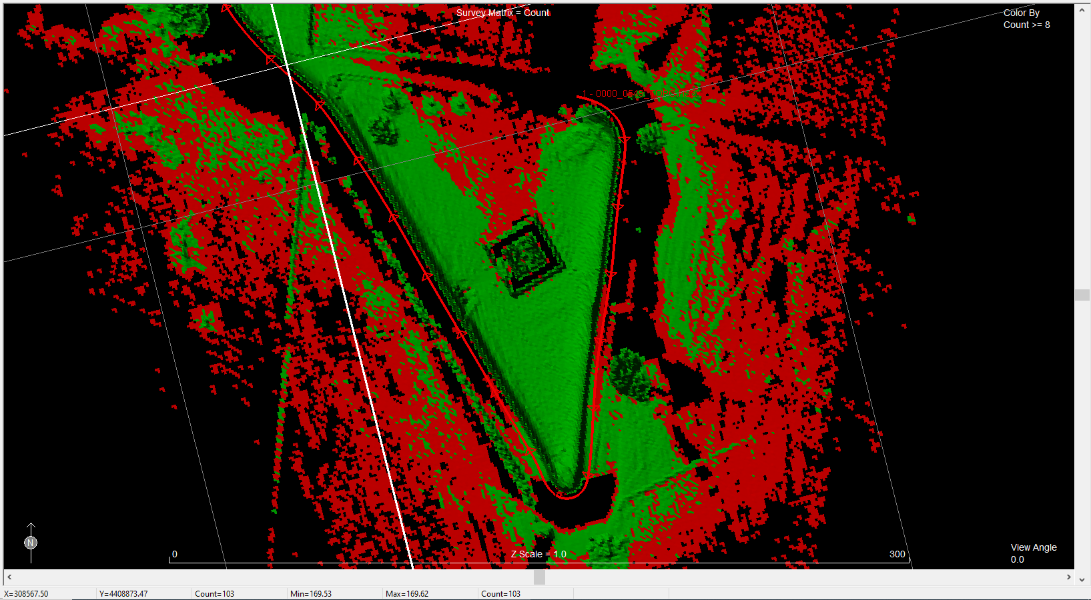
Accuracy Specifications
ASPRS and USGS have minimum standards for Digital Geospatial Data. With regard to elevation data, the new standards redefine how elevation accuracy is described and reported, and although any accuracy could be its own accuracy class, a number of specific common classes are explicitly defined. The requirements stated for QL0 are somewhat arbitrary and are subject to change in future revisions of this specification.
The changes relevant to lidar data QLs in this revision of the specification were as follows:
USGS Accuracy Standards
QL0 was added with accuracy of 5.0-centimeter (cm) vertical linear root mean square error in the z direction (RMSEz)
  density of at least 8 pulses per square meter (pls/m2).
  This aligns with the ASPRS 5-cm vertical accuracy class.
QL1 accuracy was changed from 9.25-cm RMSEz to 10.0-cm RMSEz
  This does not correspond directly to any ASPRS accuracy class;
  it is a hybrid of QL2 accuracy and QL0 pulse density.
QL2 accuracy was changed from 9.25-cm RMSEz to 10.0-cm RMSEz
  This aligns with the ASPRS 10-cm vertical accuracy class.
  QL2 pulse density remains unchanged at 2 pls/m2.
QL3 accuracy was changed from 18.5-cm RMSEz to 20.0-RMSEz
  density was changed from 0.7 pls/m2 to 0.5 pls/m2.
  This aligns with the ASPRS 20-cm vertical accuracy class.
(RMSEz) : root mean square error in the z direction
Green denotes cells that meet QL0

Slide 8
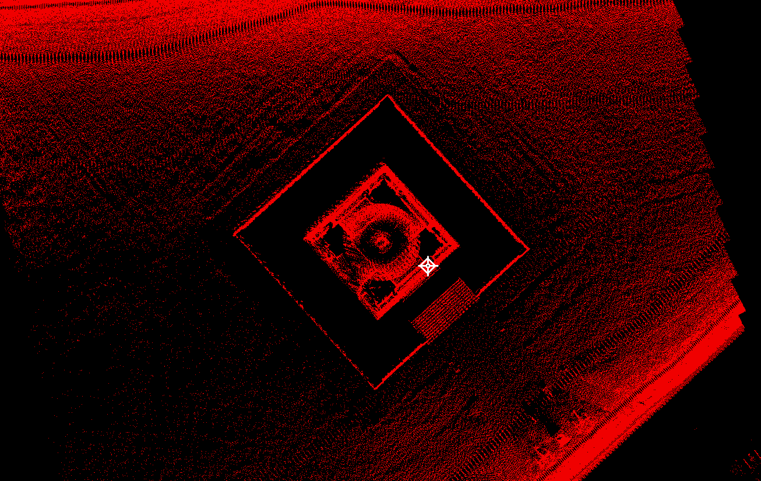
Point Density and Spacing
The most prominent attribute of LiDAR data is point density.
In this image you can see the higher density near the road and the lower density area to the south west of the building.
When planning to survey it is therefore generally referred to the Nominal Point Density (NPD) or respectively to the Nominal Point Spacing (NPS).
As stated before, The USGS has published their standards regarding LiDAR surveys.
This standard defines that only last-returns shall be considered when evaluating the point density of a dataset
Notes:
Using only one return per emitted signal allows to verify that the laser scanning system performed as required by the project specifications. Including all returns of an emitted beam obviously increases the observed point density in areas where multiple returns occur.

Slide 9
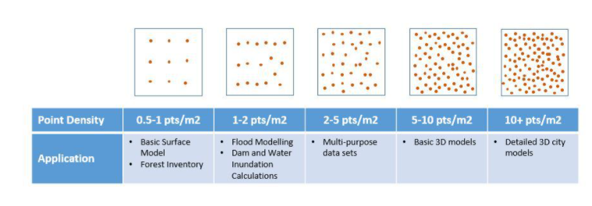
Point Density – How much is too much?
Understanding the purpose of the survey helps to determine the point density required. The definitions of density here were taken from a website, Point Density and Point Spacing (rohrba.ch)
Sparse Density 0.5-1 pts / m² : Used for large scale digital models or low changing terrain
Low Density 1-2 pts / m² : Used in flood modeling and basic terrain changes
Medium Density 2-5 pts / m² : Suitable for most use cases of LiDAR Data
High Density 5- 10 pts / m² : 3d Modeling of basic structure shapes
Extreme Density 10+ pts / m² : Detailed shapes and structures, very large datasets
Notes:
The data in the Gettysburg Monument qualified as high density

Slide 10
LiDAR Sensors

Slide 11
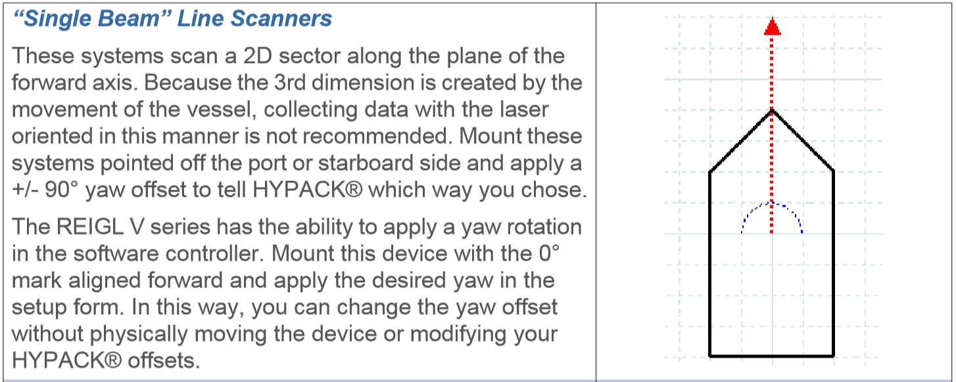
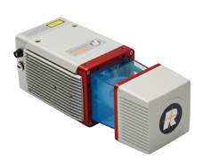
LiDAR – Single Beam Line Scanners

Slide 12
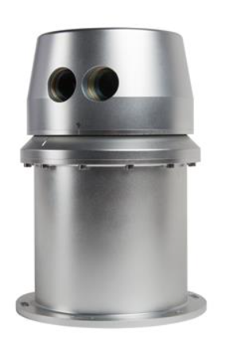
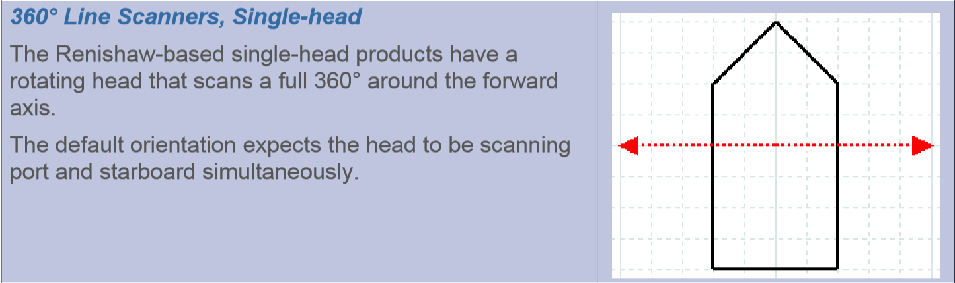
LiDAR – 360 Line Scanners

Slide 13
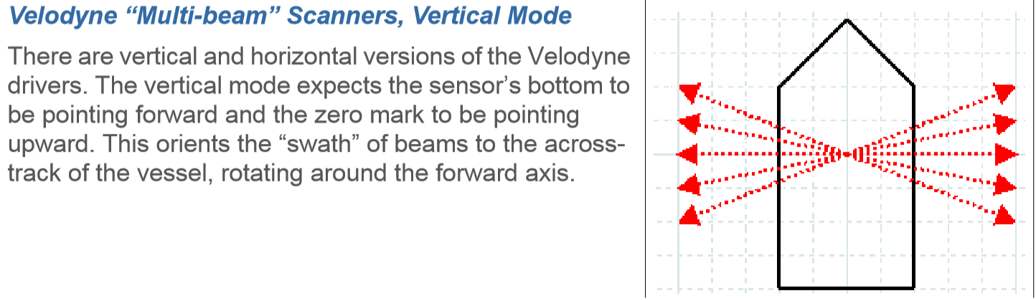
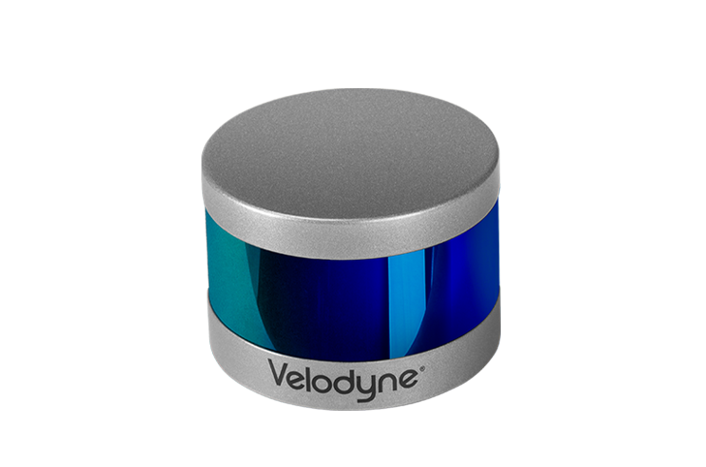
LiDAR – Multibeam Scanners

Slide 14
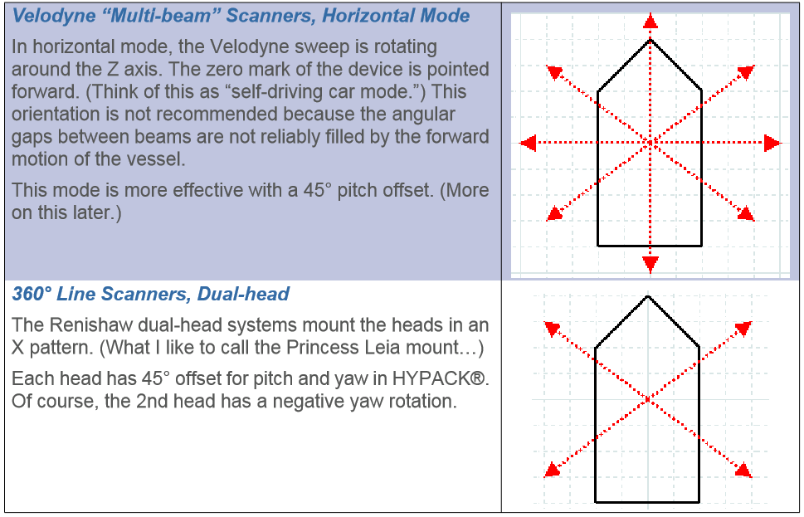
LiDAR – Mounting Preferences

Slide 15
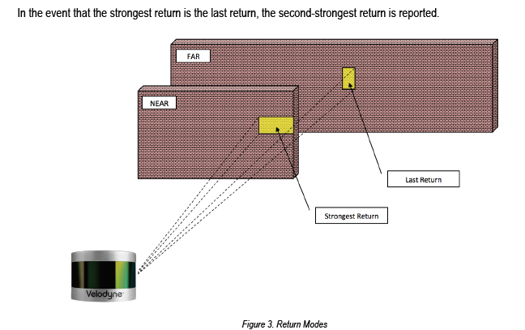
VLP-16 Return Modes
Return Modes
Due to the laser’s beam divergence, a single laser firing often hits multiple objects producing multiple returns. The VLP-16 analyzes multiple returns and reports either the strongest return, the last return, or both returns.
HYPACK does not differentiate the returns if they are both provided in Dual Mode.
All of the points will be stored that are passed from the VLP to HYPACK.

Slide 16
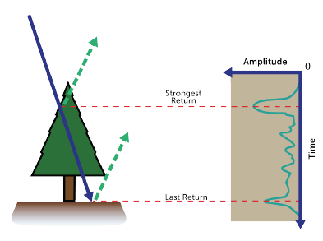
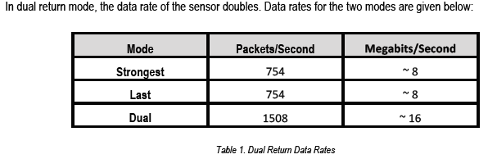
VLP-16 Data Rates
The dual return function is often used in forestry applications where the user needs to determine the height of the trees. The figure below illustrates what happens when the laser spot hits the outer canopy, penetrates the leaves and branches, and eventually hits the ground.

Slide 17
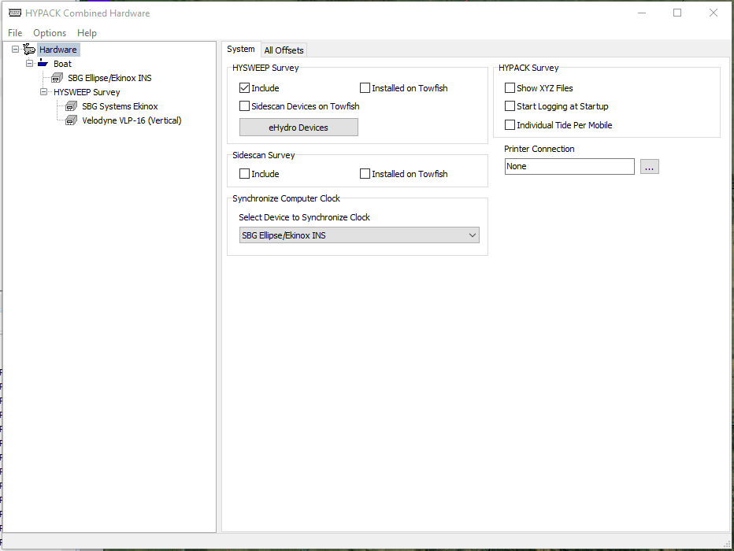
HYPACK Hardware
Basic HYPACK Hardware includes a positioning device, a motion device and the LiDAR unit.
The HYPACK Payload uses an SBG Ellipse 2d as the position and motion device.

Slide 18
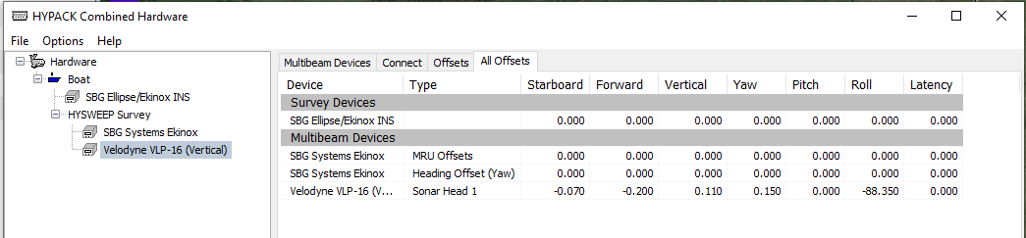
Offsets – Measure as accurately as you can
HYPACK 2022 allows a view where all of the device offsets are visible
Notes:
A 1 degree offset in the heading can cause a 5 ft error in data placement at the maximum range of the VLP-16

Slide 19
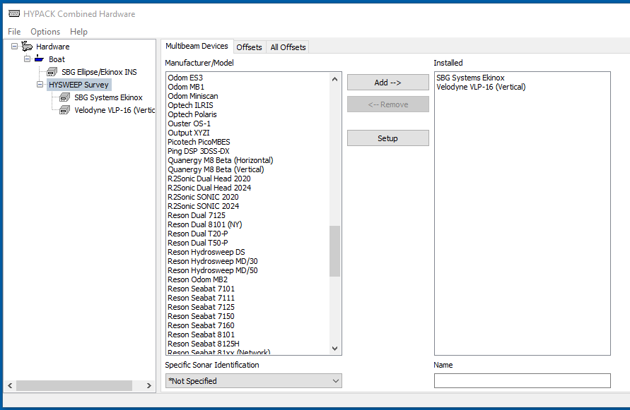
LiDAR supported by HYPACK
Carlson Merlin LiDAR
Leica Laser
Newton Laser
Optech ILRIS
Optech Polaria
Ouster OS-1
Quanergy M8
Reigl LMS Series
Reigl V Series
Reigl VUX
Velodyne VLP-16
Velodyne VLP-32
Velodyne HDL-32E
Notes:
13 LiDAR systems in both horizontal and vertical

Slide 20
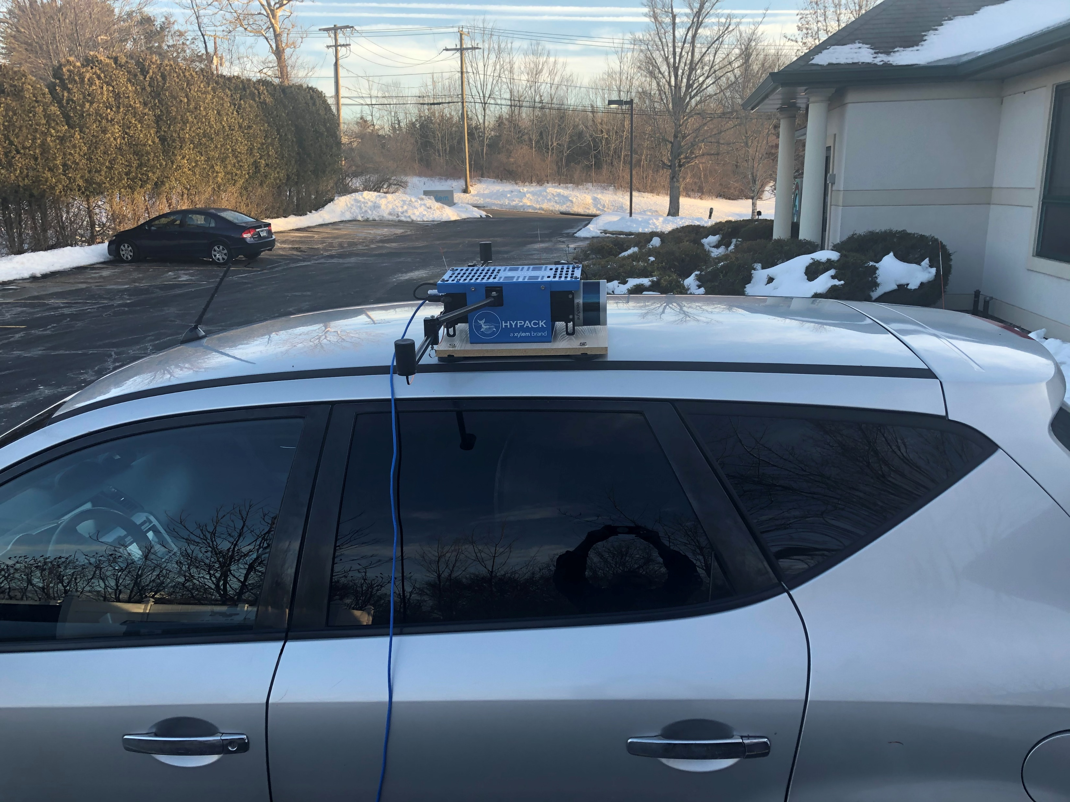
Sensor Positioning
Field of View is important when positioning the LiDAR unit. In this case the system was used for calibration and was mounted to view data on the left side of the car.
Due to the offsets remaining relative to the system, it was positioned on the opposite side when running clock wise calibration data.

Slide 21
LiDAR Data Collection

Slide 22
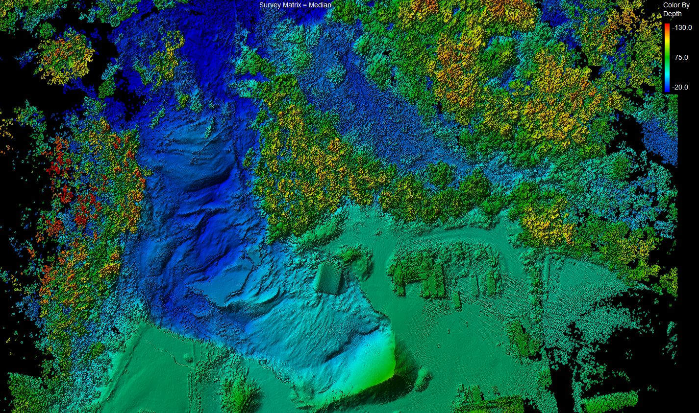
Speed Considerations
Data Collected from a LiDAR is not like any other system we generally use.
Data rates are so high and the latency from measurement to reception is so low that any variation can cause error.
Typical survey speeds with a LiDAR unit, regardless of the vehicle, should be less than 10 MPH.
LiDAR survey from a drone at 6 MPH

Slide 23
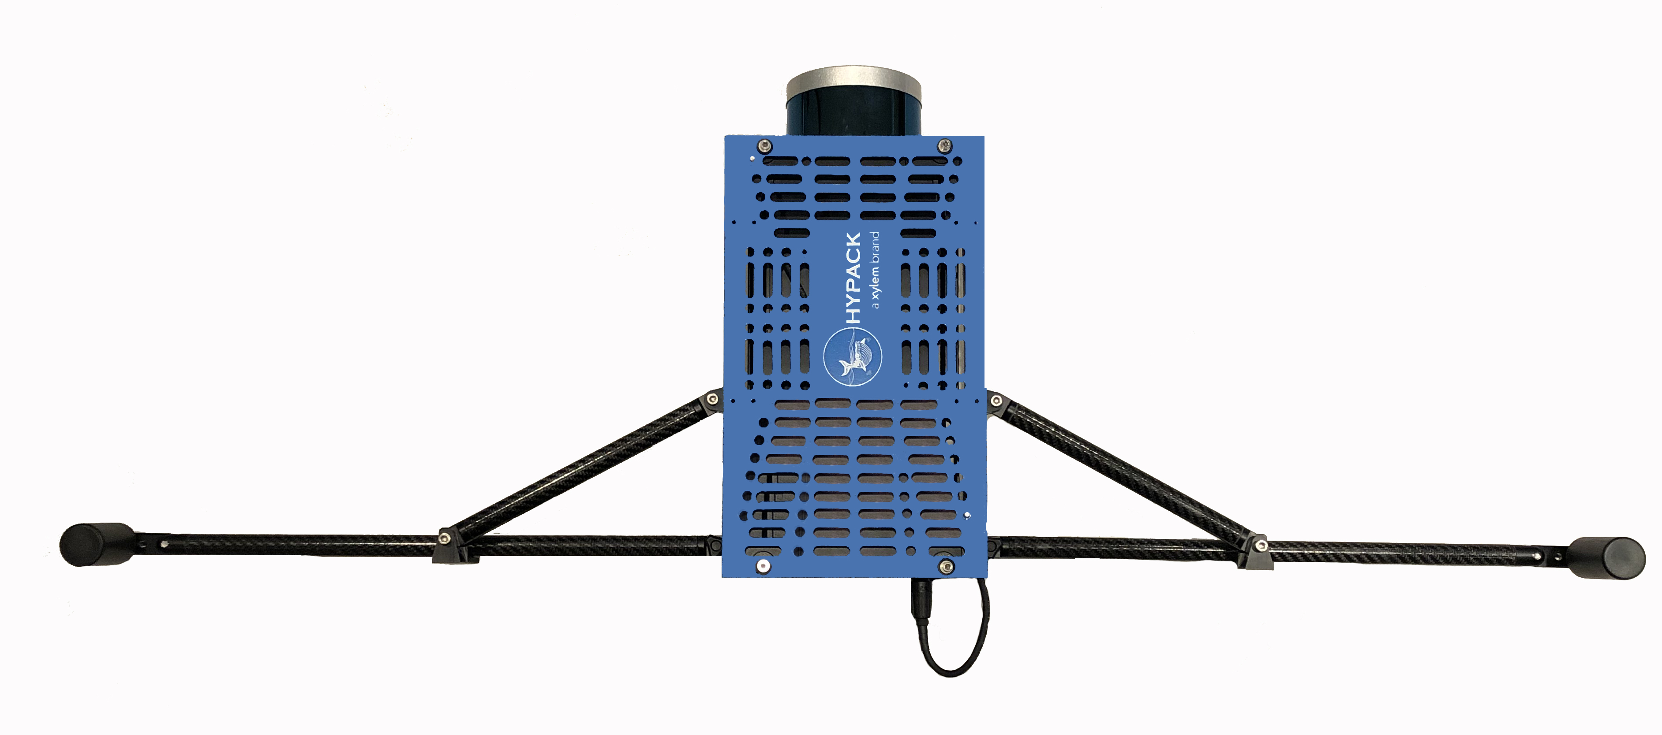
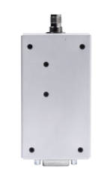
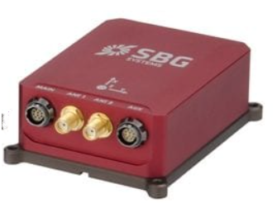
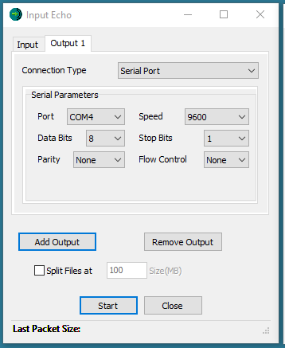
RTK Base Station Options
Any Serial Radio will work, the system was tested with a set of Satel Radios and RFD-900 Radios
USB to Serial Connection
USB Serial Device
RTK Base Station
Data is routed from the USB Serial interface to the SBG Aux port for RTK Corrections

Slide 24
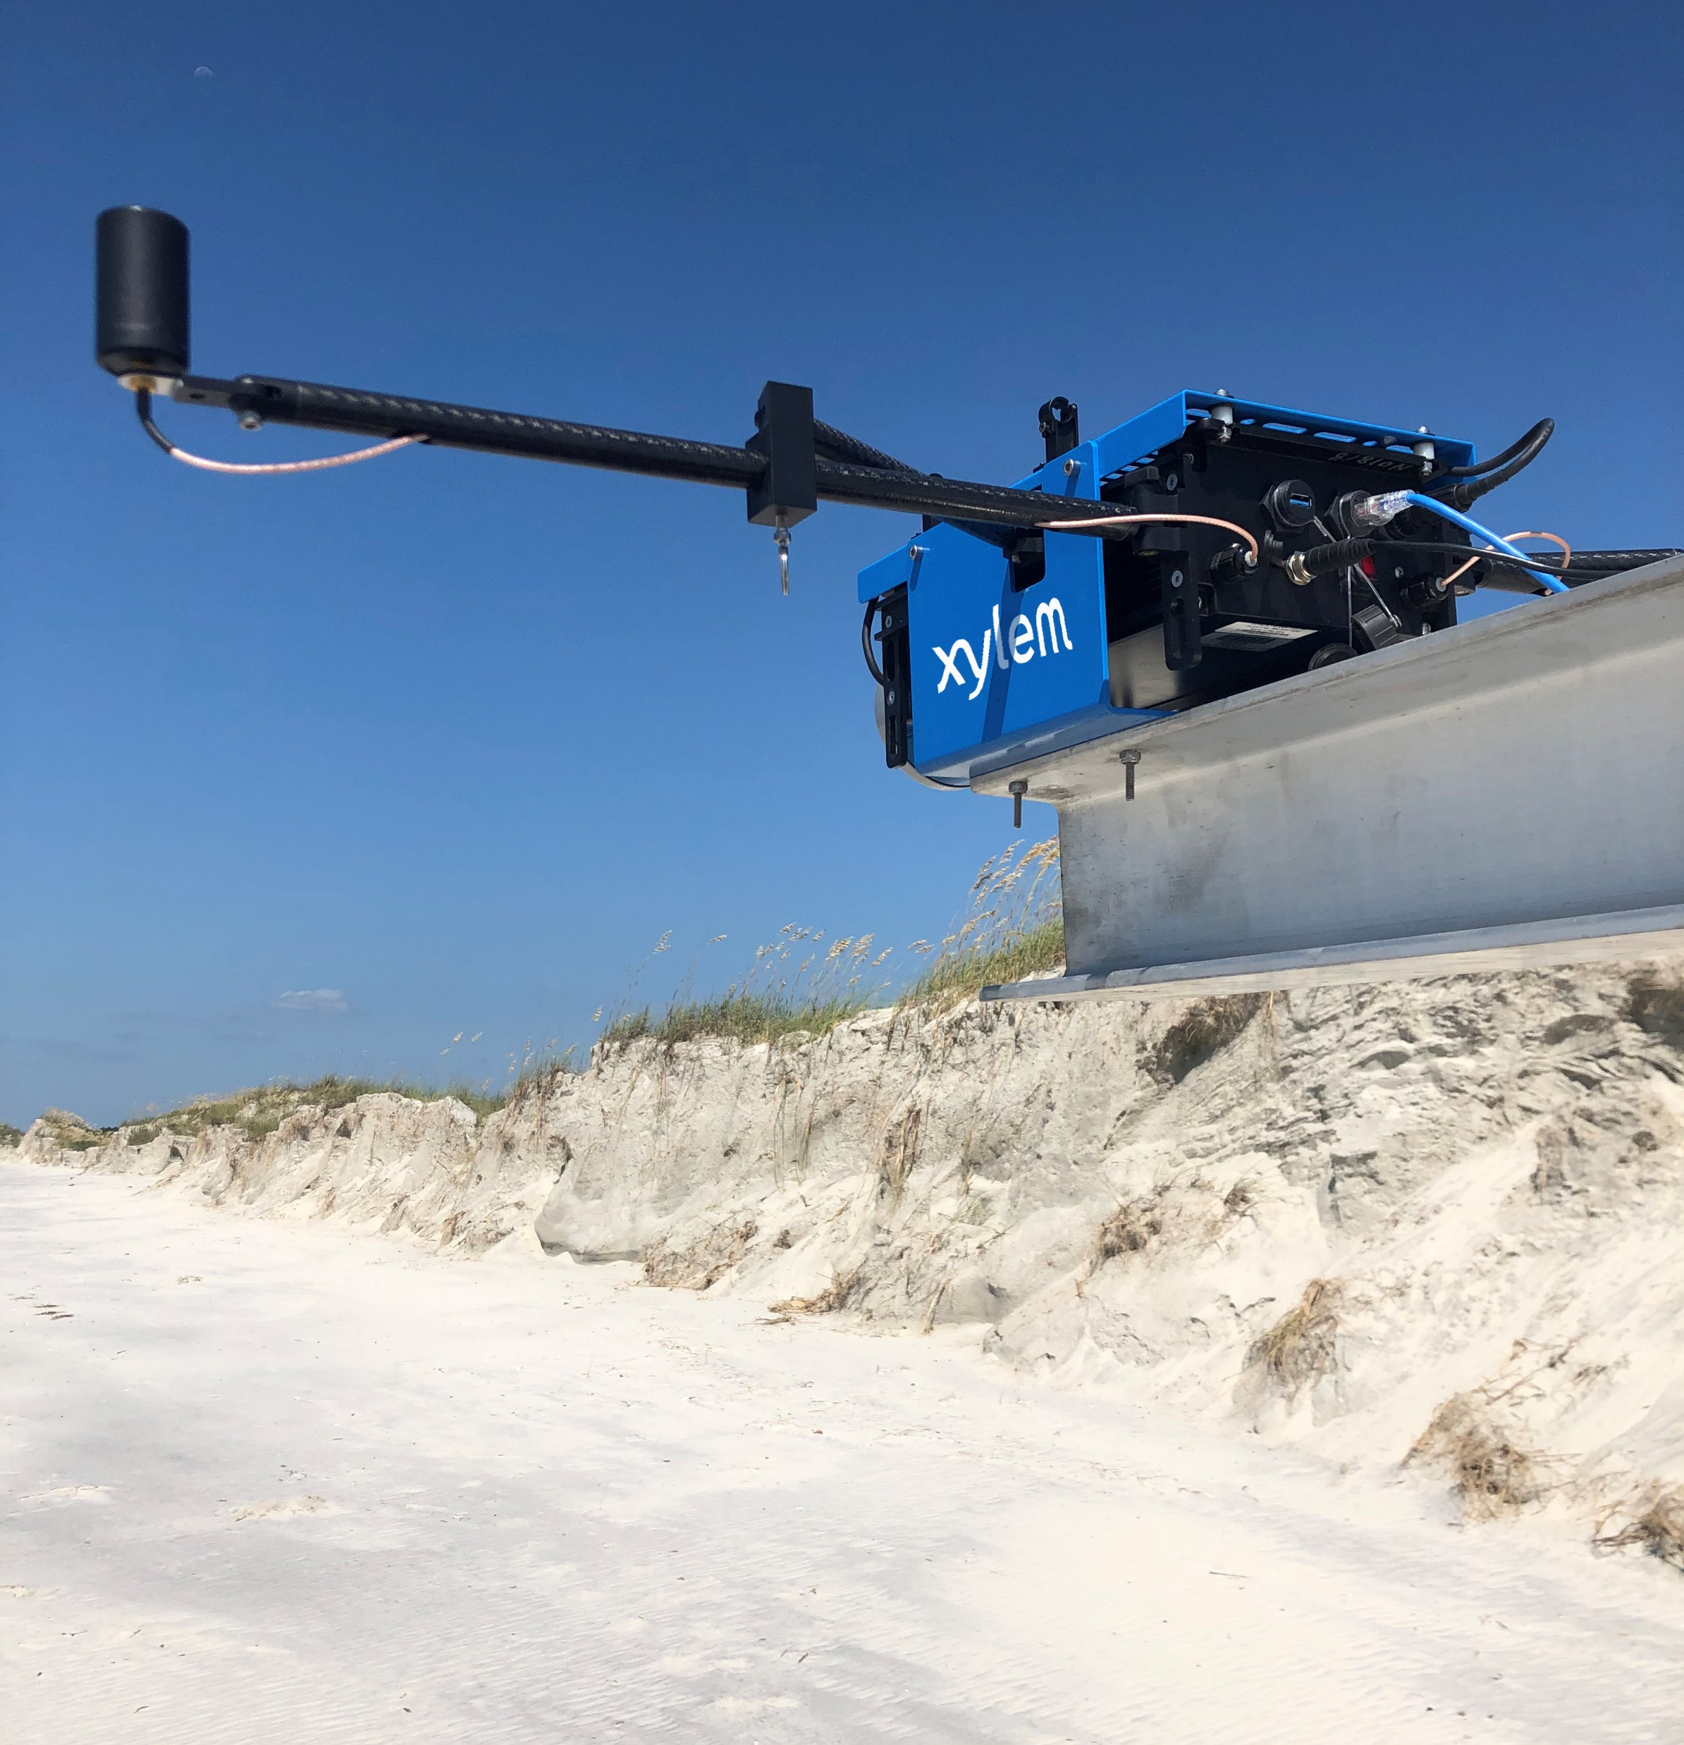
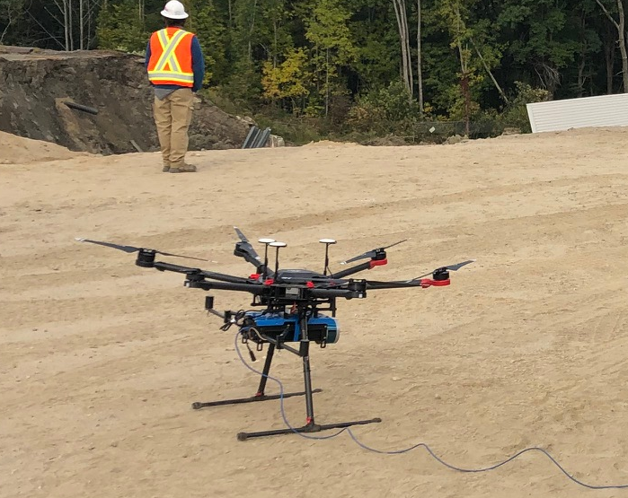
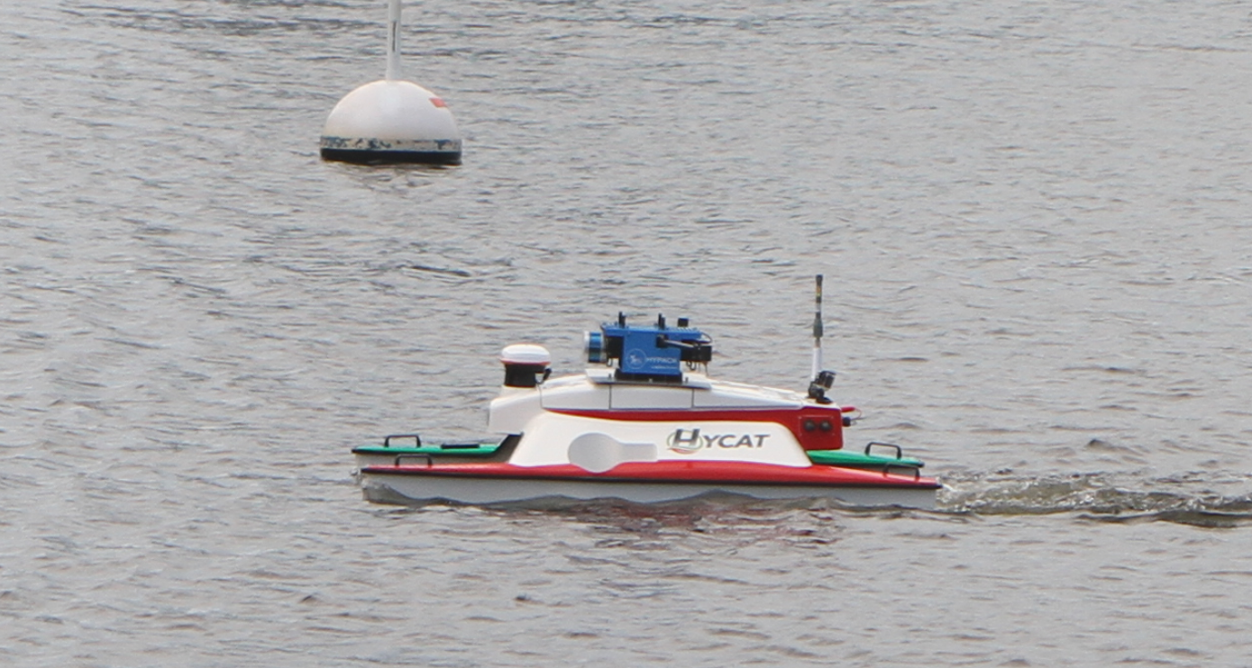
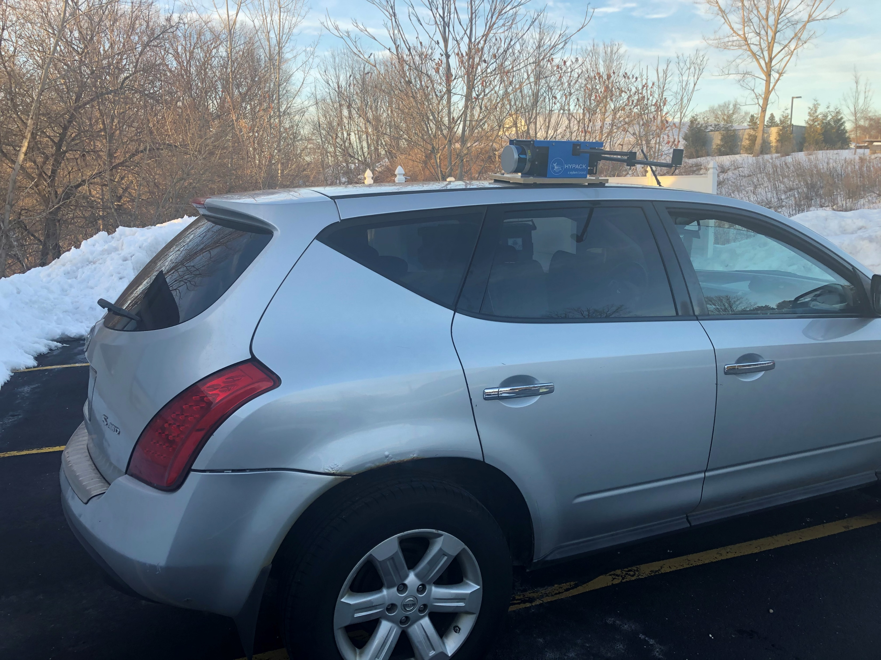
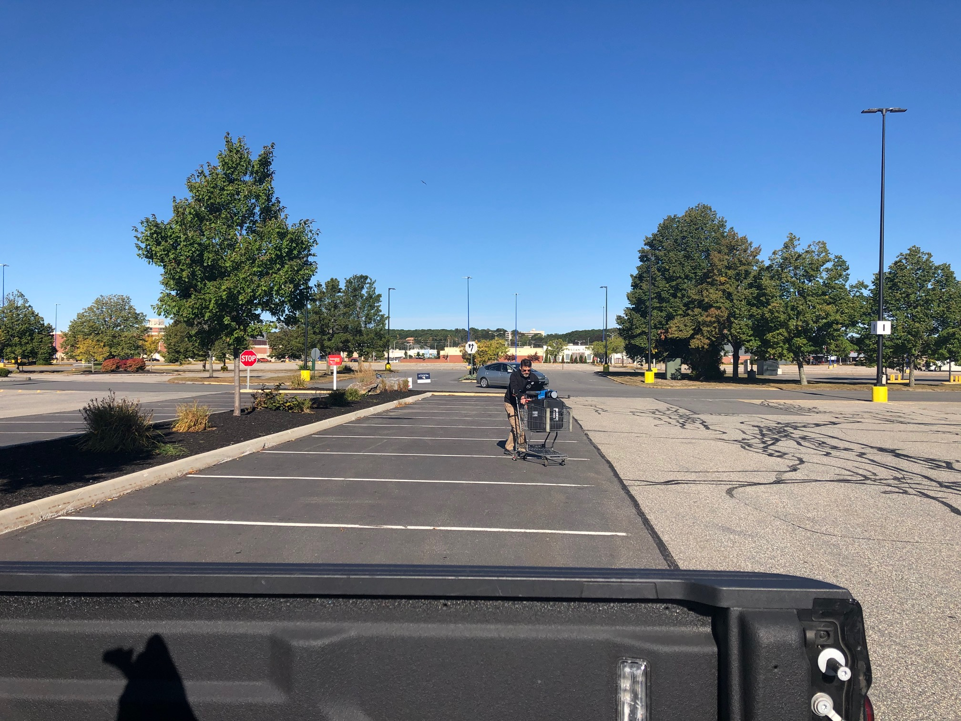
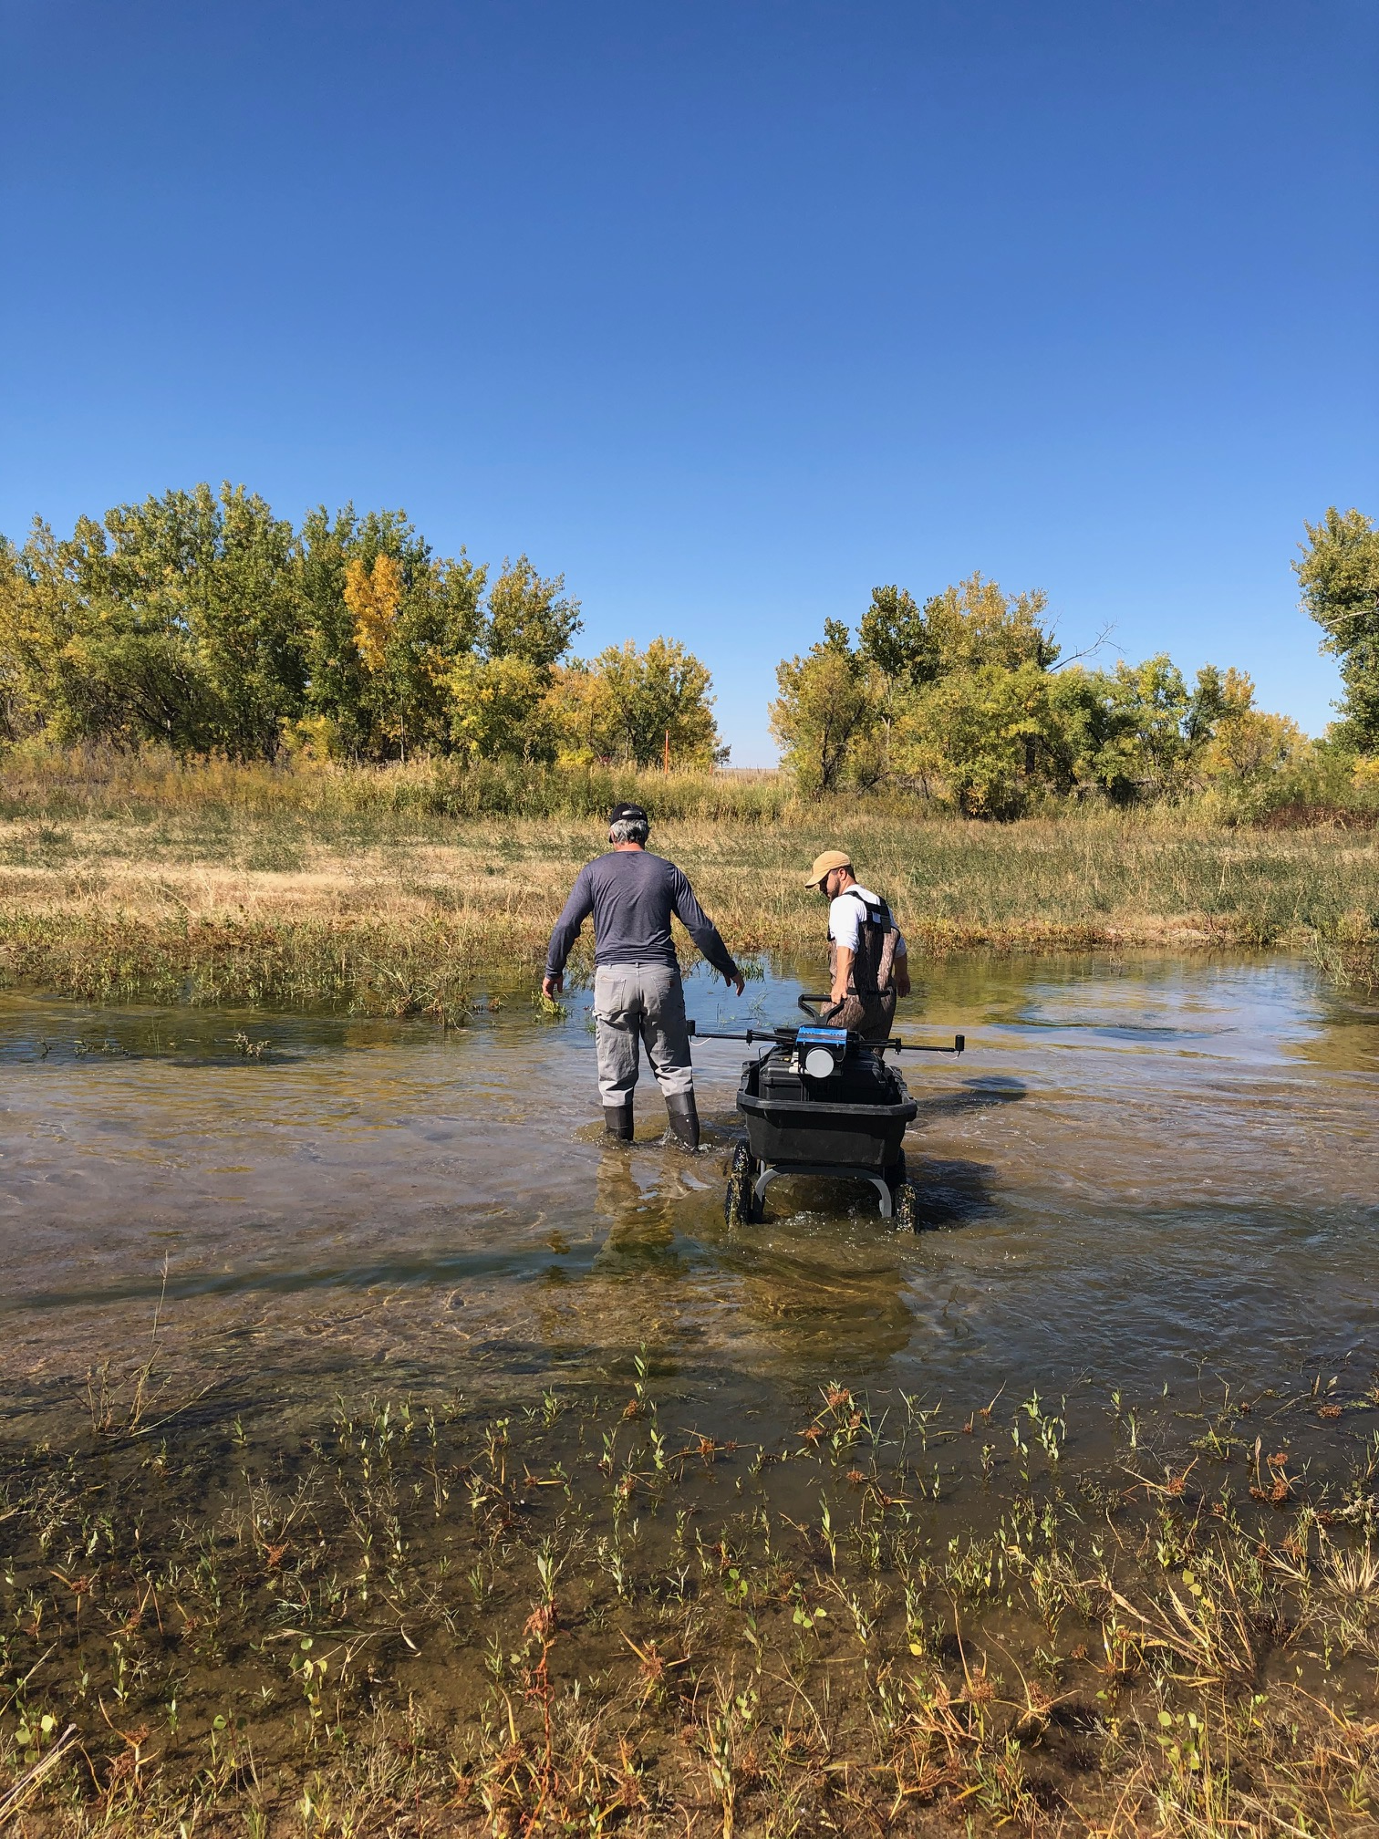
Vehicle Mounting – Much more than a Drone LiDAR
A strength of the system is that the hardware is all internal to the Payload, therefore a single calibration would work on all of these surveys.

Slide 25
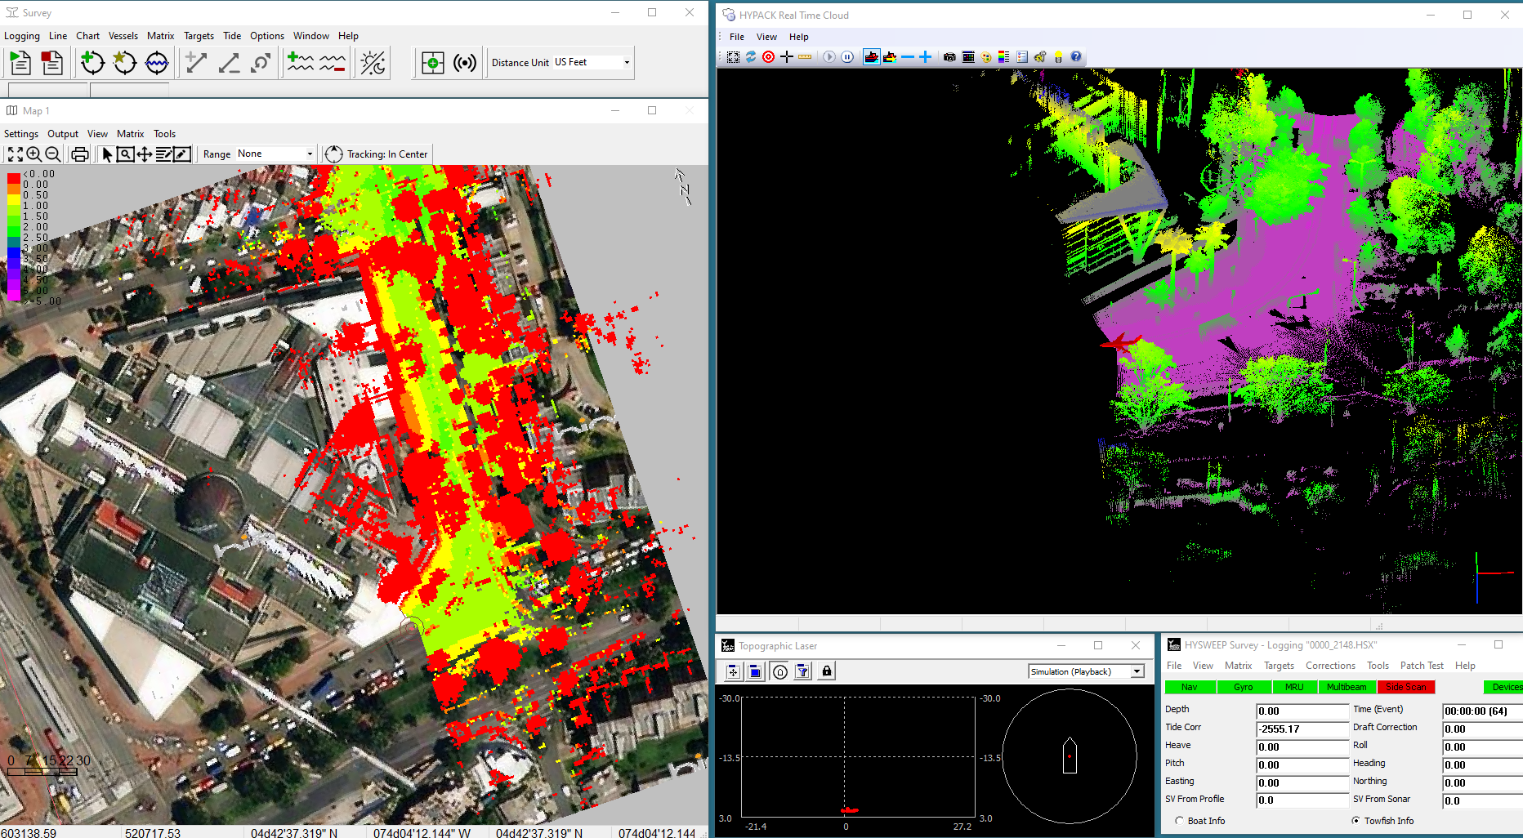
Survey Display Windows
During Data Collection the Real Time Cloud can be used as a QC tool to monitor the quality of the LiDAR data being collected.

Slide 26
Processing LiDAR Data

Slide 27
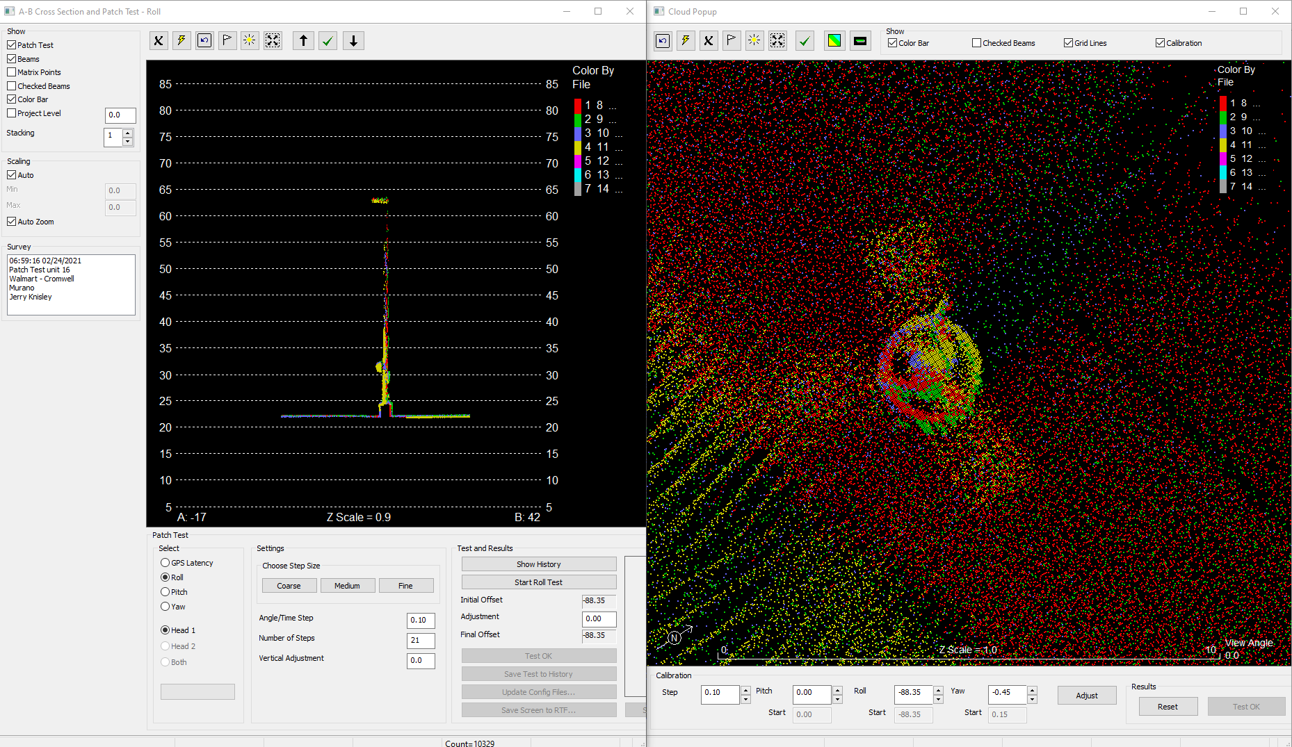
Calibration – 2D and 3D Patch Test Adjustments
Every LiDAR Payload is calibrated and Patch Tested prior to shipment.
HYSWEEP offers both Automated Patch Testing as well as Manual Adjustments in 3D.
The Grid Convergence option is enabled to allow the user a quick solution when the Payload has traveled long distance from the original calibration.
Automated Patch Test
Manual Patch Test Adjustments

Slide 28
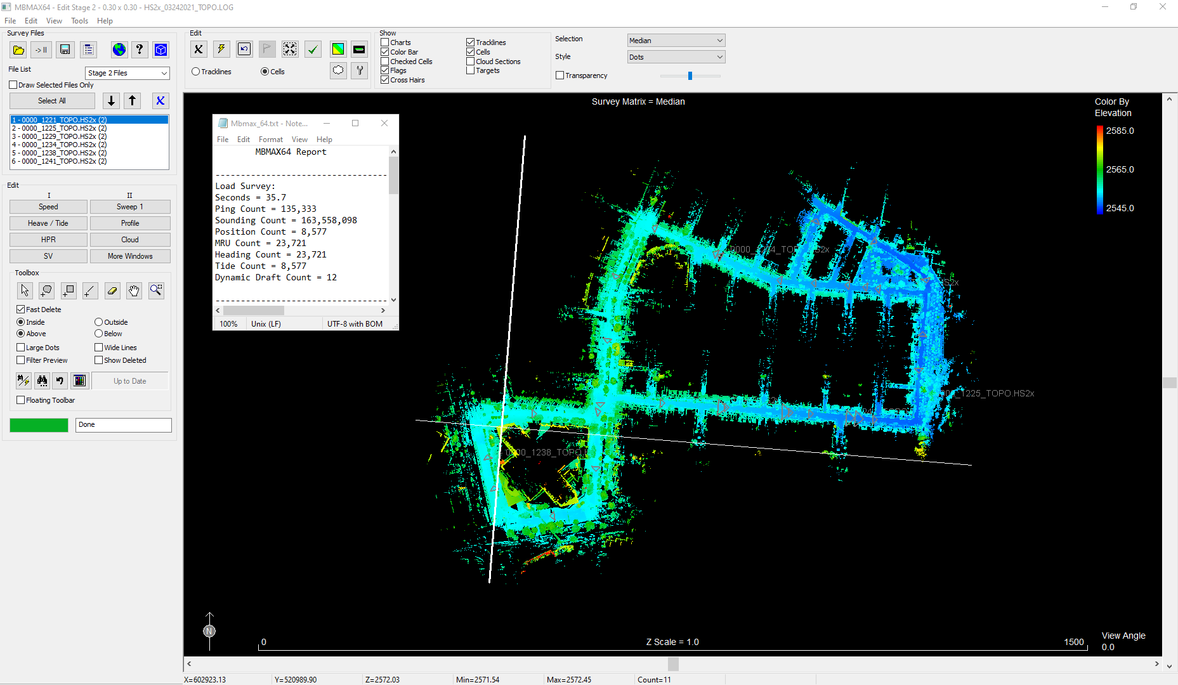
LiDAR Dataset – Amount of Processed points
LiDAR Data is processed in the MBMAX64 software
6 Lines of LiDAR data
Collected from a truck in an urban environment over the course of 22 minutes
163 Million data points, roughly 123,907 points per second.

Slide 29
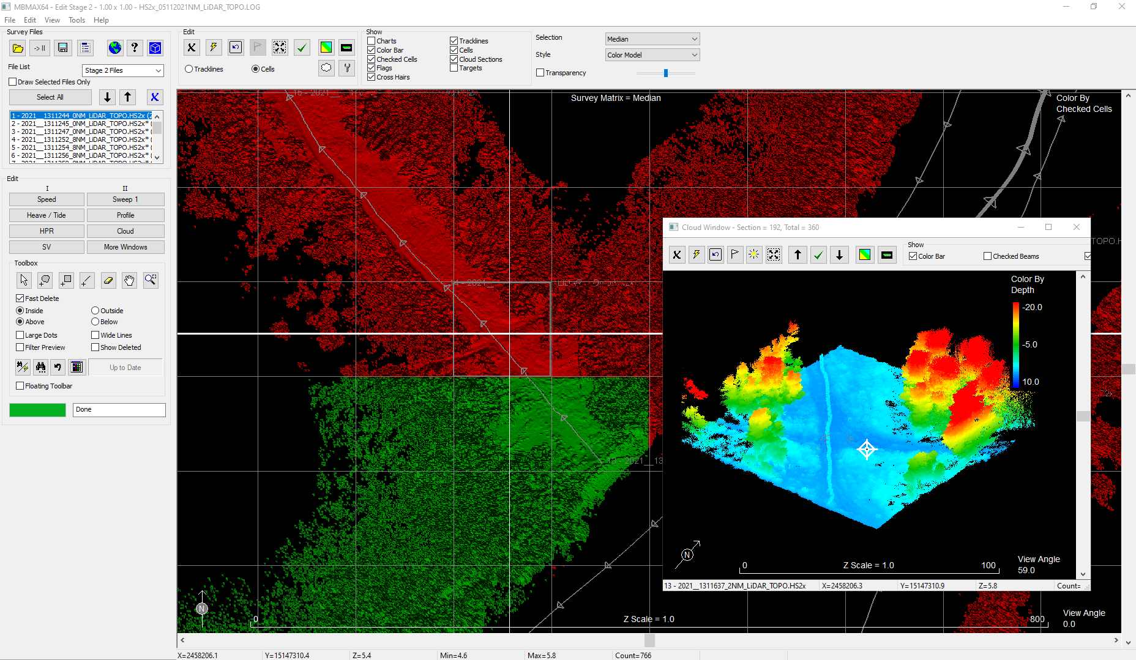
Editing In Cloud Window
Using the Cloud Window with the Checked Beams allows the user to visually see where edits have been stored and new edits are required

Slide 30
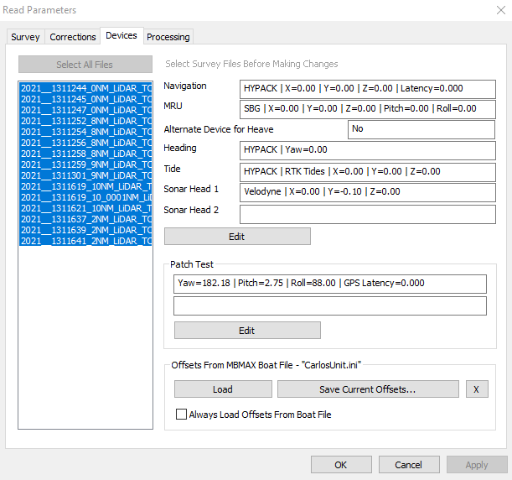
Saving a Calibration – Boat File
The Read Parameters menu allows the user to load and save a calibration file for a particular set of hardware.
This setting is useful to store and recall offsets for the Payload if there is ever a question of the correct offsets during survey.

Slide 31
LAS Output from HYPACK

Slide 32
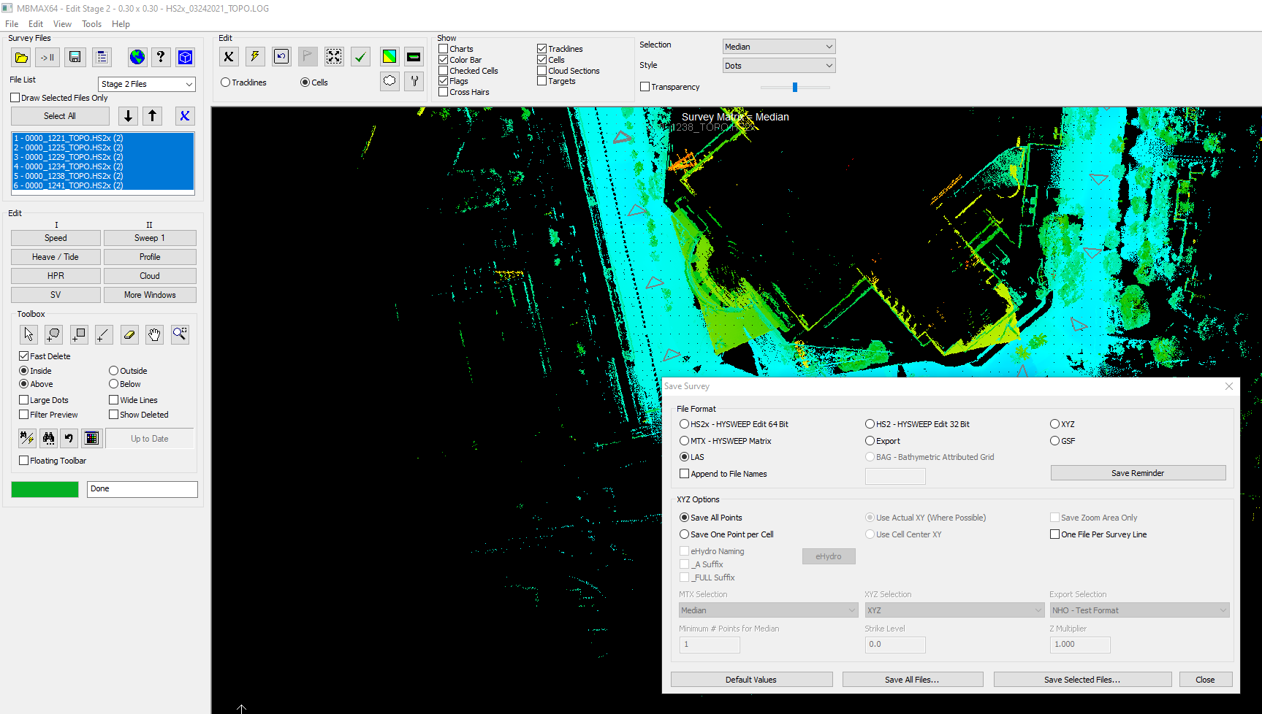
Saving an LAS File
The MBMAX64 Editor allows the user to save an LAS file with one point per cell or all of the data.

Slide 33
Esri Output for LiDAR Data

Slide 34
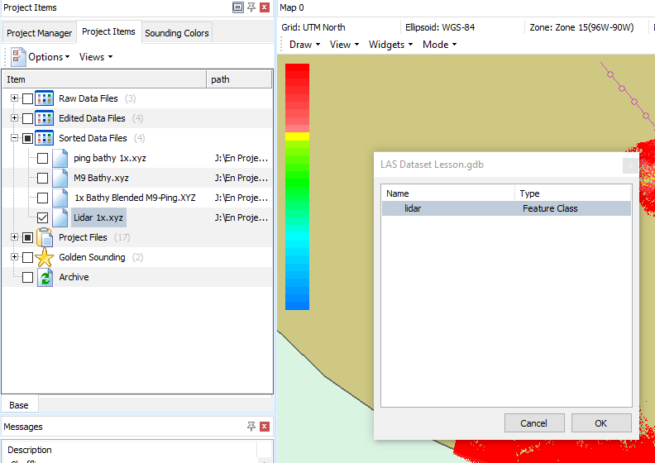
Export XYZ from HYPACK Shell
In the HYPACK Shell the user can right click on the XYZ file and Export to the ArcGIS Geodatabase

Slide 35
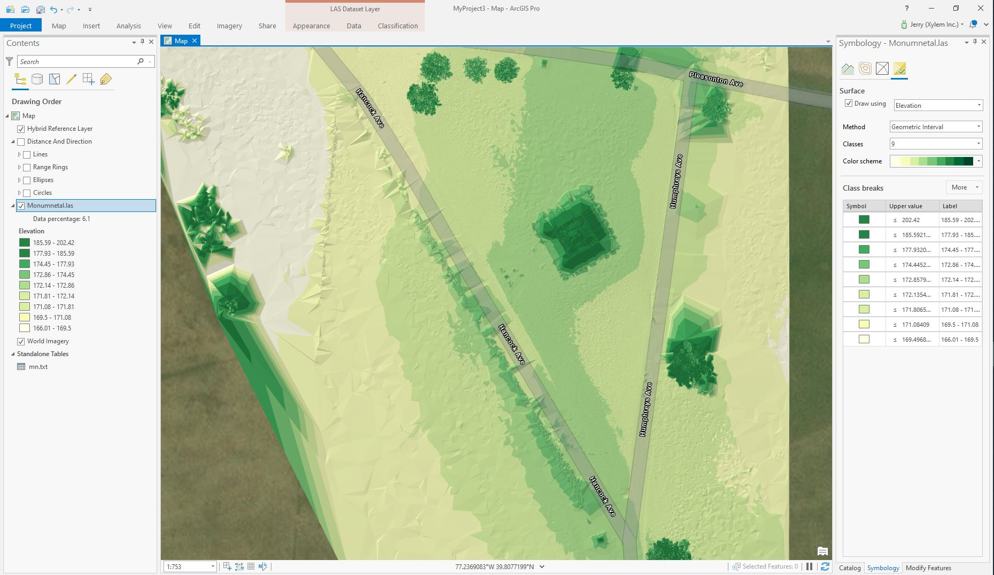
Esri – ArcGIS Pro
Once the data is saved into the ArcGIS Geo-database the full power of ArcGIS is available to the user.

