Slide 1
Magnetometer Survey

Slide 2
Objectives of this session
1
2
What does a Magnetometer do?
What is a Magnetometer
Variables that affect data
Connecting a Magnetometer
Unified Device interface
3
4
Surveying Principles
Planning the Survey
Real Time Data Acquisition
Post Processing
Using the MAG Editor
Analyzing targets
Notes:
Stressed Water Supply
Issue
Maintain the health of traditional water sources and execute a water source diversification strategy
Solution
Xylem’s leading-edge technologies monitor, pump and treat water from all sources and enable water reuse
Aging Infrastructure
Issue
Utilities have to effectively assess and identify high-risk areas for repair/replacement before problems occur
Solution
Xylem’s intelligent pipeline and critical infrastructure services perform condition assessment, identify defective assets, provide bypass services and replacement technologies, reduce or eliminate combined sewer overflows and leaks/non-revenue water
Stormwater & Flooding
Issue
Significant increase in severe weather patterns is causing flooding and related damages to communities
Solution
Xylem’s flood management solutions include sensors for early warnings, dewatering for disaster response, communications for recovery and submersible pumping for resilient infrastructure
Regulatory Compliance
Issue
Utilities must successfully comply with a growing body of compliance regulations
Solution
Xylem’s analytics and sensors evaluate a broad range of water quality parameters, and our technologies treat water and wastewater to meet regulatory standards
Non-Revenue Water
Issue
Utilities have an important opportunity to reduce persistent and costly water losses from leaks and faulty meter readings
Solution
Xylem’s broad portfolio of solutions monitors for, and identifies, water leaks, as well as faulty meters. Our communications network enables point-to-multipoint communications throughout the system
Operating Strategy Reducing Costs
Issue
Utilities want to lower operating and energy costs, and leverage new revenue opportunities
Solution
Xylem offers industry-leading pumping and treatment solutions for energy efficiency, and software-enabled solutions to optimize operations and identify revenue opportunities

Slide 3

What Is A Magnetometer?
Magnetometers measure magnetism
Metal magnetic objects will register on a magnetometer
    A metal detector is a magnetometer
    A compass measures the Earth’s magnetic field
Measured in units of “gamma” or “nanotesla” (nT)
    Earth’s magnetic field ranges from 20,000 - 80,000 nT based on location, with fluctuations of 100nT over time
Notes:
The ones we use for surveying are much more powerful and much more sensitive.
So sensitive that they are affected by solar storms from the sun

Slide 4
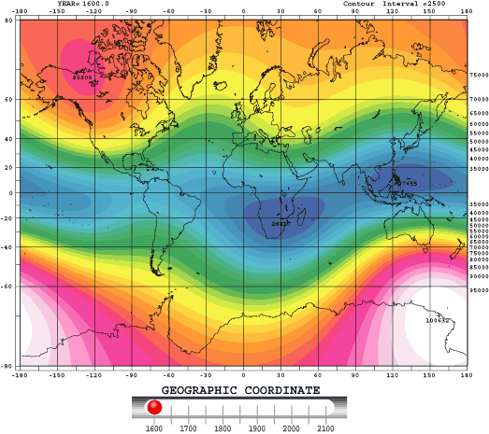
Variables that Affect a Magnetometer Survey
International Geomagnetic Reference Field (IGRF)
A standard mathematical description of the Earth's main magnetic field and its secular variation.
This is the magnetic field generated by the Earth’s inner core.

Slide 5
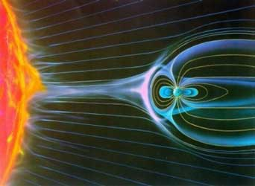
Geomagnetic Storms
Geomagnetic Storms
Everyday the earth is bombarded with magnetic impulses from the sun.
These magnetic storms affect the gamma readings of the magnetometer.
The intensity and duration of a Geomagnetic Storm can range from seconds to hours.

Slide 6

Monitoring Background
We don’t want to measure solar storms or the Earth’s magnetic field
INTERMAGNET measures changes in the magnetic field due to this interference
These changes are recorded at sites with known gamma signatures
These recordings are available for download
The recorded variations can be used with a HYPACK survey to clean interference

Slide 7
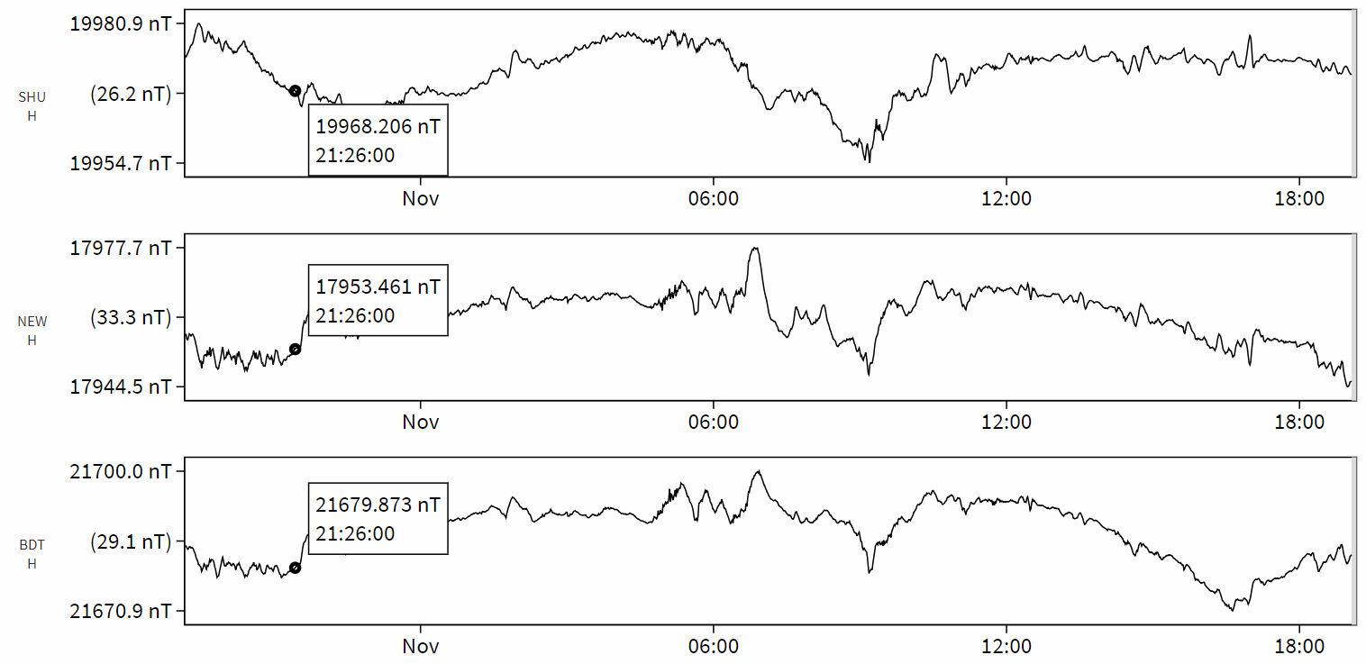
Fluctuations Affect Each Station Differently
Fluctuations Affect Each Station Differently

Slide 8
Connecting A Magnetometer

Slide 9
Data Collection – Supported Systems
Data Collection – Supported Systems
DF 1000 (Serial)
Geometrics 881/882/G-858 Map Mapper/G-882TVG
Insight Marine (881 Dual)
IXSEA Magis
JW Fisher Proton 3/4 and Pulse 12
Marine Magnetics Seaspy, Seaquest, and Explorer
Scintrex Envigrad
Seaquest
UC Mag
GEM Systems GSM-19/GSMP-35UC
Quantro Sensing Magnetometer
SMM II
HYPACK’s MAGNET.DLL is a standard device driver that supports the above magnetometers. All HYPACK users have access to this driver as a standard feature of HYPACK.

Slide 10
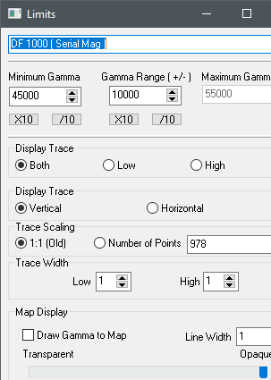
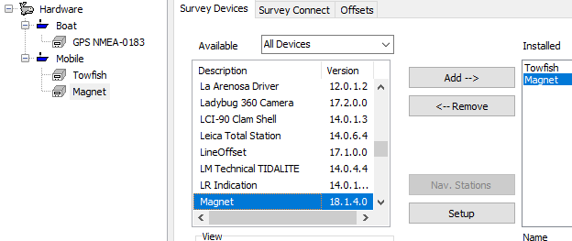
Setting Up A Magnetometer
Follow the instructions for your towfish from last section
Add the “Magnet” device
With “Magnet” selected on the right, click “Setup”
Configure your device in this window
Use the Survey Connect tab and Offsets tab
1
3
2
4

Slide 11
Magnetometer Surveying

Slide 12
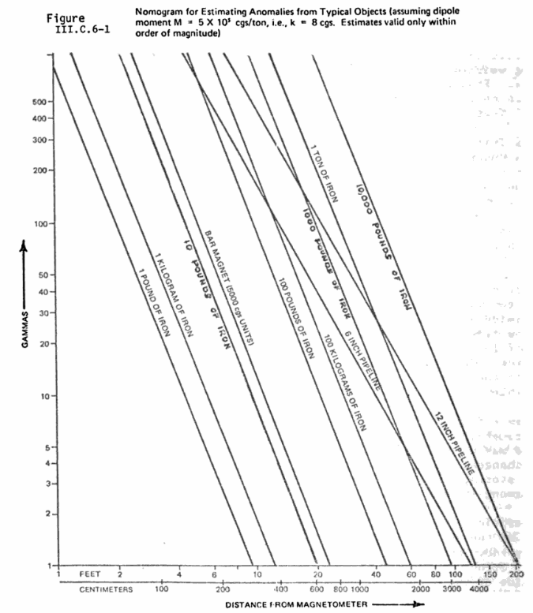
Planning Your Survey
Planning Your Survey
Understanding the target and the range detection will allow the user to plan the line spacing
100 Kilograms of iron is not going to be detectable at a range of 20 meters

Slide 13
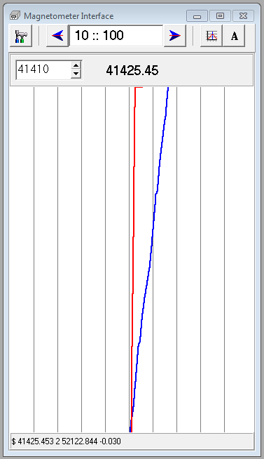
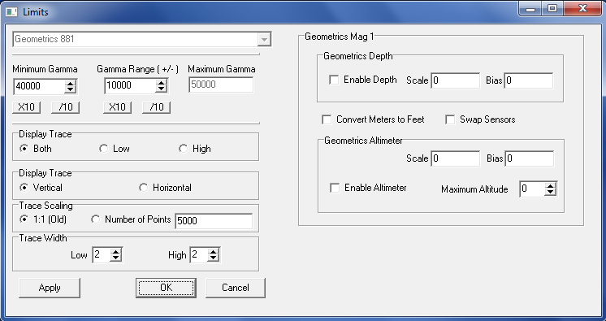
Magnetometer Data in HYPACK
The display shows the gamma readings at two scales simultaneously or individually.
This allows for a target that jumps off the total visible scale of the lower scale ( blue ) graph to be monitored by the larger scale ( red ) graph.
10 nT
100 nT
Notes:
13

Slide 14
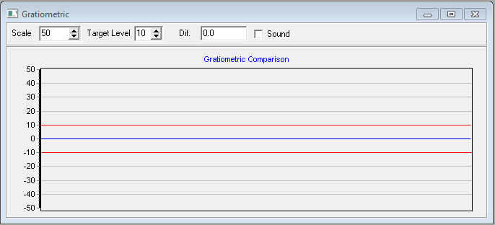
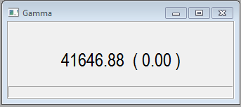
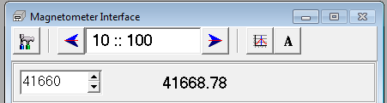
Magnet Driver - Real Time Display
Scale Ranges
Current Reading - Click on the current Gamma reading to set the Center of Scale. The reading will be rounded to the nearest ten’s value.
Center of Scale
Notes:
14

Slide 15
Magnet Driver - Settings Tab
Minimum Gamma – No gamma below this value is recorded
Gamma Range – used to set the maximum gamma
Maximum Gamma – No gamma above this value is recorded
Sensor Selection
Display Trace – Allows the user to choose to display either the Red, Blue or both scales in the scroll
Display the scroll vertical or horizontal
Number of samples to hold in the display
Thickness of the trace
Notes:
15

Slide 16
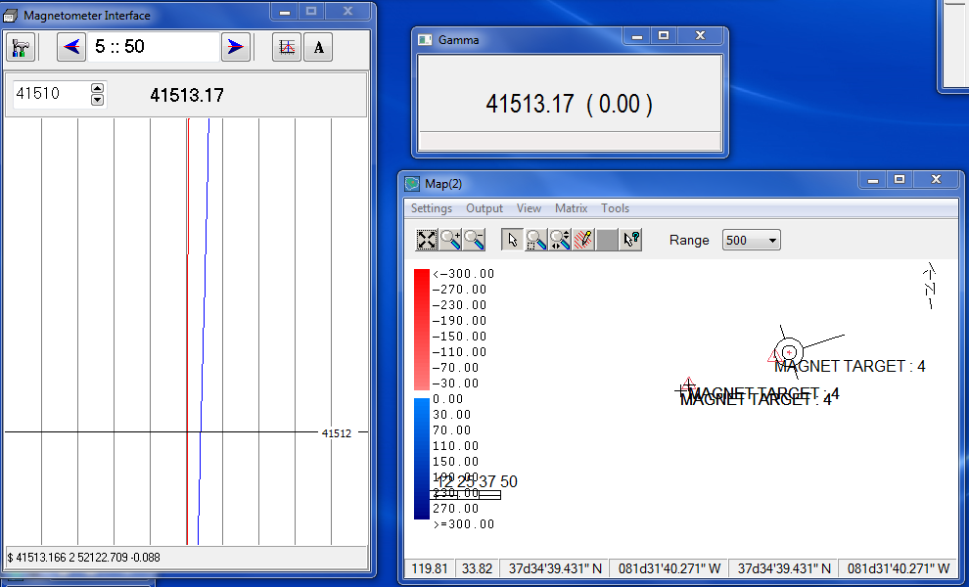
Magnet Driver - Marking Targets
By double clicking on the scrolling chart the user can mark a target.
This target is then displayed in the map and stored for later reference
Notes:
16

Slide 17
Magnetometer Editor

Slide 18
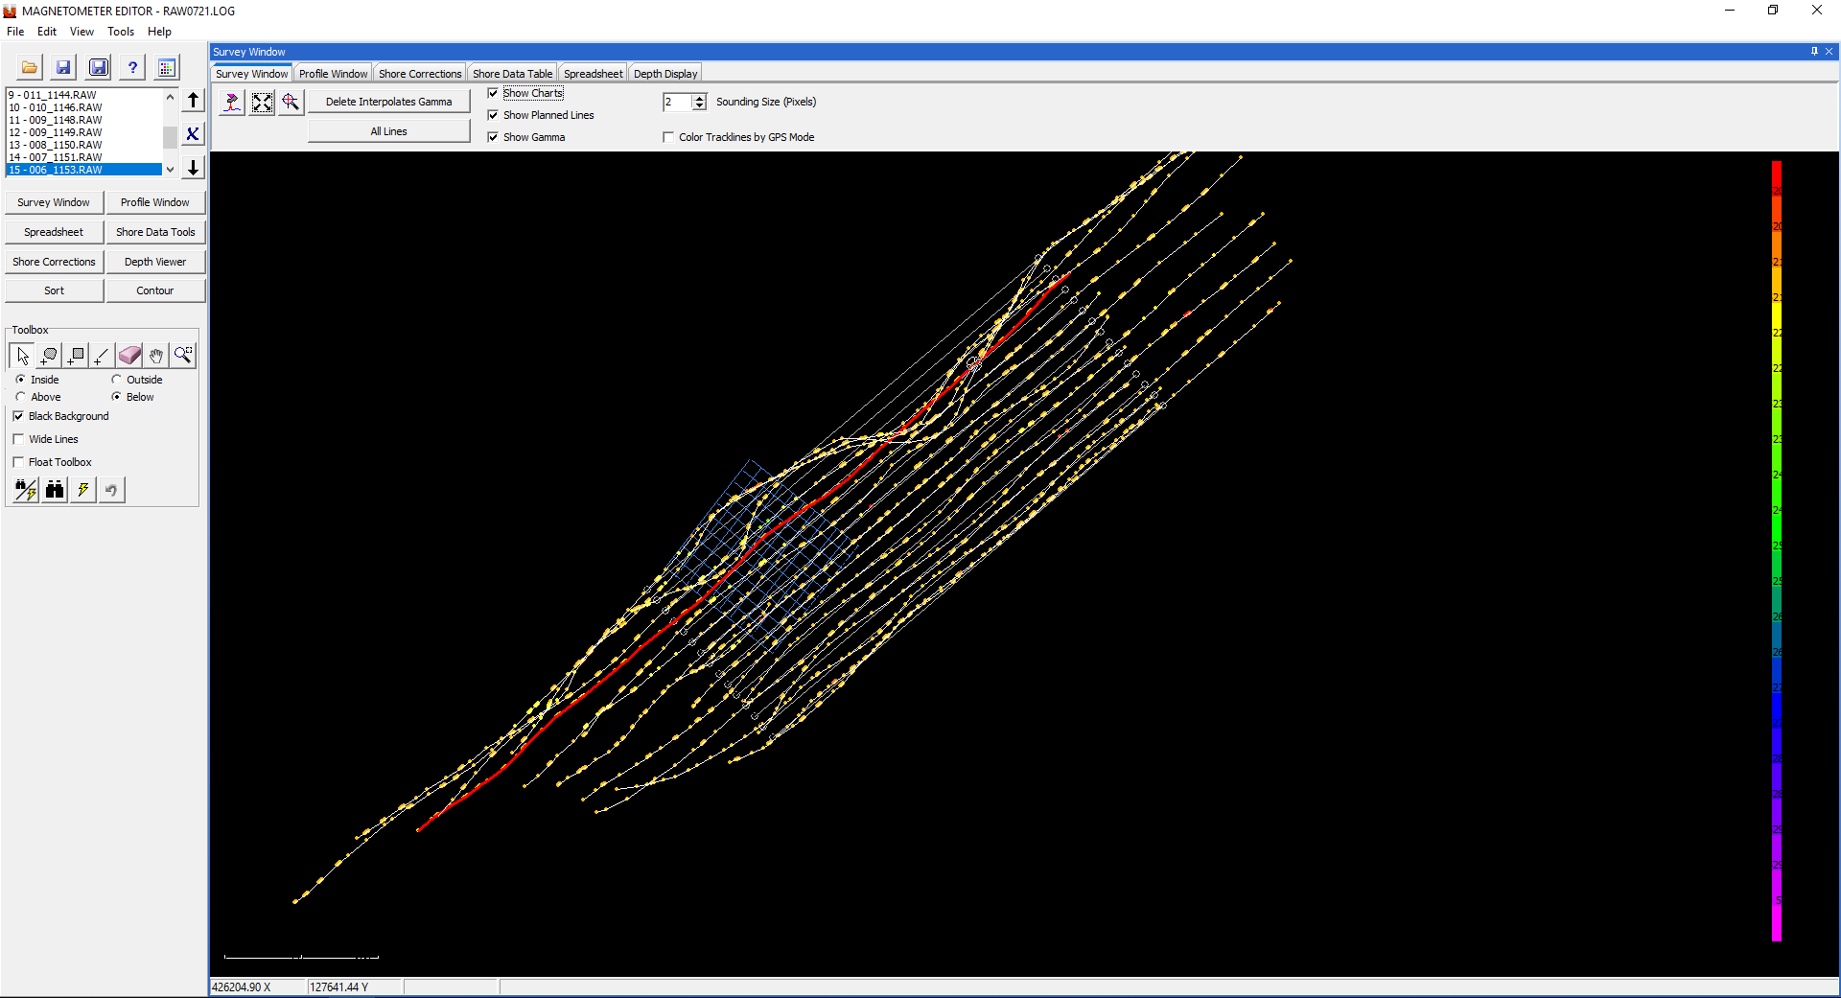
Magnetometer Editing
Magnetometer Editing

Slide 19
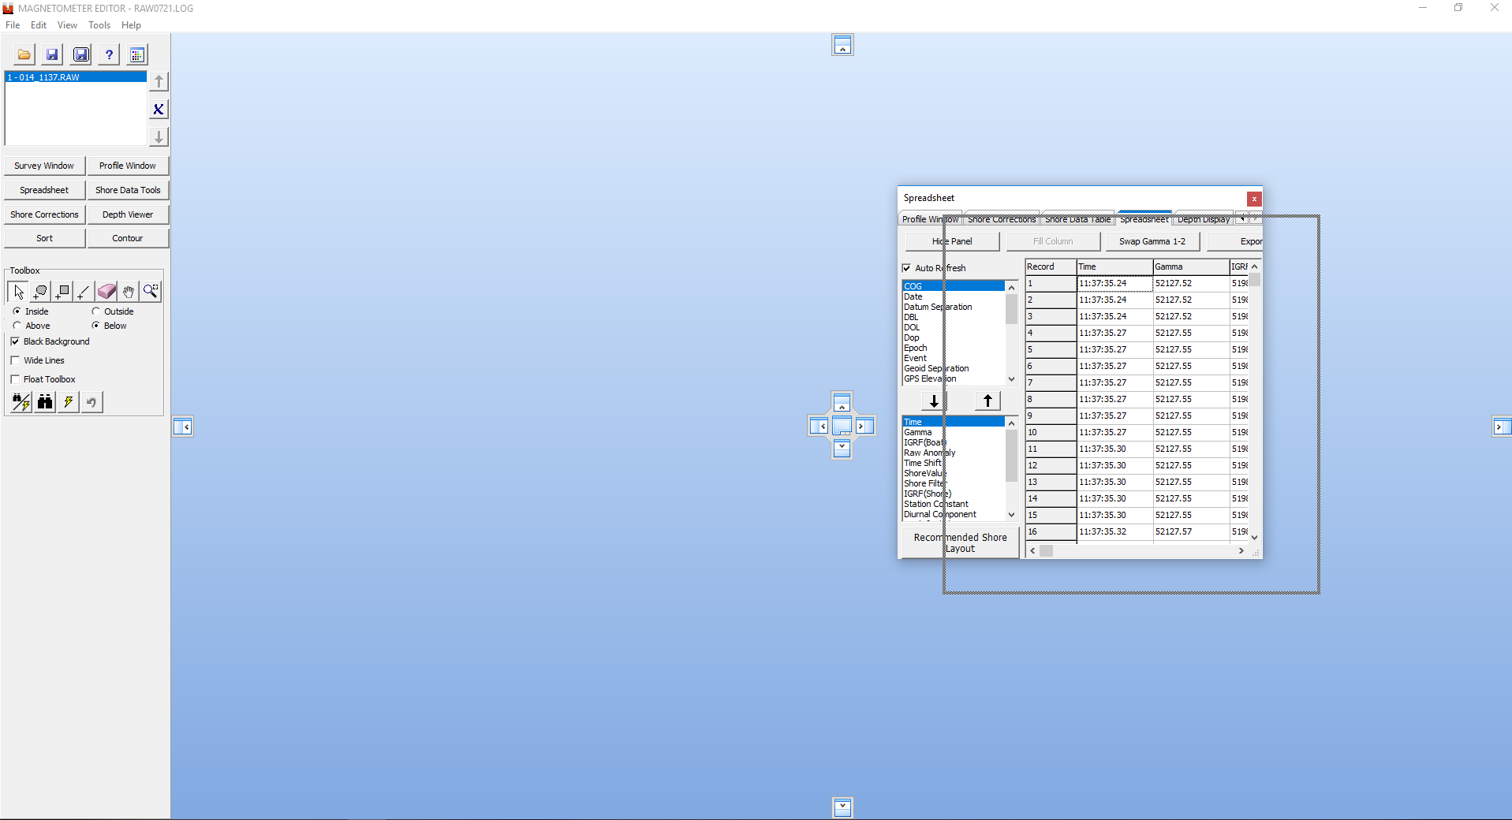
Docking ability of Windows
The windows can be docked to various areas of the editor.

Slide 20
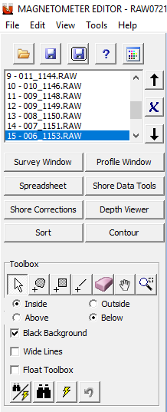
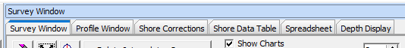
Left Menu Area
Open and Save Session
Remove File from Session
Tabs to view the data can be directly accessed or selected through the menu
New tools for Contouring and Sorting in the Editor
Common HYPACK Tool set to edit data

Slide 21
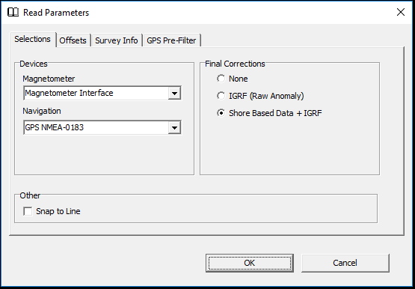
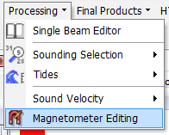
Magnetometer Editing
Magnetometer Editing
MAG EDIT Supports:
  Stand-alone magnetometers.
  Stand-alone magnetometers with IGRF corrections.
  Sea magnetometer with Shore Based magnetometer, both with IGRF corrections.

Slide 22
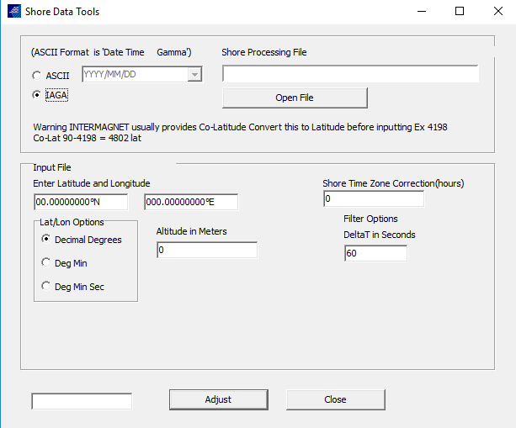
Shore Data Tools
The time shift to accommodate the distance between the boat and shore station. If shore data is at a different time interval than the raw data, the MAGNETOMETER EDITOR interpolates the shore data to calculate values to match the raw data
The elevation is provided for IAGA stations
IAGA positions are provided in co-latitude: the difference between the latitude and 90°

Slide 23
New Session Methodology
HYPACK 2020 Magedit reads HYPACK Raw files and saves to XYZ or a Session File per line with a LOG File.
XYZ data can be taken into the TIN MODEL program to generate a color filled DXF or 3d Displays.
The new Session file is a BINARY file which contains the corrections and raw information to allow users to visualize the corrections applied.
Using the Binary file format the file size is smaller and loads quicker while containing more information.

Slide 24
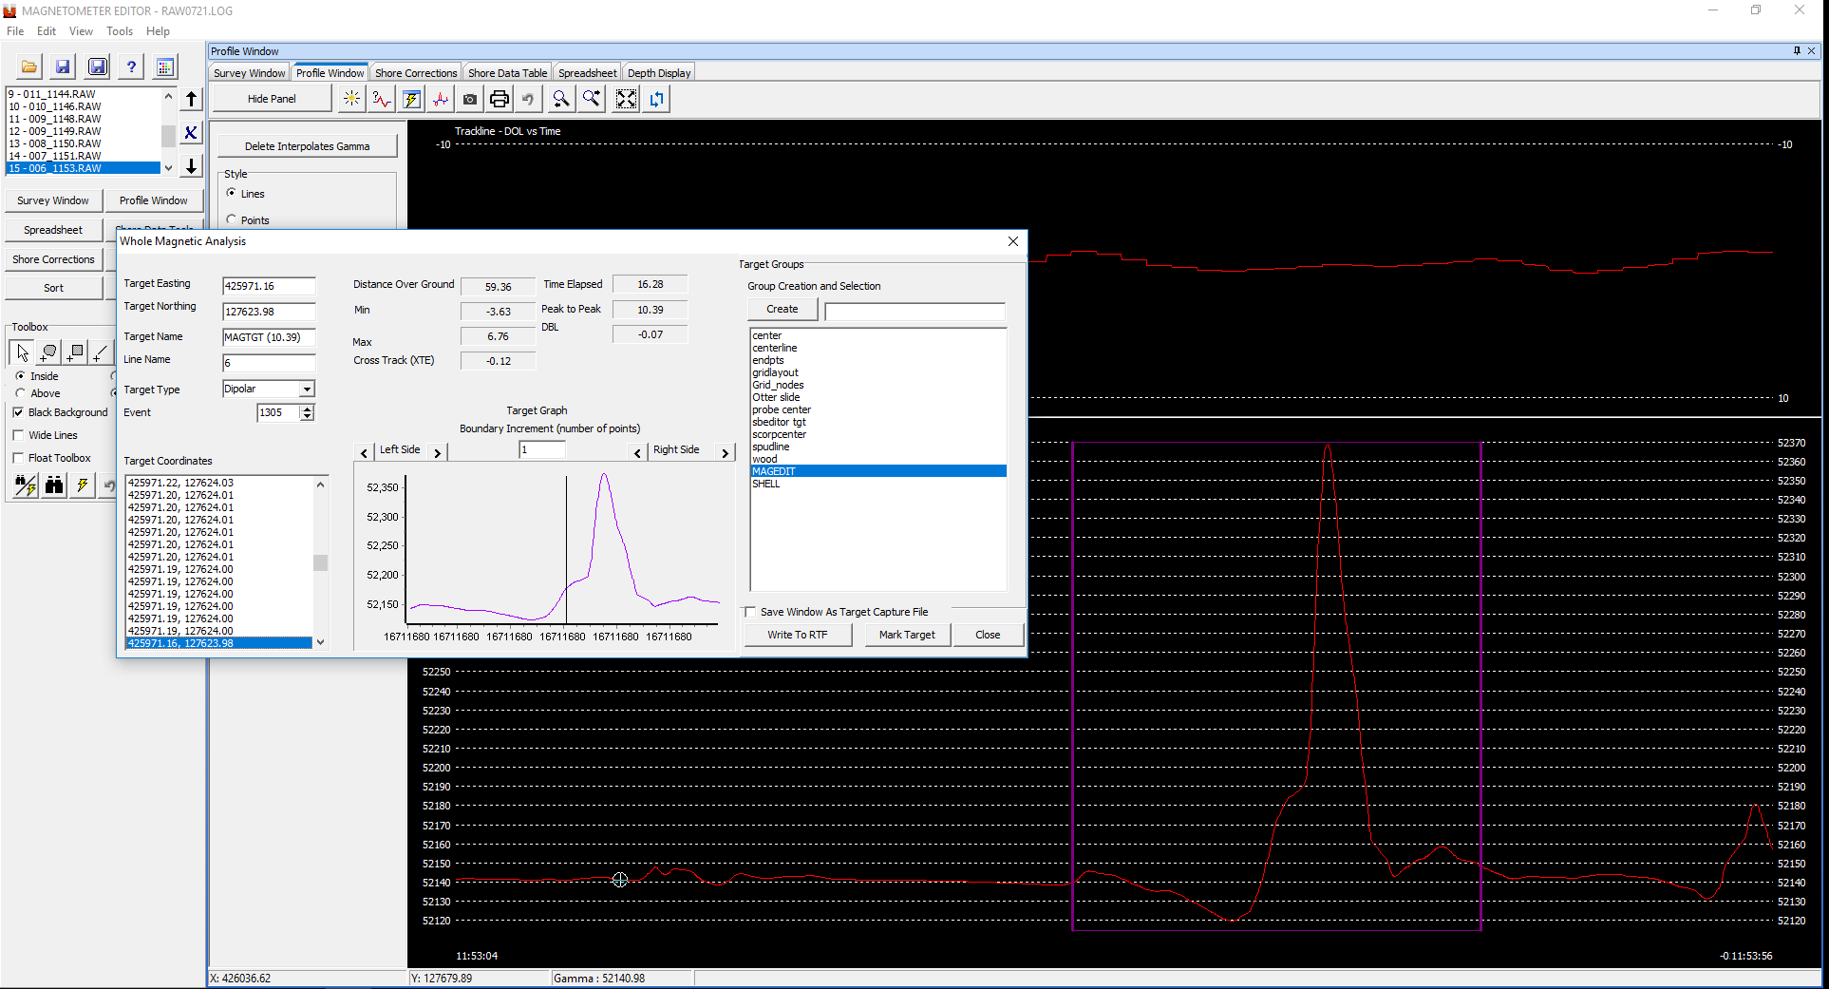
Editing Tools
Editing Tools
Gamma values in Profile Window

Slide 25
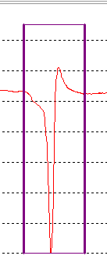
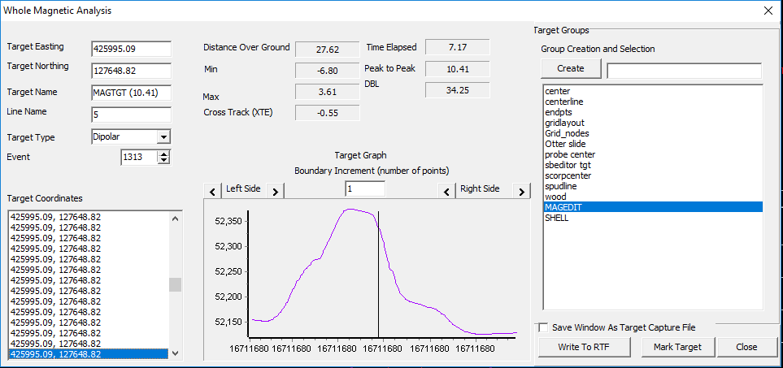
Target Tool – Whole Magnetic Analysis
Target Tool – Whole Magnetic Analysis
To target an area, click and drag with the left mouse button around the area you wish to mark.
Information about the target will appear in a new window.
Click “Mark Target” to save the data to the target database.

Slide 26
Target Tool – Whole Magnetic Analysis
Target Tool – Whole Magnetic Analysis
Target properties
Target location and name
Write to RTF will create an image of the display and add it to a RTF file that can be used as a target report.

Slide 27
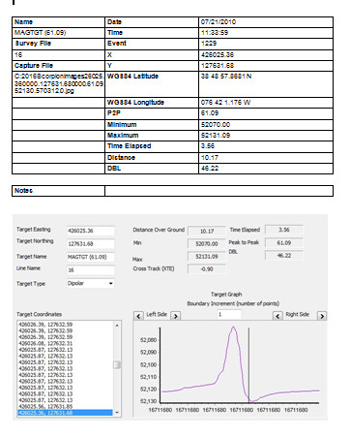
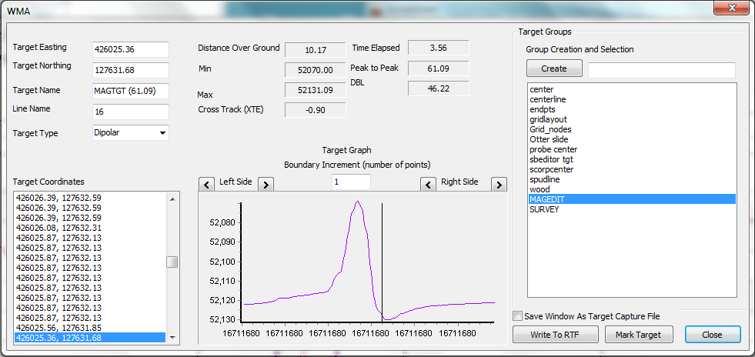
Mag Edit Report in RTF – Rich Text Format
Mag Edit Report in RTF – Rich Text Format

Slide 28
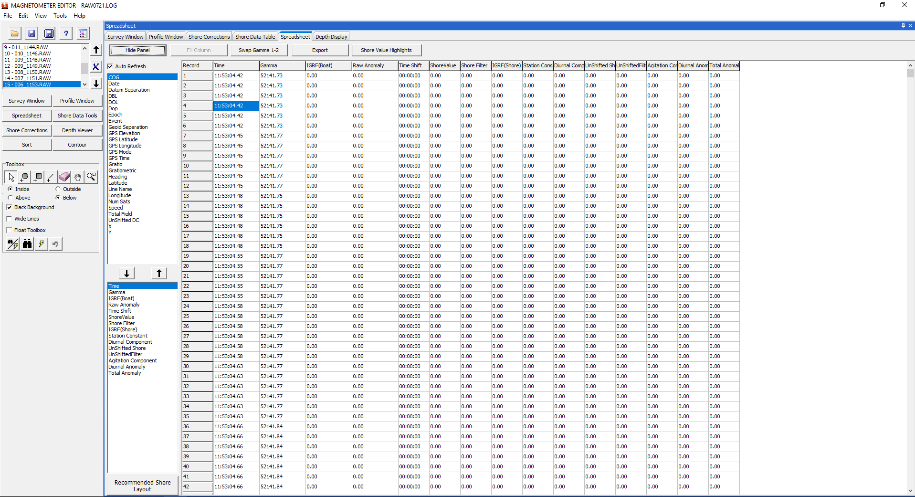
Spreadsheet - Layout
Recommended Shore Layout Button

Slide 29
Spreadsheet
Spreadsheet
Vessel with Shore-Based Adjustments
Raw Anomaly: Gamma1 – IGRF(Boat)
Diurnal Component: Shore Filter –(IGRF (Shore) + Station Constant)
Agitation Component: Unshifted Shore – Unshifted Filter
Diurnal Anomaly: Gamma 1 - IGRF(Boat) - Diurnal Component
Total Anomaly: Gama 1- IGRF(Boat)- (Diurnal Component – Agitation Component)

Slide 30
Spreadsheet –
Vessel with Shore-Based Adjustments
Spreadsheet –
Vessel with Shore-Based Adjustments
Boat
Gamma 1: Measurement with no corrections
IGRF(Boat): IGRF adjustment for boat
Raw Anomaly: Gamma 1 – IGRF (Boat)
Shore
Time Shift: Latency correction between the ship and the shore station
Shore Value: Gamma value of shore station or IAGA at shifted time
Shore Filter: 5 hours filter on shore value
IGRF (Shore): IGRF adjustment for shore station at shifted time
Station Constant: Station magnetic field average
Diurnal Component: Diurnal variation at shifted time
Unshifted Shore: IGRF adjustment for shore station at unshifted time
Unshifted Filter: Gaussian filter on unshifted time
Agitation Component: high frequency component
Diurnal Anomaly
Total Anomaly

Slide 31
Standalone Magnetometer with IGRF Corrections
Standalone Magnetometer with IGRF Corrections
Raw Anomaly = Raw Gamma – IGRF Boat
The Raw Anomaly is the difference in the readings from the magnetometer and the calculated earth’s magnetic field at the location (IGRF)
Each sample has a calculated IGRF value. This calculation can take several minutes to calculate.
Sample location
and time
IGRF Model
IGRF Boat

Slide 32
Shore-Based Magnetometer with IGRF Corrections
*Shore based data could be input in SHOM or IAGA Formats
Station Constant = Average Shore Based Data – Average IGRF (Shore Based Data)
Shore Based DATA*
IGRF Model
IGRF Shore

Slide 33
Shore-Based Magnetometer with IGRF Corrections
Diurnal Component: Oscillations of the earth's magnetic field that:
Have a periodicity of about a day
Depend only on local time and geographic latitude.
Diurnal Anomaly =
Shore Filter*- (IGRF (Shore)+Station Constant)
* 5 hours Filter
The variation is calculated with a time shift as this variation is not simultaneous. It depends on the longitude difference between the ship and the shore station.
Delta t = 240* [longitude (ship) – longitude (shore-based)]

Slide 34
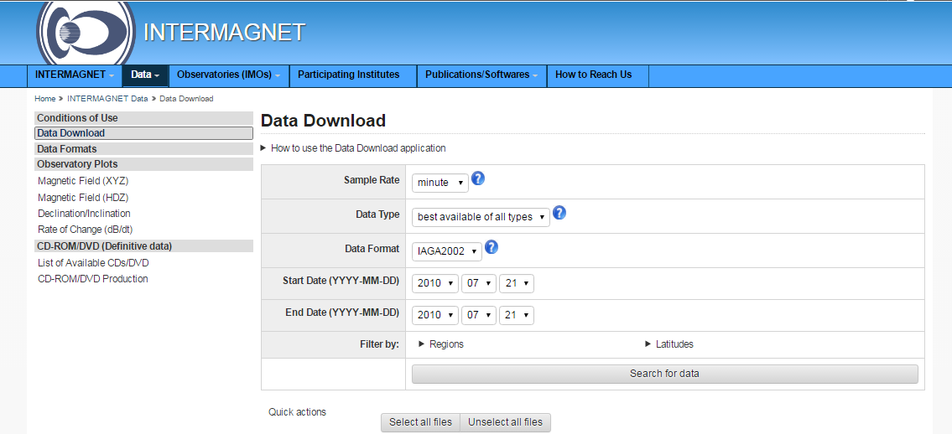

Downloading INTERMAGNET data
Downloading INTERMAGNET data
http://intermagnet.org/data-donnee/download-eng.php
Select the date of your survey, select the station, and download the file.

Slide 35
Shore-Based Magnetometer with IGRF Corrections
Variation of magnetic fields caused by solar activity are considered simultaneous for the ship and the shore station
Agitation Component = Unshifted Shore Base Data - Unshifted Filtered* Shore Base Data
*5 hours Filter

Slide 36
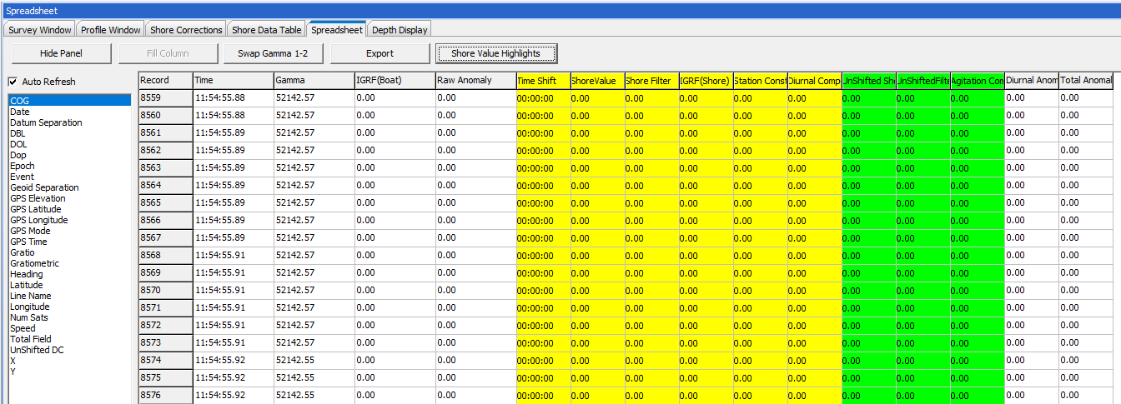
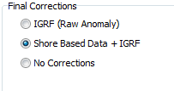
Spreadsheet
Spreadsheet
With Shore-Based Reference Station and IGRF Corrections
Reference station can be user-supplied or IAGA station
Separate IGRF values are computed for both vessel and shore-based measurements
5 hour filter is applied on Shore Based Data
Time Shift is applied to the Diurnal Component
Unshifted Value is applied to Agitation Component
Shore Based data and results calculation could be display in color

Slide 37
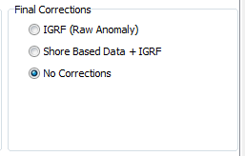
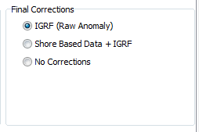
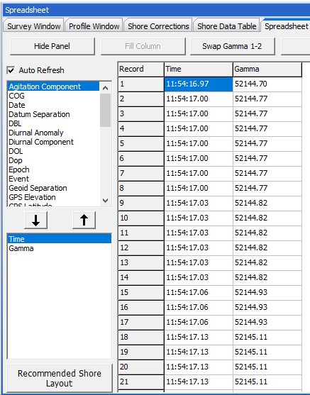
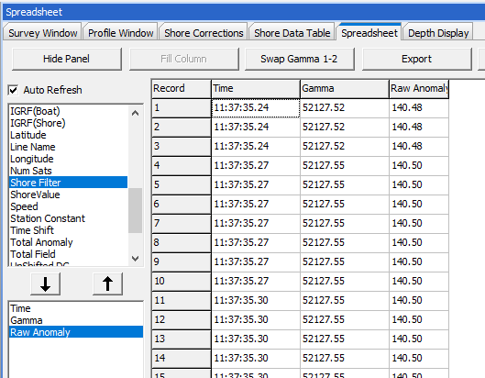
Spreadsheet
Spreadsheet
Values are large
Values are small
Stand Alone Mode with IGRF Corrections
IGRF corrections
NO shore-based magnetometer
Stand Alone Mode
No IGRF corrections
NO shore-based magnetometer

Slide 38
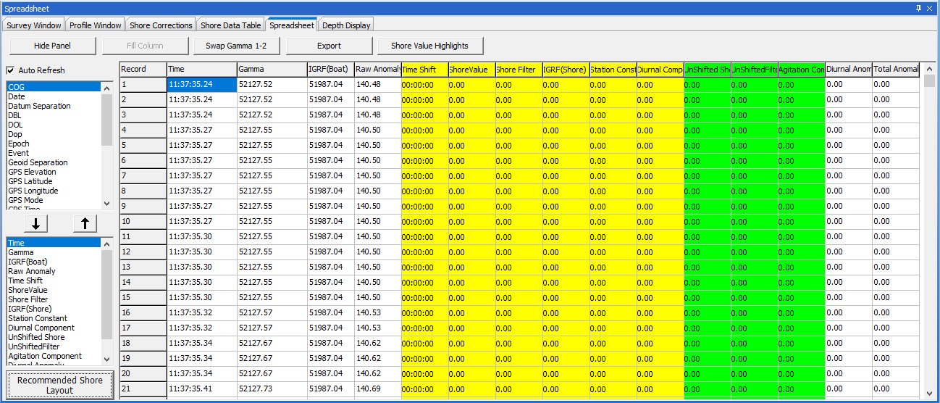

Spreadsheet
Spreadsheet
Display recommended information

Slide 39
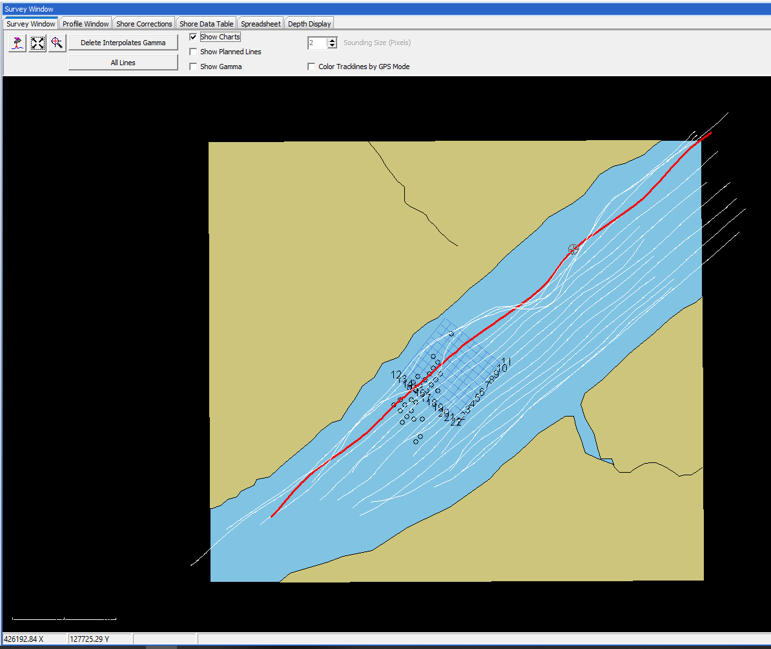
SURVEY Window
SURVEY Window
Displays track lines and background chart
A marker indicates your current position
Use this to correlate anomalies with features on the charts
All charts displayed in the shell will show up here

Slide 40
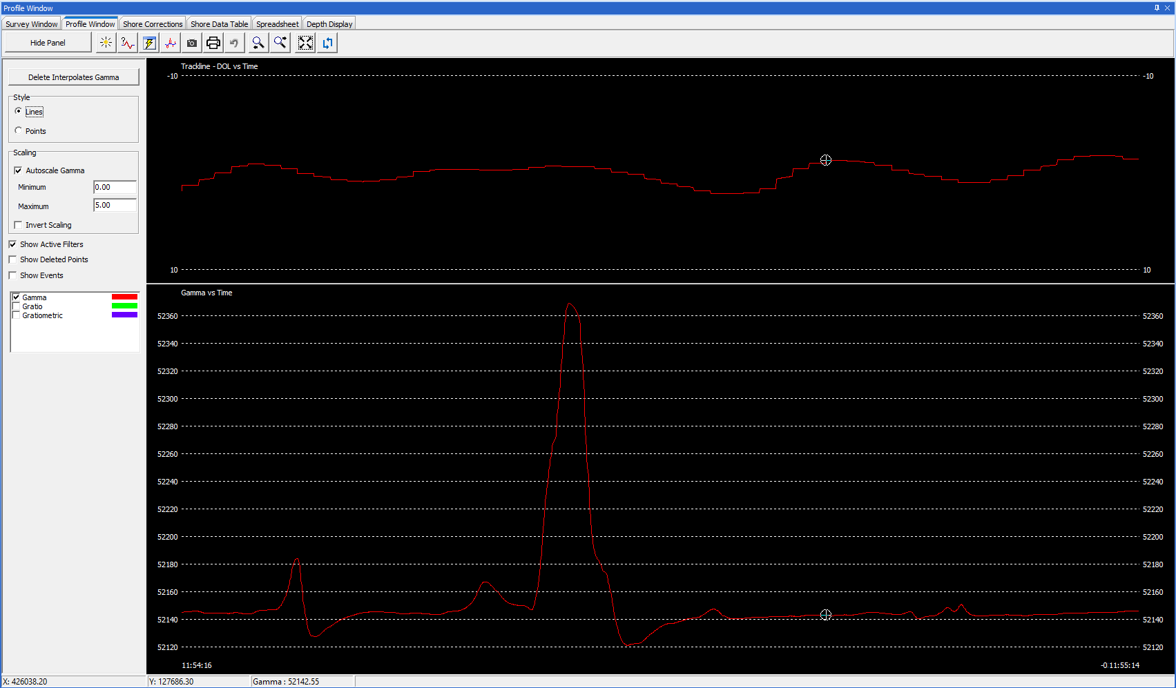
Profile Window IGRF Correction
Profile Window IGRF Correction
Trackline
Gamma

Slide 41
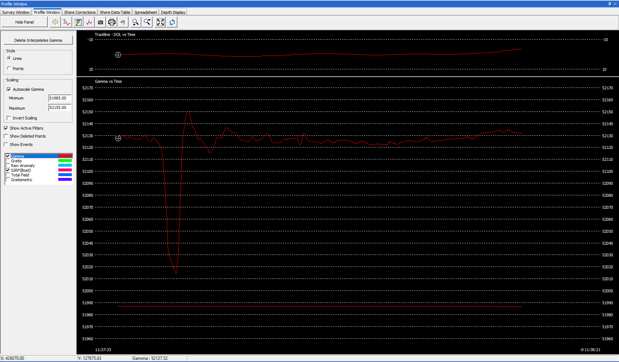
Profile Window IGRF Correction
Profile Window –
With Shore-Based Magnetometer Applied
Allows for editing of outliers of gamma values, raw anomalies (blue), and/or total anomalies (red)

Slide 42
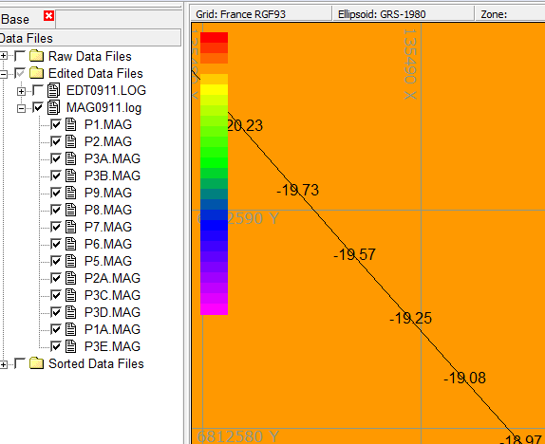
MAG EDIT – Default Edited Extension
*.RAW
Mag Edit
*.MAG

Slide 43
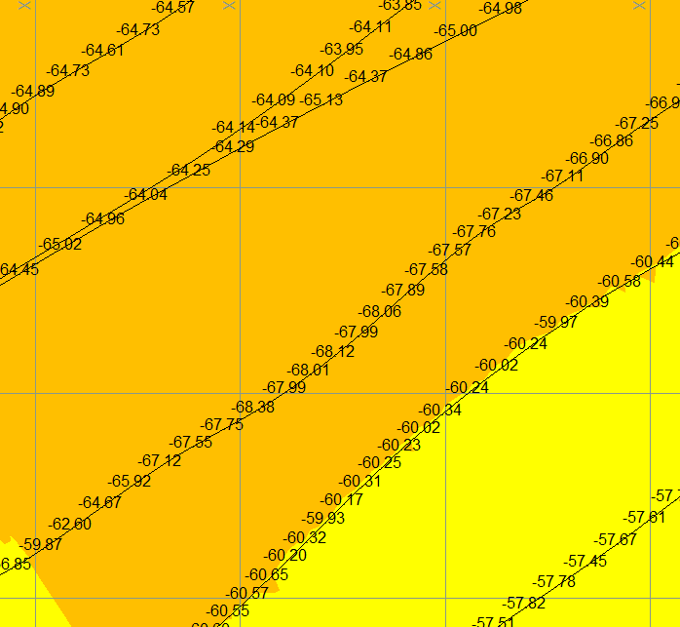
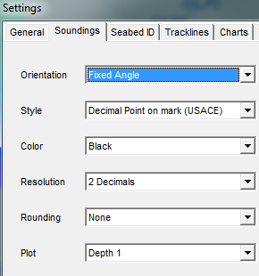

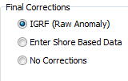

MAG EDIT

Slide 44
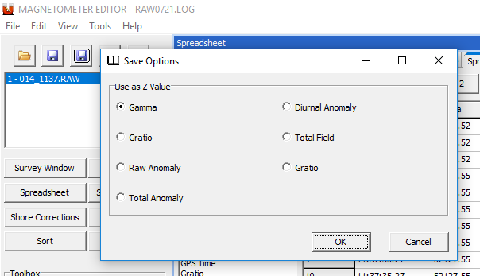
MAGEDIT Save Options
MAGEDIT Save Options
Save in XYZ format or to new binary Session format.

Slide 45
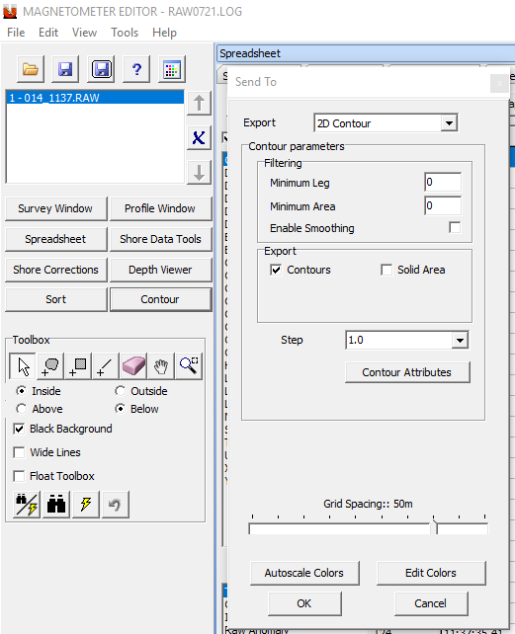
Magedit – Generating Contour
The Magedit program now has the ability to generate contours within the program.
Select the Contour button
If you haven’t saved the data you will be prompted to
The Contour Dialog will appear and allow the user to generate contours without opening the Tin Model program.

Slide 46
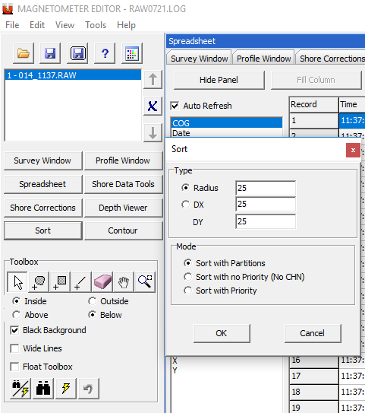
Magedit – Sorting Routines
The Magedit program now has the ability to Sort Data within the program.
Select the Sort button
If you haven’t saved the data you will be prompted to.
The 2D Sort option dialog will appear allowing the user to sort the gamma readings for display.

Slide 47
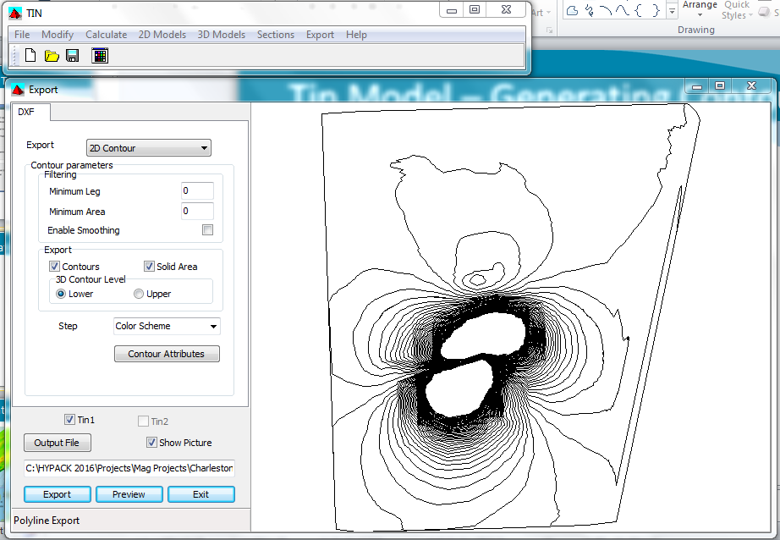
Tin Model – Generating Contours
Tin Model – Generating Contours
Creating a Tin Model of the data allows the user to generate a DXF map of the gamma contours

Slide 48
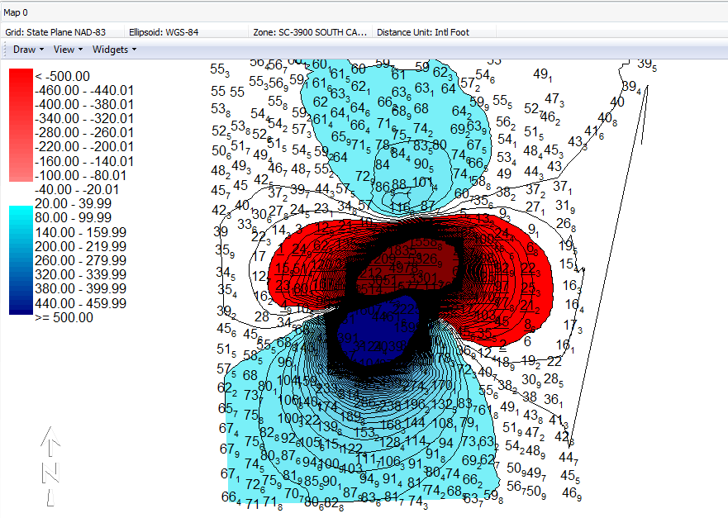
Raw Anomaly Allows Better Representation

Slide 49
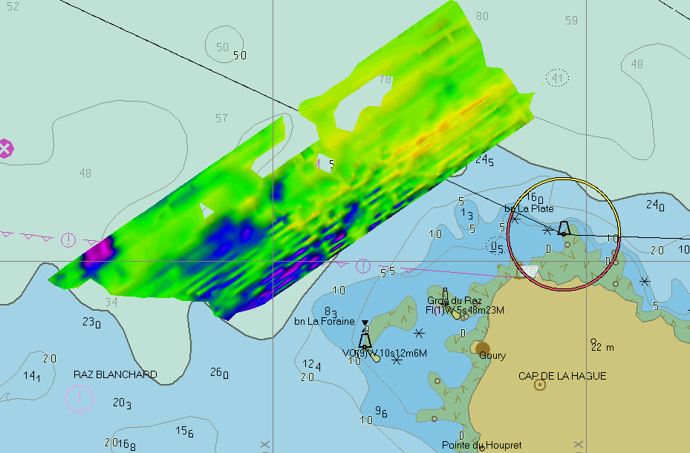
Data Presentation
Data Presentation
GeoTIF created in HYPACK TIN MODEL displayed on top of S-57 nautical chart in the HYPACK SHELL.

Slide 50
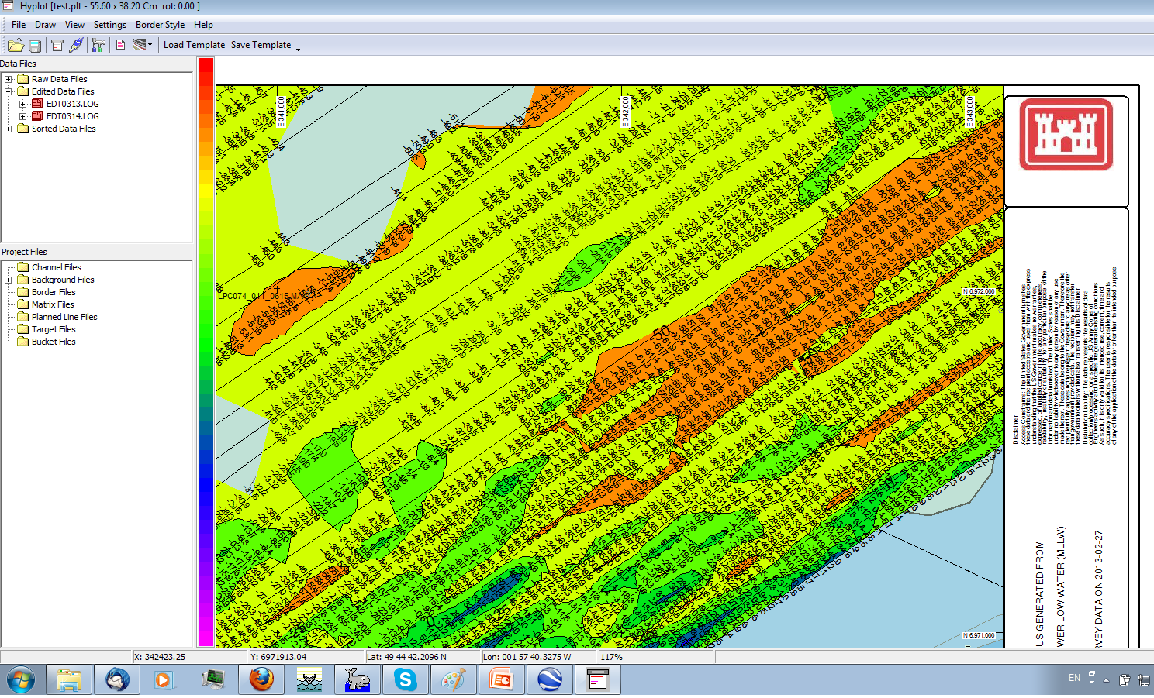
Data Presentation: Mag Anomalies
Data Presentation: Mag Anomalies
Smooth sheets can be sent to printer/plotter, GeoTIF, DXF or PDF.

Slide 51
Thank You !
Contact Us:
Sales@HYPACK.com
Help@HYPACK.com
(860) 635 - 1500
Links to more information:
HYPACK on Youtube.com ( Historical Sessions ) HYPACK Live Chat
HYPACK on Youtube.com ( Newer Sessions ) HYPACK Ustream
HYPACK SUPPORT Site HYPACK Website

