Slide 1
What’s New in HYPACK 2022

Slide 2
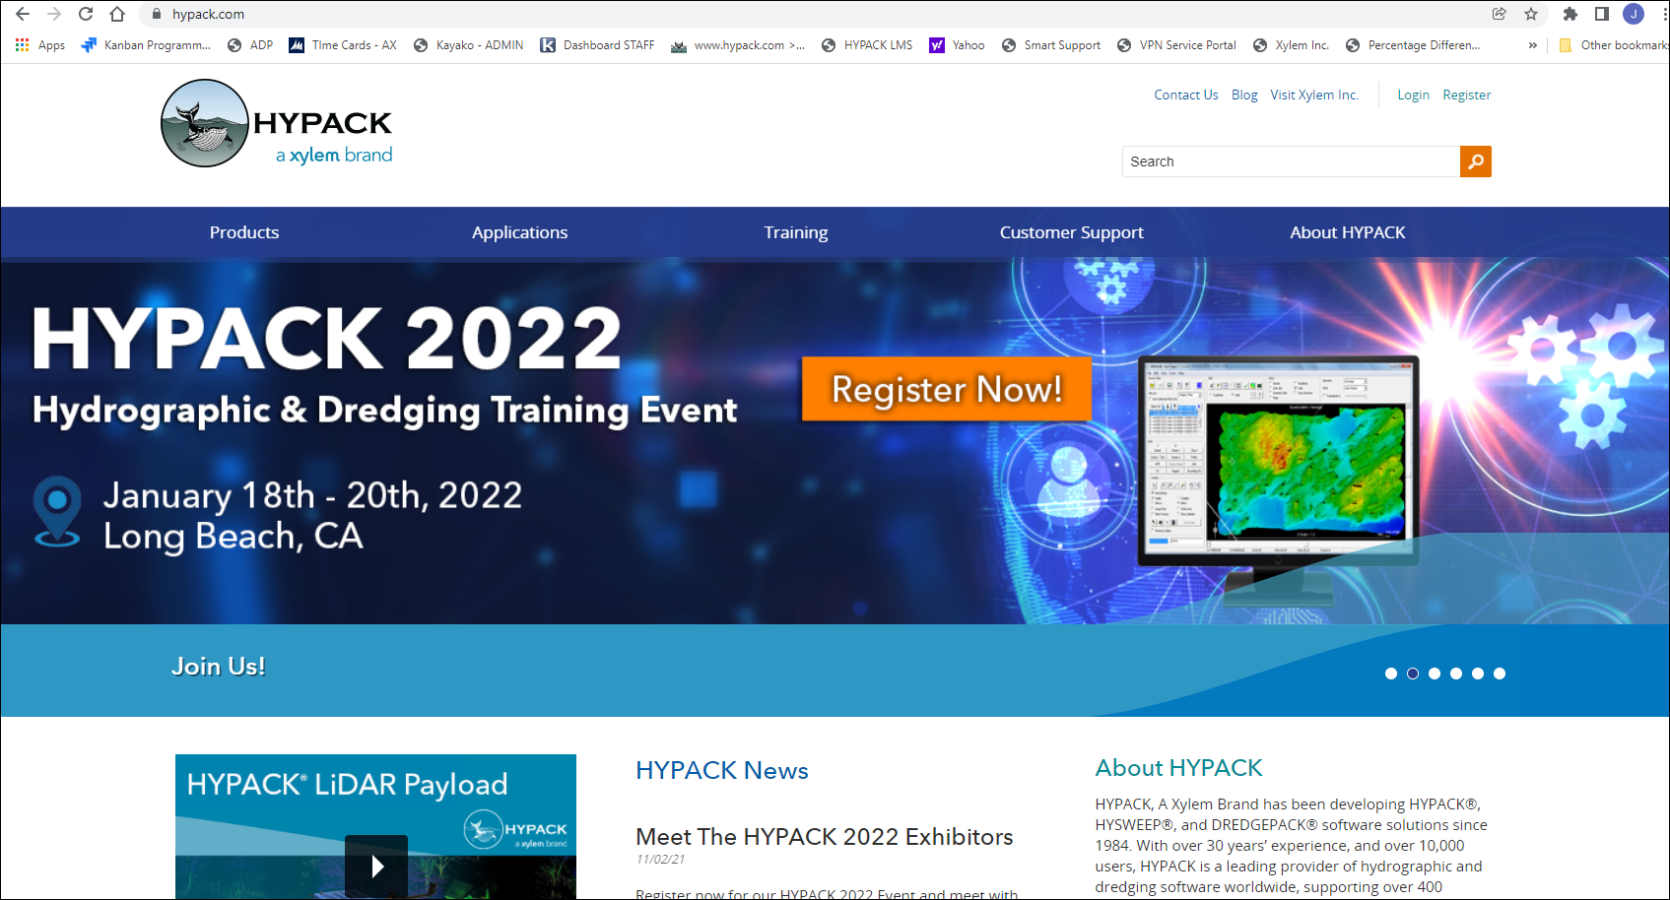
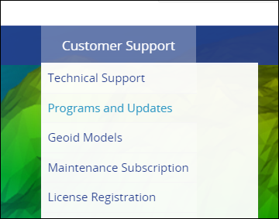
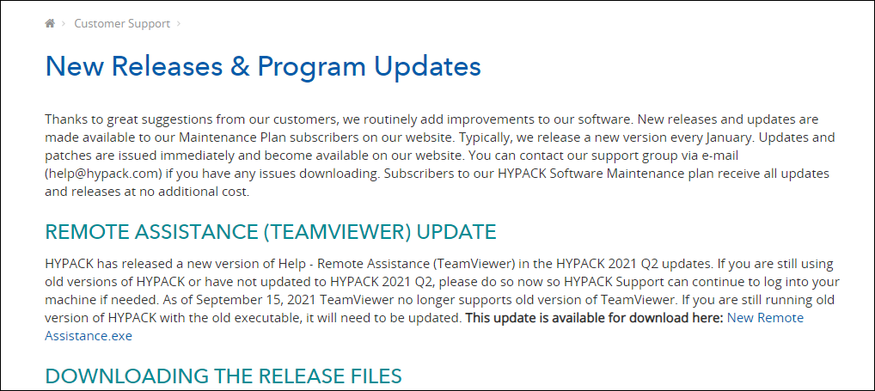
OVERVIEW
Expected January Release
Free to all MP members!
Download from www.hypack.com
Contains all updates from 2021 quarterly releases.
Hundreds of new features, enhancements, bug fixes, etc.

Slide 3
NEW PRODUCTS – Engineered to meet the job requirements
HYPACK ECHO
Software for Single Beam Survey
_________________________________
Support for positioning devices, including RTK features
Support for Echo-Sounders including those with Echogram capability
Editing tools, including the SB Editor with Contour and Sort options to streamline workflow
New HYPLOT MAX program to support final product renderings
HYPACK GEOPHYSICS
Side-scan, Sub-Bottom and Magnetometers
_________________________________
Support for positioning devices, including RTK features
Magnetometer interfaced to 24 models
Sub-Bottom device interfaces to 11 models
Side-scan interface supports 38 models
Real-Time Mosaic during Survey aids in rapid target location and area coverage
Post-Processing tools to complete the analysis of the survey
New HYPLOT MAX program to support final product renderings
WATER QUALITY MAPPING
Software to cover ADCP and Environmental sensor data
_________________________________
Support for positioning devices, including RTK features
Acoustic Doppler Profiler collection and editing
User configurable interface to read up to 32 sensors and record them for later editing. If the interface does not exist, configure the Generic Parser to record your data
New Water Quality Editor allows up to 32 sensor readings to be processed, cleaned, contoured and sorted for analysis
New HYPLOT MAX program to support final product renderings
HYPACK has many tools to offer. These products provide a clear path to the tools specific to the job.

Slide 4
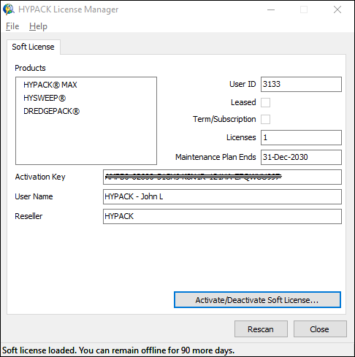
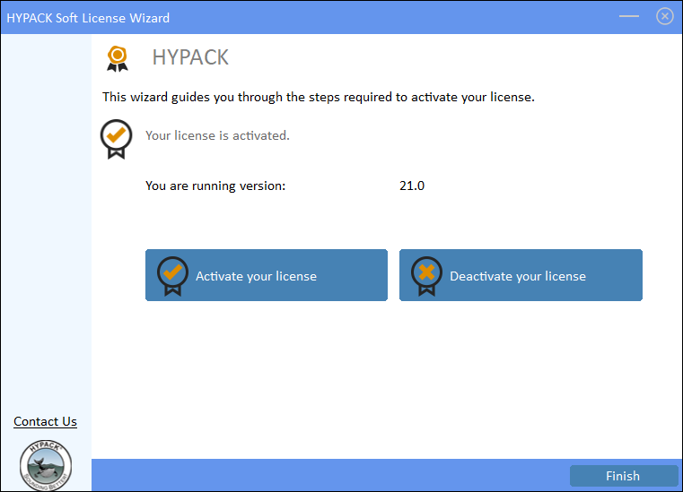
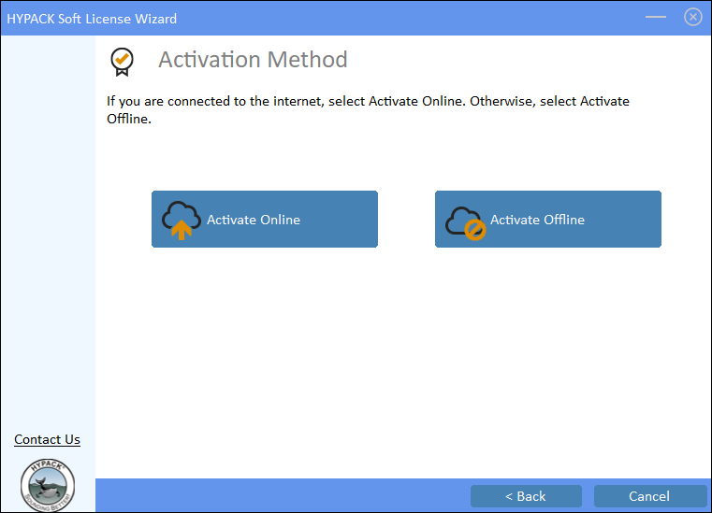
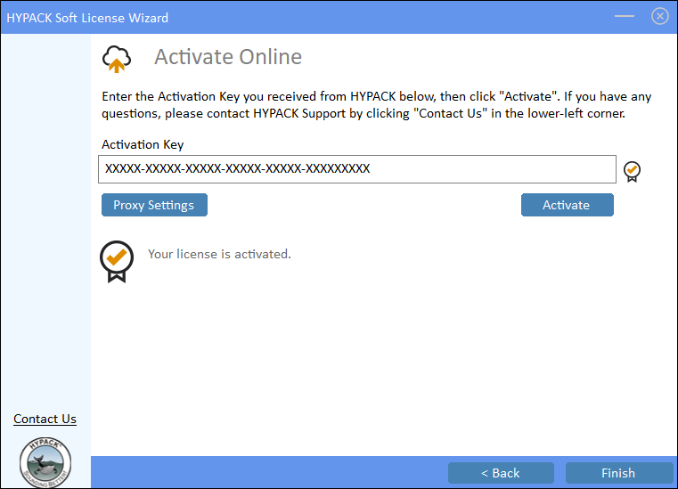
SOFT LICENSE
Web-based license activation.
No need for a dongle!
Easy transfer between computers, even if they are in different locations!
Disadvantages
A soft license does not support ARCS and S63 chart permits.
A soft leased license cannot convert to a permanent license.

Slide 5
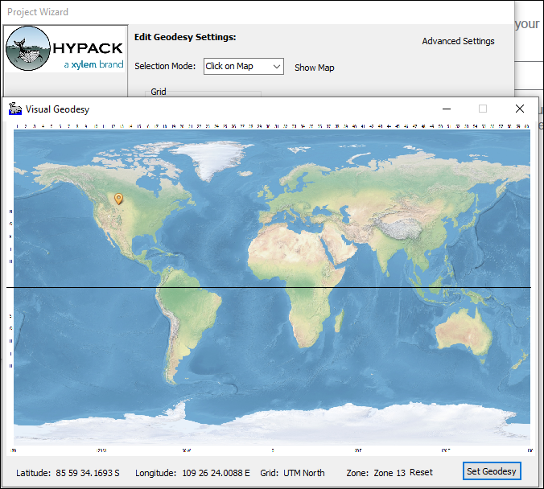
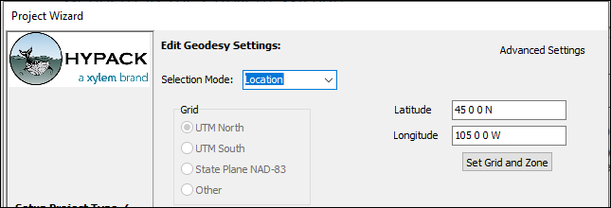
PROJECT WIZARD
Select geodesy by entering latitude - longitude or click on map.
HYPACK will select nearest UTM Zone.

Slide 6
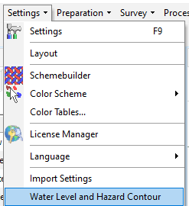
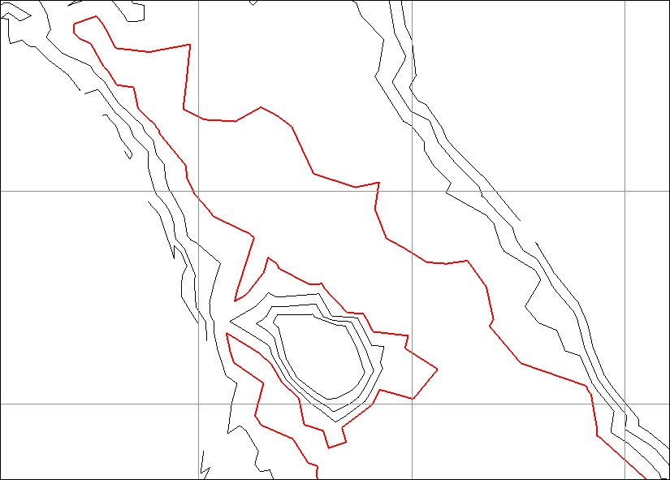
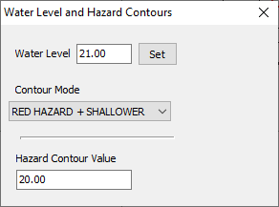
HYPACK SHELL – Hazard Contour Control
Adjust Contour display based on Water Level and Draw Setting.
Water Level determines what the nearest Hazard Contour Value will be.
Contour Mode controls how the contours should be displayed.
            Show all, hazard only, hazard and shallower, etc.

Slide 7
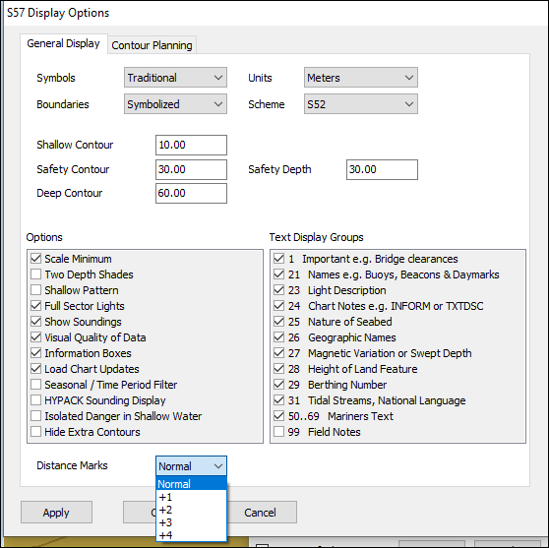
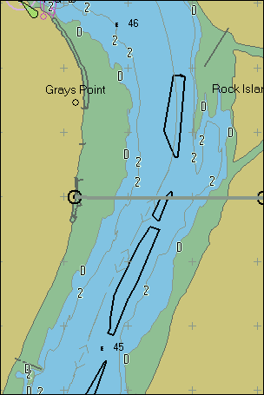
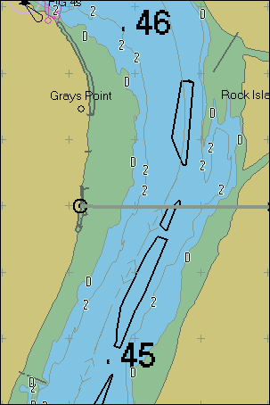
HYPACK SHELL – Continued
Added ENVIRONMENTAL EDITOR to the PROCESSING menu.
Added OBJ EDITOR to the PREPARATION-EDITORS menu.
Updated to provide Polish language interface.
Updated to provide Ukrainian language interface.
ENC Charts - Distance Marks display option increases the font size for river mile numbers.
Normal
+2

Slide 8
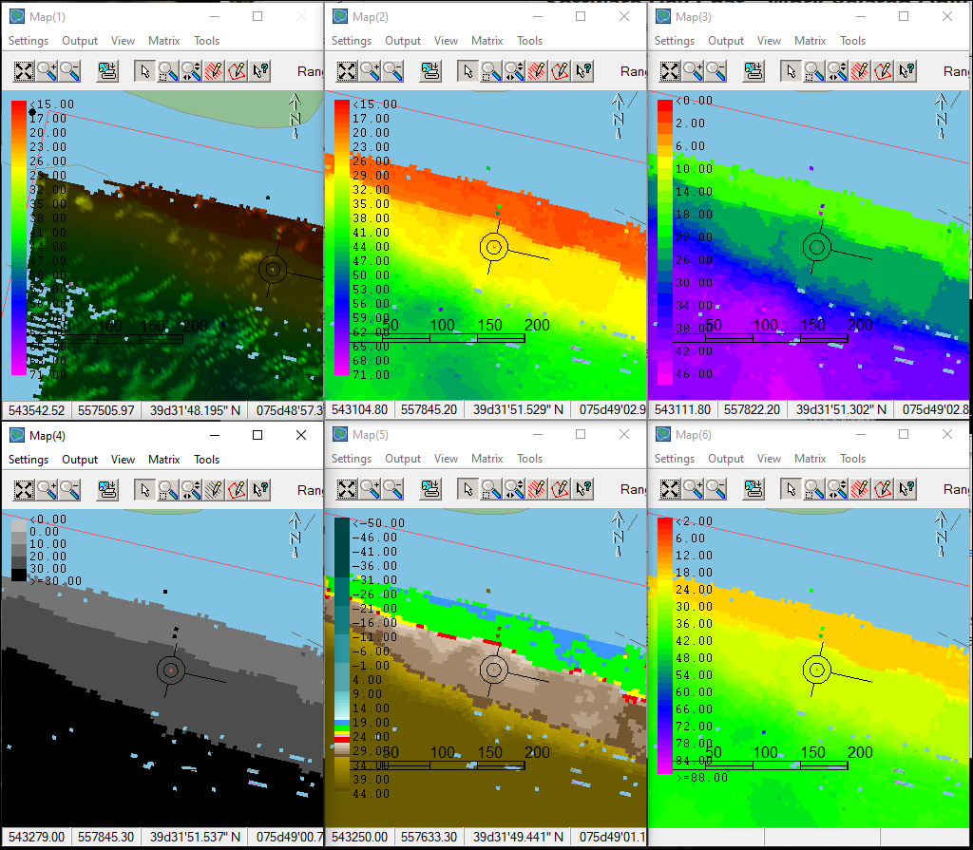
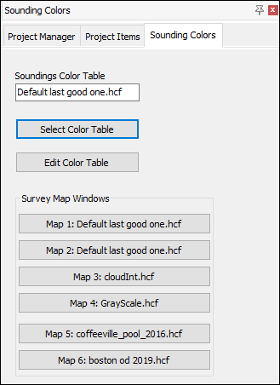
PROJECT COLORS
Assign colors to various Survey maps via Shell tab.

Slide 9
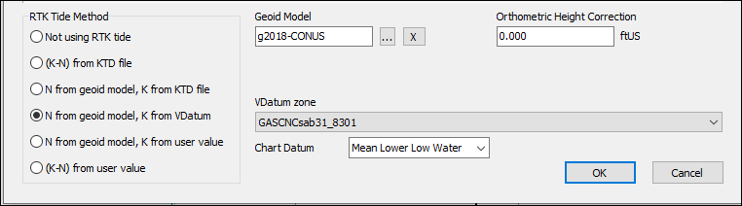
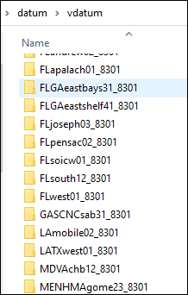
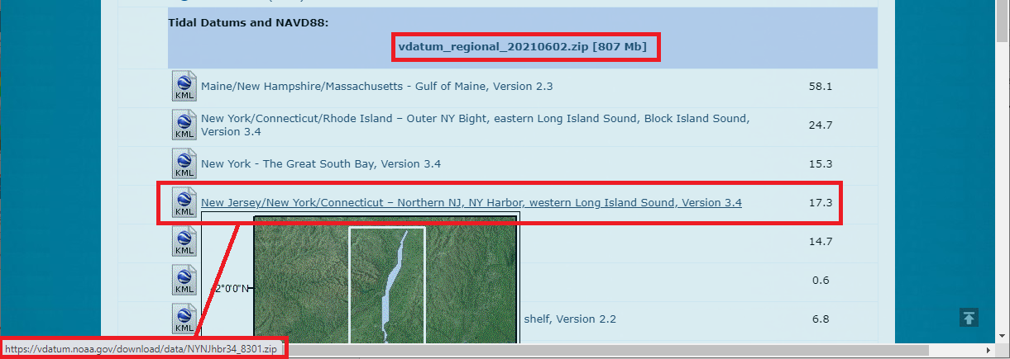
GEODESY - VDATUM
Simplified VDatum
  Eliminates an installer. Simply download the zones from NOAA website.
    https://vdatum.noaa.gov/download.php
  Avoids potential IT restrictions regarding software installation.
  Instantly updates the options for new and updated VDatum files. We don’t have to synchronize our coding for each NOAA change, and users can implement NOAA changes instantly.
  VDatum zone = NOAA folder name.

Slide 10
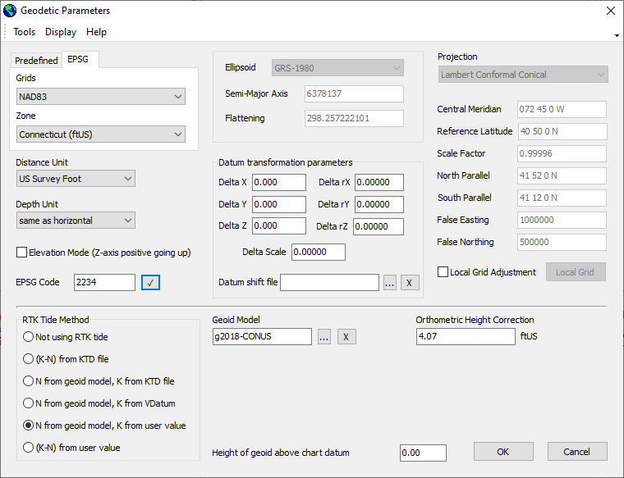
GEODESY – EPSG CODES
Select Geodesy based on EPSG Code.
  Choose “EPSG” tab.
  Enter EPSG Code or select from dropdown list.

Slide 11
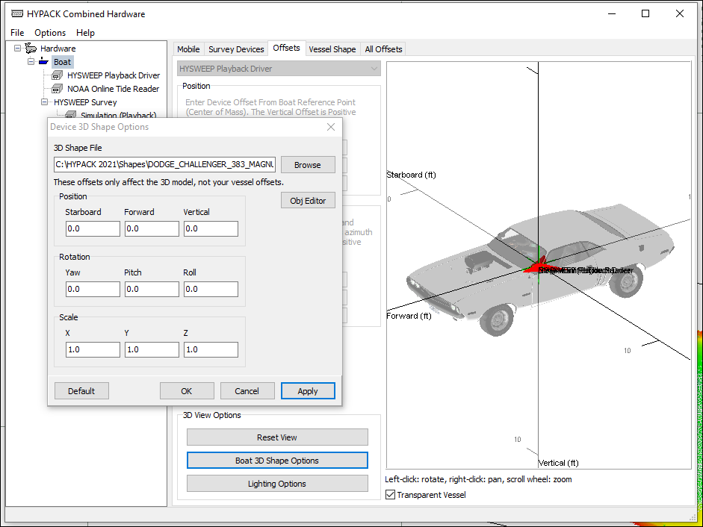
HARDWARE
Support for 3D OBJ boat shapes.
New Test Device window for MB and SS devices.

Slide 12
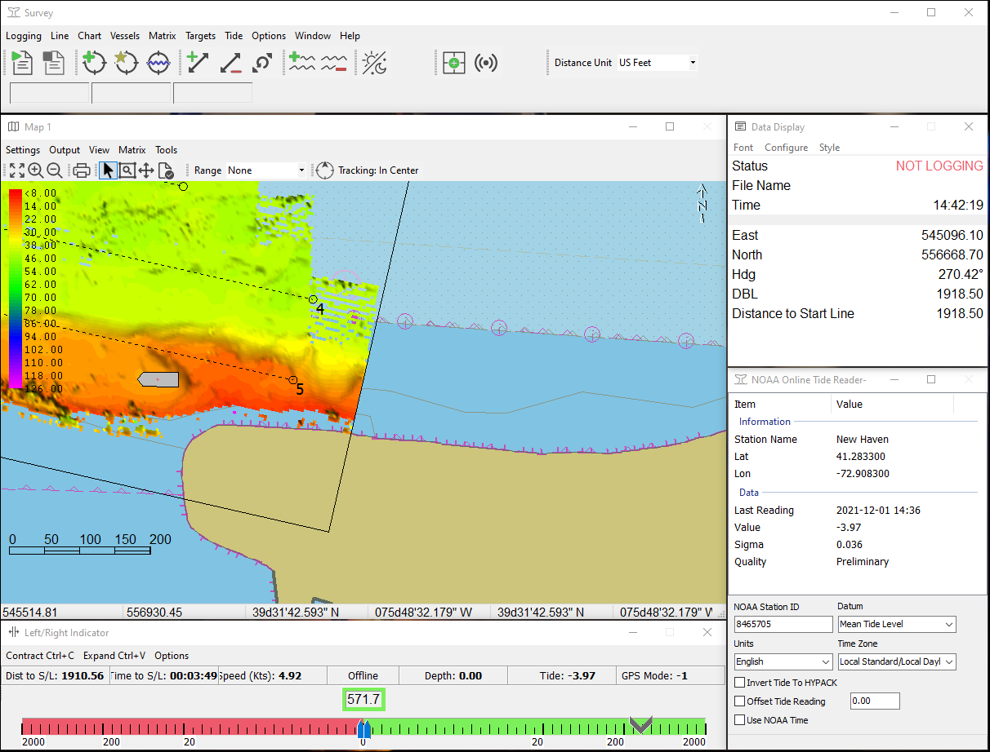
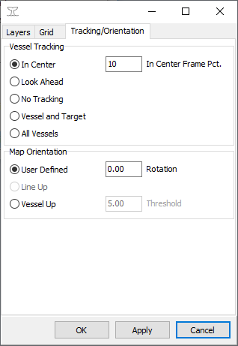
SURVEY
New code base!
Same functionality.
Updated icons.
More reliable.
Easier to update with new features.

Slide 13
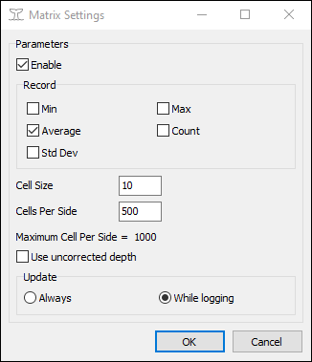
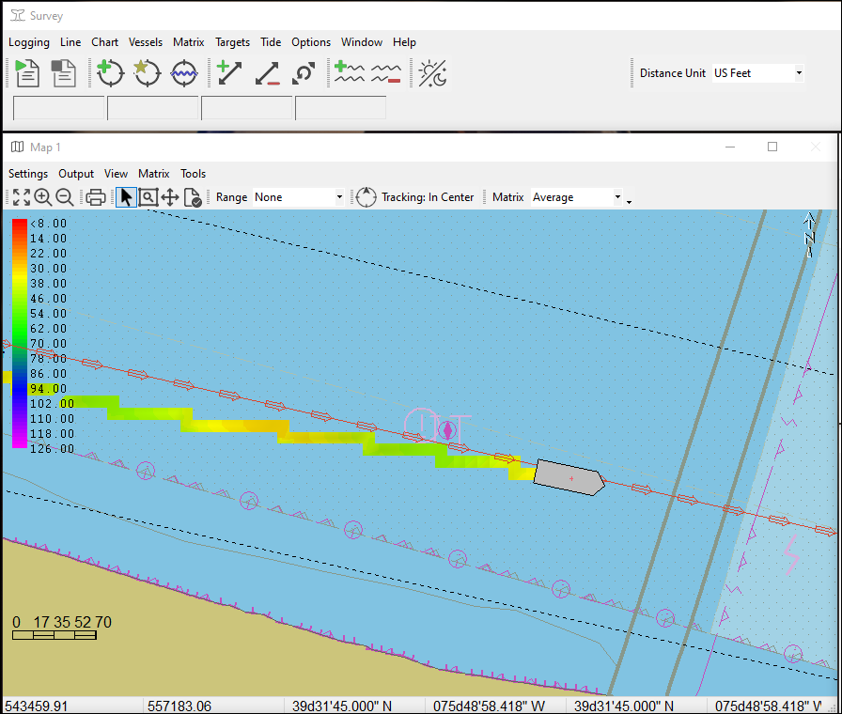
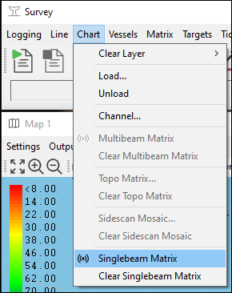
SURVEY – Single Beam Auto Matrix
New feature for 2022.
Automatically paint matrix with single beam echosounder data.
Same options as multibeam auto matrix.

Slide 14
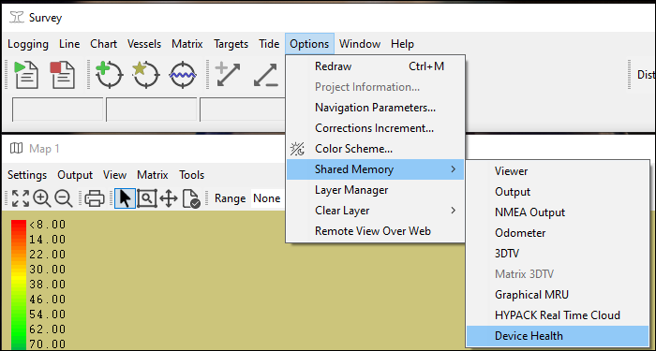
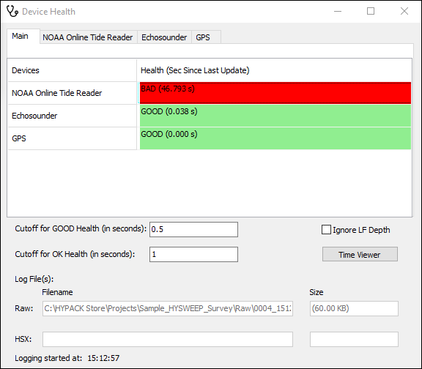
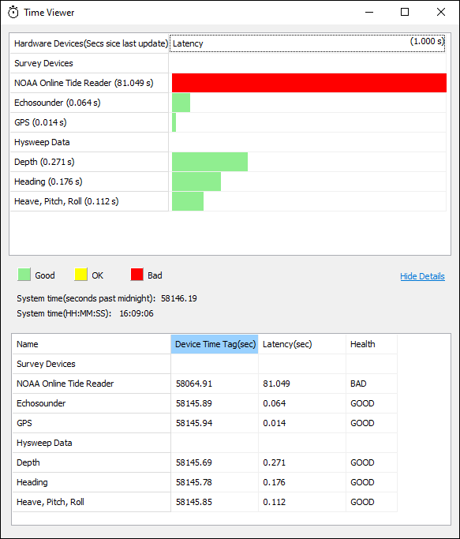
SURVEY – Device Health
Launches from Survey program
Tracks device timing from HYPACK, HYSWEEP and Side Scan devices.
Color-coded warning indicators.
Tracks file logging and file size.

Slide 15
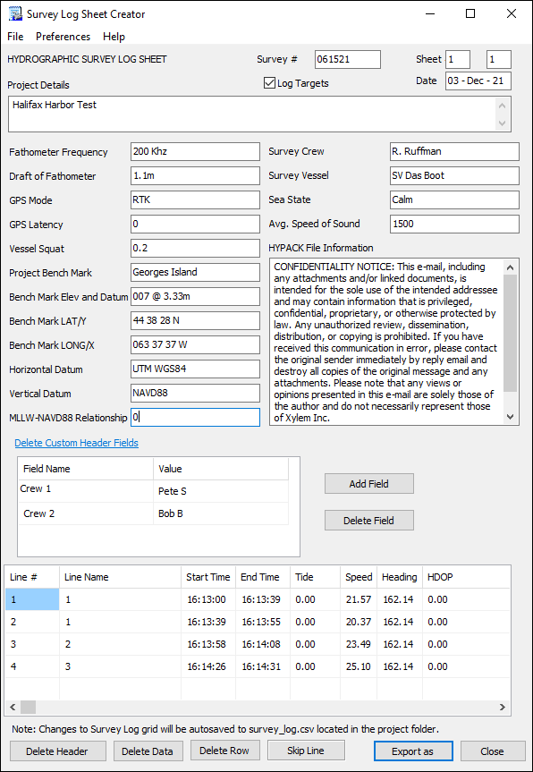
SURVEY LOG
Automatically saves data to *.csv file so survey can be reloaded.
Import Survey *.log file.
Import/export header info
Export sheet to PDF, XLS, and CSV format files
Add custom header fields
Log targets to Memo section

Slide 16
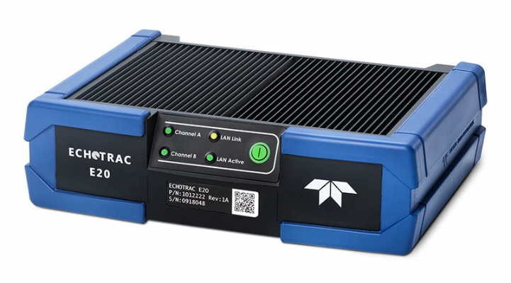
DEVICE DRIVERS
Added support for 32-bit echogram. Any data logged with the E20 is logged at full-quality—no downsampling as in earlier versions.
Survey device window includes Signal Range buttons to adjust the display brightness.
32-bit and 64-bit Single Beam Editors have also been updated to process echogram data.

Slide 17
SURVEY DRIVERS – More!
DRIVER | CHANGES
Advanced Nav INS driver | Corrected inverted heave.
DQM_Mechanical.dll | Enhancements and bug fixes Added US Digital T7 sensor
Geodimeter Driver | Added support for Trimble S6 Robotic Total Station
Magnet.dll | Changed the Marine Magnetics labels to be more clear Added support JW Fisher Proton 5
PosMV.dll | Fixed SURVEY crash if Tide is disabled.
Towfish.dll | Added [Reset Towfish Position] to reposition the towfish at its maximum cable length directly behind the vessel until the driver receives device input data to calculate it. Added an LCI-90i “Legacy” option
Vectornav.dll | Support for VectorNav IMU

Slide 18
SURVEY DRIVER UPDATES - Even More!
DRIVER | CHANGES
GenCutterDQM.dll | Based on the original GenDevParse with a few additions
NOAATides.dll | Added tide offset Option to use NOAA time.
Inclinometer.dll | Added the 2Gig Engineering option Added Telestra / SignalQuest sensor
GPS.dll | Enhanced PTNL,GGK quality indicator codes

Slide 19
HYSWEEP SURVEY
IMU warning if no altitude device is installed

Slide 20
HYSWEEP SURVEY DRIVERS
DRIVER | CHANGES
Advanced Nav INS driver | Corrected inverted heave.
AML Driver | Support for AML-3 and AML-6 SVPs
Kongsberg drivers | Supports Kongsberg KMALL datagrams. Sonar frequency logged in RMB datagrams of HSX file. Supports GPS transfer to HYPACK Survey via the HYSWEEP_Extended.DLL.
WASSP driver | Extend slant range maximum from 650 m to 65,000 m.
Klein Drivers | Updated to latest Klein SDK
VectorNav Driver | Support for VectorNav IMU
Other: Added an option to suppress logging WGS84 data to HSX files (FILE –LOGGING OPTIONS in HYSWEEP Survey).

Slide 21
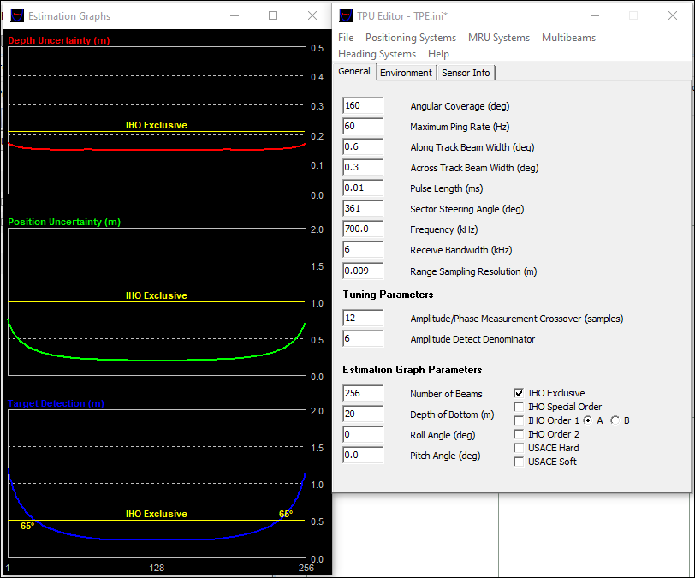
TPU EDITOR
Added IHO Exclusive Order to Estimation Graph Parameters.

Slide 22
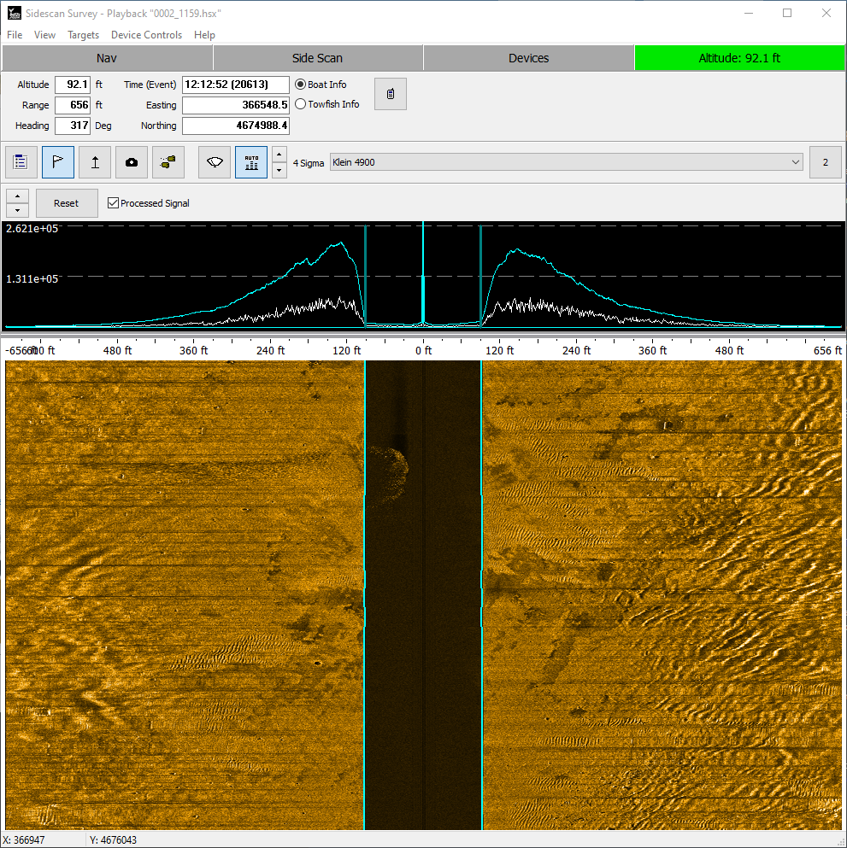
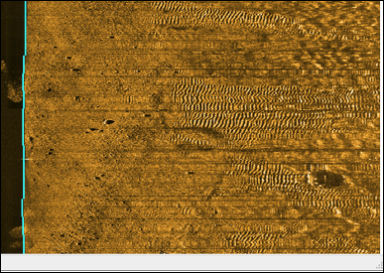
SIDE SCAN SURVEY
Support for Edgetech 4205
Upgraded to latest Klein SDKs
Removed down-sampling for improved waterfall display
New water column display

Slide 23
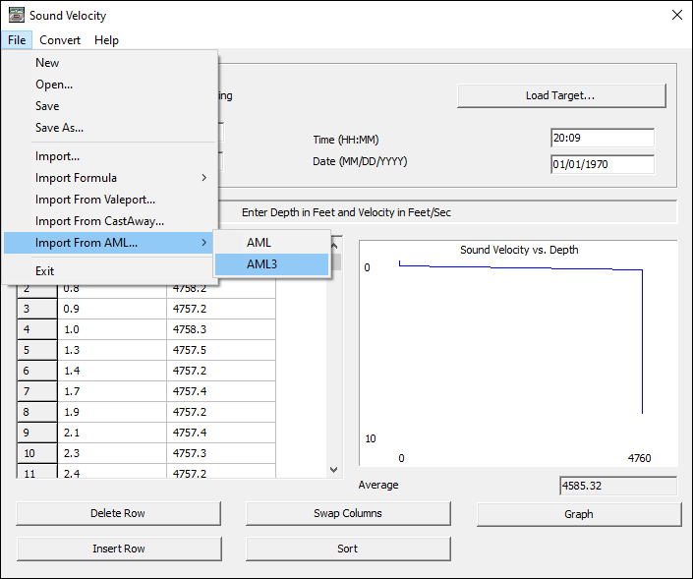
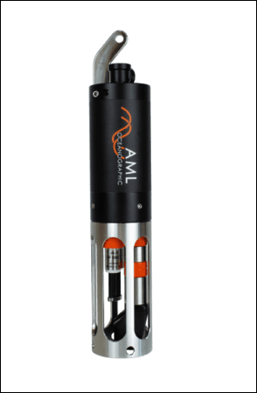
SOUND VELOCITY
Added Support for AML-3 and AML-6 SVPs.
Connects via WiFi

Slide 24

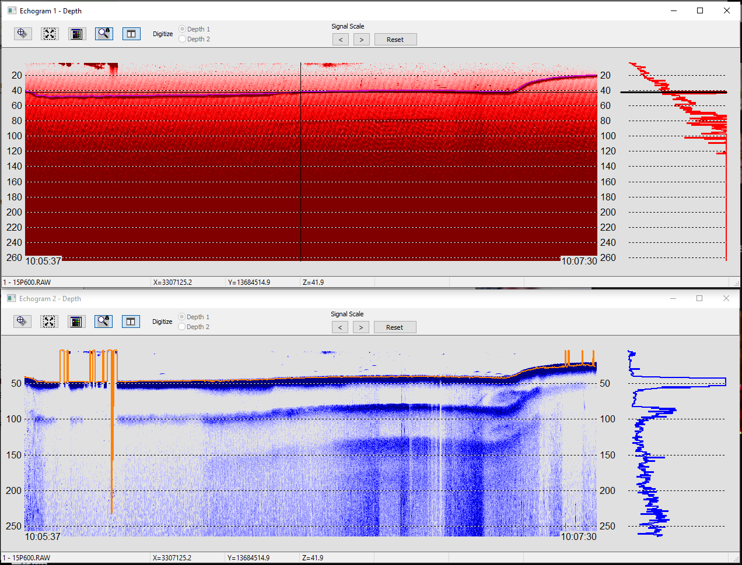
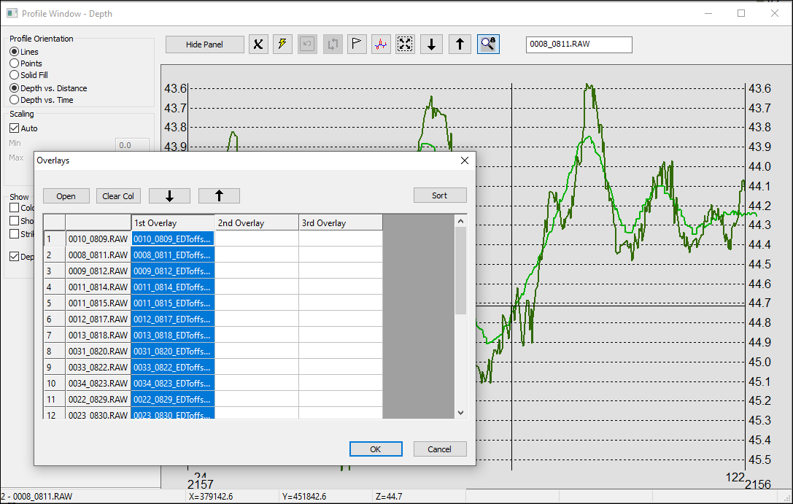
SBMAX64 – SINGLE BEAM EDITOR
Updated to process the full-quality, 32-bit echogram data logged with the 21.2.x Echotrac E20 driver
Faster echogram drawing!
Signal Range buttons to adjust the display brightness.
Split echogram into 2 windows!
Many updates to the File Overlay options

Slide 25
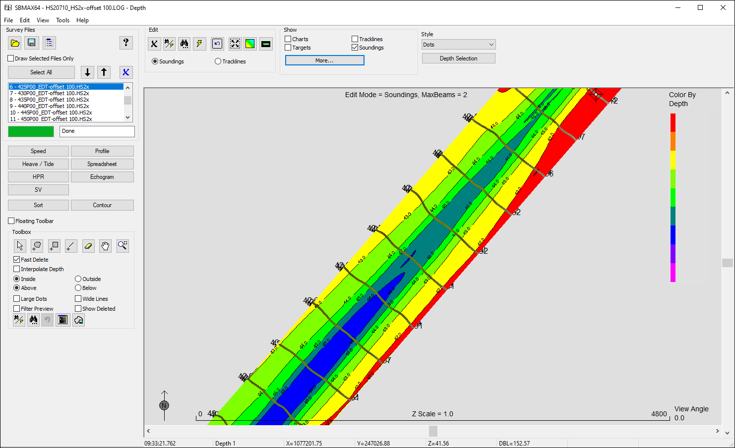
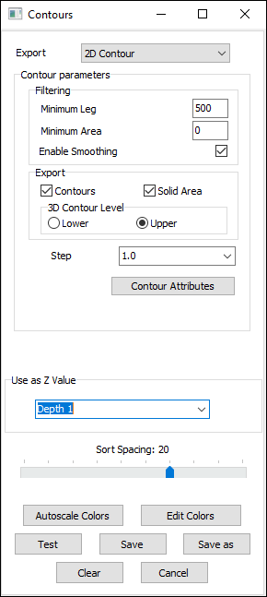
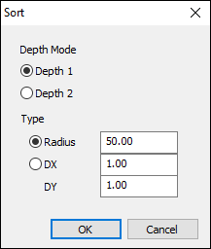
SBMAX64 – SORTING AND CONTOURING
Sort and contour data right in SBMAX.
Utilizes default sorting routine from Sort program.
Utilizes contouring engine from TIN Model.

Slide 26
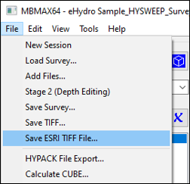
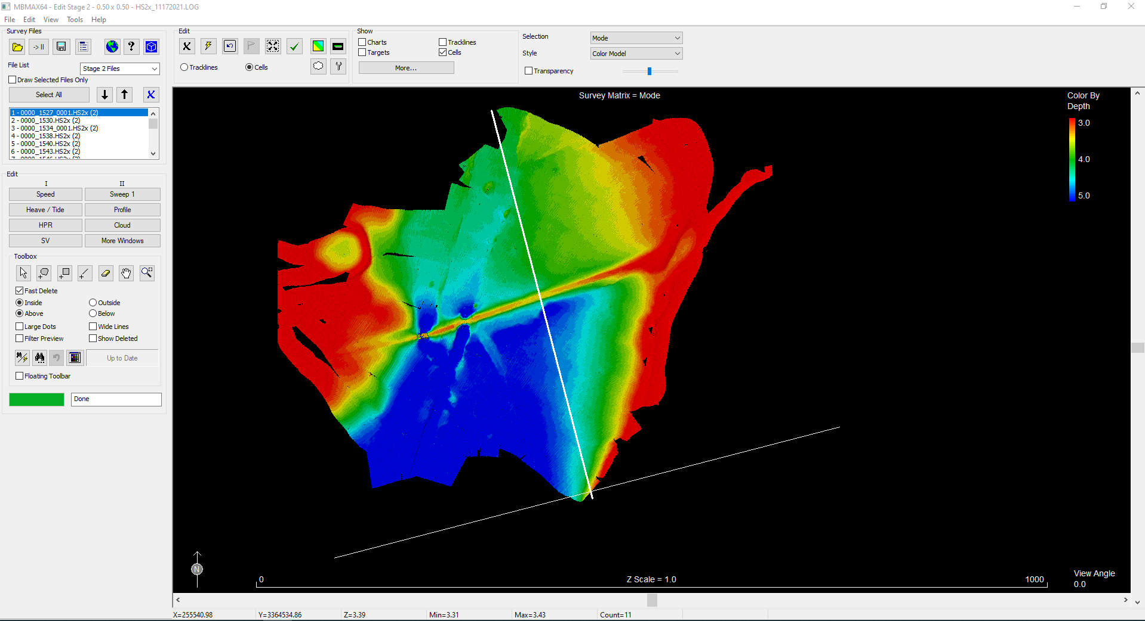
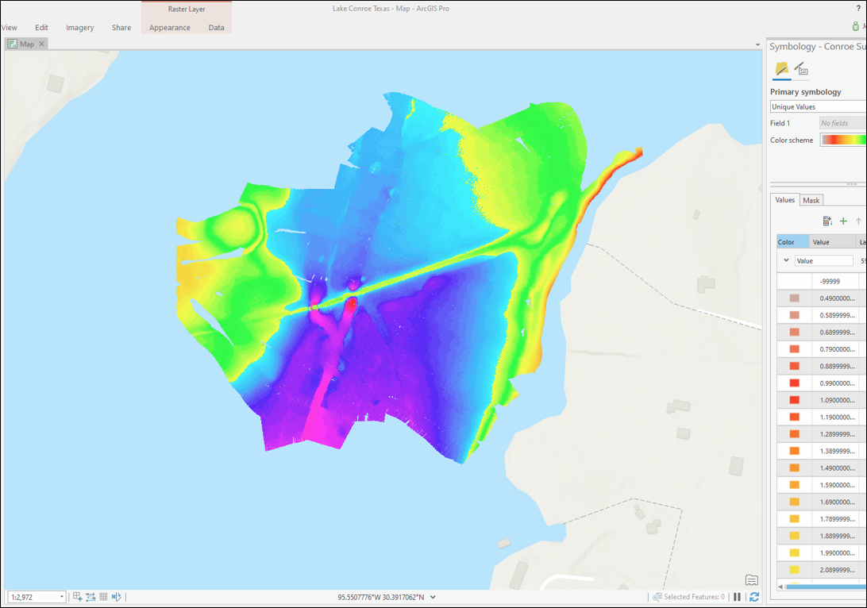
MBMAX64 – Direct Export to ArcGIS
Save ESRI TIFF file – creates a GeoTIFF of the Multibeam Data in a format acceptable to ArcGIS for easy input to their tools

Slide 27
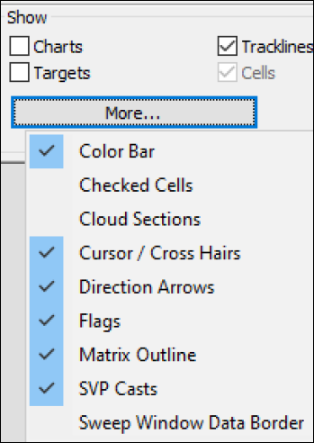
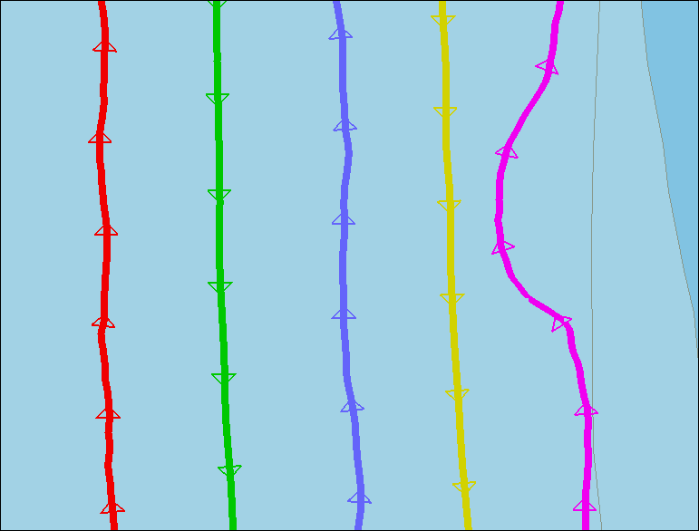
MBMAX64 - continued
Improved (faster!) drawing!
Additional SHOW Options for Survey Map:
  Direction Arrows draws survey direction arrows on the track lines. (Phase 1)
  Matrix Outline shows the border of the matrix. (Phase 2)
  SVP Casts tagged with location. (Phase 1)
Reads sonar frequency from both RMB and SNR records, as drivers may log the data to either location.
Saves WGS84 positions (when available) to the HS2X position datagram (These positions can be omitted in HYSWEEP® SURVEY in the Logging Options dialog.)
Improved S7K data loading.
Now supporting Kongsberg KMALL files!

Slide 28
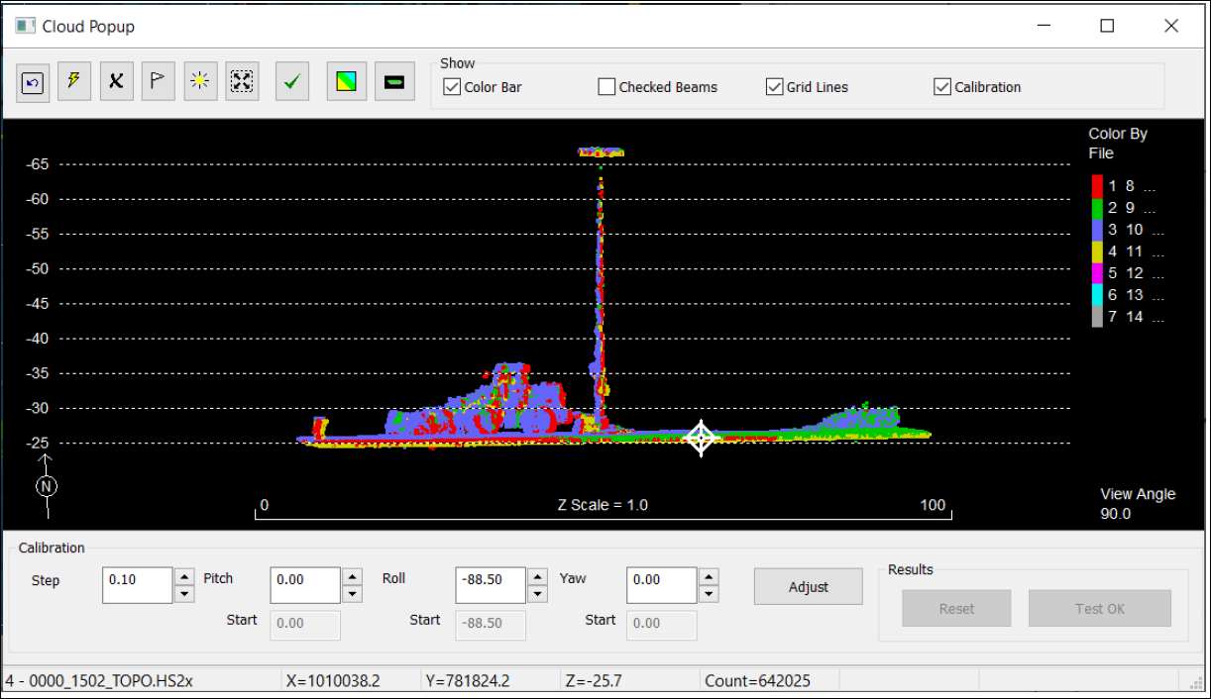
MBMAX64 - continued
LiDAR Calibration in Pop-up Cloud window.
Uses cloud points instead of the cross section of our traditional patch test.
Better suited to LiDAR systems

Slide 29
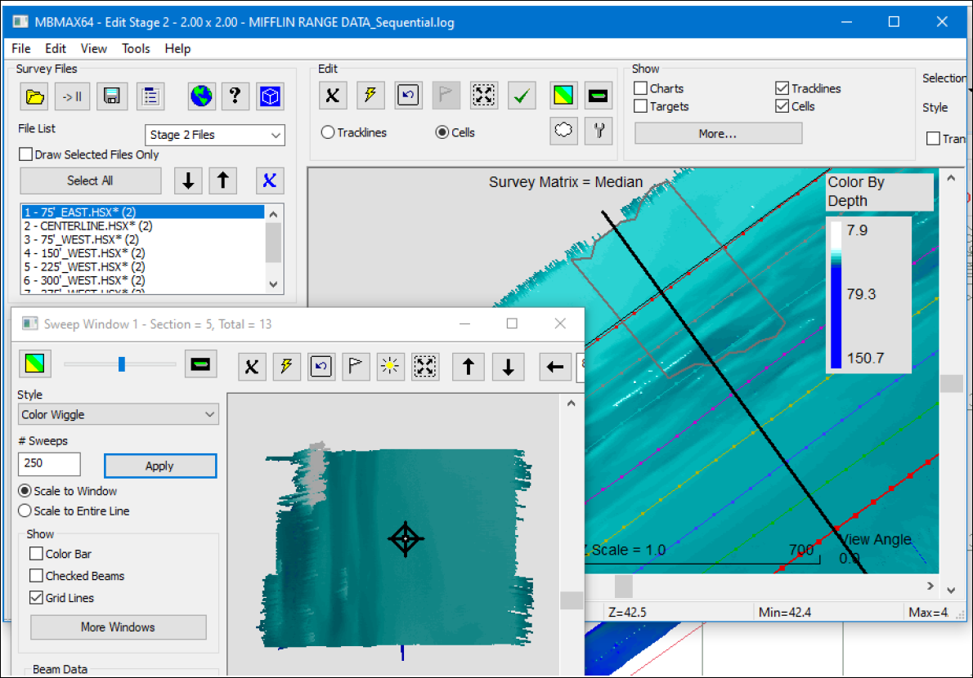
MBMAX64 - continued
Sweep Window Data Border: Outlines the area shown in the Sweep Window.
Custom Colors: Define your own colors for various items.

Slide 30
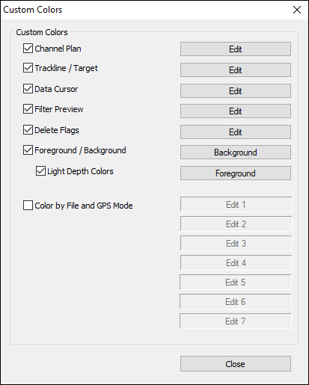


MBMAX64 - continued
Custom Colors: Define your own colors for various items.
Export to Color File: Exports MBMAX64 depth colors to HCF files.
Use in other HYPACK programs.

Slide 31


MBMAX64 - continued
Use Project Rounding Rules: Use rounding rules as defined in the HYPACK Shell Settings when exporting to XYZ file.

Slide 32


MBMAX64 – AUTO-PROCESSING
Auto Process – Export to XYZ as part of the Auto Process output

Slide 33

HYPLOT MAX
New for 2022!
Uses paper space.
Plot multiple maps to one sheet!
Create plot area without PLT file.
Plots all background files.
Lock items to prevent editing.
Multiple undo’s.
Define settings in main window.

Slide 34



TIN MODEL
Improved 2D drawing
New volume report options
  PDF
  CSV
  XLS

Slide 35

CLOUD – Enhancements
Toggle off axis and perimeter display
File list view to enable/disable files without unloading them

Slide 36

ADCP PROFILE
Information Window
More extensive Information
display: Added Ensemble Depth,
Bin Size, Max Bin/Ensemble.,
Distance to First Bin. Bin Depth
and Final Bin Depth.
• Corrected off-screen dialog
problem.

Slide 37



MAGNETOMETER / ENVIRONMENTAL EDITOR
MagEdit now has special ‘water quality’ mode.
Launches from PROCESSING – ENVIRONMENTAL EDITOR
Supports directly loading EXO Bin Files. All files must contain the same data combination logged in the same order in each record.
Load up to 32 values!
Built-in sorting and contouring.

Slide 38



CROSS SECTIONS AND VOLUMES
Export sections to image files (*.jpg, *.png, *.bmp)
Images stored in your project’s \Edit\CS&V Images folder.

Slide 39

Sounding Better!
Quarterly Newsletter
What is new in the HYPACK world!

Slide 40
Thank You !
Contact Us:
Sales@HYPACK.com
Help@HYPACK.com
(860) 635 - 1500
Links to more information:
HYPACK on Youtube.com ( Historical Sessions ) HYPACK Live Chat
HYPACK on Youtube.com ( Newer Sessions ) HYPACK Ustream
HYPACK SUPPORT Site HYPACK Website

