Slide 1
Sensor Theory Understanding the Hardware

Slide 2
Objectives of this session
1
2
3
Physics of sound
Understanding acoustic terms and relationship to survey
GPS and Positioning
Understanding of the geometry required for computing a position
Sound Velocity Sensors
Understand the reason for measuring sound speed
Types of sensor used
3
4
5
Single Beam Sonars
The principles of beam footprint as it applies to depth measurement
Multibeam Sonars
The types of multibeam sonars used.
What is the source of Snippet data?
Water Column Data description
LiDAR Sensors
Understanding the types of LiDAR sensors used in surveying
Return modes from the LiDAR sensors
6
Side-scan Sonars
How do Side-scan sonars paint a picture of the bottom
What is the water column
How to understand the shadow area in a side-scan image
7
Magnetometers
Understanding the relationship of range to target size
Effects on gamma readings by Geomagnetic Storms
Notes:
Stressed Water Supply
Issue
Maintain the health of traditional water sources and execute a water source diversification strategy
Solution
Xylem’s leading-edge technologies monitor, pump and treat water from all sources and enable water reuse
Aging Infrastructure
Issue
Utilities have to effectively assess and identify high-risk areas for repair/replacement before problems occur
Solution
Xylem’s intelligent pipeline and critical infrastructure services perform condition assessment, identify defective assets, provide bypass services and replacement technologies, reduce or eliminate combined sewer overflows and leaks/non-revenue water
Stormwater & Flooding
Issue
Significant increase in severe weather patterns is causing flooding and related damages to communities
Solution
Xylem’s flood management solutions include sensors for early warnings, dewatering for disaster response, communications for recovery and submersible pumping for resilient infrastructure
Regulatory Compliance
Issue
Utilities must successfully comply with a growing body of compliance regulations
Solution
Xylem’s analytics and sensors evaluate a broad range of water quality parameters, and our technologies treat water and wastewater to meet regulatory standards
Non-Revenue Water
Issue
Utilities have an important opportunity to reduce persistent and costly water losses from leaks and faulty meter readings
Solution
Xylem’s broad portfolio of solutions monitors for, and identifies, water leaks, as well as faulty meters. Our communications network enables point-to-multipoint communications throughout the system
Operating Strategy Reducing Costs
Issue
Utilities want to lower operating and energy costs, and leverage new revenue opportunities
Solution
Xylem offers industry-leading pumping and treatment solutions for energy efficiency, and software-enabled solutions to optimize operations and identify revenue opportunities

Slide 3
GNSS and Vessel Positioning

Slide 4
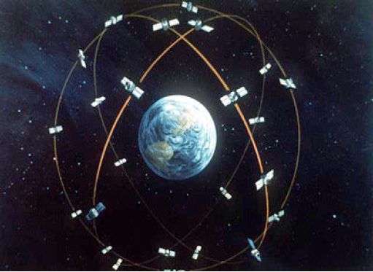
GNSS - Positioning
GNSS (Global navigation satellite system) currently comprised of 4 systems
  GPS (U.S.A) – 32 satellites
  GLONASS (Russia) - 24 satellites
  BeiDou (China) - 30 satellites
  Galileo – (E.U) – 22 satellites
A user needs to “see” 4 satellites to get a position fix, but more is better. For an RTK fix 5 satellites are required
GNSS works on the WGS84 datum and spheroid
Dynamic GNSS positioning accuracy ranges from 10-20 m to 0.05-0.02 m depending upon method employed.

Slide 5
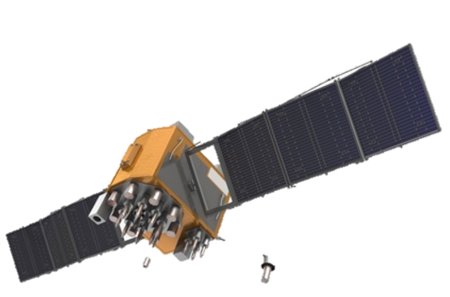
GNSS – Determining Position Geometry
The spread of satellites determines the quality of the position (DOPs).
Satellites too low on the horizon can provide errors as well as satellites too close together.
Elevation masking is used to prevent satellites low on the horizon from causing error in the position.
Skyplot showing bad geometry and poor positioning (high DOPs)
Skyplot showing good geometry and good positioning (low DOPs)
N
N

Slide 6
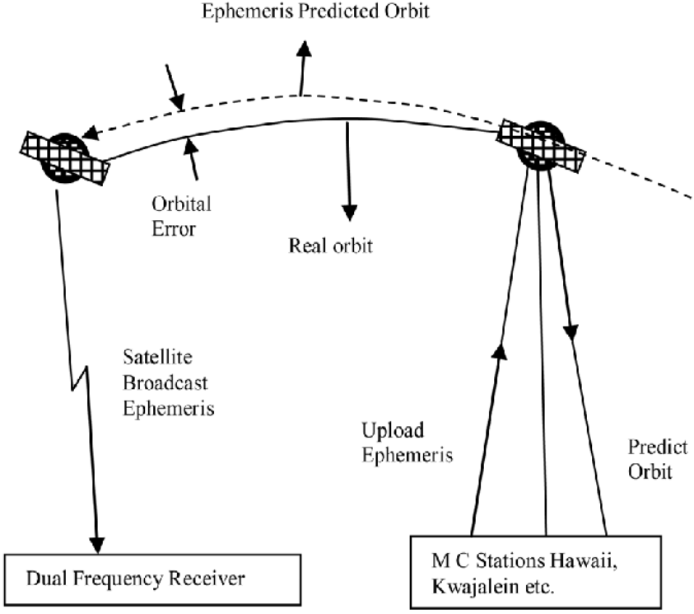
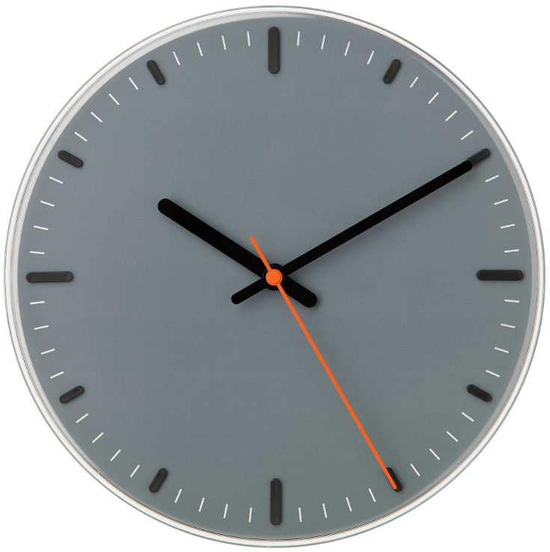
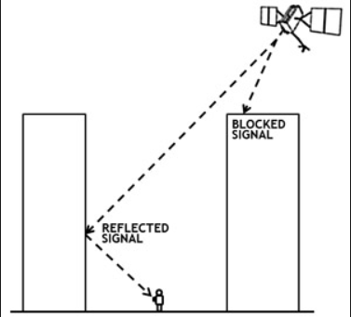
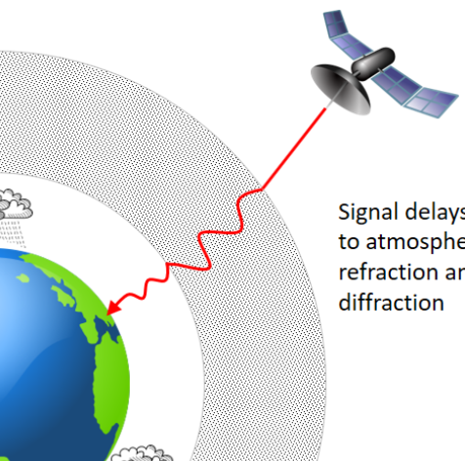
DGPS/RTK – Error Corrected Position
Error Types
Timing – Clocks not in sync
Ephemeris (satellite orbit) – Not exactly where it should be.
Atmospheric – Ionospheric scattering of GNSS signal
Multipath – Signal bounces off objects
Ephemeris errors
Timing errors
Reference Station Assumptions
Ionospheric and Tropospheric effects are the same at the reference station and user GNSS receiver
Reference Station and User GPS “see” the same satellites
*Distance from the reference station impacts accuracy*
Multipath error
Atmospheric

Slide 7
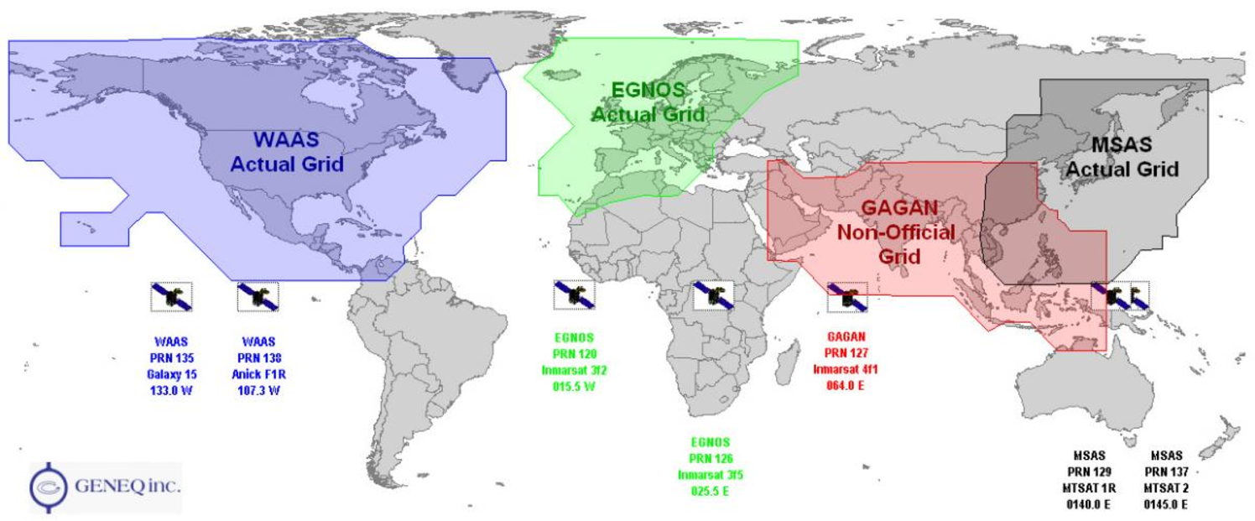
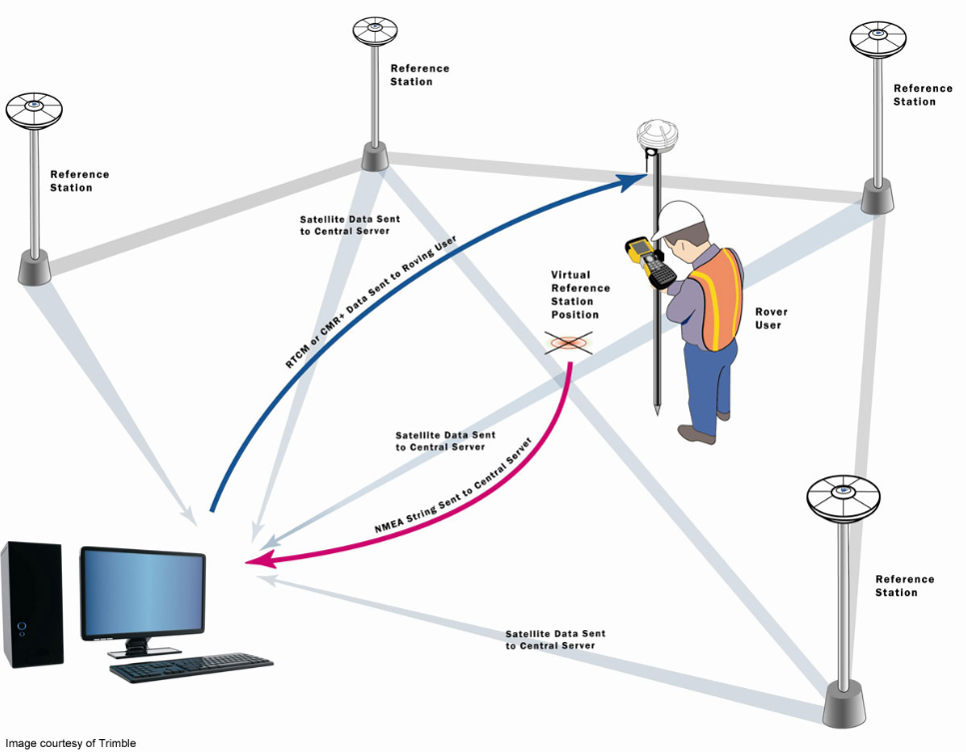
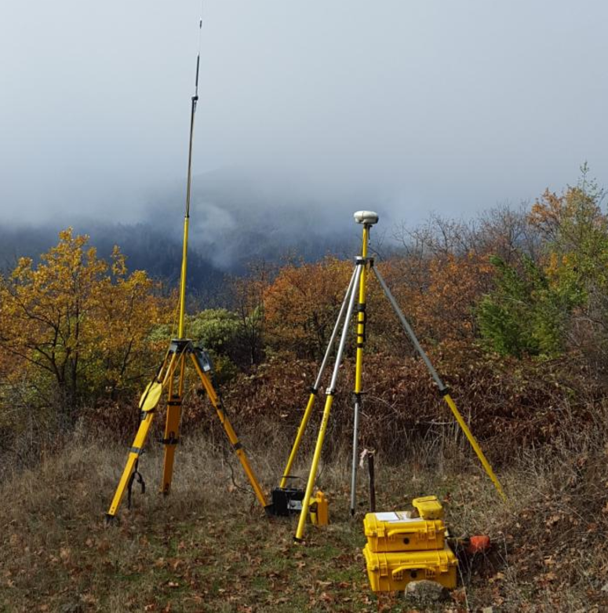
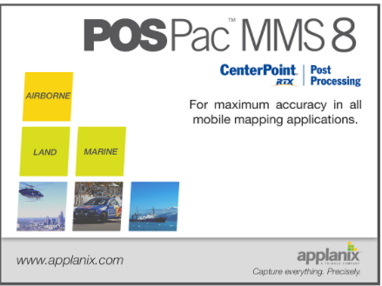

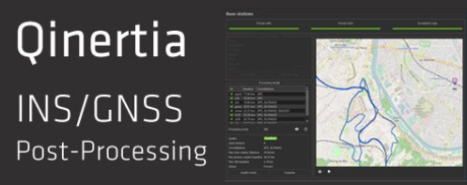
GNSS Corrections - There are several methods to improve the positioning of the vessel.
DGNSS – Relies on GPS stations setup and maintained by USCG. Correctors or broadcast via radio with each station having a designated frequency. Currently phasing out
Precise Point Positioning (PPP) – Decimeter accuracy – relies on single rover antenna. May require a subscription to use in realtime. Examples: MarineStar & Atlas Link
Free SBAS – Similar to PPP however composed of geostationary satellites that broadcast corrector for a given geographic location.
No subscription required. Examples: WAAS (U.S.A) & EGNOS (E.U)
Real Time Kinematic (RTK) - Centimeter-level accuracies achieved in real time on the vessel. Can be provided by radio link from user base stations or NTRIP provider.
Post Processed Kinematic (PPK) - Accuracies achieving or besting RTK. Can collect data without real time correctors so long as all raw positioning and base station data is recorded at a sufficient data rate.
*mnspoint.com

Slide 8
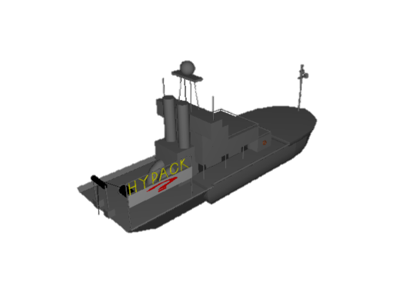
Vessel Motion – Where is the sonar pointing?
Yaw
Z
Rotation around the Port/Starboard axis is Pitch
  Pitch Bow Up is positive
Rotation around the Fore/Aft axis is the Roll
  Roll to Starboard is positive
Rotation around the Z axis is Yaw
  Yaw Clockwise is positive
Vertical motion on the Z axis is HEAVE
*Measurement of motion is REQUIRED for multibeam and lidar operations. In some cases it can be optional for singlebeam, sub-bottom, and sidescan operations
Center of Gravity
Motion measurement types
Pitch
Motion Reference Unit (MRU): Heave, Pitch, Roll and sometimes Heading. Less expensive than full INS system.
Inertial Navigation System (INS): Heave, Pitch, Roll, Heading and Position – Can temporarily maintain position without GNSS signal. Good to have when working under bridges or limited GNSS environments.
Port/Starboard
Roll
Fore/Aft

Slide 9
Sound Velocity Profilers

Slide 10
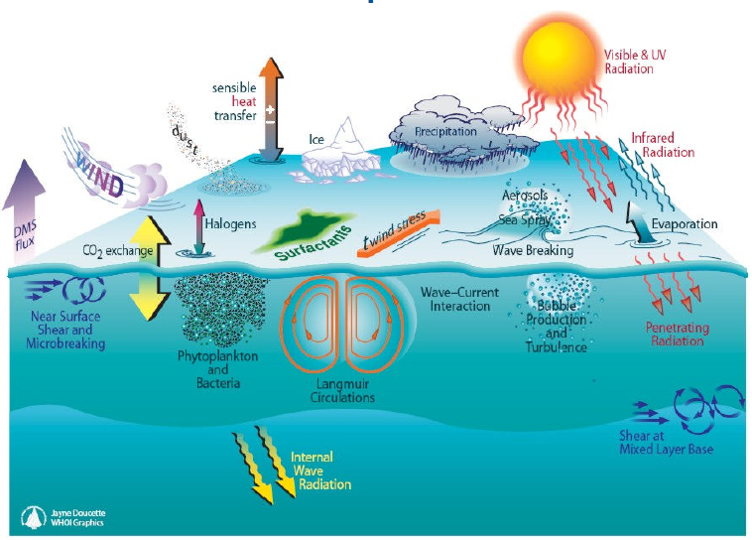
Environmental Characteristics
When using acoustic measurements the speed of sound affects the result.
Each of the items in this image affect the speed of sound.

Slide 11
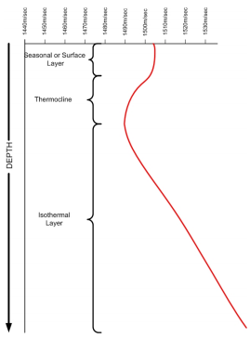
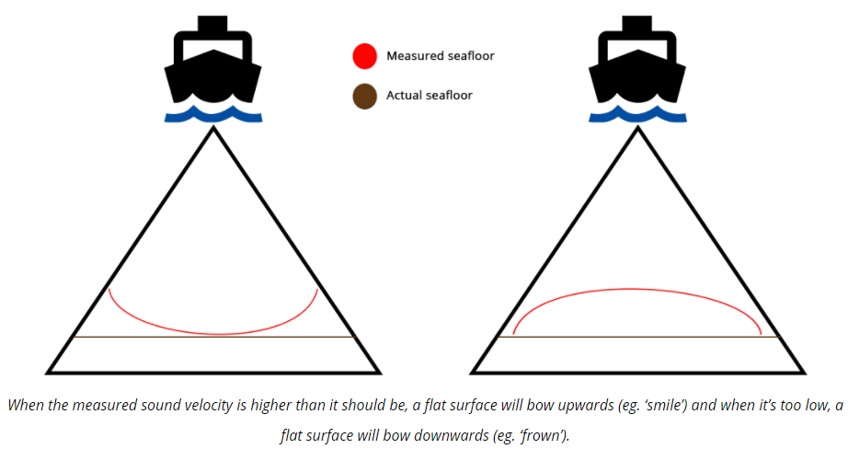
Sound Velocity Profile (Sound speed cast) – Why we measure.
Measure travel time from the sonar to the reflected Seabed. To get a proper distance we need to know speed of sound through the water column.
Speed of Sound * Time = Distance
If improperly measured then depth measurements will be incorrect.
Speed of sound impacted by
Temperature
Salinity/Conductivity
Pressure
Single beam – Requires AVERAGE speed of sound of the water column
Multibeam – Requires FULL PROFILES showing all changes in sound speed
*Take frequent Sound speed measurements in environments with changing water conditions. Especially for multibeam surveys!!!
*AML Oceanographic

Slide 12
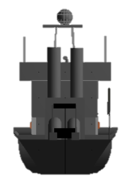
Understanding Signal Ray Tracing
By applying a Sound Velocity Profile the sounding can be corrected
High Sound Velocity
Low Sound Velocity
Higher Sound Velocity
Launch Angle
Lower Sound Velocity
True position and depth of the sounding

Slide 13
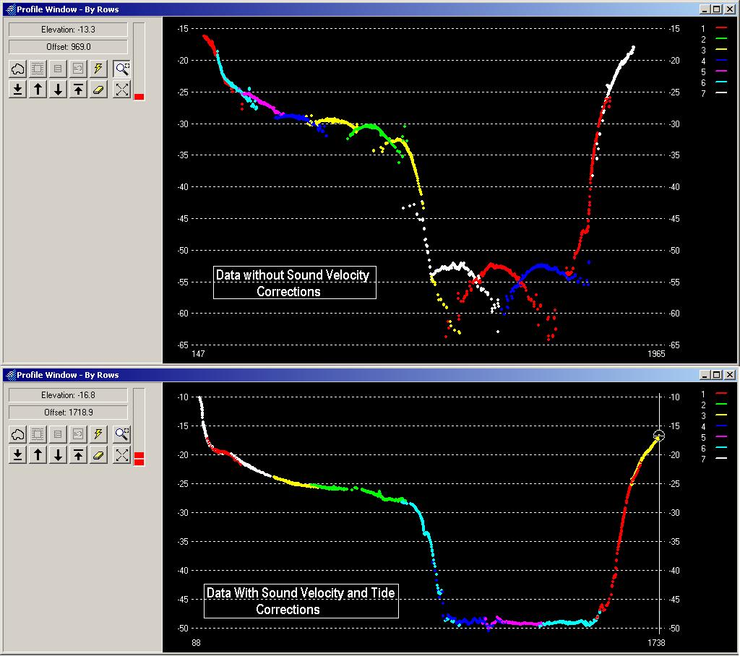
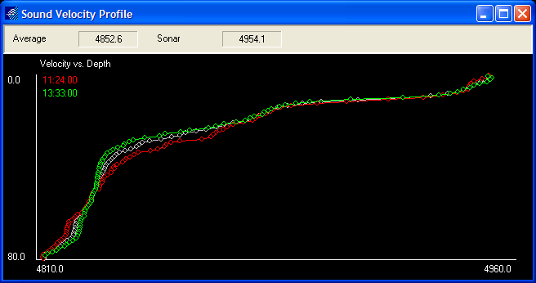
Speed of Sound – Corrected Soundings
Correctly applying the SV profile prior to editing the data is crucial in the processing of MBES data

Slide 14
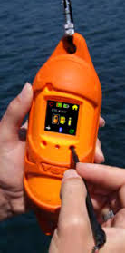
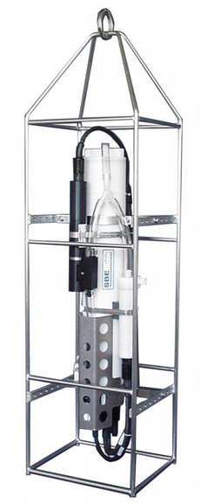
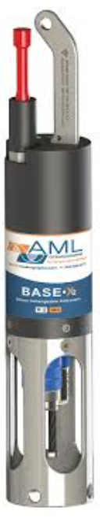
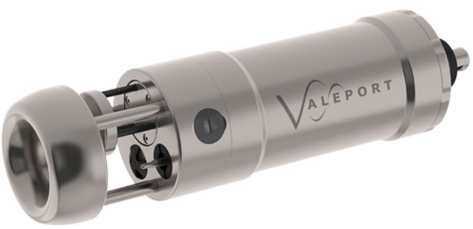

Sound Velocity Profile (Sound speed cast) – How we measure.
There are 2 types of devices/methods to measure sound speed, both acceptable for survey.
Conductivity, Temperature, Depth (CTD)
Time of flight profiler
Known distance
Measures the temperature, conductivity (salinity) and the depth to CALCULATE the sound speed using well established equations
Uses a small transducer and a fixed distance sounding plate to directly MEASURE the speed of sound. Also requires a pressure sensor.
*Sensors MUST be regularly calibrated to maintain accuracy, contact manufacturer for guidance on calibration interval.

Slide 15

Physics of Sound
Information in this section contains information from the UK Hydrographic Office – SOPAC training

Slide 16
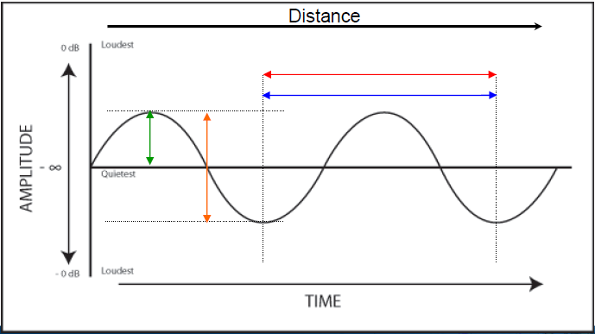
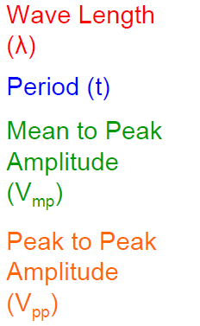
Physics of Sound – Sine Wave
In order to understand the characteristics and behavior of sound waves, it is essential to understand Sine Curves

Slide 17
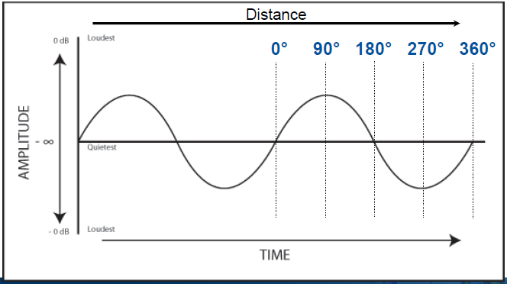
Physics of Sound - Phase
The phase of the signal is especially important in interferometry multibeam sonars.
The Phase of the signal refers to the angle in relation to the beginning of the sine wave.

Slide 18
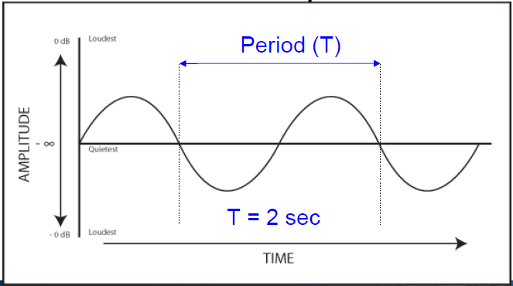
Physics of Sound – Frequency
Range vs Frequency
Low Frequency
Long Range
More Penetration
Less Definition
Less Waves/Second
High Frequency
Shorter Range
Less Penetration
Higher Definition
More Waves/Second
Frequency of the signal is given as: f(hz) = 1/T In this example f = 0.5 Hz
Hz is equal to the number of times in 1 second

Slide 19
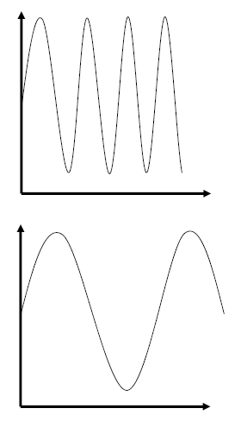
Using Acoustics to Measure Distance
The frequency of the acoustic wave used to measure the depth depends upon the type of survey.
Deep Water / Long Range surveys use Low Frequencies
Shallow Water / Short Range surveys use High Frequencies
The Higher the frequency, the greater the precision.

Slide 20
Pulse Length
Pulse length refers to the duration of the sound transmission. This impacts range resolution and depth performance.
Short pulse length = High range resolution and shallower depths
Long pulse length = Lower range resolution and deeper depths.
Keep pulse lengths as low as possible to achieve maximum range resolution.
*Range resolution is the ability of the sonar to detect two objects close together
Short pulse length = only one object ensonified at a time by the acoustic wave, data will show 2 objects.
Long pulse length = both objects ensonified at a time by the acoustic wave, data will show single object

Slide 21
Sound Interaction with Seabed
Direction of Acoustic Energy
Energy returned to sonar
The acoustic energy’s interaction with the seabed has multiple components that affect the energy returned.
The geometry of the pulse is important to the signal returned.
Reflection
Angle of Incidence
Scattering
Absorption

Slide 22
Single Beam Sonars

Slide 23
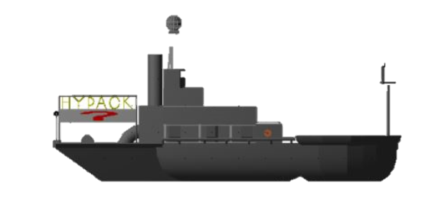
Single Beam Echo Sounder
HYPACK
Measure travel time from the sonar to the reflected Seabed.
The SBES can only take one measurement at a time, hence the Single Beam.
The system typically “pings” several times per second.
Speed of Sound * Time = Distance
Sound Pulses
Seabed

Slide 24
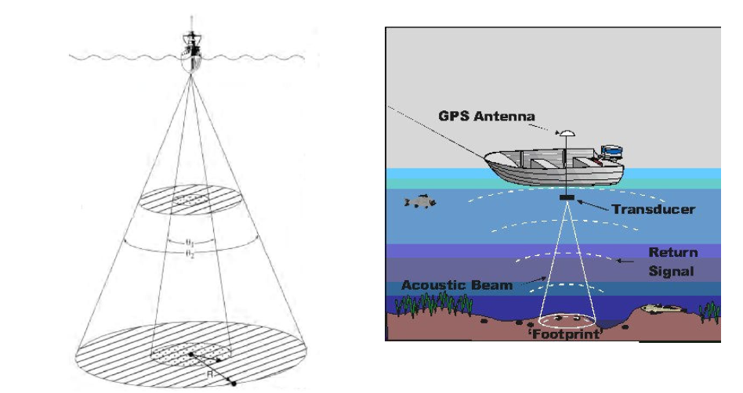
SBES – Beam Characteristics
As beam width increases the footprint on the seabed increases as well. The sounding is the strongest return within that area
 | 20’ | 40’
3 degree | 1.0 | 2.1
5 degree | 1.7 | 3.5
8 degree | 2.8 | 5.6
45 degree | 14.1 | 28.3
Footprint Radius
Fish Finders use a wide angle to “see” any fish nearby.

Slide 25
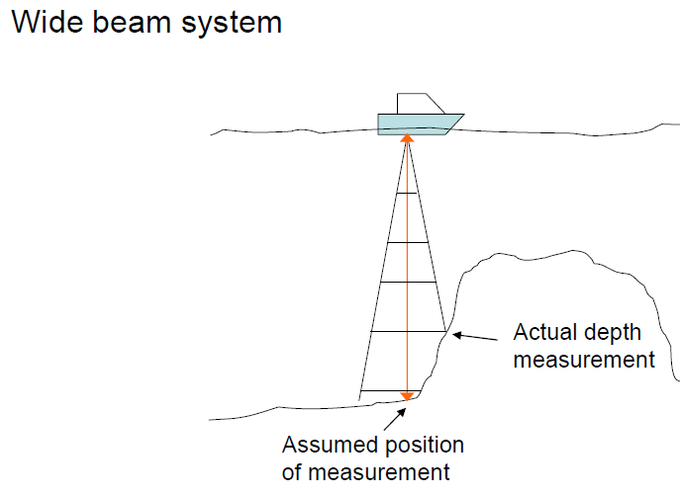
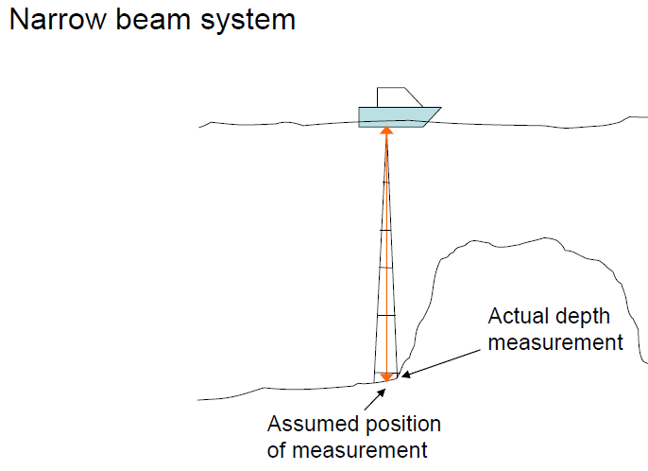
SBES – Beam Characteristics
The width of the beam in a SBES can severely affect the accuracy of a reported sounding.
Fish Finders use a wide angle to “see” any fish nearby.

Slide 26
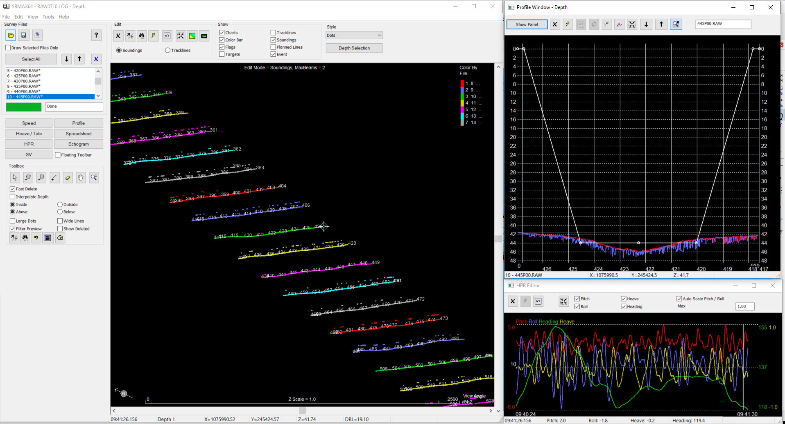
SBES in HYPACK
Using the SBMAX64 program, editing has never been easier

Slide 27
Multi Beam Sonars

Slide 28
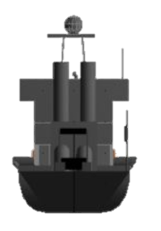
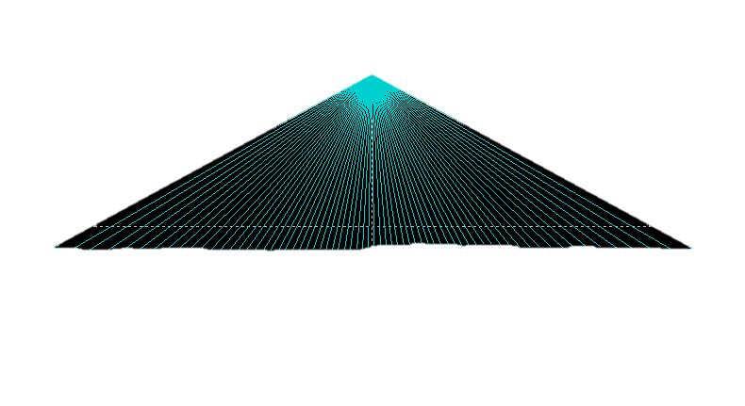
Bathymetric Sonar Types
      What is the difference between a beam former and an interferometric MBES?
      A Beam Forming System uses Amplitude Detection similar to a single beam sonar for a particular beam angle.
      An Interferometric System uses Phase Detection by finding the phase shift at two or more elements of the receiver array.
      In summary, beam formers measure range for each of a set of angles, and interferometers measure angle for each of a set of ranges. Beam former detection is based on signal amplitude & phase. Interferometer is a phase differencing system.

Slide 29
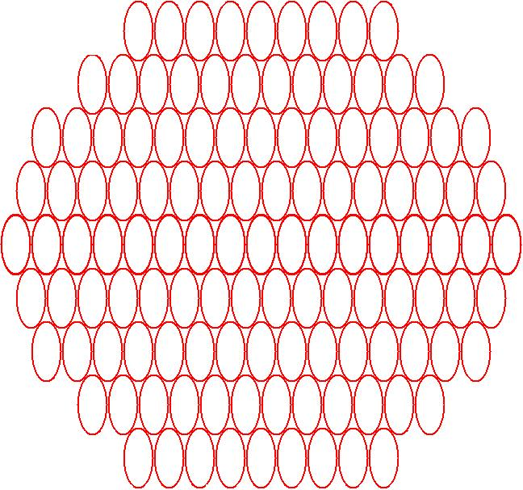

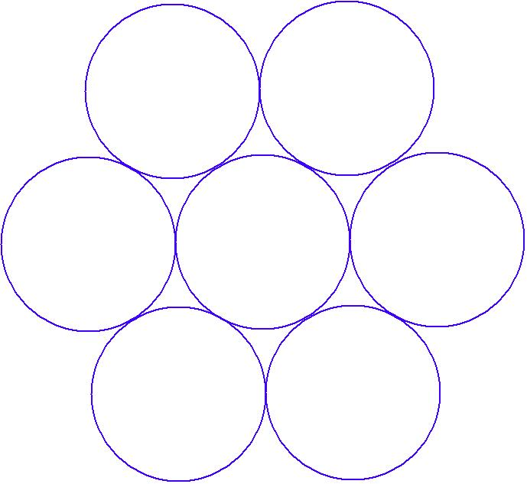
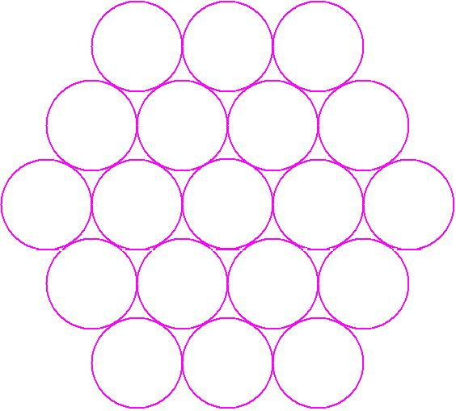
Ensonified Area or “Footprint” Size Differences
Footprint Size of 8.0 degree is 6.99 feet in 50 foot deep water
+
8.0 degree
(6.99’ or 2.13 m.)
3.0 degree
(2.6’ or 0.79 m.)
1.5 degree
(1.3’ or 0.40 m.)
0.5x1.0 degree
(0.44’ x 0.87’ or 0.14 m x 0.27 m)
Notes:
Notice the difference in data density as the beam angles get smaller.
Higher Resolution and Accuracy of the Horizontal and Vertical data.

Slide 30
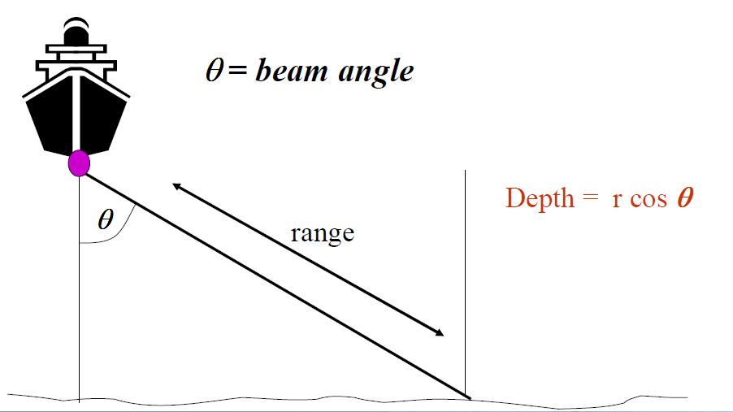
MBES Basic Principles
Measure the range at a given angle to determine the depth

Slide 31
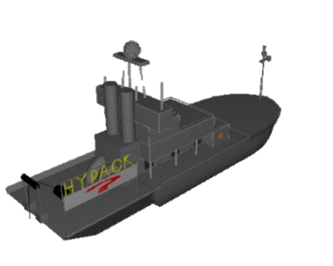
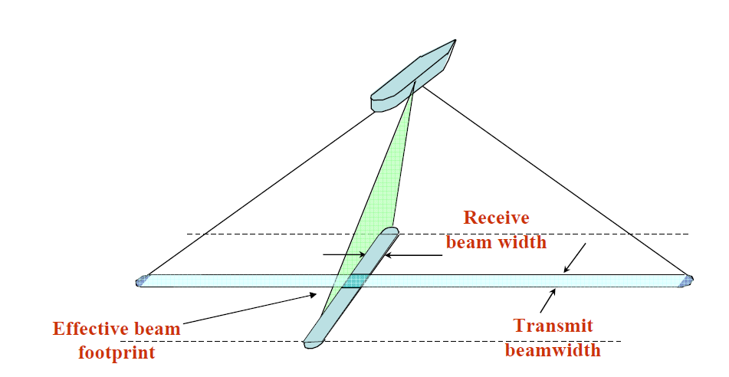
Transmit and Receive Beams
The overlapping area of the Transmit and Receive beams is considered the Beam Footprint

Slide 32
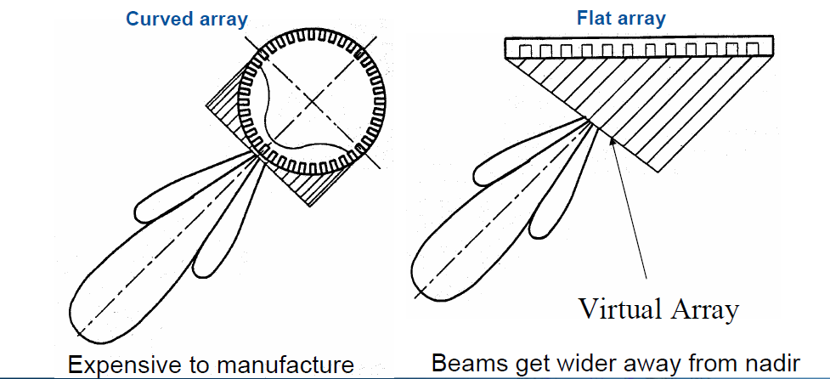
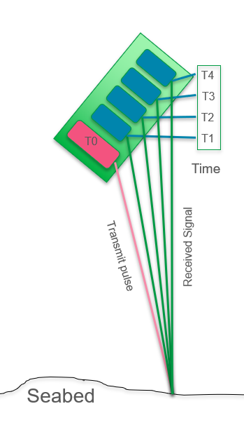
Beam-Forming
Interferometric Array
With the known phase difference and the element spacing, the angle of incidence can be computed to the object.
The difference in phase changes with distance from the sonar.
Multiple Receiver elements are used to create each beam
*For all currently available multibeam sonars, proper measurement of Surface Sound Speed is REQUIRED for proper sounding range calculations

Slide 33
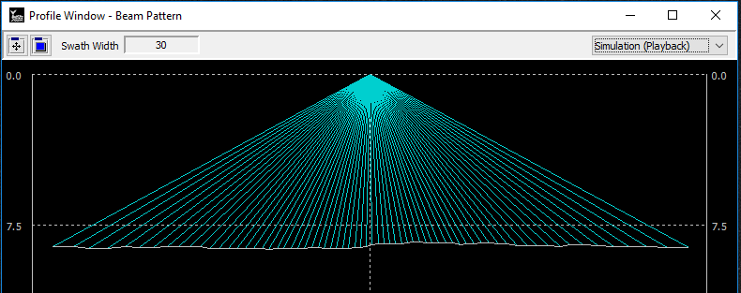
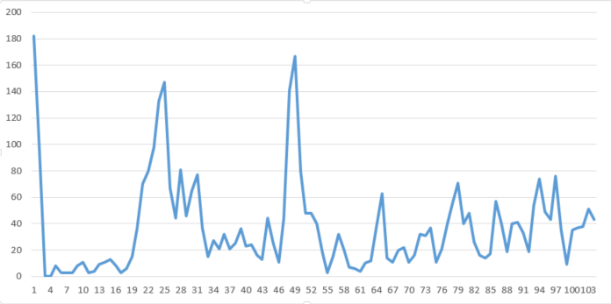
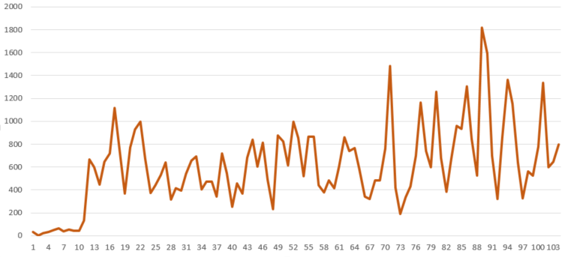
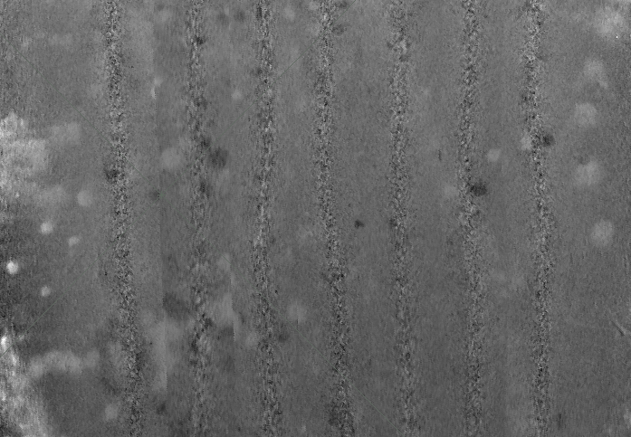
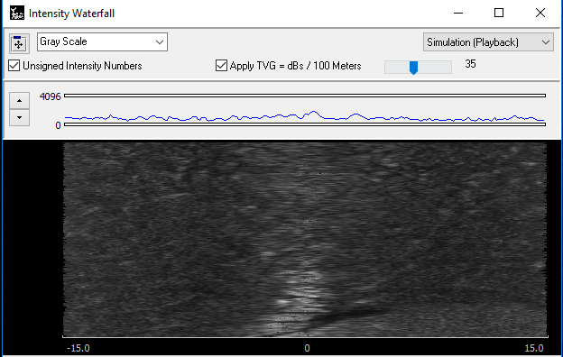
MBES – Snippet Data
Time
The “Snippet” data is the analog signal before and after the bottom detection.
The data is stitched together into a line of signal strength for mosaic.

Slide 34
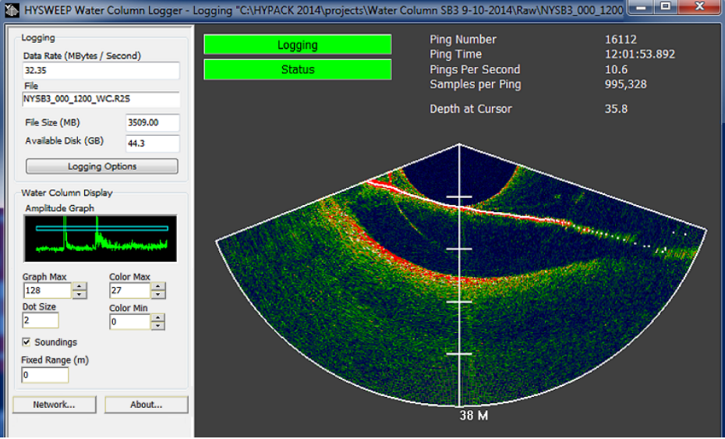
Water Column Data
All of the return data for every beam is displayed.
Logging Water Column data requires exponentially more hard drive space than a normal MBES survey. Water Column data is the equivalent of the Echogram in SBES.

Slide 35
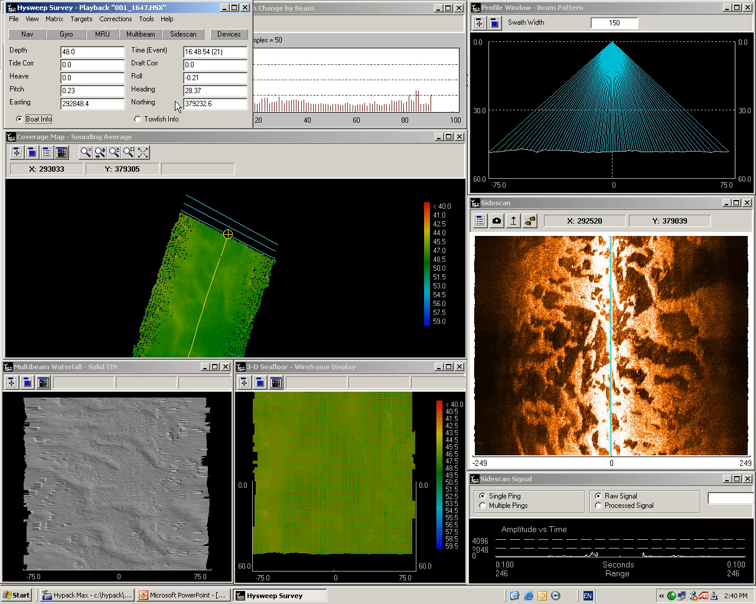
MBES in HYPACK
Multibeam Survey Program
Collects and logs multibeam and support sensors.
Real time displays, corrections and QC.
There are 15 windows to choose from.

Slide 36
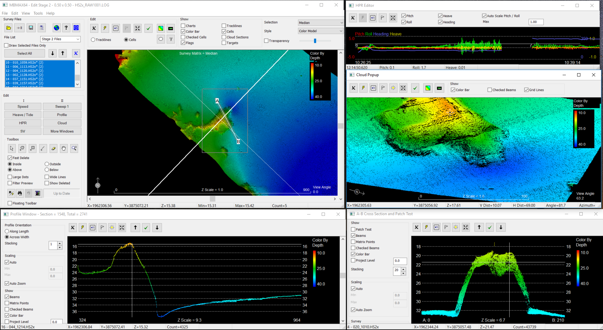
MBES – Editing in HYSWEEP

Slide 37
LiDAR Sensors

Slide 38


LiDAR – Single Beam Line Scanners
RIEGL V

Slide 39


LiDAR – 360 Line Scanners

Slide 40


LiDAR – Multibeam Scanners

Slide 41

LiDAR – Mounting Preferences

Slide 42

VLP-16 Return Modes
Return Modes
Due to the laser’s beam divergence, a single laser firing often hits multiple objects producing multiple returns. The VLP-16 analyzes multiple returns and reports either the strongest return, the last return, or both returns.
HYPACK does not differentiate the returns if they are both provided in Dual Mode.
All of the points will be stored that are passed from the VLP to HYPACK.

Slide 43


VLP-16 Data Rates
The dual return function is often used in forestry applications where the user needs to determine the height of the trees. The figure below illustrates what happens when the laser spot hits the outer canopy, penetrates the leaves and branches, and eventually hits the ground.

Slide 44

Side Scan Sonars

Slide 45


What is found in a side scan record?
Shadow
Water Column
How the sonar sees the object
Features on the seafloor block the signal from the sonar, creating shadows.
Water column provides information about tow fish height.
Target features off the seafloor will produce a shadow.
Bottom sediment signal will differ based upon return angle of incident and seabed absorption.

Slide 46


What you find with a Side Scan Record
Sidescan Signal
T₀ (Ping)
T₂
T₁ (First return)
T₂ (range)
Signal vs. Time
T₁
T₁
T₂
Time
T₀
Time
T₂
T₁
T₀
T₁
T₂
T₂

Slide 47




The Importance of the Shadow
When trying to identify a target, the shadow can be more helpful than the shape of the object.

Slide 48

Side Scan Survey Overview
A side scan sonar can be used for a wide variety of survey operations.
Search and recovery
Geological Identification
Pre- and post-dredge surveys
Target verification and location
Useful tool for correlating and verifying bathymetric data

Slide 49


Side Scan in HYPACK
Load raw side scan data – HSX, HS2, XTF, JSF, SDF, or CM2 files
Adjust bottom tracking, smooth heading
Create mosaic of the data

Slide 50
Magnetometers

Slide 51

Magnetometer Survey Concerns
It is important to understand how the range to the object affects the expected gamma reading.
When searching for a known object, target interrogation begins with an understanding of the expected gamma.
 | 0M | 15M | 20M | 30M | 50M
Offset | 0 M | 7.5 M | 10 M | 15 M | 25 M
Gamma | 277.78 | 67.72 | 37.38 | 14.23 | 3.53

Slide 52

Variables that Affect a Magnetometer Survey
International Geomagnetic Reference Field (IGRF)
A standard mathematical description of the Earth's main magnetic field and its secular variation.
This is the magnetic field generated by the Earth’s inner core.

Slide 53

Geomagnetic Storms
Everyday the earth is bombarded with magnetic impulses from the sun.
These magnetic storms affect the gamma readings of the magnetometer.
The intensity and duration of a Geomagnetic Storm can range from seconds to hours.

Slide 54


Magnetometer Data in HYPACK
The display shows the gamma readings at two scales simultaneously or individually.
This allows for a target that jumps off the total visible scale of the lower scale ( blue ) graph to be monitored by the larger scale ( red ) graph.
10 nT
100 nT
Notes:
54

Slide 55


Magnetometer in HYPACK
The MAGEDIT program allows the user to apply IGRF or Shore based corrections.
Targets are stored in the Target Database.

Slide 56

Sub-Bottom Profilers

Slide 57
Introduction to Sub-Bottom Profiling
SBP systems are single-channel instruments used for shallow reflection seismic profiling.
SBP’s operate at different transmit frequencies.
The interpreted data from these SBP systems includes the thickness and qualitative sediment characteristics.
Uses:
        Engineering and geotechnical site surveys
        Renewable energy surveys
        Dredging studies
        Mineral exploration
        Habitat mapping projects

Slide 58

Principles of Sub-Bottom Profiling
Divided into two types:
        Energy source and receiver combined as in a transducer, or
        Separate sound source & receiver (hydrophone array)
Sound energy transmitted into the water is reflected from the seabed and the sub-surface sediment layers.
The reflected energy intensity depends on the different densities of the sediments.

Slide 59
Types of Sub-Bottom Profilers
Acoustic characteristics of commonly used sub-bottom profiling systems. The depth of penetration is related to the frequency, source energy & nature of the seabed geology.

Slide 60

Installation & Towing Configuration Recommendations
Mounting a sub-bottom profiler and towing the source & hydrophone array correctly are critical to acquiring a noise-free dataset.
In vessel mounted systems, it is important that the transducers are mounted away from areas of potential noise or turbulence.
With a surface-towed system, it is a good idea to have the source and the receive array separated by the aerated propeller wash.

Slide 61
Sub Bottom in HYPACK
In SURVEY the sub-bottom profiling data is viewed in the Scrolling Data Window.

