Slide 1
Introduction to Surveying and HYPACK

Slide 2
Objectives of this session
1
2
3
HYPACK Project Structure
Project Manager
Using Project Groups
Project folder structure
Planned Line Editor
Types of Planned Lines available
Offsets options
Extend and Shorten a group of Lines
Target Editor
Display options for a Target
How to mark a target in various programs
S-57 Symbols for targets
Importing Targets from TXT Files
Comparing two Target Databases
4
5
Matrix Editor
Understanding the Matrix purpose
Creating a Matrix
Filling a Matrix
Border Editor
Creating a Border File
Uses of a Border File
Border File Report for area coverage
Notes:
Stressed Water Supply
Issue
Maintain the health of traditional water sources and execute a water source diversification strategy
Solution
Xylem’s leading-edge technologies monitor, pump and treat water from all sources and enable water reuse
Aging Infrastructure
Issue
Utilities have to effectively assess and identify high-risk areas for repair/replacement before problems occur
Solution
Xylem’s intelligent pipeline and critical infrastructure services perform condition assessment, identify defective assets, provide bypass services and replacement technologies, reduce or eliminate combined sewer overflows and leaks/non-revenue water
Stormwater & Flooding
Issue
Significant increase in severe weather patterns is causing flooding and related damages to communities
Solution
Xylem’s flood management solutions include sensors for early warnings, dewatering for disaster response, communications for recovery and submersible pumping for resilient infrastructure
Regulatory Compliance
Issue
Utilities must successfully comply with a growing body of compliance regulations
Solution
Xylem’s analytics and sensors evaluate a broad range of water quality parameters, and our technologies treat water and wastewater to meet regulatory standards
Non-Revenue Water
Issue
Utilities have an important opportunity to reduce persistent and costly water losses from leaks and faulty meter readings
Solution
Xylem’s broad portfolio of solutions monitors for, and identifies, water leaks, as well as faulty meters. Our communications network enables point-to-multipoint communications throughout the system
Operating Strategy Reducing Costs
Issue
Utilities want to lower operating and energy costs, and leverage new revenue opportunities
Solution
Xylem offers industry-leading pumping and treatment solutions for energy efficiency, and software-enabled solutions to optimize operations and identify revenue opportunities

Slide 3
Understanding HYPACK Project Structure

Slide 4
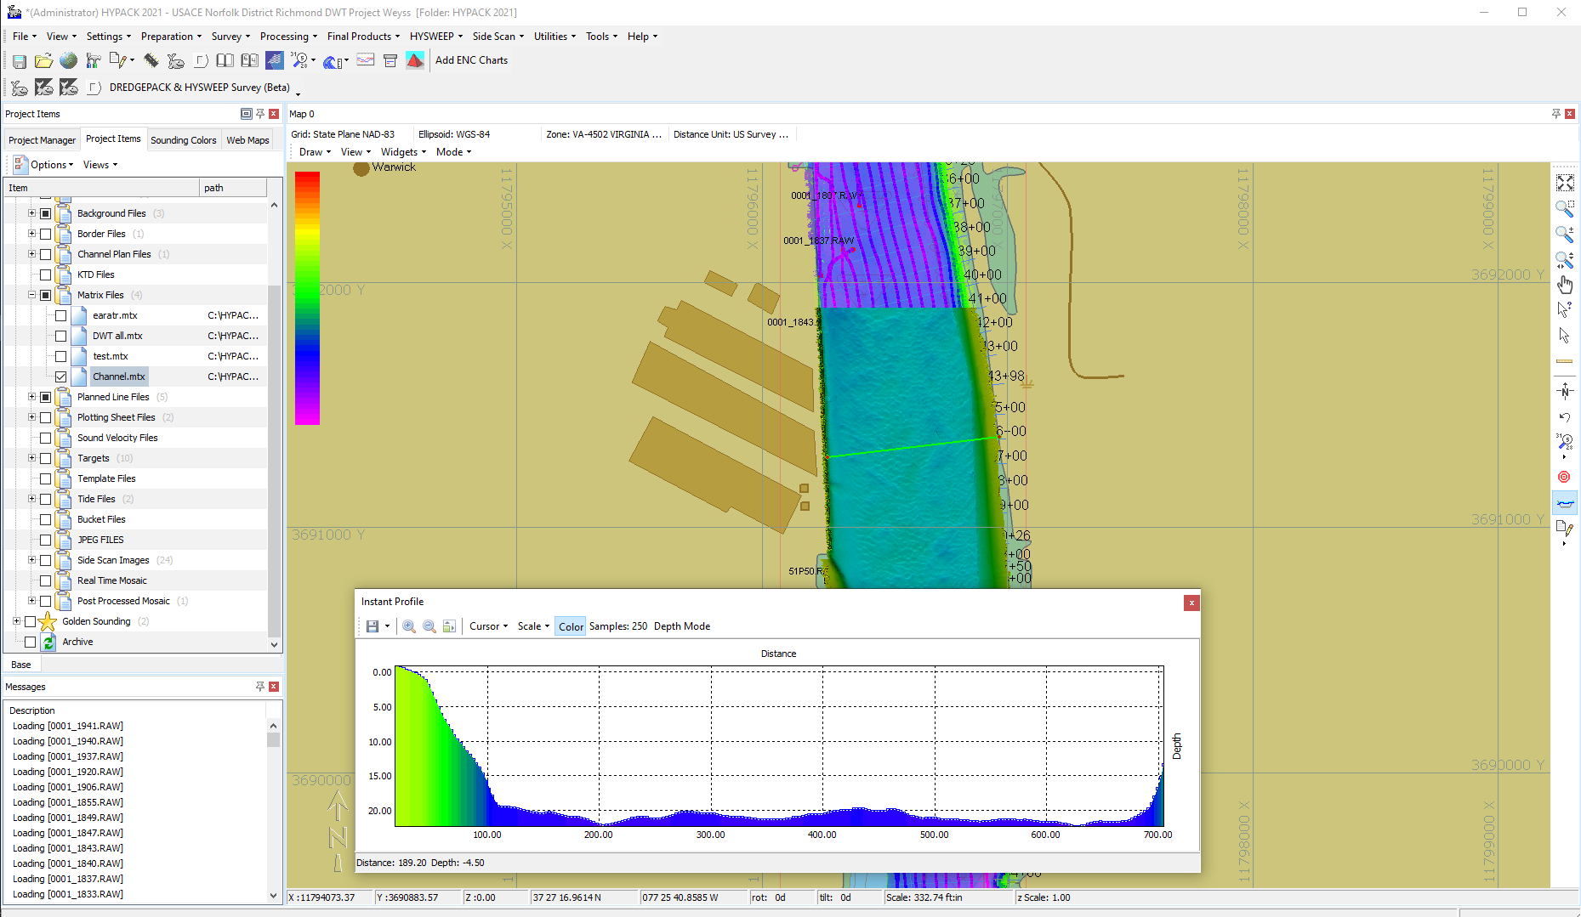
HYPACK Main Interface
The HYPACK Main Interface is used to launch applications, plan the survey and view the data once a survey has been completed.

Slide 5
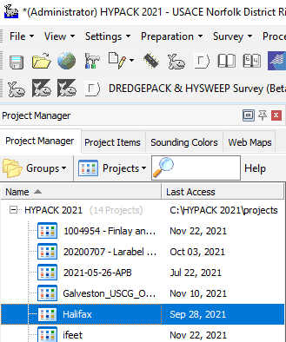
Project Manager Window
Sort by Date:
  Click the Last Access item
To Change Groups:
  Click the Groups tab.
Quickly locate Projects
User defined keywords may be assigned to each project. Typing text in the Search Dialog will display all projects with a partial match against Project Name and full match on keywords.

Slide 6
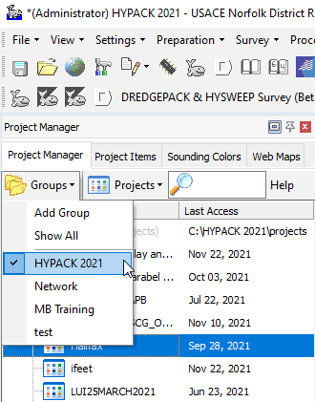
Project Groups
Add projects from previous versions of HYPACK by clicking “Add Group” and selecting the Project Folder from that version.
Click on “Project Manager” tab to access the Groups tab.
The HYPACK 2022 folder is created when you install the HYPACK 2022 package.
The “Network” group allows you to designate any folder on any computer as a project source.
Each “Group” points to a folder on your computer where HYPACK Projects are stored.

Slide 7
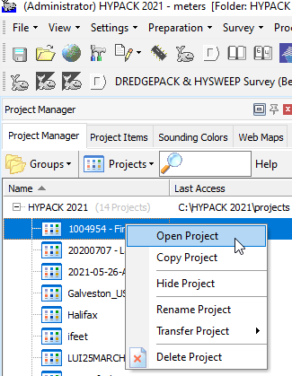
Open an Existing Project
You can open an existing project by
Double-clicking on the name in the Group listing
Right-clicking on the Project in the Group listing and selecting “Open Project”.

Slide 8
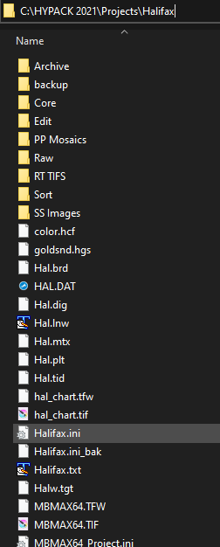
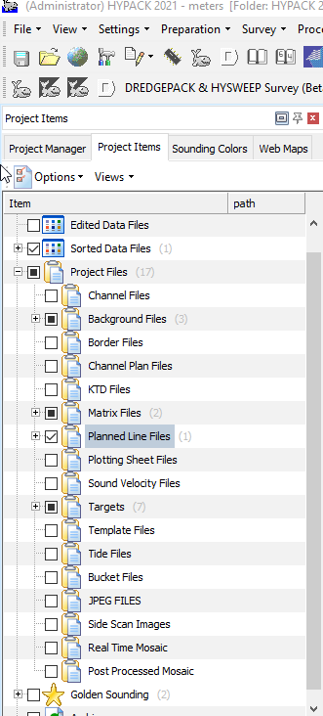
HYPACK Project Structure
A HYPACK Project is a folder that contains all of the information pertaining to that project.
A valid project MUST contain a Configuration File of the same name as the folder.
Within the project there are a series of important folders.
  RAW
  EDIT
  SORT

Slide 9
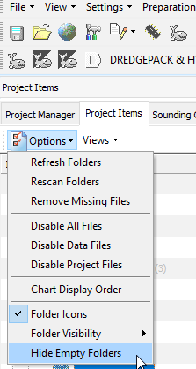
Project Items: Options
Refresh Folders: Checks access of all Project Items.
Rescan Folders: Checks for new files in Project folder.
Remove Missing Files: Gets rid of files listed in the Project Listing that cannot be found.
Disable All Files: No files are displayed in the SHELL.
Disable Data Files: No data files are displayed in the SHELL.
Disable Project Files: No project files are displayed in the SHELL.
Chart Display Order: Allows you to change the order in which the Project files are displayed.
Folder Visibility: Removes folder from listing.
Hide Empty Folders: Removes folder that are empty.

Slide 10
HYPACK Shell Screen Tools

Slide 11

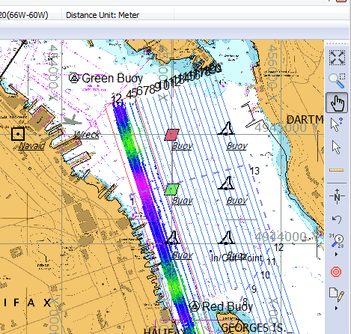
Screen Tools
Zoom Extents
Zoom Window
Pan / Rotate Screen
Query Sounding or S-57
Selection Tool
Ruler
Snap to North Up
Previous Screen Zoom
Sounding Style and Color
Add a Target
Return to Editor for Digitizing

Slide 12
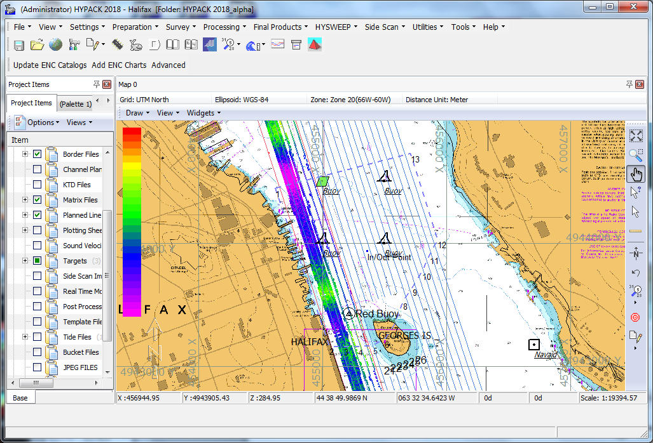
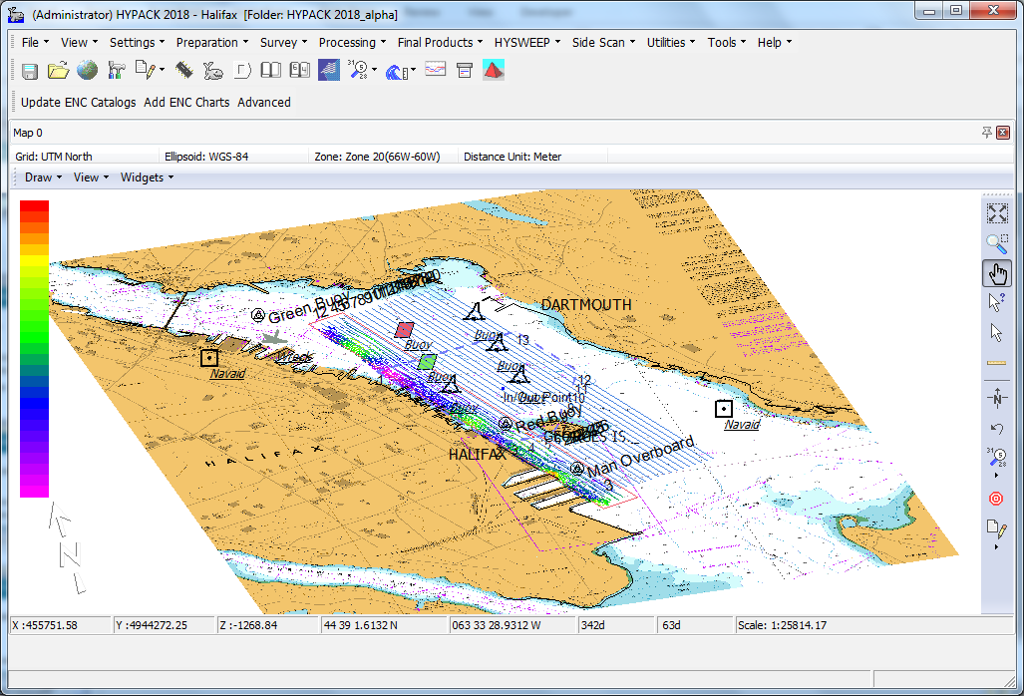
Shell Rotation in 3D
Display in the Shell can be rotated to show data elements in 3D.
Use a combination of hand icon and mouse to move data. Information about the cursor location and rotation is shown below
Depth Latitude Longitude Rotation Tilt Scale

Slide 13
Query Tool
Used to get more information about:
Edited ALL Format Sounding
S-57 Object Attributes
S-57 TIF and TXT Info
Target Info
Planned Line Info

Slide 14
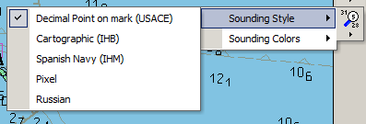
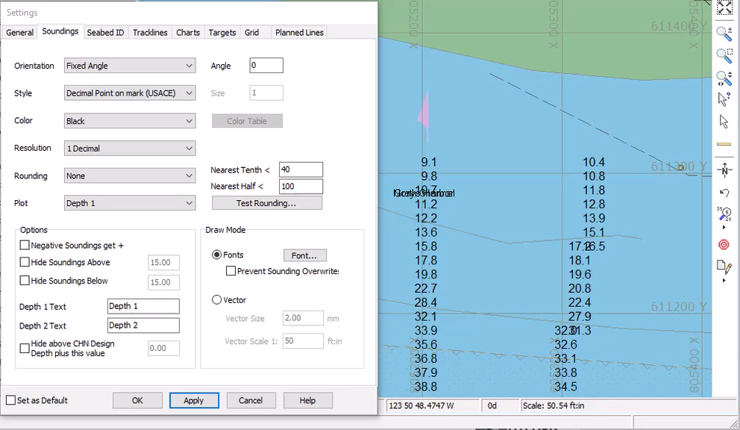
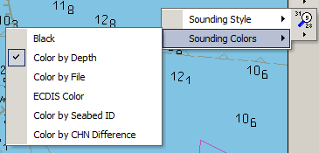
Sounding Style and Color Icon
Saves a little time from having to go to the Settings window…

Slide 15
Other HYPACK Project Settings

Slide 16

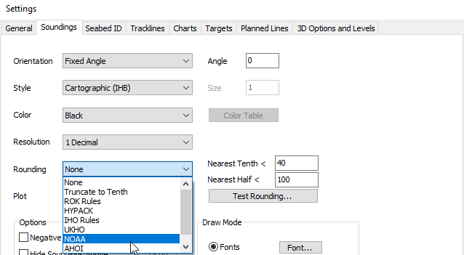
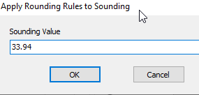
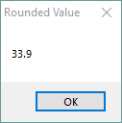
Rounding Rules
Test the rounding selection by clicking “Test Rounding” and entering a value
HYPACK Rounding Rules apply to the display only

Slide 17
Planned Line Editor

Slide 18

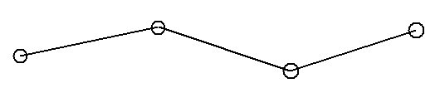
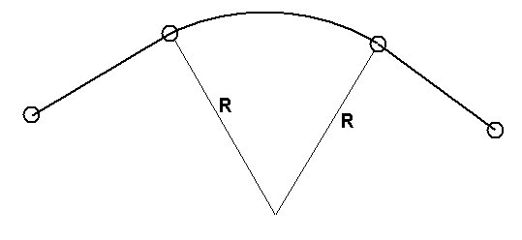
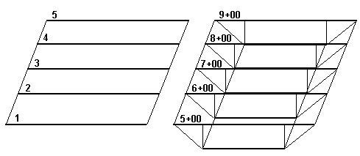
Planned Lines Basics
A planned line needs a minimum of two waypoints.
A planned line can have over 100 segments.
Internal segments can be made as arcs by entering the radius for the arc.
Lines can be:
  2D: Only X-Y at waypoints
  3D: X-Y at waypoints and design depth at Distance Along Line
You can survey without Planned Lines. Many multibeam surveys do not use them and rely on a MTX file(s) to ensure 100% coverage.

Slide 19
Programs for Making Planned Lines
Program ↓ | Location | 2D vs. 3D | Arcs | Multiple Segments | Input
LINE EDITOR | Preparation-Editors | 2D & 3D |  |  | X-Y or Lat-Long
CHANNEL DESIGN | Preparation-CHANNEL DESIGN | 3D Only |  |  | X-Y
DXF/DGN TO LNW | Right click on DXF or DGN file | 2D & 3D (3D – DXF Only) |  |  | XY
BRD to LNW (shown in BORDER EDITOR presentation) | Line Editor | 2D Only |  |  | BRD File
ADVANCED CHANNEL DESIGN | Utilities Menu | 3D |  |  | X-Y

Slide 20
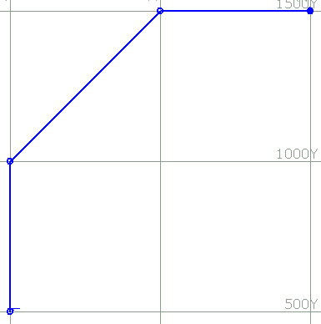
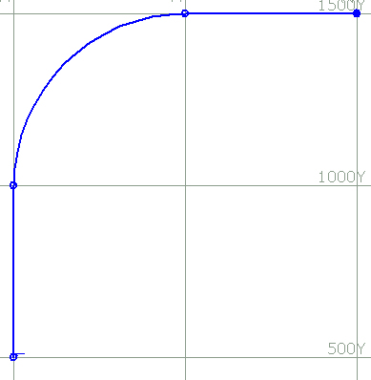
Line Editor: Arc Segments
Enter inside (or outside) radius for a segment.
Curved lines CANNOT be used when computing volume quantities.
If the arc is created on the wrong side, add a “-” to the radius to flip it to the other side!

Slide 21
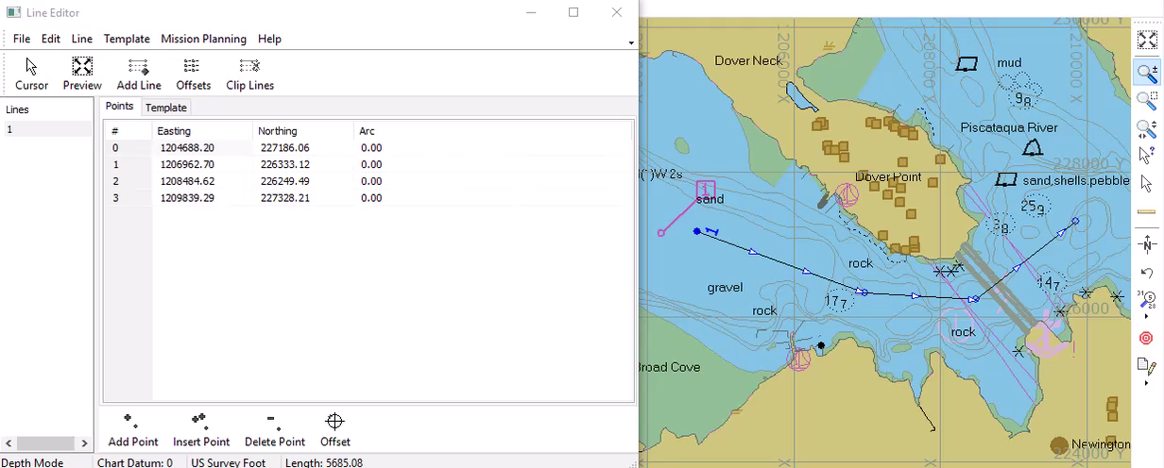
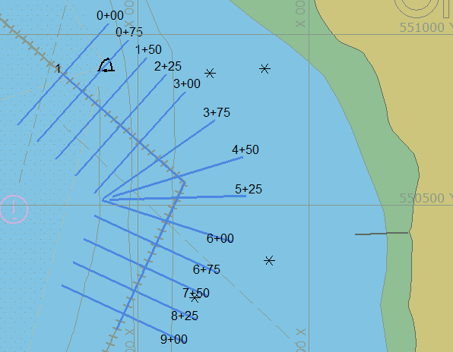
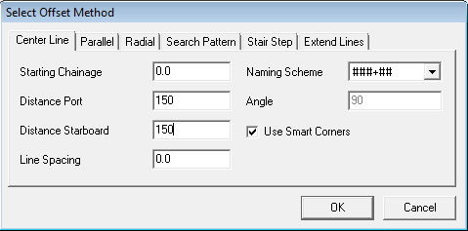
Offsets: Centerline
Smart Corners, Centerline Offsets.
Create your centerline, Select Offsets: Centerline, Generate perpendicular lines.

Slide 22
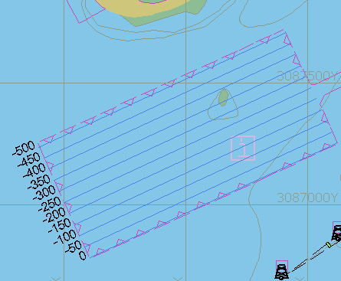
Offsets: Parallel Lines
Enter your initial line.
Select Offsets: Parallel
Generate your parallel lines.
You can now stagger the offsets:
  50m, 100m, 50m, 100m, etc.
For Parallel Offsets, lines are renumbered North to South and West to East.

Slide 23
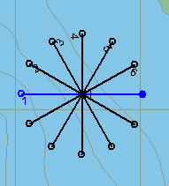
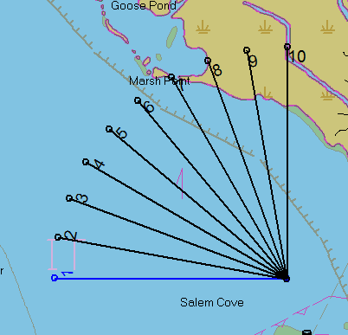
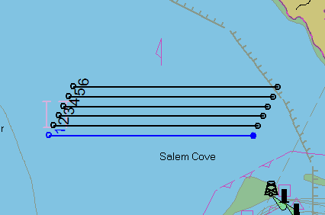
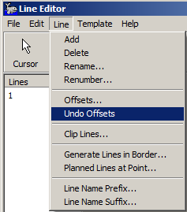
Offsets: Other Offset Patterns
Stair step
Search Pattern
Radial
You can ‘Undo’ an offset pattern by clicking on the “Line – Undo Offsets” menu item in the Line Editor.

Slide 24
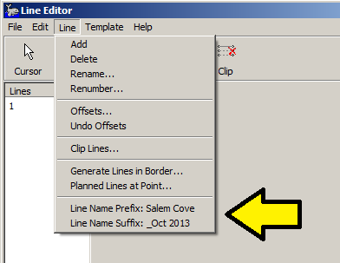
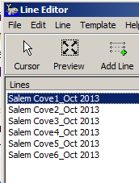
Adding a Prefix and Postfix to Line Names
You can add both a Prefix and a Suffix to the Line Names.
Go to the “Line” menu and click on the bottom two items.

Slide 25
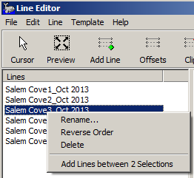
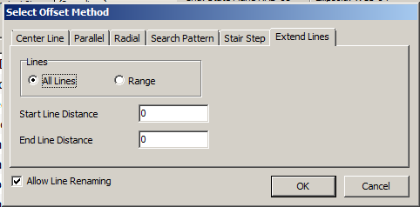
LINE EDITOR: Other Options
Right-click on a line name and you can “Rename”, “Reverse the Order”, “Delete Lines”, or “Add Lines Between Two Selections”.
In the Offsets, you can also extend your lines, or reduce your lines. Go to the “Extend Lines” tab.
Extend Lines now adjusts any channel template information by the adjustment distances.

Slide 26
TARGET EDITOR

Slide 27
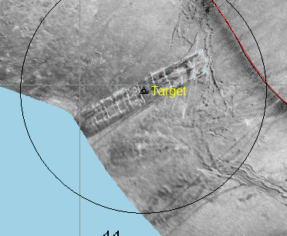
What are Targets?
Targets mark a point of interest
Each HYPACK project maintains a target database. Targets can be created in:
Target Editor
HYPACK SURVEY (F5 or Double Click)
HYSWEEP SURVEY (Double Click)
SIDESCAN SURVEY (Double Click)
SINGLE BEAM EDITOR (SBMAX)
MULTIBEAM EDITOR (MBMAX)
SIDE SCAN MOSAICKING (HYSCAN)
MAGNETOMETER EDITOR (MAGEDIT)
SUB-BOTTOM PROCESSING

Slide 28
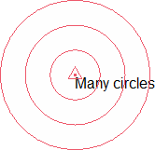
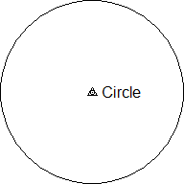
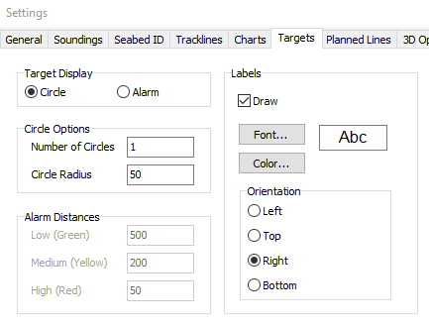
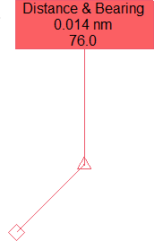
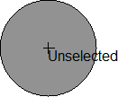
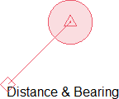
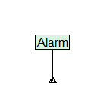
Many display options in SHELL & Survey
Or F9 Settings Menu.
Further target display options such as symbols can be found within the target editor

Slide 29
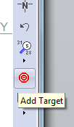
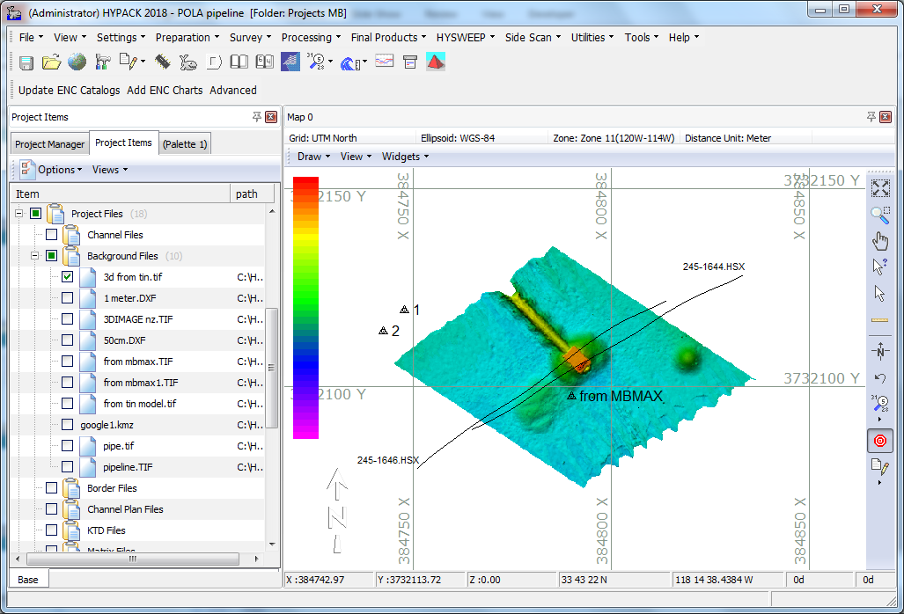
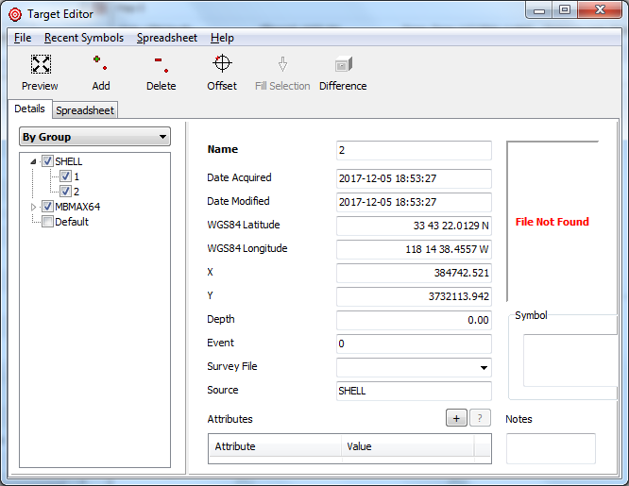
Adding Targets: Cursor Mode
Use the Icon on the Shell screen for Targets, and double click in the map area.
Targets are listed under Targets – Shell.
Name, adjust, add symbol as required
*found in screen tools to right of map window

Slide 30
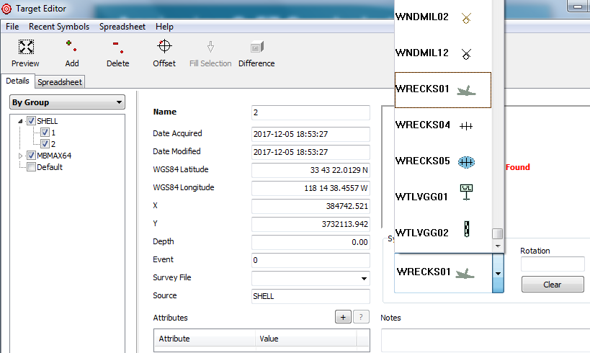
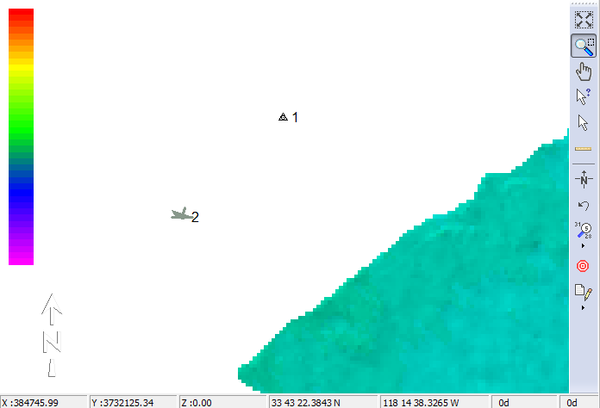
Assigning S-57 Symbols to Targets
In the target editor, Select S-57 Symbol.
Target will now display with selected symbol

Slide 31
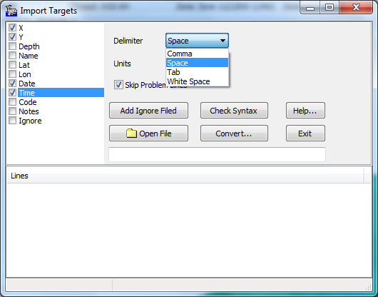
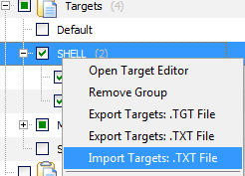
Importing Targets from TXT Files
Text (TXT) files can be imported into the Target Editor.
Under the Target -> select Import Targets
Select delimiter and order for data fields

Slide 32
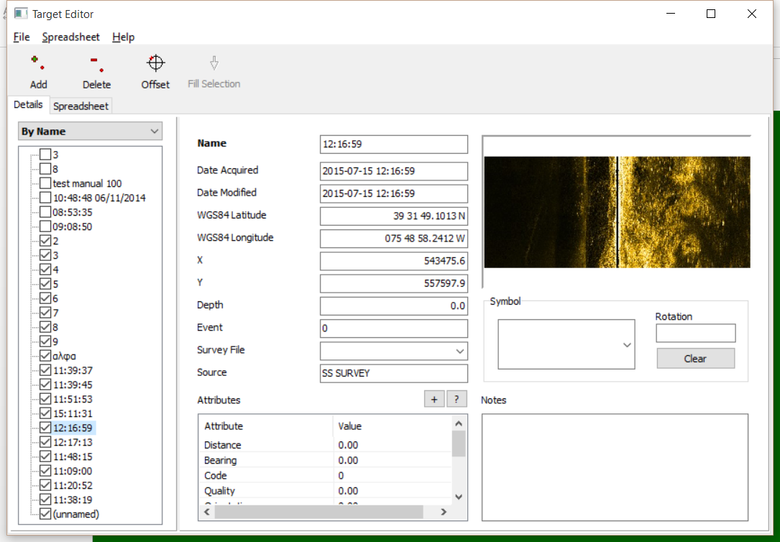
Target Editor – Details View
Manage database
Add metadata
Import / Export
Generate Reports
Change Display Options
Group Targets
By Name
By Date
By Survey Line
By Data Source
Custom Groups

Slide 33
Extensive Metadata Capture
38 data fields and counting
Context-specific metadata
Side Scan
  Imagery captures
  Measurements
Magnetometer
  Gamma statistics
Sub-bottom
  Depth of burial
Name
X
Y
Latitude
Longitude
Date & Time Acquired
Date & Time Modified
Source Program Name
Survey Line Name
Depth
Event Number
Notes
S57 Symbol
Distance
Bearing
Code
Quality
Angle
Sigma
Circle Radius
Number of Circles
Height
Length
Width
Range
Tow Fish Altitude
Tow Fish Heading
Capture File Name
Display Method
Target Class Name
Distance
Time Elapsed
Peak Minimum
Peak Maximum
Peak Spread
Depth of Burial
Enabled in Shell

Slide 34
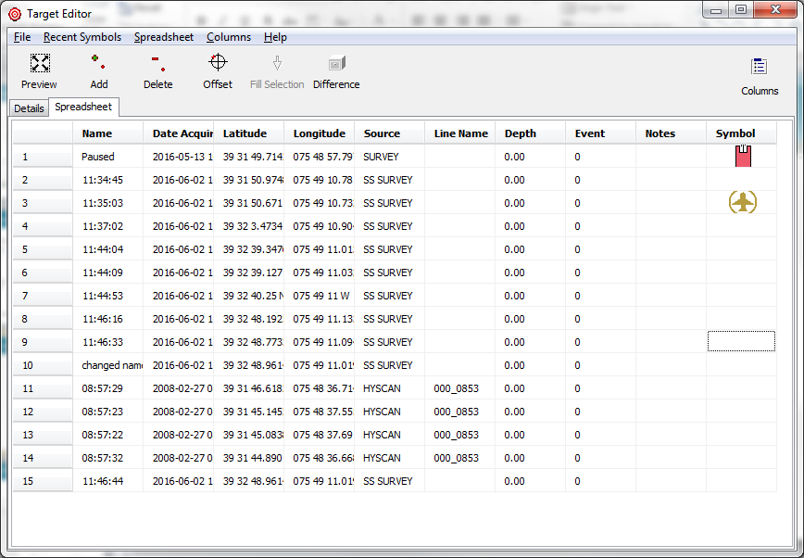

Target Editor – Spreadsheet View
Customize the spreadsheet view
Adjust Visible Columns
Sorting
Batch Editing

Slide 35


Target Editor – Difference Tool
Difference Tool
Compare two target databases to find new or shifted targets.

Slide 36
MATRIX EDITOR

Slide 37

MATRIX EDITOR (*.MTX)
MTX Files Are Created In:
  Matrix Editor
  XYZ TO MTX
MTX Files are Used In:
  HYPACK® SURVEY, HYSWEEP® SURVEY, and DREDGEPACK®: Filled with depth or coverage info.
  MAPPER: Used to reduce multibeam data.
  SURVEY, DREDGEPACK®, SBMAX and HYPLOT: Displayed as backgrounds.
  TIN MODEL Input.
Note: | When creating a MTX file, be sure you specify whether you intend to use it in HYPACK® SURVEY, DREDGEPACK®, or HYSWEEP® SURVEY.

Slide 38


Making a MTX in the MATRIX EDITOR
Rotation Point
Move origin by click-and-drag on corner with circle.
Rotate by click-and-drag on corner opposite circle.
Change length and width by click and drag on other corners.
Note: Matrix settings do not impact final survey data, they are only for display
Enter the desired cell width and height for the matrix as well as matrix type
Origin Point

Slide 39


MTX File Display in HYPACK SURVEY
Accessed by clicking Matrix – Options from the main menu of HYPACK SURVEY
These are the settings if you have a user-defined MTX file that you want to use in HYPACK SURVEY or DREDGEPACK
You cannot mix and match using your own MTX file and using Auto Matrix. Once you select a method, do not change it.

Slide 40



Auto Matrix Display and Setup – Multibeam or Side Scan Mosaic
Accessed by clicking Matrix – Options from the main menu of HYPACK SURVEY
You cannot mix and match using your own MTX file and using Auto Matrix. Once you select a method, do not change it.
These are the settings for the AutoMTX.
MTX files are made automatically as the survey boat moves.
This option is NOT available in DREDGEPACK.
Creates a real time Side Scan Mosaic

Slide 41



Map Window Options
Matrix Appearance window is accessed from Area Map menu.
The AutoMTX display is now always light shaded. You can also exaggerate the vertical (capture on right) to see more detail at the bottom.
You can also switch between displaying the Average Depth, the Number of Depths per Cell, or the Standard Deviation in each cell.
You can have different settings in each Map window.

Slide 42

MTX Displays in HYPACK SURVEY
Each Map Window in SURVEY can have different settings for the MTX Display. You can display Average Depth, Number of Samples, or Standard Deviation as shown above.

Slide 43
BORDER EDITOR

Slide 44


Border Files (*.BRD)
Created:
In the Border Editor.
Used:
LINE EDITOR:
  Clip Lines to BRD
  Make Lines in BRD
HYPACK SHELL:
  Clip XYZ File
TIN MODEL:
  Clip Model to Limit Volumes
CSV:
  Limit Area Computations Using a BRD
HYSCAN:
  Limit mosaic to BRD
Border Editor in Lat/Long
Change between X-Y and Lat-Long from the Edit Menu.
Border Editor in XY

Slide 45

Border: Cursor Entry
Existing Points
Click the ‘Outside’ check box if you want it on the outside of your polygon.
The points can be grabbed with the cursor and repositioned by dragging to the desired location.
New Points can be inserted by clicking on the handle point between two existing points
Mid Point Handles

Slide 46


Trimming XYZ Data Files
Trim an XYZ File by Right-Clicking on it in the Project Items listing.

Slide 47




Trimming in TIN MODEL
Limit your volume calculations to a user-defined area by clipping your TIN MODEL with a BRD file.

Slide 48

Limiting Volumes in CS&V
Using a Border File
You can limit the area computation to the region inside a BRD file in the CSV program

Slide 49




Creating Planned Lines Inside a *.BRD
Create the *.BRD File. Open the Line Editor. Click ‘Lines – Generate Lines in Border’.
Select Border, Set spacing and azimuth to create lines in Line Editor

Slide 50


New Border Area Report and Filled area
Area is reported in the Border File Editor
Border area is filled in 3D Mode

Slide 51


Border Report
Right-click on the BRD file in the Project Files list.
Select ‘Border File Report’
Routine displays the perimeter distance and area of the border file.

Slide 52
BOAT SHAPE EDITOR

Slide 53

Import of DXF Files
Users can make their own shape in the BOAT SHAPE EDITOR or import a DXF shape.
For DXF Shapes:
    Save it to a DXF/Version 12 file.
    DXF Origin (0,0) must be the same as the HYPACK Boat Reference Origin!
Boat shape files are stored in a …\Boat Shapes folder.

Slide 54

Drawing a Vessel
Select Vessel Parameter, anchor points, and interior features.
Use mouse to point and click.
Be certain of reference point (0,0) before drawing
Mouse Entry Mode

Slide 55


2D Shapes in SURVEY
From the Vessel menu – select Display Shape and select from the directory of boat shapes. Select which MAP to apply the drawing.
Shapes can be used on main vessel or mobile.

Slide 56
PLOTTING SHEET EDITOR

Slide 57

PLOTTING SHEET (*.PLT)
Created:
  PLOTTING SHEET EDITOR
Used:
  HYPLOT & HYPLOT MAX: To define the plotting sheet limits.
  CROSS SORT: For sounding selection of single beam data.
  EXPORT TO CAD: Exporting projection tics.
Note: | For foot grids, the scale is in feet/inch, length and width are in inches. For metric grids, the scale is in meters/meter, length and width are in centimeters.

Slide 58

Pre-Defined Sheet Sizes
Pre-defined sheet sizes are available from the Edit menu of the Plotting Sheet Editor.

Slide 59

Making a *.PLT File
Rotation Point
Origin Point
Manually set the ‘scale’.
  Meters/meter for metric grids / Feet/inch for foot grids.
Dragging the sheet corners can optionally:
  Change the scale of the sheet or change the length or width of the sheet.

Slide 60

Plotting Sheet (*.PLT) in HYPLOT
Once in HYPLOT, objects placed on a plotting sheet (title blocks, north arrows, scale bars, etc.) will be associated with the PLT and restored when it is reloaded.

Slide 61
KINEMATIC TIDAL DATUM (KTD) EDITOR

Slide 62


KTD EDITOR
Kinematic Tidal Datum (KTD) Files can be used in RTK TIDES
Can be Accessed by GPS.dll and INS drivers (posmv.dll, sbg.dll, f180.dll, etc.) for computing RTK Tides.
Can contain:
  Separation between reference ellipsoid and chart datum
  (N-K).
  Separation between geoid model and chart datum (-K). (Must use Geoid model for N.)
For more details on RTK TIDES, see the RTK TIDES presentation under ‘Processing SB Data’

Slide 63

Determining (N – K) at a Bench Mark
N-K is determined at all tidal benchmarks.
(N – K) = T1 + A + H + D
where D = 0
If a geoid model is used, then ‘N’ is taken from the geoid model and –K is determined from the test.
(N-K) = -2.5 + 7.1 + (-4.0)
(N-K) = 0.6
H = -4.0
Note: In the USA, ‘K’ value can be determined by using a VDatum model and ‘N’ can be determined from a geoid model.

Slide 64

Wide Area RTK
In our large survey area (right), we have performed the test at four tidal benchmarks.
The (N - K) values at each site are shown.
We will create ‘gridded’
(N – K) values and save them to the KTD file.
The GPS.dll and most INS drivers will determine an (N – K) value, based on the vessel’s position in the grid.
3.85
3.45
3.25
KTD Area
3.40
3.60
3.15
3.10
3.06
3.10
2.79
2.89
2..84

Slide 65

Display of KTD Values
KTD values are now displayed in the HYPACK SHELL as black text inside colored circles.

Slide 66
CHANNEL DESIGN

Slide 67
CHANNEL DESIGN
Left Top of Bank
Left Toe
Right Toe
Right Top of Bank
Centerline
By entering the location of the lines that define your channel:
  Left Toe Line
  Centerline
  Right Toe Line
  Side Slope Info
  Turning Basins
CHANNEL DESIGN computes where each planned line intersects these channel lines and creates a 3-D planned line file.
1
2
3
4
5
Planned Line
1
Plan View
5
2
3
4
Resulting Profile
CHANNEL DESIGN can only handle simple channels.
For more complex geometry, go to ADVANCED CHANNEL DESIGN.

Slide 68

CHANNEL DESIGN: Toe Shift
Toe Shift: Is available in the Left Toe and Right Toe tabs. It raises the toe line by the amount entered.

Slide 69

Top of Bank
You can set the Top of Bank level, relative to the chart datum, for the Left and Right Side Slopes in the “General” tab.

Slide 70

Extensions
You can extend your planned lines and templates beyond the top of bank points. This is not necessary, but some hydrographers like it….

Slide 71




Smart Corners
The “Smart Corners” option will rotate your lines around a turn so they do not intersect. This is VERY important when computing volume quantities. You DO NOT want your planned lines to intersect.

Slide 72
CHANNEL DESIGN: Turning Basins
TB4
The Toe List and Turning Basin list must contain the same points from where the Turning Basin departs from the Toe Line.
In the Left Toe List:
  LT1, LT2, LT3, LT4, LT5, LT6
In the Turning Basin List:
  TB1, TB2, TB3, TB4, TB5
Where:
  LT2 = TB1
  LT5 = TB5
TB3
Left Turning Basin
TB5
LT4
LT5
LT6
LT3
TB2
TB1
LT2
LT1

Slide 73

CHANNEL DESIGN
By entering the geometry of your channel, CHANNEL DESIGN (CD) will generate planned lines that have the cross sectional designs embedded for each line.

Slide 74
CHANNEL DESIGN
What’s Required
Centerline Points
X – Y – Z - Chainage
Left Toe Points
X – Y – Z – Side Slope
General
Top of Bank (L/R) Z-Value
Extension Distance (L/R) beyond TOB
Spacing Between Planned Lines
Naming Scheme
Smart Corners (Y/N)
Right Toe Points
X – Y – Z – Side Slope
Left Turning Basin Points
X – Y – Z – Side Slope
Right Turning Basin Points
X – Y – Z – Side Slope
Saved:
Planned Line File (*.LNW)
Channel Plan File (*.PLN)

Slide 75

CHANNEL DESIGN: Example #1
Centerline Points
1000X 1000Y 25Z CH=0
1000X 2000Y 25Z CH=1000
2000X 3000Y 25Z CH=2414.21
2000X 4000Y 25Z CH=3414.21
Left Toe Points
850X 1000Y SS = 3.0
850X 2062.13Y
1850X 3062.13Y
1850X 4000Y
Right Toe Points
1150X 1000Y SS = 3.0
1150X 2062.13Y
2150X 3062.13Y
2150X 4000Y
With smart corners turned off, all lines are perpendicular to the centerline.
Planned lines that intersect are NOT a good thing when you compute volumes.
General
TOB(L/R) = 0.0
Extension (L/R) = 0.0
Spacing = 50
Name Format = 00+00
Smart Corners = NO

Slide 76

CHANNEL DESIGN: Example #1A
Centerline Points
1000X 1000Y 25Z CH=00+00
1000X 2000Y 25Z
2000X 3000Y 25Z
2000X 4000Y 25Z
Left Toe Points
850X 1000Y SS = 3.0
850X 2062.13Y
1850X 3062.13Y
1850X 4000Y
Right Toe Points
1150X 1000Y SS = 3.0
1150X 2062.13Y
2150X 3062.13Y
2150X 4000Y
With smart corners turned on, lines that would intersect are now proportioned around a turn.
General
TOB(L/R) = 0.0
Extension (L/R) = 0.0
Spacing = 50
Name Format = 00+00
Smart Corners = YES

Slide 77

CHANNEL DESIGN: Example #1B
Centerline Points
1000X 1000Y 25Z CH=00+00
1000X 2000Y 25Z
2000X 3000Y 25Z
2000X 4000Y 25Z
Left Toe Points
850X 1000Y SS = 3.0
850X 2062.13Y
1850X 3062.13Y
1850X 4000Y
Right Toe Points
1150X 1000Y SS = 3.0
1150X 2062.13Y
2150X 3062.13Y
2150X 4000Y
General
TOB(L/R) = -5.0/0.0
Extension (L/R) = 0.0
Spacing = 50
Name Format = 00+00
Smart Corners = Yes
You can determine at what Z-level to terminate each Top of Bank (Left/Right). You can have different levels on the Left and Right sides.

Slide 78

CHANNEL DESIGN : Example #1C
Centerline Points
1000X 1000Y 25Z CH=00+00
1000X 2000Y 25Z
2000X 3000Y 25Z
2000X 4000Y 25Z
Left Toe Points
850X 1000Y SS = 3.0
850X 2062.13Y
1850X 3062.13Y
1850X 4000Y
Right Toe Points
1150X 1000Y SS = 3.0
1150X 2062.13Y
2150X 3062.13Y
2150X 4000Y
The extension distance (Left/Right) creates a flat area extending outward from the Top of Bank point.
This was intended to give the driver more time to get set up on the planned line.
Most people don’t like it and don’t use it.
General
TOB(L/R) = -5.0/0.0
Extension (L/R) = 50.0/50.0
Spacing = 50
Name Format = 00+00
Smart Corners = Yes

Slide 79

Changes in Chainage CD: Example #1D
Centerline Points
1000X 1000Y 25Z CH=0
1000X 2000Y 25Z CH=2000
2000X 3000Y 25Z CH=3414.21
2000X 4000Y 25Z CH=4414.21
Left Toe Points
850X 1000Y SS = 3.0
850X 2062.13Y
1850X 3062.13Y
1850X 4000Y
Right Toe Points
1150X 1000Y SS = 3.0
1150X 2062.13Y
2150X 3062.13Y
2150X 4000Y
General
TOB(L/R) = 0.0
Extension (L/R) = 0.0
Spacing = 50
Name Format = 00+00
Smart Corners = NO
The Chainage at the 2nd waypoint should be 1000, but we have forced it to 2000.
CD makes a line 10+00 and another line 20+00 at the same location.
You can write them both (and confuse your survey crew) or elect to eliminate one of them.
It will have no effect on your volumes.

Slide 80


Changes in Channel Depth
You need to create centerline, left toe, and right toe points at each location where the depth of your channel changes.
To get the best volume result, you should also generate a planned line at each centerline waypoint.

Slide 81

Changes in Channel Depth: Example #1E
Centerline Points
1000X 1000Y 25Z Chainage=0
1000X 1470Y 25Z
1000X 1480Y 20Z
1000X 2000Y 20Z
2000X 3000Y 20Z
2000X 4000Y 20Z
Left Toe Points
850X 1000Y SS = 3.0
850X 1470Y
850X 1480Y
850X 2062.13Y
1850X 3062.13Y
1850X 4000Y
General
TOB(L/R) = -5.0/0.0
Extension (L/R) = 50.0/50.0
Spacing = 50
Name Format = 00+00
Make Profile at each corner = Yes
Smart Corners = Yes
Right Toe Points
1150X 1000Y SS = 3.0
1150X 1470Y
1150X 1480Y
1150X 2062.13Y
2150X 3062.13Y
2150X 4000Y

Slide 82

CD: Example #1F
Program: | CHANNEL DESIGN
Channel Plan File: | CDE.PLN
Save to LNW: | CDE.LNW
Top of Bank (L/R) | -5. / -5.
Line Extension (L/R) | 100. / 100.
Line Spacing | 200
Naming Format | 0+000
Make Profiles at Corners: | Yes
Smart Corners: | Yes
Congratulations! You just made 5,150 lines in 1 minute.
1,342 miles of survey to go…..
You can do the same thing in ADVANCED CHANNEL DESIGN!

Slide 83

CHANNEL DESIGN Function Inside
ADVANCED CHANNEL DESIGN
All functions of CD are being ported to ACD
Before creating planned lines in ACD, you need to convert the PLN data to a 3D channel!
Program: | ADV. CHANNEL DESIGN
File Open (*.PLN) | CDE.PLN
PLN Tab: | Top of Bank: -5. / -5. Extension: 100. / 100. Generate CHN
Centerline Tab: | Spacing: 100 Name Format: 0+000 Add Lines at Centerline: Yes Smart Corners: Yes Generate LNW

Slide 84

Turning Basins
A turning basin is an area to the side of the channel THAT IS AT A DIFFERENT DEPTH than the main channel.
Turning basins must start and end at points that are included in the Left and Right Toe listings.

Slide 85
Example #1-G - Adding a Turning Basin
Left Turning Basin = 20’
850x 1700y
385x 2235y
580x 2680y
1390x 2600y
Side Slope Transition 1:1
Program: | CHANNEL DESIGN
Task: | Add a turning basin
Save to PLN: | DEFTB.PLN
Save to LNW | DEFTB.LNW
Line Extension (L/R) | 0. / 0.
Top of Bank (L/R) | 0. / 0.
Spacing: | 50
Smart Corners: | Yes
Hints:
Step 1: Insert the end points in your Left Toe list.
Step 2: Add the points to a Left Basin list.
Step 3: Generate your planned lines.
Step 4: Save your data.

Slide 86


Example #1-G What it should look like….
1:3 Side Slope on Left and Right Sides
Turning Basin
1:1 Side Slope on Transition into Turning Basin

Slide 87
DXF/DGN to LNW
Importing Polylines from DXF/DGN to 2-D and 3-D LNW Files

Slide 88
What You Need…
Import of 2-D Lines
  DXF File with only planned lines on designated layer.
    Lines must be 2-D.
    Only 2 waypoints per line.
  XY basis of DXF file must be the same as XY projection in HYPACK®.
Import of 3-D Lines (DXF Only)
  DXF file with:
    Planned lines (2D or 3D polylines) on a distinct layer.
    Centerline (3D) on a distinct layer.
    Left Toe Line (3D) on a distinct layer.
    Left Top of Slope (3D) on a distinct layer.
    Right Toe Line (3D) on a distinct layer.
    Right Top of Slope (3D) on a distinct layer.

Slide 89

DXF to LNW: 2-D Example

Slide 90
3-D Rules
3D lines contain the cross section template info.
In your DXF file:
  Create separate polylines on different layers for:
    Planned Lines (2-D)
    Left Top of Bank (3-D)
    Left Toe Line (3-D)
    Centerline (3-D)
    Right Toe Line (3-D)
    Right Top of Bank (3-D)
  Enter depths as positive Z-values for your polylines.
  Planned lines must intersect all channel limits!
The computer calculates the intersection for each point of the channel template.
Planned Line
1
Left TOB
Left Toe
2
3
Centerline
4
Right Toe
Right TOB
5
1
5
2
3
4

Slide 91

3-D Example

Slide 92

Capturing Images in Google Earth
Mark 2 targets (opposite corners) and write down the latitude-longitude (WGS-84), or, copy and paste the Lat/Long in the Name of the Placemark.
It’s recommended to use the “Circle” Placemark shown in the capture.
Click File – Save – Save Image.
Launch the IMAGE GEO-REFERENCE program from the Editors list.
Note: Captured images are Spherical Mercator projection. There will be some distortion when the image is referenced using targets in the user’s projection.

Slide 93

Image Georeference - Information Panel
Name and dimensions of source image
The transformation matrix. Can be edited manually.
If you are importing from Google Earth, then after doing the Transformation, the D and B values should be close to 0. Otherwise, you have screwed up.
Generate the transformation matrix.
Visual display of referenced image on HYPACK screen

Slide 94



Flow Diagram For Image Geo-Reference
Load an un-referenced JPG, BMP or TIF into the IMAGE GEO-REFERENCE EDITOR
Register two or more points
Determine the picture’s scale and orientation.
Save to a GeoTIFF.

Slide 95
Utility Programs

Slide 96
Utility Programs
Calibration Programs
  LATENCY TEST
  ZDA TEST
File Work Programs
  CONTOUR EDITOR
  DATA SPLITTER/JOINER
  MANUAL ENTRY
  MERGE XYZ
  METADATA
  PATHFINDER
  SBET EDITOR
  XYZ MANAGER
Seabed ID Programs
  SEABED ID
  SEABED MAPPER
Dredging Utility Programs
  BUCKETS
  BUCKET REPORT
  CORE LEVELS
  DREDGE REPORT
  DREDGE STATS
  INTERSECTOR
  LNW GENERATOR
Geodesy Programs
  DATUM TRANSFORMATION
  GRID CONVERSION
  GEODETIC LIST CONVERSION
  PROJECT CONVERSION
  TRAVERSE CALCULATION
  UNITS CONVERSION
  Communication Programs
  COM PORT QUERY
  Comtrol’s WCOM32
ADCP Programs
  ADCP PROFILE
  ADCP IN SITU
CHANNEL CONDITION REPORTER
CLOUD
CROSS CHECK STATISTICS
ECHOGRAM
XYZ TO MTX

Slide 97

Latency Test
Used for single beam surveys to determine the time delay between your GPS and your echosounder.
See the presentation under ‘Single beam – HARDWARE Clock Synch’ for details.

Slide 98

ZDA Test
A test that determines the reliability of your $GPZDA and/or 1PPS output for time synchronization.
See the presentation under ‘Single beam – HARDWARE Clock Synch’ for details.

Slide 99

CONTOUR EDITOR

Slide 100


DATA SPLITTER / JOINER
Allows users to split HSX file and generate new lines based on a defined area.

Slide 101


MANUAL ENTRY
MANUAL ENTRY allows you to enter distance and depth pairs and save the data to an ALL format data file.
This can be used to save ‘Tagline’ data to a file so that it can be used in HYPACK.

Slide 102

MERGE XYZ
TOPO data
HYDRO data
Merges hydrographic data and topographic data and saves to Edited ALL format.
Any XYZ topographic point within a user-defined distance of a planned hydro line is assigned to that file. Files are re-sequenced from beginning to end.

Slide 103


METADATA
FGDC Compliant Program
METADATA creates an FDGC compatible metadata file.
You can also create a METADATA file by right-clicking on the XYZ filename in the Data Files List.
Simplified Program

Slide 104


PATHFINDER
User runs the river center, saving position data and processing it to an edited ALL format file in SBMAX.
PATHFINDER will create a planned line that matches the “path” of the edited file using ‘n’ waypoints (10 in this example)

Slide 105


SBET Editor
Image 1: Original (before interpolation).
Image 2: After interpolation
Compares the SBET elevations with the POSMV true heave elevations.
Removes bad data and automatically superimposes the heave motion on the interpolation.

Slide 106

XYZ Manager
Creates a database that contains all of the XYZ data from multiple surveys and outputs an XYZ file that contains the latest soundings for the entire area.
Details can be found in the ‘Utilities - XYZ MANAGER’ presentation.

Slide 107

Seabed ID
SEABED ID is used to process your ROXANN and ECHO PLUS information to create bottom classification polygons and to re-assign classifications to existing data.
Details can be found in the ‘Utilities - XYZ MANAGER’ presentation

Slide 108
Seabed Mapper
SEABED
MAPPER
Program
RAW or EDIT
Data Files
New RAW or EDIT Data
Files with Updated ID
Seabed ID
Square
Used to re-classify seabed ID info using an updated classification diagram (*.SIX)

Slide 109


Bucket Report
Used to create a detailed report for one BKT file at a time. Include statistics and bucket pattern graphic and bar graph for the time and depth of each bucket.

Slide 110

CORE LEVELS
Used to define levels of different materials for input to CSV.
Works only with Chinese 1 AEA 1 Method.
See the presentation under ‘Cross Sections and Volumes – Utility Programs.’

Slide 111

Intersector
Creates a template transition point everywhere a planned line file (*.LNW) intersects a 3-D polyline from a DXF file.
Can also output an X-Y-Z file of the intersection points (LNW vs 3-D DXF)
Details are provided in the CSV presentation.

Slide 112

LNW Generator
Used to create an LNW by fixing a planned line (with template) perpendicular to a user selected DXF-polyline.
Details are in the CSV presentation.

Slide 113

DATUM TRANSFORMATION
Used to compute a 3 or 7-parameter transformation.
Details in Project Geodesy presentation.

Slide 114

GRID CONVERSION
Used to convert from Lat-Long to X-Y and back.
Performs height conversions when using VDatum.
Details in geodesy presentations.

Slide 115

GEODETIC LIST CONVERSION
Converts lists between X-Y and Lat-Long values.

Slide 116

PROJECT CONVERSION
Convert all of the files in a HYPACK® project from one geodetic basis to another geodetic basis.
See Geodesy – Geodetic Tools Presentation for details

Slide 117

TRAVERSE CALCULATION
Computes a traverse on the ellipsoid.
Requires geodetic angles and geodetic distances.
Does not perform any closure computation or adjustment.

Slide 118

COM PORT QUERY
Program used to verify available COM ports for data communication.
Also available from HYPACK® HARDWARE.

Slide 119

ADCP PROFILE
Computes the flow across a river transit.
Combines the ability of the older ADCP PROFILE and ADCP TO DXF programs. Details are in the ‘Utilities – ADCP’ presentation.

Slide 120

ADCP ‘IN SITU’
Used to analyze ADCP data from ‘in situ’ ADCP installations.
Designed to work with internally logged data from:
  SonTek, RDI, Nortek, Rowe

Slide 121

CHANNEL CONDITION REPORTER (CCR)
Determine the ‘controlling depth’ for your channel sections as per NOAA requirements.
Details in CHANNEL CONDITION REPORTER presentation.

Slide 122

CROSS CHECK STATISTICS
Compute z-value difference between regular and cross check lines and generate statistics.

Slide 123


XYZ TO MTX
Automates the creation of filled MTX files from XYZ Data.

Slide 124
Thank You !
Contact Us:
Sales@HYPACK.com
Help@HYPACK.com
(860) 635 - 1500
Links to more information:
HYPACK on Youtube.com ( Historical Sessions ) HYPACK Live Chat
HYPACK on Youtube.com ( Newer Sessions ) HYPACK Ustream
HYPACK SUPPORT Site HYPACK Website

