Slide 1
Geodesy and RTK

Slide 2
Understanding Geodesy

Slide 3

What is Geodesy?

Slide 4
In HYPACK® …
On WGS-84 or NAD-83 projects:
On other projects:
GPS
GPS
SURVEY
Lat-Long on
WGS-84
SURVEY
Lat-Long on
WGS-84
Datum
Transformation
Grid
Conversion
Lat-Long on
Local Datum
X-Y on
Projection
Grid
Conversion
X-Y on
Projection

Slide 5
The Ellipsoid - A mathematical shape that approximates the geoidal surface.
You are here
H
Geoid: An equipotential surface, meaning the pull of gravity measured anywhere on the surface is a constant.
Flattening = (a-b)/a
ɸ = Latitude
a = semi-major axis
b = semi-minor axis

Slide 6
Datums
European Datum 1950
Your datum will usually determine which ellipsoid is to be used.
North American Datum 1927: Clarke 1866 Ellipsoid
North American Datum 1983: GRS 1980 Ellipsoid
UK National Grid: Airy Ellipsoid
Riks Drihoek (Holland): Bessel 1841
Hong Kong 80 Grid: International
Jamaica Old Grid: Clarke 1880 Ellipsoid
International Ellipsoid
Bogota Datum
When an ellipsoid is moved to fit your ‘local’ geoidal conditions, it becomes a “datum”.

Slide 7
Datum Transformation
Converting your position from one datum (usually WGS-84) to a local datum.
WGS-84
Your latitude, longitude and height above ellipsoid varies depending on the datum being used.
The process of going from one datum (WGS-84) to another datum is called a “Datum Transformation”.
Φ
Φ’
European Datum 1950 International Ellipsoid

Slide 8
Datum Transformations
Surveying on WGS-84 Ellipsoid?
YES
No Datum Transformation is Required.
Typical survey of UTM and WGS-84
NO
Surveying on NAD-83
State Plane Coordinate System?
YES
No Datum Transformation is Required.
NO
For a Datum Transformation, you can:
Determine your own parameters.
Use published parameters.
Use a Datum Shift model, if available for your area.
You Need to Do a Datum Transformation!

Slide 9
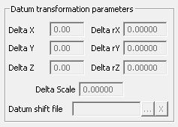
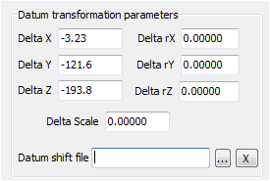
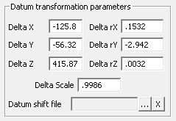
Datum Transformations: Configurations
Don’t do a Datum Transformation
Do a 3-Parameter Datum Transformation
Click here for available models:
Do a 7-Parameter Datum Transformation
Use a National Transformation Model

Slide 10
Projections:
Projection: A 2-D representation of the ellipsoidal surface
1000 kg
B
C
D
A
A’
B’
C’
D’

Slide 11
Typical Projections
Mercator | Transverse Mercator | Oblique Mercator | Lambert Conformal Conic I | Lambert Conformal Conic 2
No distortion along equator. | No distortion along a line of longitude. Good for N-S Areas Basis of UTM | No distortion along selected azimuth. For countries not N-S or E-W | No distortion along a line of latitude. Good for E-W areas. | No distortion along two lines of latitude. A little bit of distortion between the lines.

Slide 12
Project Geodesy

Slide 13
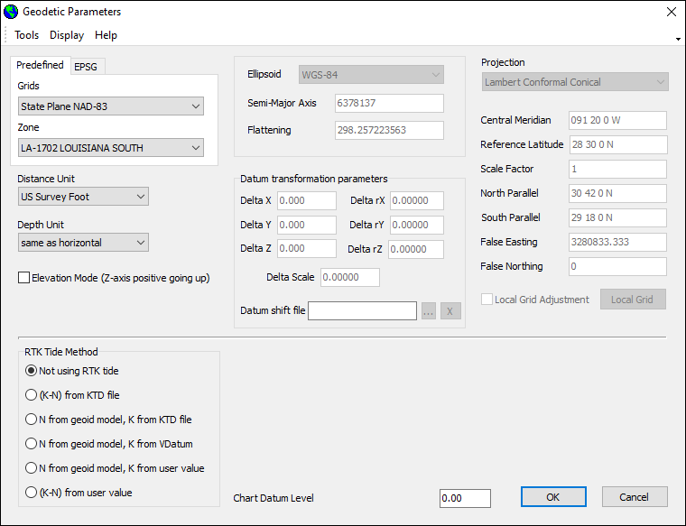
GEODETIC PARAMETERS
Each project has its own geodetic parameters. Details are saved in the project.ini file
Create a new project or copy an existing project
Your new project inherits the geodesy from the previous project.

Slide 14
Starting GEODETIC PARAMETERS
Click the ‘World’ icon.
Or… Click the ‘Preparation – Geodesy’ menu item.

Slide 15
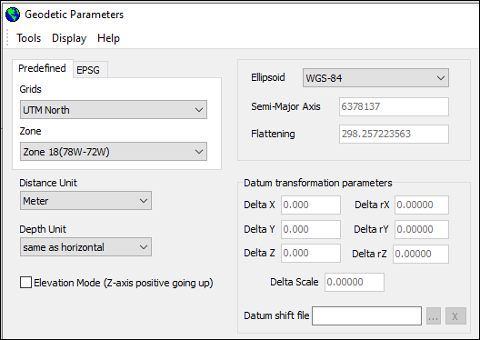
UTM Grid
Grids:
  UTM North for northern hemisphere.
  UTM South for southern hemisphere.
Zone:
  Divided into 6º of longitude.
Ellipsoid:
  If your Ellipsoid is not WGS-84: You need a datum transformation.

Slide 16
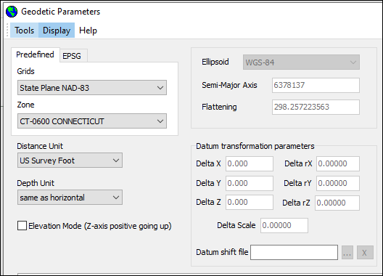
NAD-83 Grids
Grids:
  Select ‘State Plane NAD-83’
Zone:
  Select the appropriate state zone.
Ellipsoid:
  Even though NAD-83 is based upon GRS-80, you will see WGS-84 listed as the ellipsoid.
  This is because the US government treats the two as the same, even though there are slight differences.

Slide 17
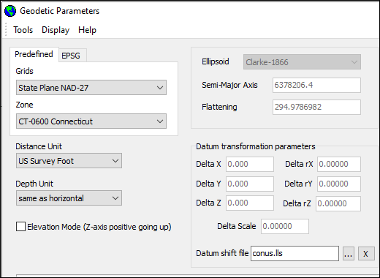
NAD-27 Grids
Grids:
  Select ‘State Plane – NAD-27’
Zone:
  Select your state plane zone.
Ellipsoid:
  Fixed to ‘Clarke-1866’.
  You have to do a Datum Transformation!
  Set the Datum Shift file to CONUS.

Slide 18
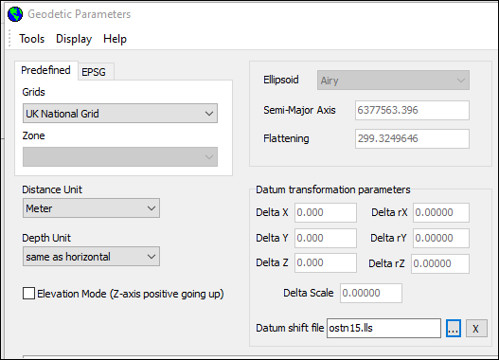
UK National Grid
Grids:
  Set to ‘UK National Grid’
Zones:
  There are no zones!
Ellipsoid:
  Fixed on ‘Airy’.
  You have to do a Datum Transformation.
  Set the Datum Shift file to OSTN15.

Slide 19
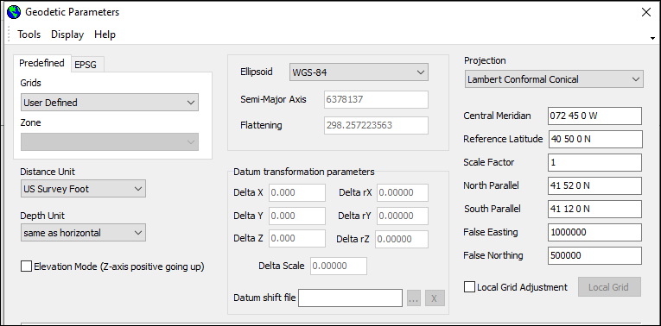
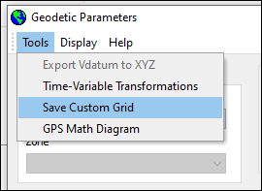
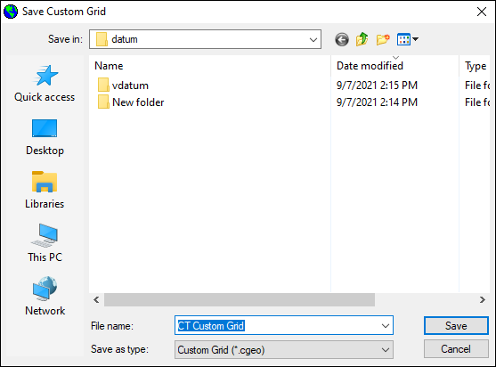
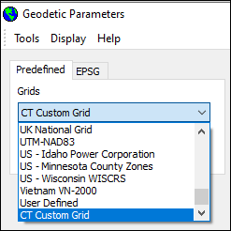
User Defined Projection
Grids:
  Set to ‘User Defined’ (bottom of list).
  This opens up the Projection items.
Projection:
  Select your projection.
  Enter the projection parameters.
Ellipsoid:
  If not WGS-84, do a Datum Transformation.
  Your user-defined projection can now be saved so that it shows up in the drop-down listing.

Slide 20
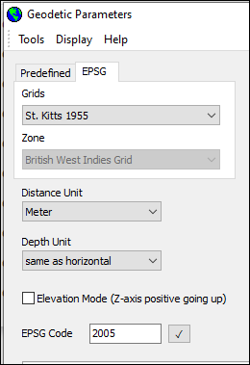
EPSG Codes
Define geodesy using EPSG (European Petroleum Survey Group) Code.
Compound (horizontal and vertical) and vertical codes currently not supported.
Enter EPSG Code or choose from dropdown box.
Supported grids will be loaded from database.

Slide 21
Setting Up a Local Grid

Slide 22
Working on a Local Grid
 | Point 1 | Point 2
UTM X | 562,000.00 | 563,000.00
UTM Y | 3,245,000.00 | 3,246,000.00
Local Grid X | 10,000.00 | 10,940.709
Local Grid Y | 10,000.00 | 11,063.278
You need two points in your area where you know:
X-Y on your Local Grid
X-Y on a normal HYPACK® Project Grid, such as UTM, State Plane, etc.

Slide 23

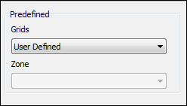

GEODETIC PARAMETERS: Setup for Local Grid
Set GEODETIC PARAMETERS to a Grid/Zone that HYPACK knows about (e.g. UTM).
Next, change the ‘Grids’ entry to “User Defined”.
Click the ‘Local Grid Adjustment’ check box and then the ‘Local Grid’ button.

Slide 24
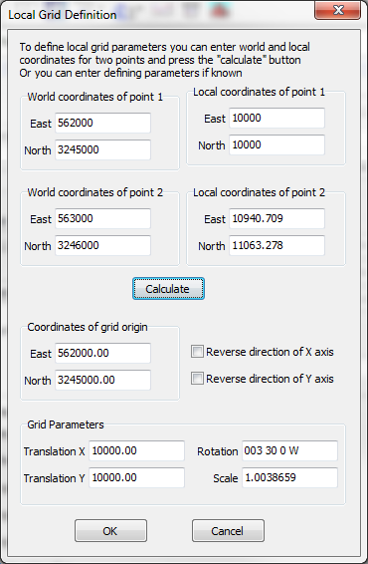
LOCAL GRID: Window
Enter the ‘World’ and ‘Local’ coordinates, select your origin and have the program compute the rotation, translation and scale.

Slide 25
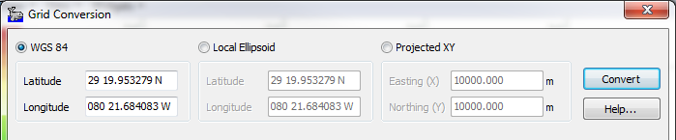
Checking Results in GRID CONVERSION
Point 1
UTM Zone 17.
    X = 562,000.000
    Y = 3,245,000.000
  UTM Lat-Long:
    Lat = N29° 19.953279’
    Lon = W80° 21.684083’
  Local Grid Coordinates
    X = 10,000.000
    Y = 10,000.000

Slide 26
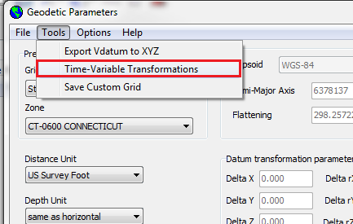
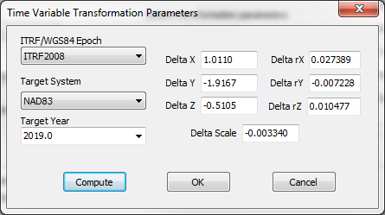
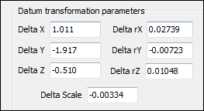
Time Variable Datum Transformations
Due to continental drift, a time-variable datum transformation may be necessary.
HYPACK has models for North America, Europe and Australia available in GEODETIC PARAMETERS.
Go to TOOLS Menu to select transformation option.
  Choose epoch, system and year
  Click COMPUTE!

Slide 27
Real Time Kinematic - RTK

Slide 28
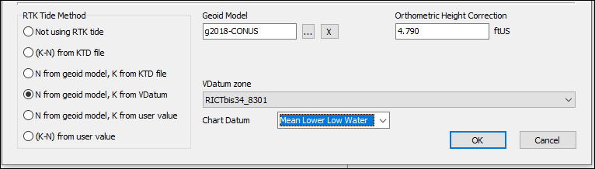
RTK Tide Calculation
  Choose from which source the K and N values are based upon
Geoid Model
Orthometric Height Correction
VDatum Zone and Chart Datum
KTD File
User Value

Slide 29
RTK Tides: Definitions
H
D
WHERE THINGS COME FROM
T’: Height of Water Above Chart Datum
T: HYPACK Tide Correction = -T’
A: From your RTK GPS
H: From HYPACK
HARDWARE offset.
B: From your Echosounder
D: From your Dynamic Draft Entry
N and K:
Method Specified in GEODETIC PARAMETERS.
  (K – N) in KTD File
  N from Geoid Model & K in KTD File
  N from Geoid Model and K from VDATUM (USA)
  N from Geoid Model and K Manually Entered
  (K – N) Manually Entered
T’: Height of Water Level Above Chart Datum
T : HYPACK Tide Correction
= -T’
A: Ellipsoid Height
H: Antenna Height
  Positive is downwards!
  Measured Above Static Waterline when Static Draft = 0.
B: Measured Depth
  Echosounder Calibrated to Static Water Line.
CS: Chart Sounding
D: Dynamic Draft
K: Height of Geoid Above Chart Datum
N: Height of Geoid Above Reference Ellipsoid.
Water Line
Vessel Static Ref.
T’
Geoid Ref. (MSL)
K
Chart Datum
A
B
CS
K-N
N
Ellipsoid Ref.
Bottom

Slide 30
RTK Tides: Basics
Works with:
  GPS.DLL
  F-180
  NOVATEL.DLL
  PHINS.DLL
  POSMV.DLL
  SBG.DLL
  SEAPATH.DLL
Valid when GPS Status is:
  RTK Fixed
Loads Kinematic Tidal Datum file (KTD) if K-N or K varies in survey area.
  KTD File is specified in GEODETIC PARAMETERS.
Note: Remember, tide corrections in HYPACK® are negative if the water line is above the chart datum.
H
D
Water Line
Vessel Static Ref.
T’
Geoid Ref. (MSL)
K
Chart Datum
A
B
CS
K-N
N
Ellipsoid Ref.
Bottom
  Check ‘Tide’ Option in ‘Device Type’ to Activate RTK Tides.

Slide 31
RTK Tides
Height of WGS-84 Ellipsoid Above the Chart Datum:
  = K – N
Height of WGS-84 Ellipsoid Above the Water Line:
  = - A – H - D
Height of Water Line Above Chart Datum:
  T’ = K – N + A + H + D
HYPACK Tide Correction:
  T = N – K – A – H - D
Chart Sounding:
  CS = B + D + T
  CS = B + N – K – A - H
H
D
Water Line
Vessel Static Ref.
T’
Geoid Ref. (MSL)
K
Chart Datum
A
B
CS
K-N
N
Ellipsoid Ref.
Bottom
Note: The Dynamic Draft cancels out in formula for Chart Soundings.
You only need to measure the dynamic draft if you want your RTK Tide to be equivalent to your normal tide correction

Slide 32
RTK Tides: Example
Height of WGS-84 Ellipsoid Above the Chart Datum:
  = K – N = 2 – (-8) = 10.0
Height of WGS-84 Ellipsoid Above the Water Line:
  = - A – H - D
  = -(-2) –(-4) - 0.5 = 5.5
Height of Water Line Above Chart Datum:
  = K – N + A + H + D
  = 2 –(-8) + (-2) + (-4) + .5
  = 4.5
HYPACK Tide Correction:
  T = N – K – A – H – D
  = -8 – 2 –(-2) – (-4) - .5
  = -4.5
Chart Sounding:
CS = B + D + T = 21.0
CS = B – K + N – A – H
= 25 – 2 + (-8) – (-2) – (-4) = 21.0
Ellipsoid Ref.
A = -2.0
N = -8.0
H = -4.0
D = 0.5
Water Line
Vessel Static Ref.
T
Geoid Ref. (MSL)
K = 2.0
Chart Datum
B = 25.0
CS= 21.0
Bottom

Slide 33
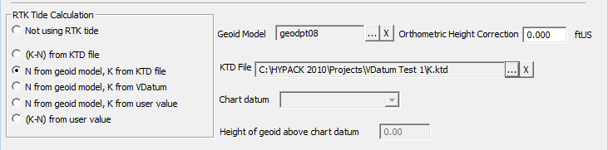
RTK TIDES Configuration Options
Method | N (Geoid Height) | K (Geoid-Chart Datum Separation) | Notes
(K-N) from KTD File | A KTD File is created containing K-N values and is specified in GEODETIC PARAMETERS. |  | No Geoid File is used. Large Areas with Varied Separation
N from Geoid Model, K from KTD File | Geoid Model Selected in GEODETIC PARAMS. | KTD File Contains K Values | Large Areas Where Separation Between CD and Geoid are small.
N from Geoid Model, K from VDatum | Geoid Model Selected in GEODETIC PARAMS. | K Values come from VDATUM | Coastal USA, parts of France. Select Zone and CD in GEODETIC PARAMS.
N from Geoid Model, K from User Value | Geoid Model Selected in GEODETIC PARAMS. | K Value Entered in GEODETIC PARAMS. | Separation Between CD and Geoid is a Constant.
(K – N) from User Value | Manually Enter Height of WGS-84 Ellipsoid Above the CD in GEODETIC PARAMETERS. |  | Separation Between CD and Ellipsoid is a Constant.

Slide 34
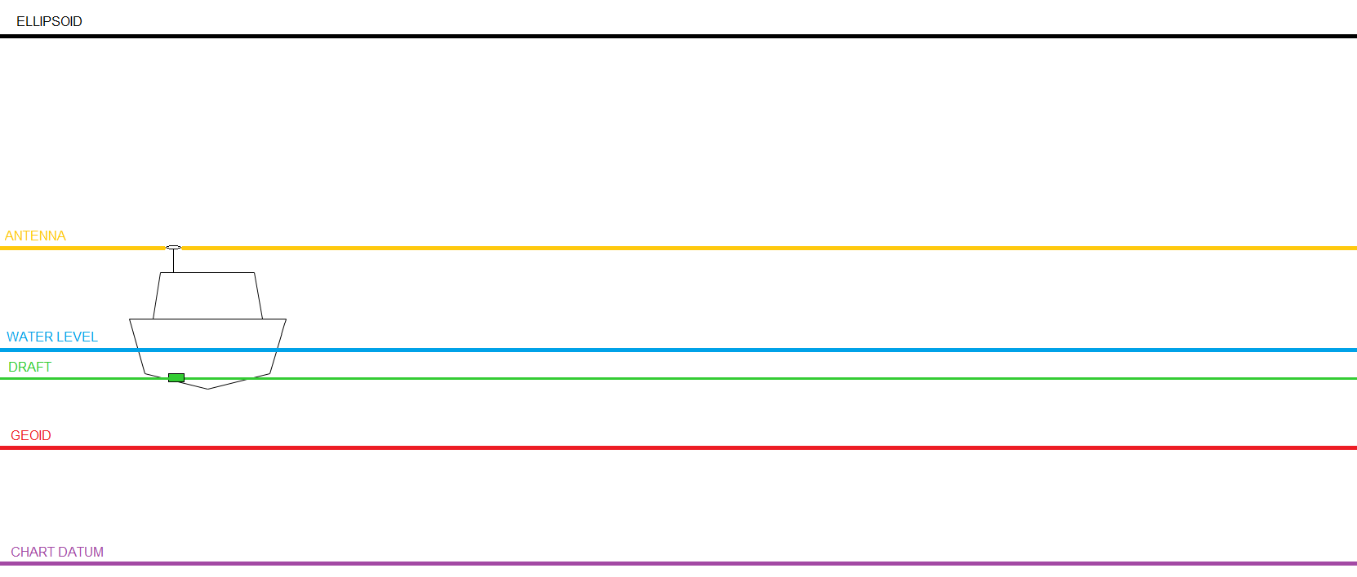
RTK Tides – How it Works
N from Geoid Model, K from VDATUM
N from Geoid Model, K from User Value
N from Geoid Model, K from KTD
(K – N) from KTD File
(K – N) from User Value
All methods, when set up correctly, will achieve the same result.
All methods determine separation between chart datum and ellipsoid.
Measured by GPS
Geoid Model
Geoid Model
Geoid Model
Measured
KTD File
User Defined
????
VDatum
User Defined
KTD File
HYPACK Tide Correction (T) = (N – K) – A – H – D

Slide 35
RTK Tides: (K – N) from KTD File
Height of WGS-84 Ellipsoid Above Chart Datum:
  K - N
Create a KTD File that contains K-N values gridded across your survey area.
In GEODETIC PARAMETERS:
  Select the (K-N) from KTD File
  Enter the name of your KTD File
In HYPACK HARDWARE:
  Make sure the ‘Tide’ option is on.
  Check the ‘Settings’
  Test it near a tidal bench mark!
Water Line
Geoid
K
Chart Datum
N
K-N in KTD File
Ellipsoid Ref.
Bottom

Slide 36
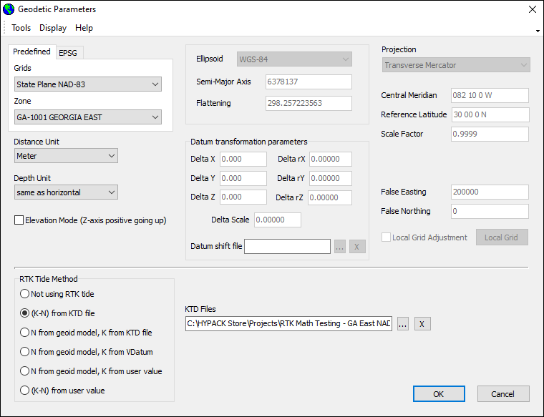
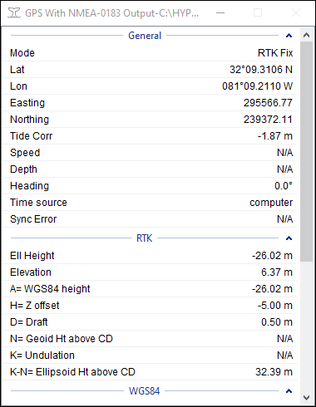
RTK Tides: (K – N) from KTD File - example

Slide 37
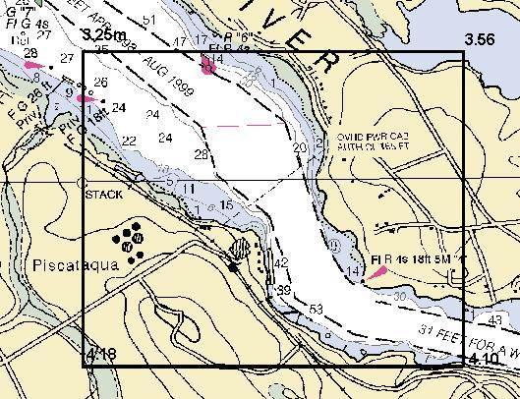
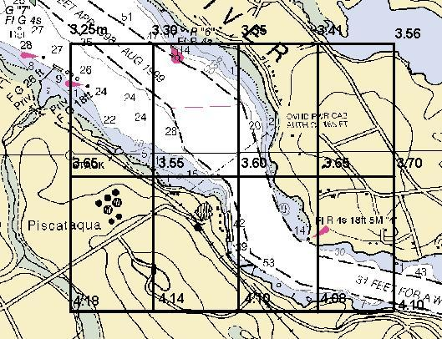
Making a KTD File
Used if separation between layers is not a constant and you are not using VDatum.
KTD file contains:
  K - N values
    Height of Ellipsoid Above Chart Datum.
    Used if No Geoid File Is in Use.
  K values
    Height of Geoid Above Chart Datum
    Used if a Geoid File Is in Use.
KTD Grid: 2 x 2 nodes
KTD Grid: 5 x 3 nodes

Slide 38
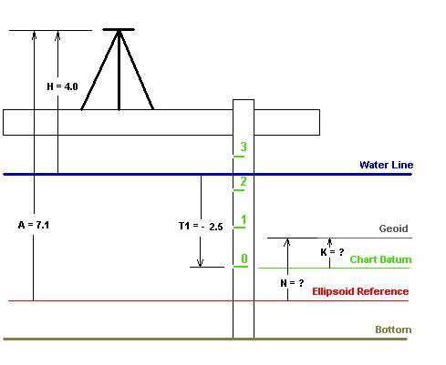
Determining (K - N) at a Point
Set up your RTK GPS Antenna next to the tidal benchmark.
Observe:
H = Height of Antenna Above Waterline
A = Height of RTK Antenna Above Reference Ellipsoid
T1 = Observed Tide Correction
From our Formula:
  T1 = -H –A –K +N - D
  -2.5 = -(-4.0) – 7.1 – K + N - 0
  K - N = -0.6
H = -4.0
Note that in this test, we cannot separate N and K. We could only do this if we had information from the Geoid Model regarding N.

Slide 39
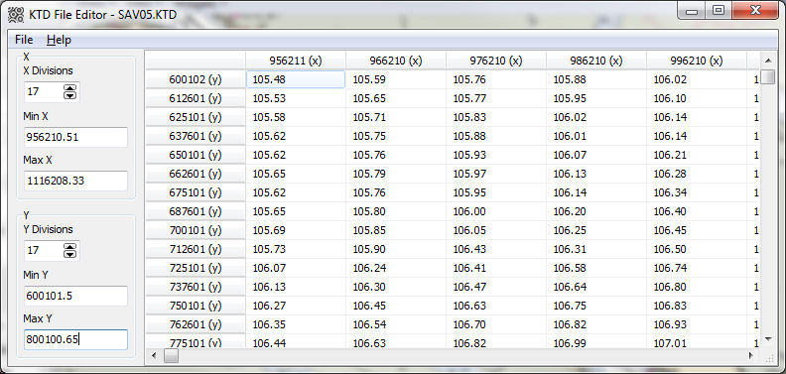
Creating a KTD File
Go to PREPARATION – EDITORS – KTD TIDE EDITOR
Enter number of X and Y grid divisions
Enter Min X and Min Y values
Enter separation values
Save *.ktd file
Enable in Geodetic Parameters
NOTE: You can also create a KTD file in TIN Model

Slide 40
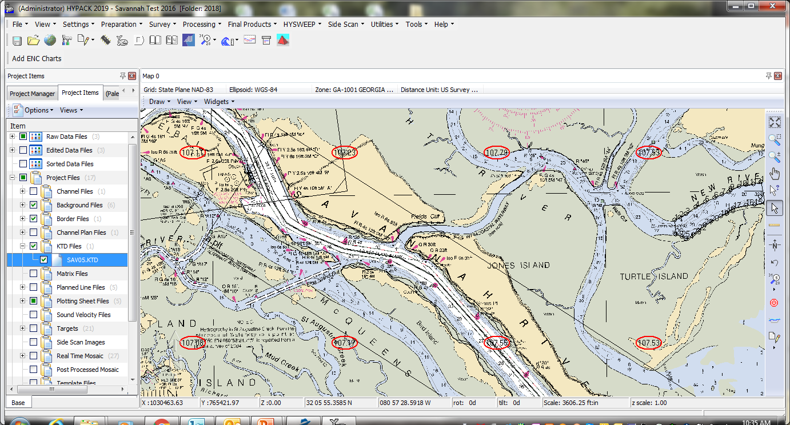
Displaying a KTD File
Enable KTD File in Shell
Change circle color in SETTINGS

Slide 41
RTK Tides: N from Geoid Model, K from KTD
Height of WGS-84 Ellipsoid Above Chart Datum:
  K - N
Create a KTD File that contains K values gridded across your survey area.
In GEODETIC PARAMETERS:
  Select the “N from Geoid Model, K from KTD File” Method.
  Select your Geoid File.
  Enter the name of your KTD File
In HYPACK HARDWARE:
  Make sure the ‘Tide’ option is on.
  Check the ‘Settings’
  Test it near a tidal bench mark!
Water Line
Geoid
K: From KTD File
Chart Datum
N: From Geoid Model
Ellipsoid Ref.
Bottom

Slide 42
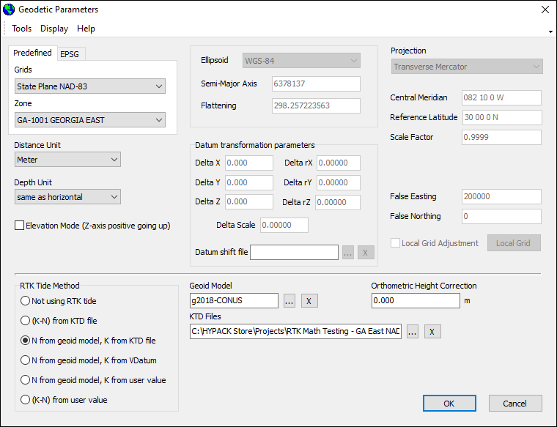
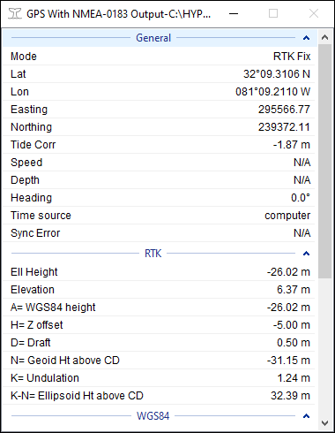
RTK Tides: N from Geoid Model, K from KTD - example

Slide 43
RTK Tides: N from Geoid Model, K from User
Height of WGS-84 Ellipsoid Above Chart Datum:
  K – N
In GEODETIC PARAMETERS:
  Select the “N from Geoid Model, K from User Value” Method
  Select your Geoid Model
  Enter the K value
In HYPACK HARDWARE:
  Make sure the ‘Tide’ option is on.
  Check the ‘Settings’
  Test it near a tidal bench mark!
Water Line
Geoid
K: Manual Entry
Chart Datum
N: From Geoid Model
Ellipsoid Ref.
Bottom

Slide 44
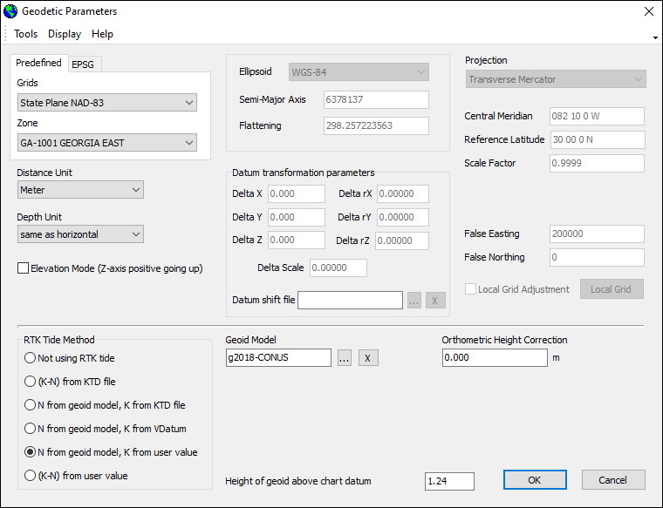
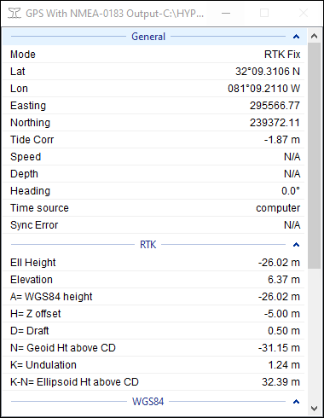
RTK Tides: N from Geoid Model, K from User - example

Slide 45
RTK Tides: (K – N) from User Value
Height of WGS-84 Ellipsoid Above Chart Datum:
  K – N
In GEODETIC PARAMETERS:
  Select “(K-N) from User Value” method.
  Enter the K-N value.
  Do not use a Geoid file.
In HYPACK HARDWARE:
  Make sure the ‘Tide’ option is on.
  Check the ‘Settings’
  Test it near a tidal bench mark!
Water Line
Geoid
K
Chart Datum
N
K – N from User Entry
Ellipsoid Ref.
Bottom

Slide 46
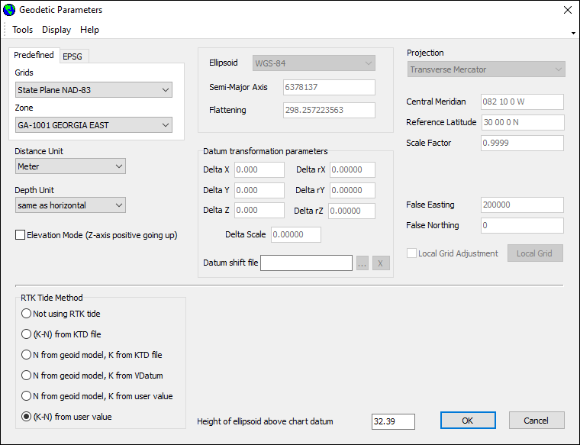
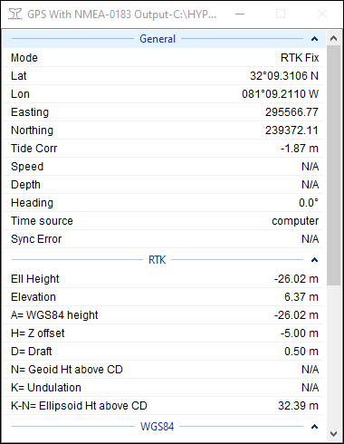
RTK Tides: (K – N) from User Value - example

Slide 47
RTK Tides: N from Geoid Model, K from VDATUM
Height of WGS-84 Ellipsoid Above Chart Datum:
  K – N
In GEODETIC PARAMETERS:
  Select the “N from Geoid Model, K from VDATUM”
  Select your Geoid Model
  Select your VDatum Region
  Select your VDatum Chart Datum
In HYPACK HARDWARE:
  Make sure the ‘Tide’ option is on.
  Check the ‘Settings’.
  Test it near a tidal bench mark!
Water Line
Geoid
K: From VDatum
Chart Datum
N: From Geoid Model
Ellipsoid Ref.
Bottom

Slide 48
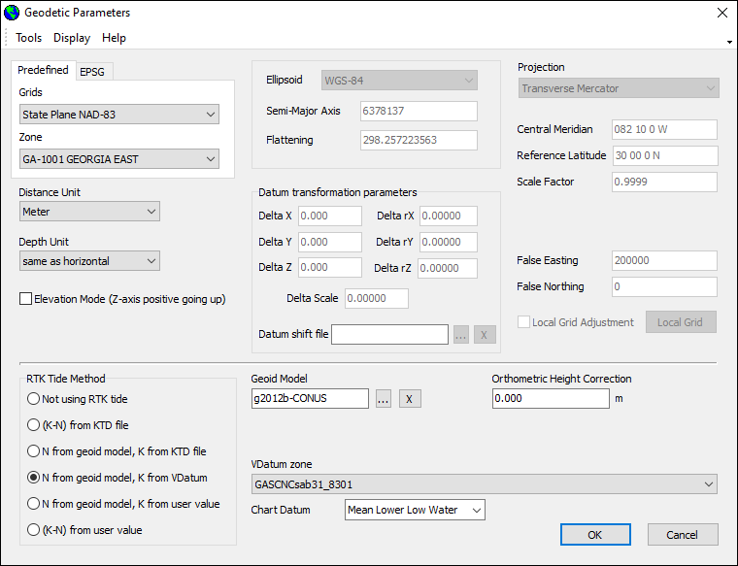
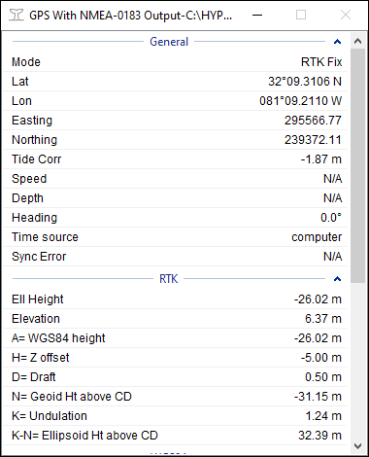
RTK Tides: N from Geoid Model, K from VDATUM - example

Slide 49
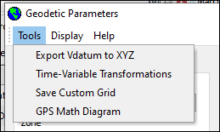
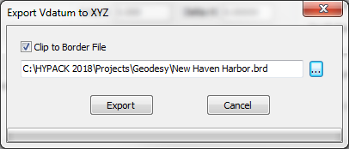
VDATUM to XYZ
Go to GEODETIC PARAMETERS
Setup up your VDatum options
Go to TOOLS – EXPORT VDATUM TO XYZ
Load option border file to limit export area, otherwise entire zone will be exported
Click EXPORT and Save XYZ file

Slide 50
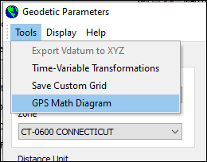
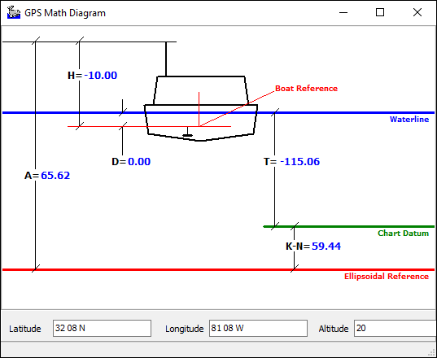
GPS Math Window
Under TOOLS menu
Enter latitude, longitude, height
Antenna height above water and draft read from hardware setup.
Quickly calculates separation and tide correction.

Slide 51
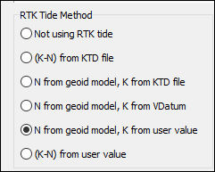
RTK Tides: All methods achieve same result.
(K-N) from KTD
(N) from geoid model
(K) From user value
(N) from geoid model
(K) From VDatum
(N) from geoid model
(K) From KTD fIle
(K-N) from user value

Slide 52
Inside a RAW File
Header
ELL WGS-84 6378137.000 298.257223563
PRO TME -82.166667 0.999900 30.000000 0.000000 0.000000 656166.6670 0.0000
DTM 0.00 0.00 0.00 0.00000 0.00000 0.00000 0.00000
GEO "g2012a-CONUS.geo" -0.012
HVU 0.3048006096 0.3048006096
VDatum GASCNCsab31_8301
VSurface MLLW
TND 13:39:25 01/03/2017 300
DEV 0 33253 "GPS NMEA-0183" 57348 C:\HYPACK 2017\devices\gps.dll 17.0.5.0
OFF 0 0.000000 0.000000 -10.000000 0.000000 0.000000 0.000000 0.000000
PRD 0 KTD "" "GASCNCsab31_8301" "MLLW"
DDT 0 SYN KTC
RAW Records
POS 0 49165.174 973164.010 778430.404 16.886
QUA 0 49165.174 7 5.000 0.700 13.000 4.000 0.000 0.000 0.000
RAW 0 49165.174 4 320816.57260 -810855.32490 -27.40400 124452.00000
TID 0 49165.174 -6.887
KTC 0 49165.174 11 -89.908 -89.908 -102.280 4.515 -10.000 0.000 6.887 0.000 0.000 0.000 3.000
MSG 0 49165.174 $GPGGA,124452.00,3208.165726,N,08108.553249,W,4,13,0.7,4.136,M,-31.540,M,1,0001*61

Slide 53
KTC Record
0 | Device #
49165.174 | Time (seconds past midnight)
11 | # values following
-89.908 | WGS-84 ellipsoidal height at antenna
-89.908 | Local ellipsoid height at antenna
-102.280 | Undulation (N) value
4.515 | K
-10.000 | antenna height from boat ref point (offset)
0.000 | draft
6.887 | tide
0.000 | pitch deg*100
0.000 | roll deg*100
0.000 | heave
3.000 | RTK calculation mode: 0 = none 1 = K-N from KTD file 2 = N from geoid, K from KTD 3 = N from geoid K from VDatum 4 = N from geoid K from user 5 = N-K from user
KTC 0 49165.174 11 -89.908 -89.908 -102.280 4.515 -10.000 0.000 6.887 0.000 0.000 0.000 3.000
  T’ = K – N + A + H + D
  T’ = 4.515 – (-102.280) + (-89.908) + (-10)
  T’ = 6.887 (Tide correction = -6.887)

Slide 54
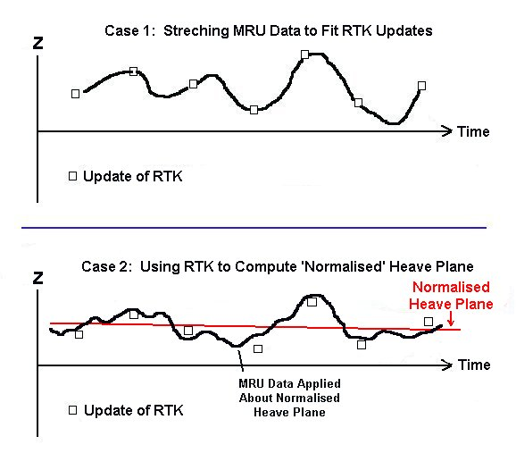
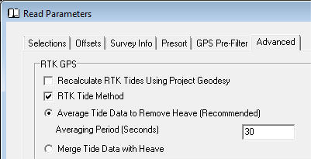
Movement Between RTK Updates
In RTK Tide surveys, you need an MRU to determine the movement of the RTK Antenna between updates.
Average Tide to Remove Heave: RTK z-values are averaged over time to determine ‘Normalized Heave Plane’. MRU data is applied directly to this plane.
Merge Tide Data with Heave: MRU is used to determine movement of antenna between fixed RTK z-values.
The decision on which method to use is made in SBMAX and MBMAX.

Slide 55
Thank You !
Contact Us:
Sales@HYPACK.com
Help@HYPACK.com
(860) 635 - 1500
Links to more information:
HYPACK on Youtube.com ( Historical Sessions ) HYPACK Live Chat
HYPACK on Youtube.com ( Newer Sessions ) HYPACK Ustream
HYPACK SUPPORT Site HYPACK Website

