Slide 1
HYPLOT

Slide 2
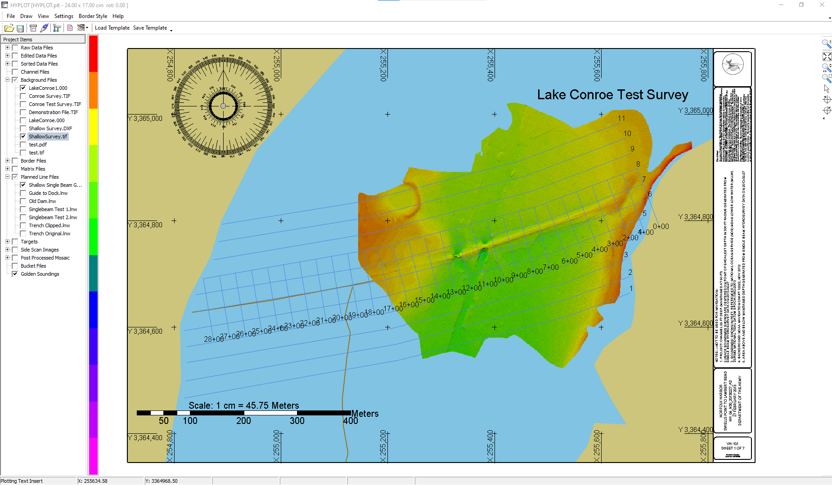
HYPLOT OVERVIEW
Plotting Smooth Sheets: HYPLOT
Interface similar to HYPACK®.
Plots all background files.
Import of Graphics (such as company logo).
Plot text.
Plot Color bar, Compass Rose and Scale Bar.
Preview plot by zooming.
WYSIWYG. (What You See Is What You Get).
Plot to any Windows® based printer/plotter.
User can save sheet settings and apply them to other plotting sheets.
User defined title blocks.
NOTE: | HYPLOT can print your smooth sheets, or save them to PDF or GeoTIF for future printing or sending to clients.
Notes:
2

Slide 3
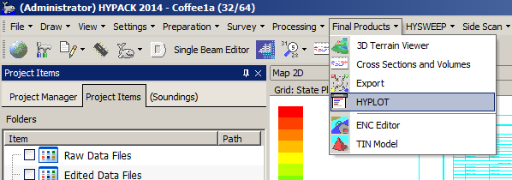
HYPLOT Menu Items
Running HYPLOT
HYPLOT requires a plotting sheet.
Create a plotting sheet. (Preparation – Editors – Plotting Sheet Editor).
  On the Training DVD, See ‘Shell Editors – Plotting Sheet Editor’
Run HYPLOT: Click on Final Products – HYPLOT.
  If there is more than one plotting sheet (*.plt file) in your project, HYPLOT will prompt you to choose one.
  If you do not have a plotting sheet in your project, HYPLOT will exit.
Notes:
3

Slide 4
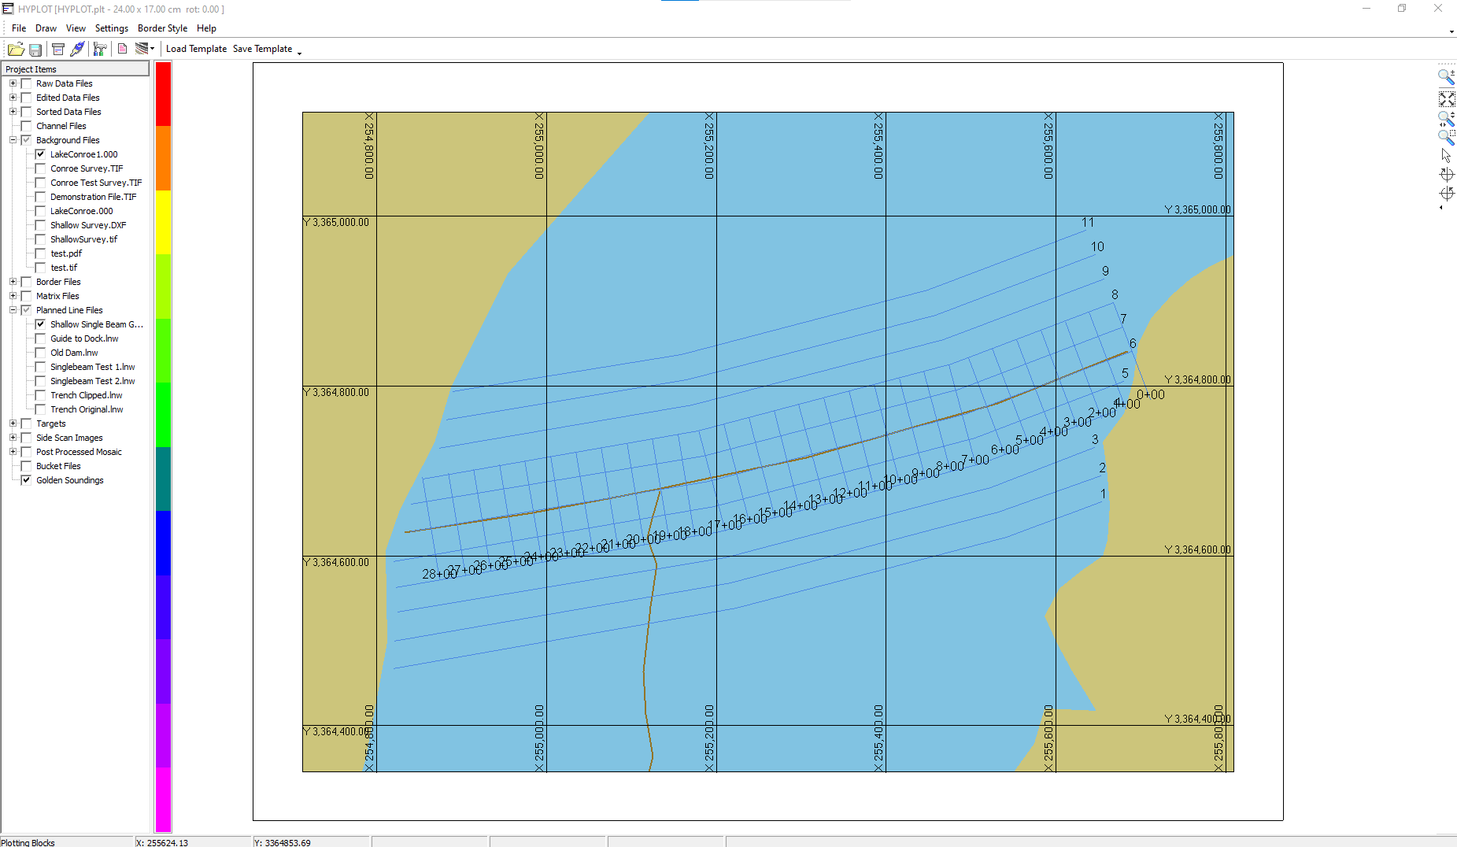
HYPLOT Program Layout
HYPLOT Layout
Menu Bar
Icon Bar
Screen Tools
Files
Info Bar
Preview Screen
Color Bar
Notes:
4

Slide 5

Templates in HYPLOT
Save and Load Template Settings
Save:
  Saves the position and status of all objects (title blocks, rules, graphics, north arrows, etc.) and writes the information to a plotting ‘Template’ file.
Load:
  Allows you to read a plotting ‘Template’ file and apply the settings to any plotting sheet.
Advantage: You don’t have to keep re-designing the same plotting sheet layout. Do it one time and save it to a template file. Then load the template file the next time you create a new plotting sheet.

Slide 6
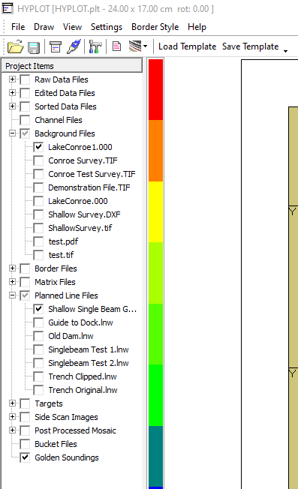
HYPLOT File Selection
Enabling Data and Project Files
Files enabled in the HYPACK® Shell will be enabled in HYPLOT.
Simply right-click to enable or disable your data and project files inside HYPLOT as you would in HYPACK®.
What you see on your preview screen is what will plot.
Notes:
6

Slide 7
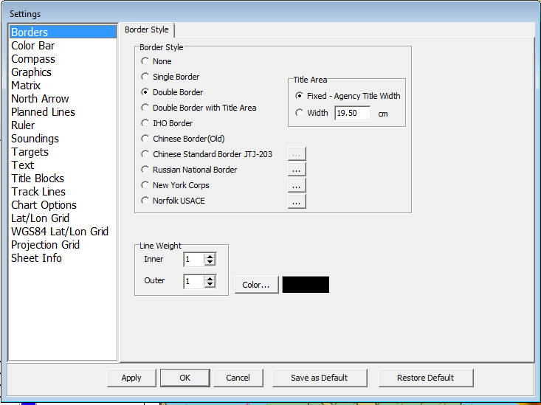
Plotting Sheet Settings
Changing Plotting Parameters
Borders
Color Bar
Compass
Grids
Import of Graphics
Matrix
North Arrow
Planned Lines
Ruler
Soundings
Targets
Text
Title Blocks
Track Lines
Chart Options
Click the Menu Item ‘Settings – Control Panel’ or hit the F9 key to change any of the Plotting Parameter settings.
Notes:
7

Slide 8
Choosing a Border Style
Control Panel - Borders
Choose:
  Border Style
  Line Weight
  Border Color
Note: Some Border Styles already have projection labels. Disable the Project Grid labeling to prevent confusing labels.
Notes:
8

Slide 9
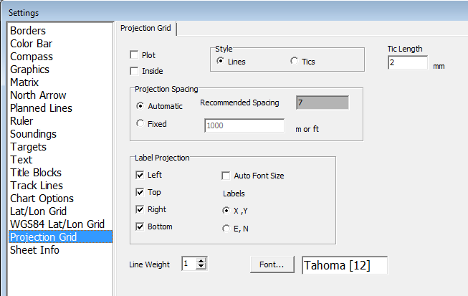
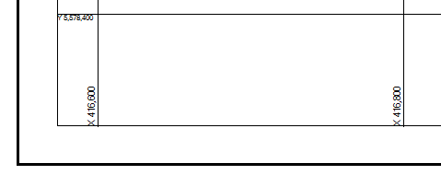
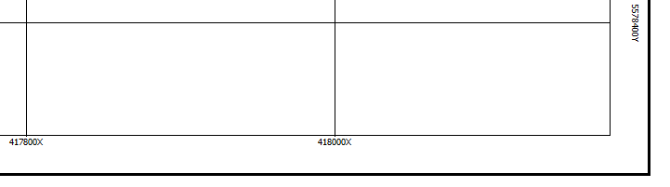
Projection Grid
Control Panel – Projection Grid
Grid Settings
Tics or Lines
Spacing
Line Weight
How labels look
Position
Font
Users can place the projection labels inside the plotting area.
Inside Labels
Outside Labels
Notes:
9

Slide 10
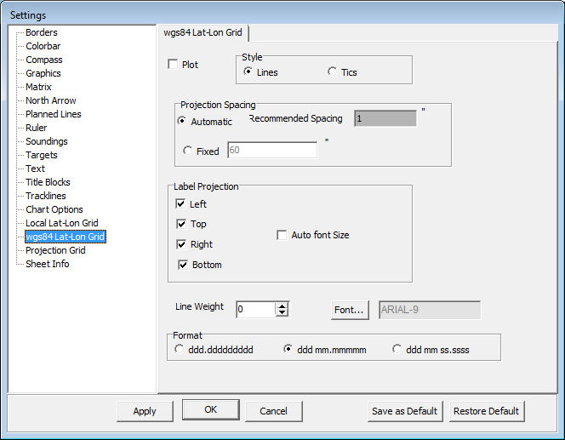
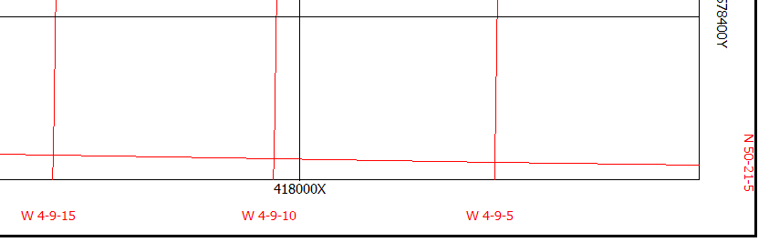
Latitude and Longitude Grid
Latitude Longitude Grids
Separate options for:
  WGS-84
  Local datum
Label Format:
  Ddd.ddddddd
  Ddd mm.mmmmm
  Ddd mm ss.sss
Auto Font Size:
  Proportions label size to fit border.
  Best for multiple grids.
Notes:
10

Slide 11
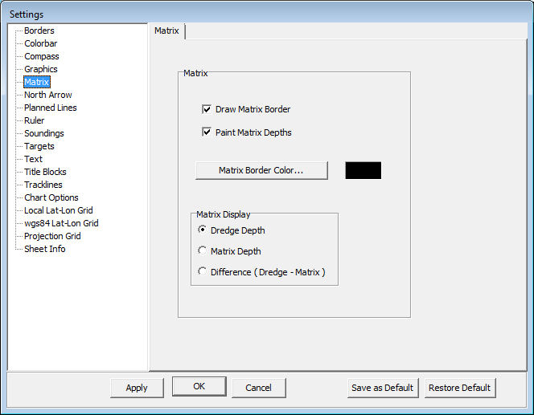
MATRIX Display Options
Control Panel - Matrix
This panel allows you to plot:
  Matrix border
  Matrix depth colors
  Both
You can plot:
  Dredge depth
  Survey depth
  Difference
Notes:
11

Slide 12
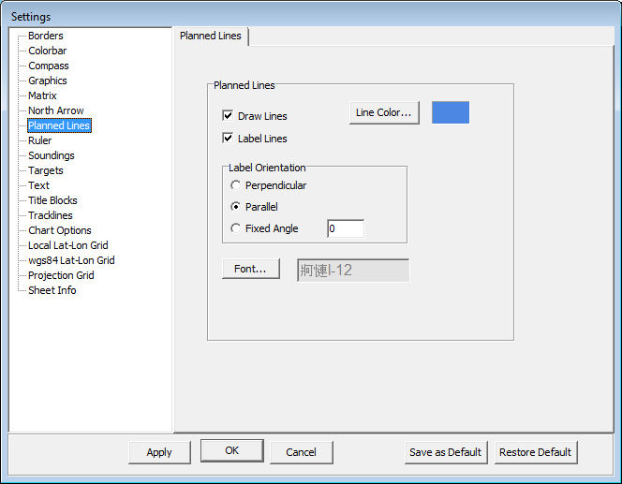
Planned Lines
Control Panel – Planned Lines
Options to:
Draw lines.
Label lines.
Change font and color size.
Notes:
12

Slide 13
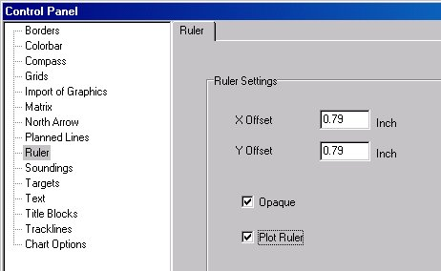

Ruler Item
Control Panel – Ruler (Scale Bar)
The Ruler shows the scale of your plotting sheet.
Notes:
13

Slide 14
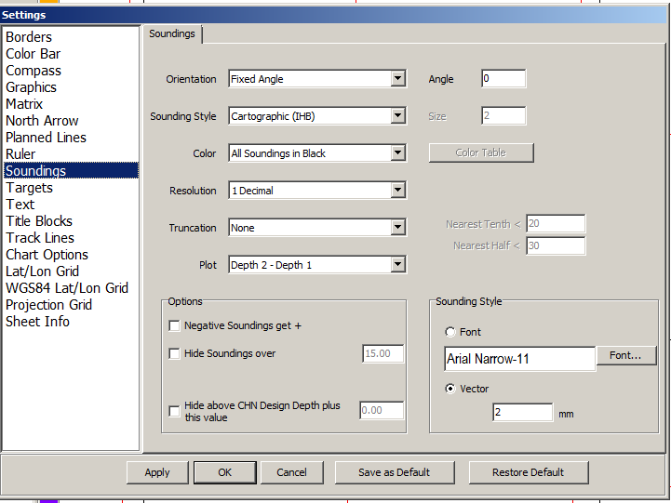
Sounding Display Options
Control Panel - Soundings
The Soundings options in HYPLOT are the same as those in the HYPACK SHELL. The settings are independent from those in the HYPACK SHELL.
Notes:
14

Slide 15
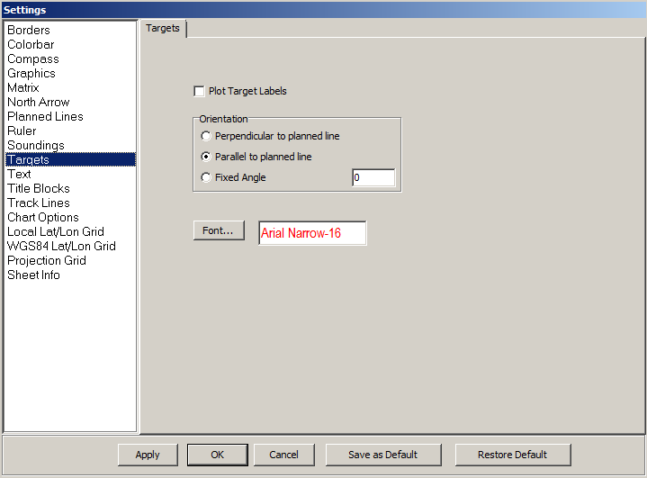
Targets
Control Panel - Targets
These options determine:
  Font
  Size
  Color
Notes:
15

Slide 16
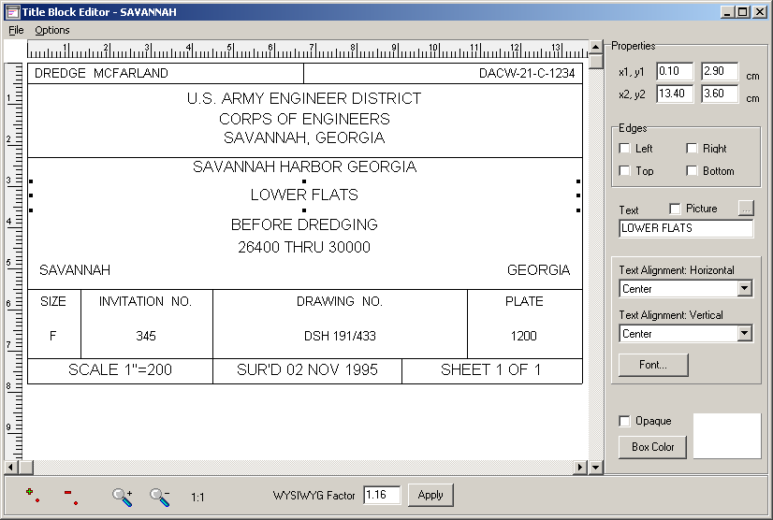
Title Block Editor
Title Block Editor
Create new title blocks or edit existing title blocks
Each title block consists of a series of ‘blocks’ that can contain text or a graphic
‘Snap to Grid’ and ‘Ruler’ aid you in lining up your blocks
The ‘Title Block’ can be saved and applied to any plotting sheet

Slide 17
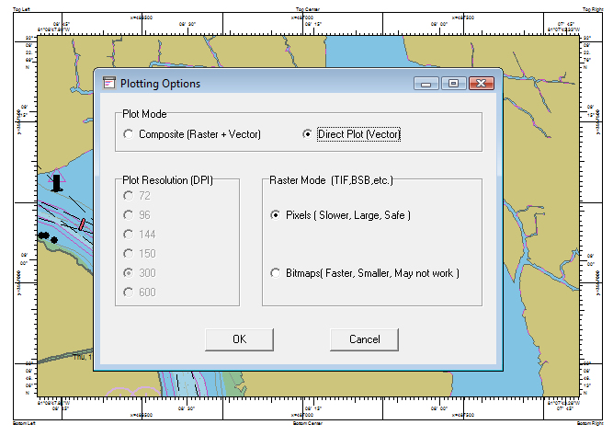
Plotting Options
HYPLOT: Going to the printer/plotter
Default Mode for plots with Raster data (TIF, BSB,…)
Default Mode for plots with no Raster data (S-57 is OK!). Faster!
Set your plot resolution for raster plots (needed if your plotter can’t handle Gigabytes of info…)
We recommend “Direct Plot”. It is a lot faster. Most plotters can handle it.
The more memory onboard your plotter, the quicker the results.
Notes:
09/18/12
17

Slide 18
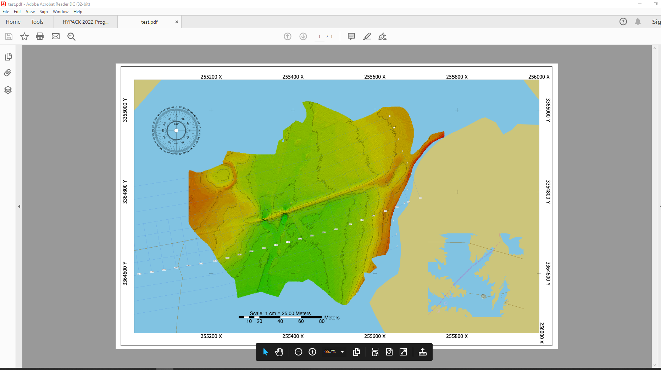
PDF Output

Slide 19
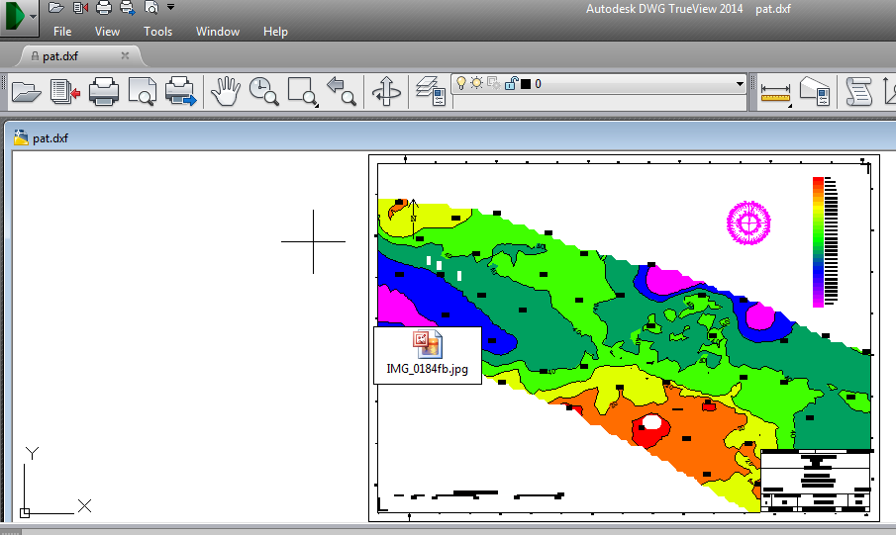
HYPLOT TO DXF
HYPLOT output to DXF viewed in Autodesk DWG TrueView 2014.

Slide 20
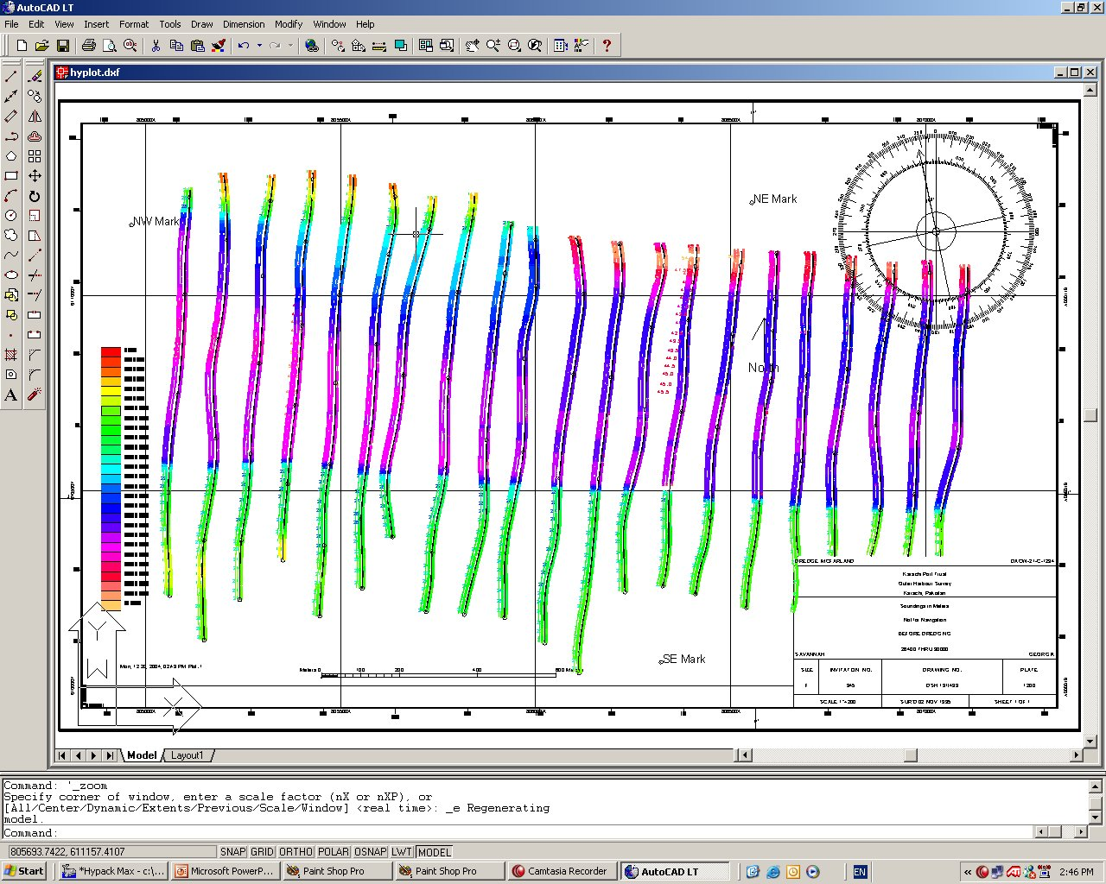
HYPLOT: Export to DXF
Great for:
  Sheet borders
  Lat-Long grids
  Title blocks
  Compass rose
  Color bars
  Rulers
  User-defined text
  Blocks
  User-input graphics
  User-designed title blocks.
Does not convert:
  Some raster and vector background charts.

Slide 21
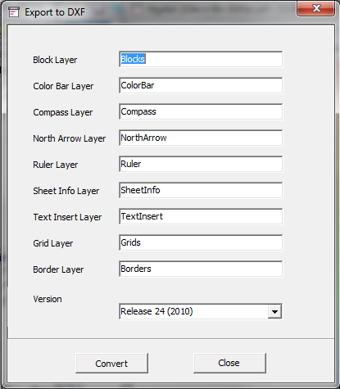
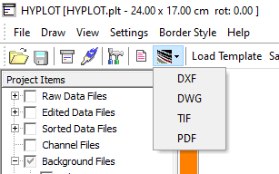
HYPLOT Export Options
Output plotting sheet info to DXF, DGN, DWG, GeoTIF or Geo-Referenced PDF.
Limited DXF options allow only the naming of layers and little else.

Slide 22
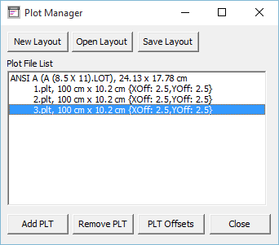
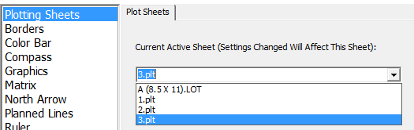
Handling Multiple Plots
Plot Manager is the key new window
  Create or load layouts
  Add or remove PLT files
  Put exact offsets in for PLTs
Active sheets
  Active PLT has a red border
  Settings changed and files activated/deactivated affect the active PLT
  Active PLT changes by clicking on desired sheet, or in the Settings window on the Plotting Sheets Tab

Slide 23
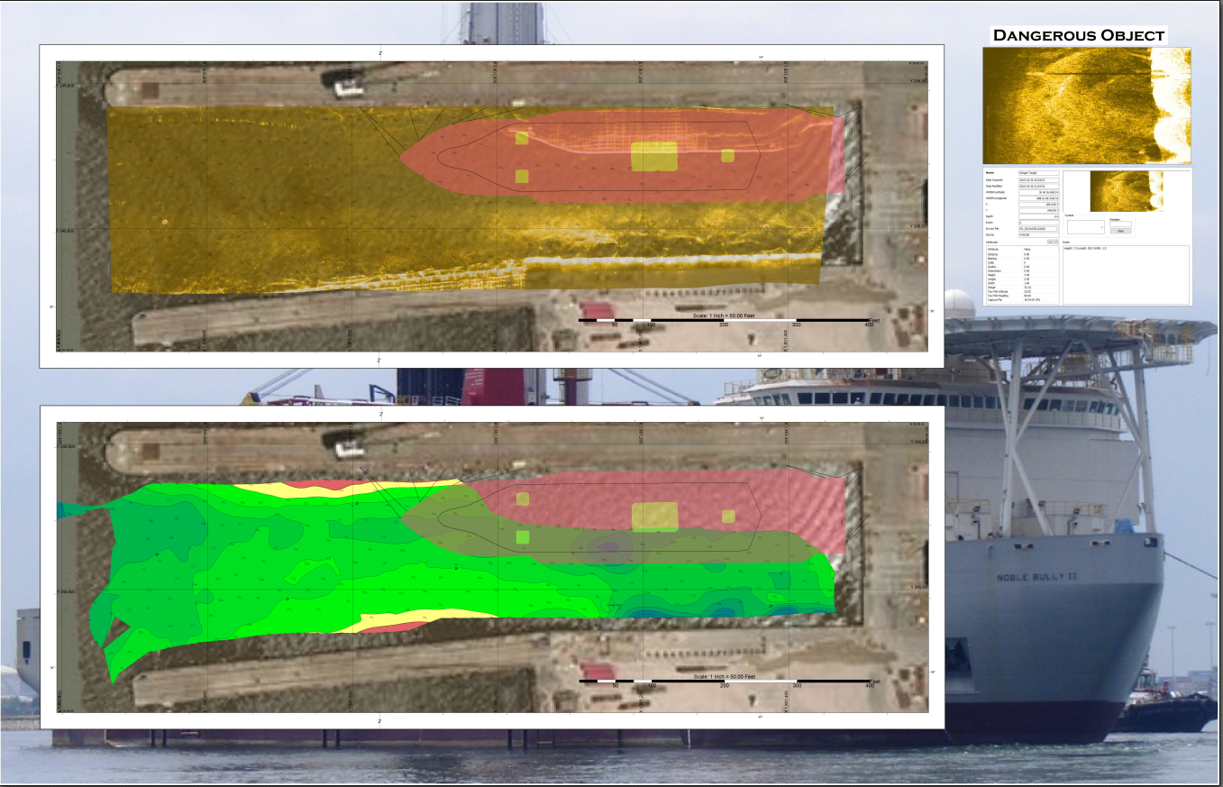
Multi-Sheet HYPLOT
Capable of plotting multiple sheets
Same features as the original HYPLOT
Layout (.LOT) files store paper size and which PLTs are showing

Slide 24
Thank You !
Contact Us:
Sales@HYPACK.com
Help@HYPACK.com
(860) 635 - 1500
Links to more information:
HYPACK on Youtube.com ( Historical Sessions ) HYPACK Live Chat
HYPACK on Youtube.com ( Newer Sessions ) HYPACK Ustream
HYPACK SUPPORT Site HYPACK Website

