Slide 1
FINAL PRODUCTS

Slide 2
Objectives of this session
1
Final Product Wizard
What outputs are available
Configuring the options
2
HYPLOT
Arranging a plotting sheet
3
HYPLOT MAX
4
ENC Editor
Building a chart from scratch
Creating an Overlay
Notes:
Stressed Water Supply
Issue
Maintain the health of traditional water sources and execute a water source diversification strategy
Solution
Xylem’s leading-edge technologies monitor, pump and treat water from all sources and enable water reuse
Aging Infrastructure
Issue
Utilities have to effectively assess and identify high-risk areas for repair/replacement before problems occur
Solution
Xylem’s intelligent pipeline and critical infrastructure services perform condition assessment, identify defective assets, provide bypass services and replacement technologies, reduce or eliminate combined sewer overflows and leaks/non-revenue water
Stormwater & Flooding
Issue
Significant increase in severe weather patterns is causing flooding and related damages to communities
Solution
Xylem’s flood management solutions include sensors for early warnings, dewatering for disaster response, communications for recovery and submersible pumping for resilient infrastructure
Regulatory Compliance
Issue
Utilities must successfully comply with a growing body of compliance regulations
Solution
Xylem’s analytics and sensors evaluate a broad range of water quality parameters, and our technologies treat water and wastewater to meet regulatory standards
Non-Revenue Water
Issue
Utilities have an important opportunity to reduce persistent and costly water losses from leaks and faulty meter readings
Solution
Xylem’s broad portfolio of solutions monitors for, and identifies, water leaks, as well as faulty meters. Our communications network enables point-to-multipoint communications throughout the system
Operating Strategy Reducing Costs
Issue
Utilities want to lower operating and energy costs, and leverage new revenue opportunities
Solution
Xylem offers industry-leading pumping and treatment solutions for energy efficiency, and software-enabled solutions to optimize operations and identify revenue opportunities

Slide 3
Final Product Wizard
Notes:
3

Slide 4
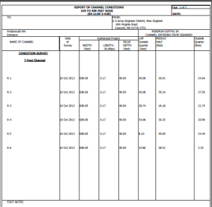
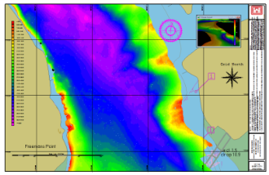
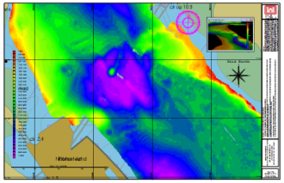
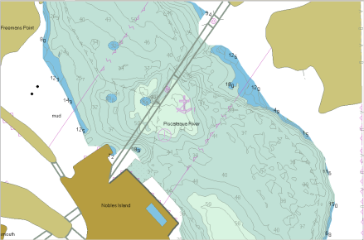
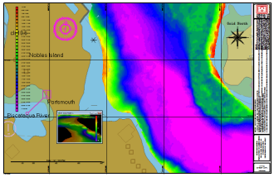
Final Product Wizard Flow
CHANNEL CONDITION REPORT:
Design File
XYZ
.Log
Edited Data
HYPLOT
PLTs, with or without PLT Templates)
Pre-Defined Process
SORT DATA:
SORT
CROSS SORT
SB SELECTION
MAPPER
No Sort
Contour Data:
Yes
No
PDFs
CHANNEL CONDITION
REPORT in PDF
GeoTIFFs
DXF
DWG
ENC EDITOR
S-57 Depth Overlay

Slide 5
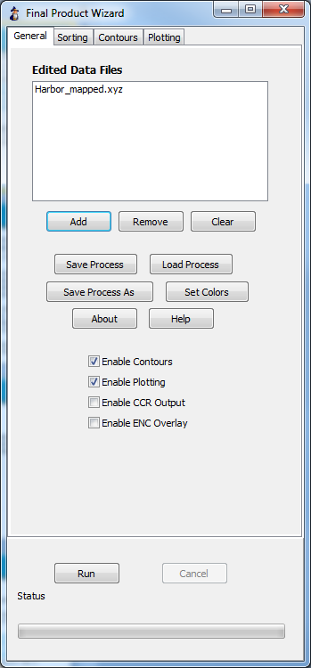
General Tab
General Tab
Select your Edited Data files
Load a Process, or Save your Process
Check the color palette for soundings
Enable the different routines in the Process:
Enable Contours (TIN MODEL)
Enable Plotting (HYPLOT)
Enable CCR Output (Channel Condition Report)
Enable ENC Overlay (ENC EDITOR)
CHANNEL CONDITION REPORTER: Requires the name of the *.RPT file (CCR Design File) created in ADVANCED CHANNEL DESIGN.

Slide 6
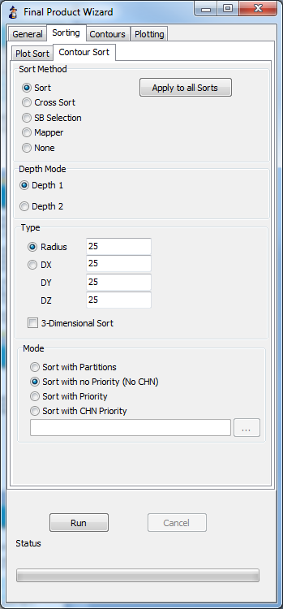
Sorting Tab
Sorting Tab
Select different Sorting routines for sounding selection (Plot Sort) and for Contouring (Contour Sort).
  SORT: For minimum (depth) or maximum (elevation) soundings
  CROSS SORT: For random soundings, typically for a dredge plot. Single Beam only!
  SB SELECTION: For depths at a uniform distance or the minimum/maximum inflection points with depths inserted in between. Single Beam Only!
  MAPPER: A binning program that saves one depth per matrix cell.

Slide 7
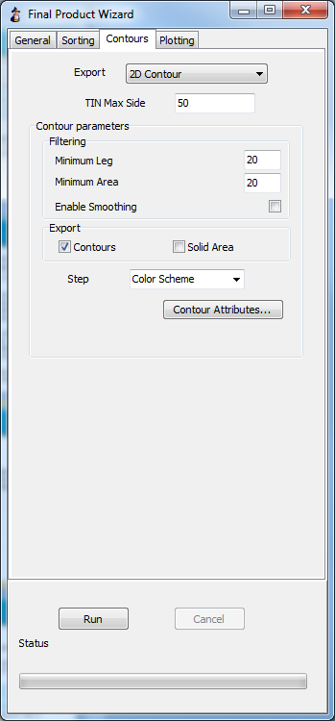
Contours Tab
Contours Tab
Export
  2D Contour (Default)
  3D Contour
  3D TIN
  2D Contour AutoCAD 2002 (Use for CAD/GIS that cannot handle complex polygons)
  3D Contour AutoCAD 2002 (Use for CAD/GIS that cannot handle complex polygons)
Minimum Leg:
  Minimum distance between contour vertices.
  Bigger the value, the rounder your contours.
Minimum Area
  Removes contour polygons with surface area less than value.
Enable Smoothing:
  Rounds out sharp edges.
  Deactivates Minimum Leg.

Slide 8
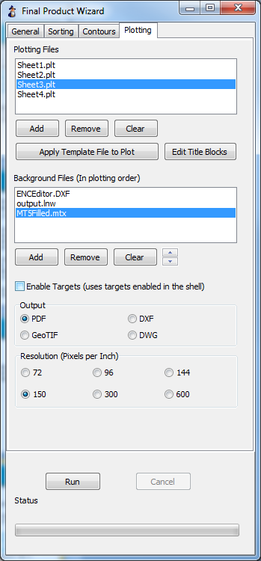
Plotting Tab
Plotting Tab
Select all of the plotting sheets you want to generate
Each plotting sheet can have its own HYPLOT Template file (*.hyt) associated with it
The HYT file contains all of the plotting objects (scale bars, color bars, north arrows, title blocks, etc) for each sheet
You can edit the title blocks in each sheet
You can also select the background files to include in your plot
Output:
  Geo-referenced PDF
  GeoTIFF
  DXF
  DWG

Slide 9
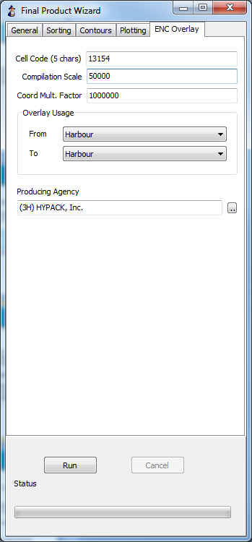
ENC Overlay Tab
ENC Overlay Tab
FINAL PRODUCT WIZARD will create an ENC Overlay that has only spot soundings and contours (if contours has been selected as a part of your process)
Set the 5-character Cell Code
Select a Compilation Scale
Enter the Coordinate Multiplication Factor
Define the “Usage”
Select the Producing Agency

Slide 10
Generating Plotting Sheets
Generating Plotting Sheets
Add one Plotting Sheet (*.PLT) or multiple plotting sheets.
Apply a Plotting Sheet Template File (*.HYT) to one PLT or to several PLTs.
Select your Background Files you want included.
PDF or GeoTIFF output with user-defined resolution. DXF or DWG vector output.
Generating Plotting Sheets is optional!

Slide 11
NEW HYPLOT – Presented in another session

Slide 12
ENC Editor

Slide 13
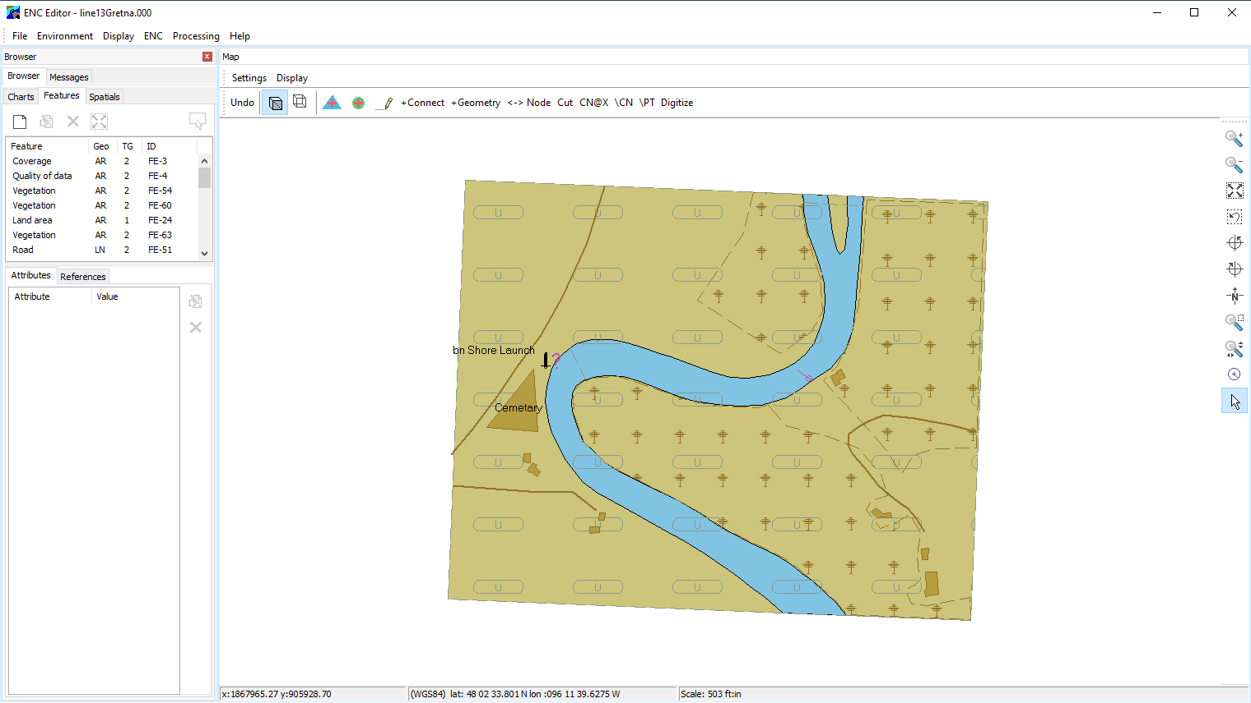
ENC Editor Summary
The ENC EDITOR allows you to:
    Modify existing S-57 Charts
    Create new S-57 Charts
    Create sounding overlays for S-57
    Validate S-57 Charts
    Digitize GeoTIFFs to S-57
    Export S-57 to DXF
    Perform real time verification
    Pilot Planning

Slide 14
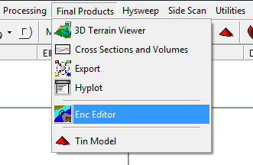
Launching ENC Editor
ENC EDITOR is used to create and/or modify electronic charts in S-57 format
Located under the ‘Final Products’ menu
ENC EDITOR reads the GEODETIC PARAMETERS for the current project
Your S-57 data is always saved in WGS-84
HYPACK performs a datum transformation (if needed) and a grid conversion to correctly display the S-57 chart on any projection
You cannot read S-63 (encrypted S-57 files) in the ENC EDITOR. This is due to copyright restrictions.

Slide 15
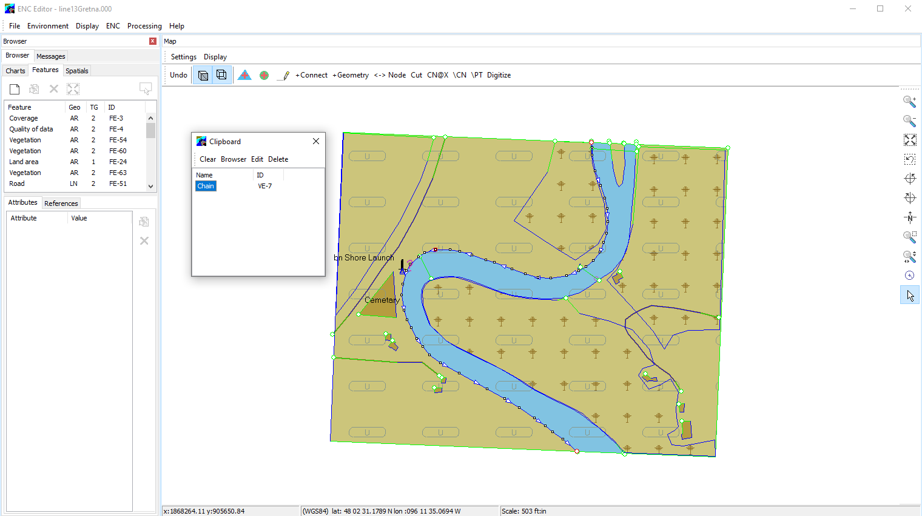
ENC Editor Layout
Object
Manager
Window
- Charts
- Features
- Spatials
Clipboard
Map
Display
Window

Slide 16

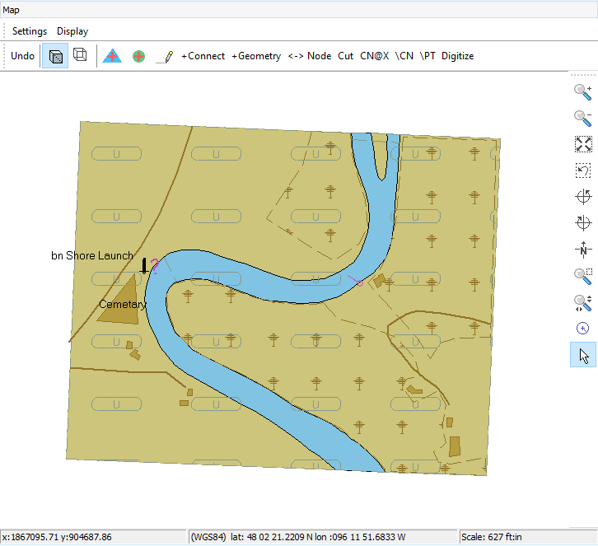
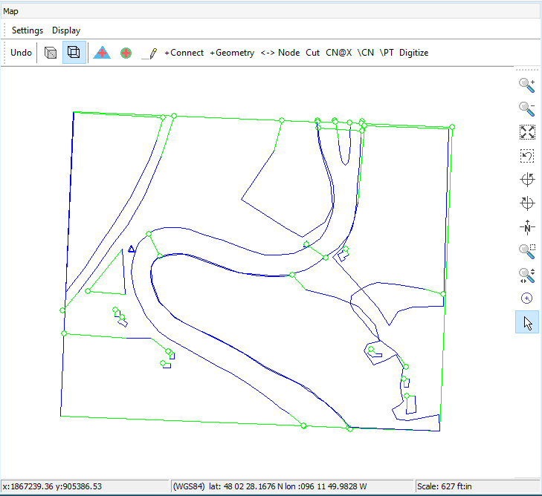
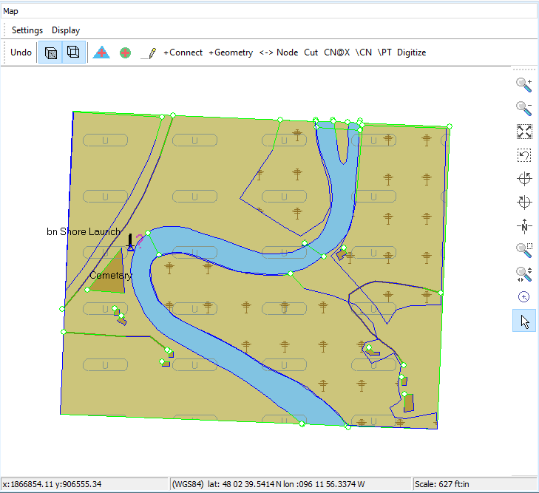
Chart Views
There are three different ways to view the map
Display Chart
Display Geometry
Display Chart and Geometry

