Slide 1
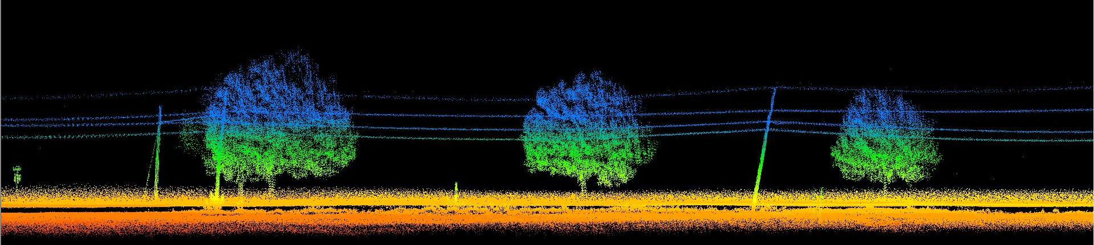
HYPACK Unmanned

Slide 2
Objectives of this session
1
2
Intro to Unmanned Systems
What are the categories of Autonomous Vessels
How does HYPACK fit in?
Surveying with an UMS
Payloads and Interfaces for Unmanned Systems
Notes:
Stressed Water Supply
Issue
Maintain the health of traditional water sources and execute a water source diversification strategy
Solution
Xylem’s leading-edge technologies monitor, pump and treat water from all sources and enable water reuse
Aging Infrastructure
Issue
Utilities have to effectively assess and identify high-risk areas for repair/replacement before problems occur
Solution
Xylem’s intelligent pipeline and critical infrastructure services perform condition assessment, identify defective assets, provide bypass services and replacement technologies, reduce or eliminate combined sewer overflows and leaks/non-revenue water
Stormwater & Flooding
Issue
Significant increase in severe weather patterns is causing flooding and related damages to communities
Solution
Xylem’s flood management solutions include sensors for early warnings, dewatering for disaster response, communications for recovery and submersible pumping for resilient infrastructure
Regulatory Compliance
Issue
Utilities must successfully comply with a growing body of compliance regulations
Solution
Xylem’s analytics and sensors evaluate a broad range of water quality parameters, and our technologies treat water and wastewater to meet regulatory standards
Non-Revenue Water
Issue
Utilities have an important opportunity to reduce persistent and costly water losses from leaks and faulty meter readings
Solution
Xylem’s broad portfolio of solutions monitors for, and identifies, water leaks, as well as faulty meters. Our communications network enables point-to-multipoint communications throughout the system
Operating Strategy Reducing Costs
Issue
Utilities want to lower operating and energy costs, and leverage new revenue opportunities
Solution
Xylem offers industry-leading pumping and treatment solutions for energy efficiency, and software-enabled solutions to optimize operations and identify revenue opportunities

Slide 3
Introduction to Unmanned Systems

Slide 4
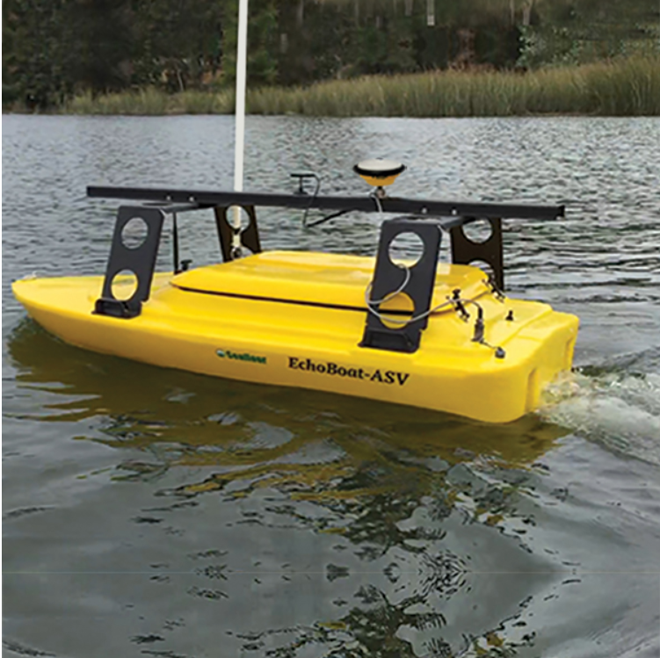
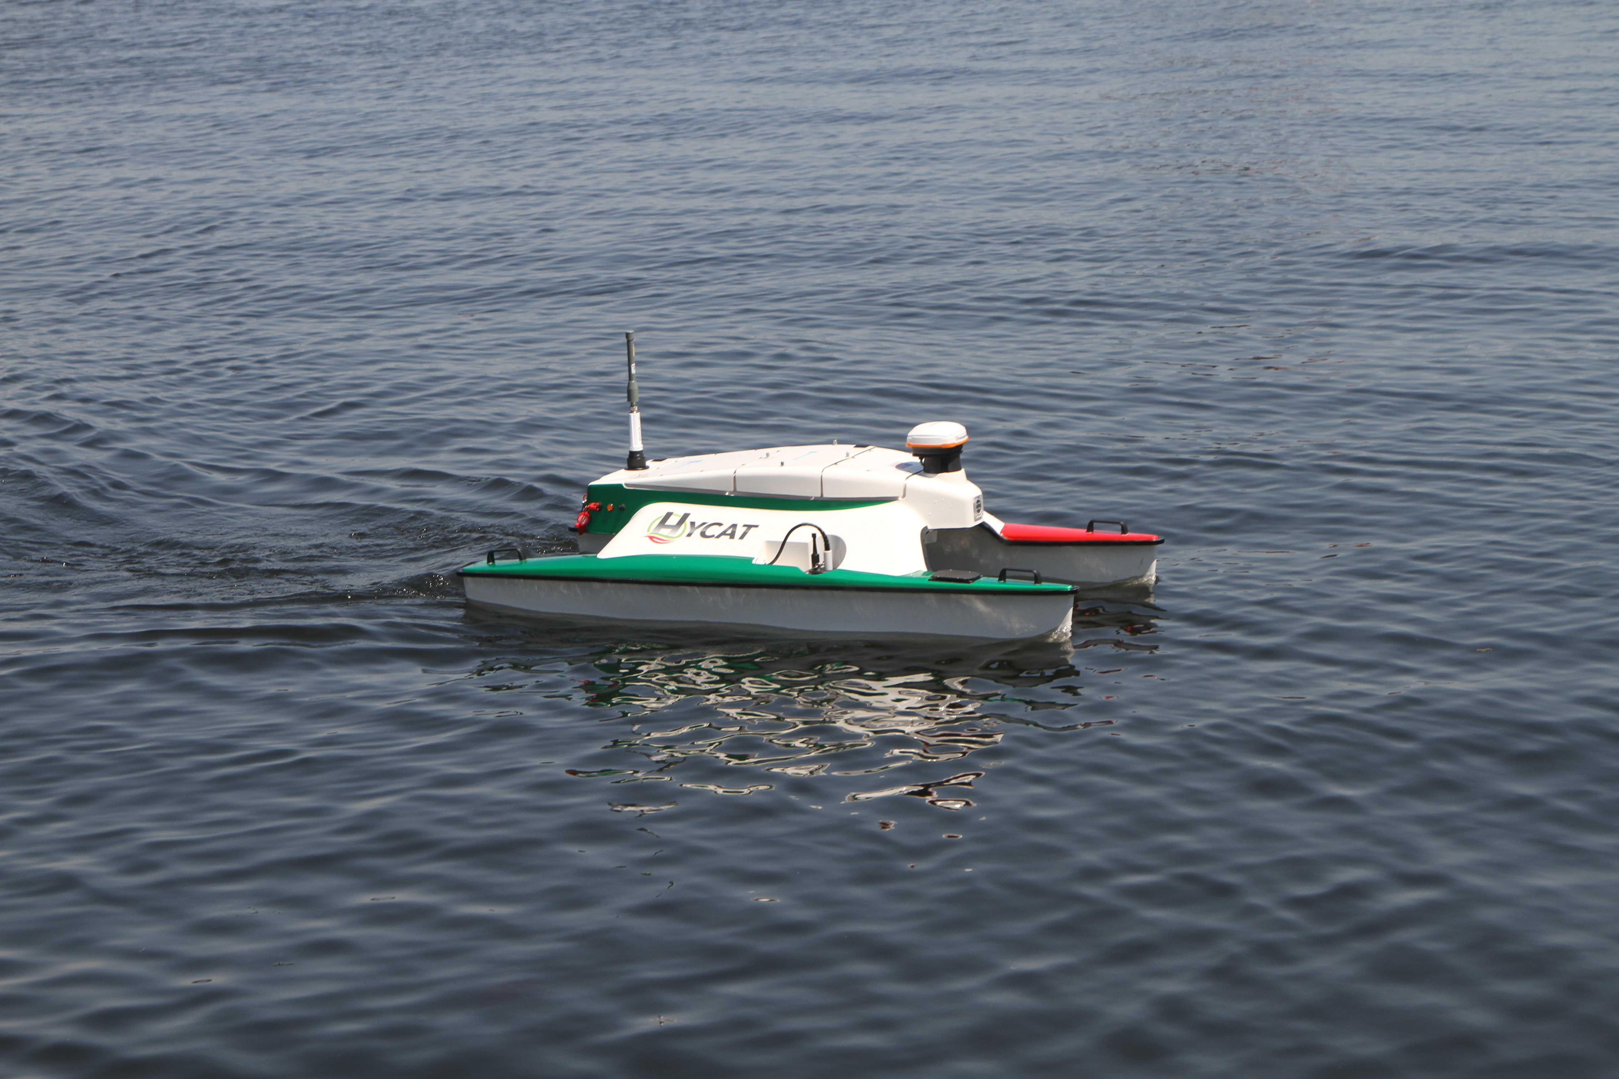
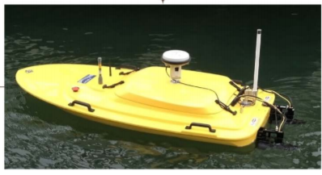
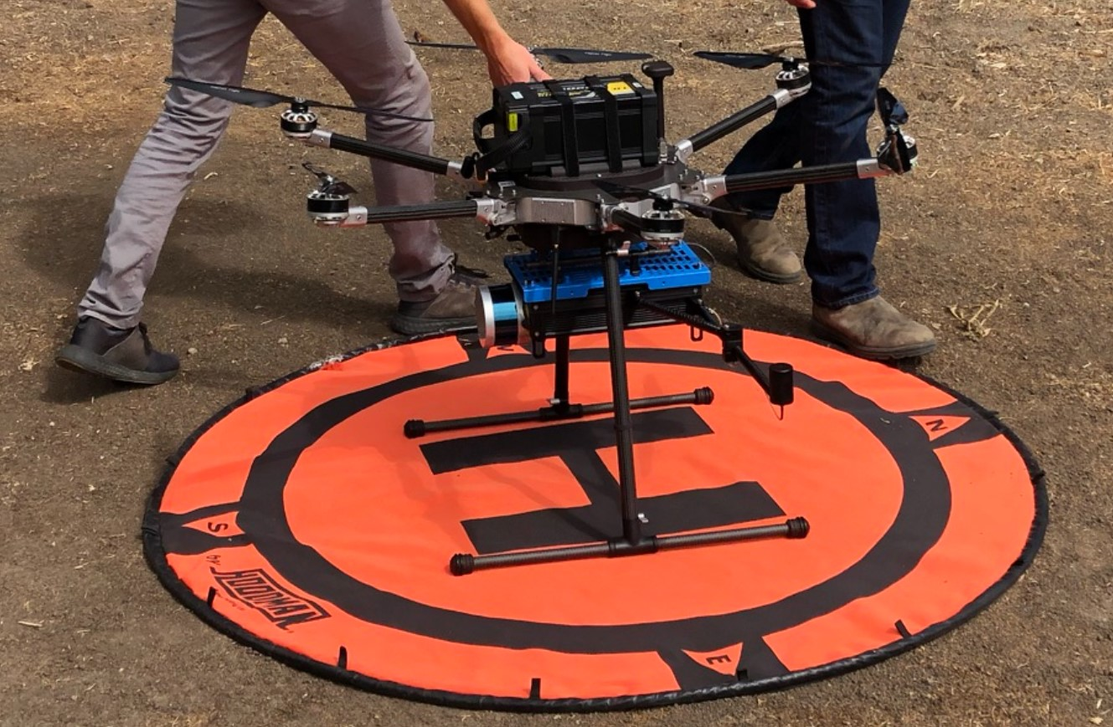
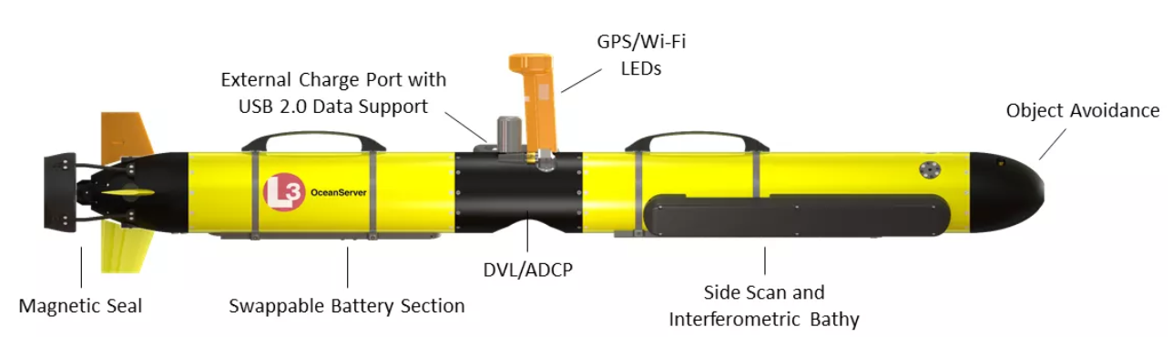
What are Unmanned Systems?
On the Surface (USVs)
Unmanned Surface Vessels
Bathymetric Mapping
In the Air (UAVs)
Unmanned Aerial Vehicles
Topographic Mapping
Not suitable for LiDAR Bathy due to size requirements
Underwater (AUVs)
Autonomous Underwater Vehicles
Vehicle tracking/Processing

Slide 5
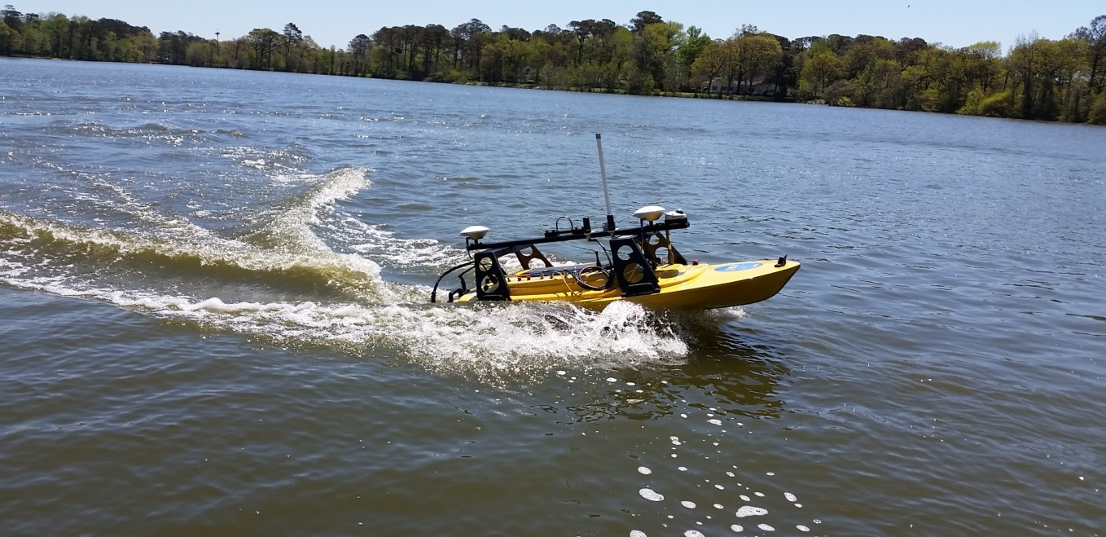
How is HYPACK Involved?
Sensor integration through HYPACK drivers
Mission planning through HYPACK combined with GNSS systems and autopilot system enables autonomous data collection
Data from sensors that are supported by HYPACK can be visualized in real time along with system health
Data acquisition and processing can be done in HYPACK
HYPACK does not drive the vessel

Slide 6
Surveying

Slide 7
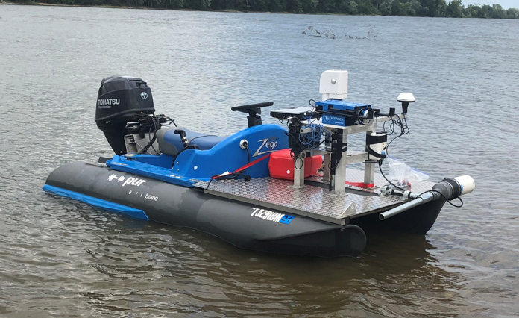
Payload Varies by Vessel and Size
Each of these vessels can carry a variety of equipment.

Slide 8
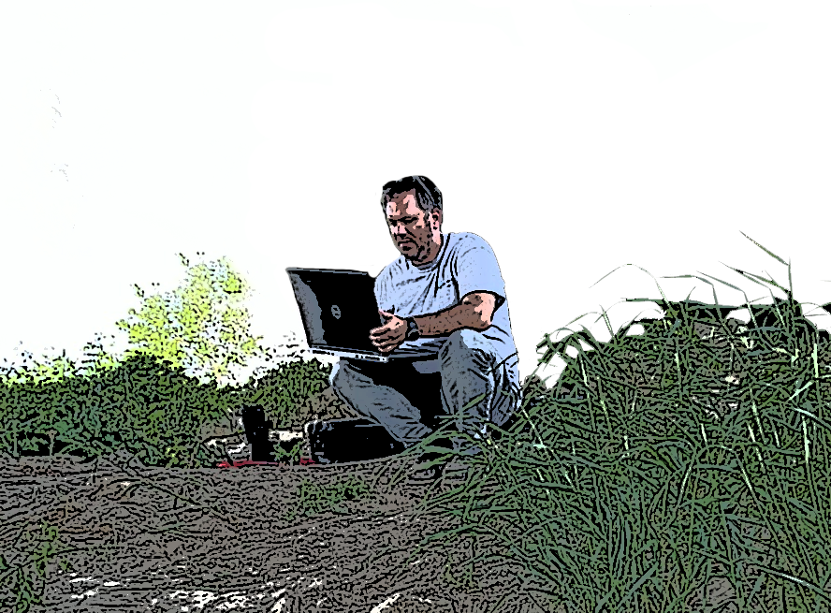
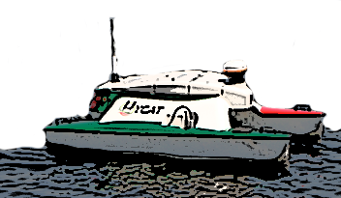
Ship to Shore Communications
Communication is often through a long range Wifi to allow the control station on shore to monitor the data as it is collected
Systems without a computer onboard typically are limited in the Payload that can be integrated due to the limit in transfer rate and timing.

Slide 9
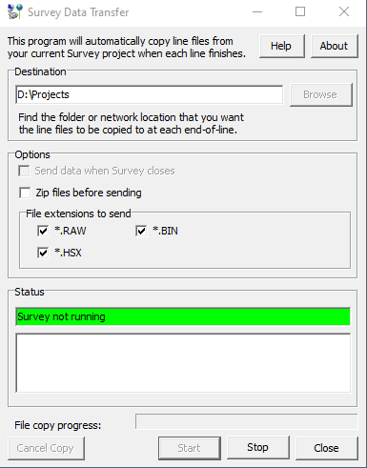
Transferring the Data Files – During the Survey
The Survey Data Transfer program allows the user to receive the files remotely
Once the lane / file is complete it is transferred to the folder specified
The Survey Data Transfer program is intended to work within a network and is not written for FTP site transfer

Slide 10
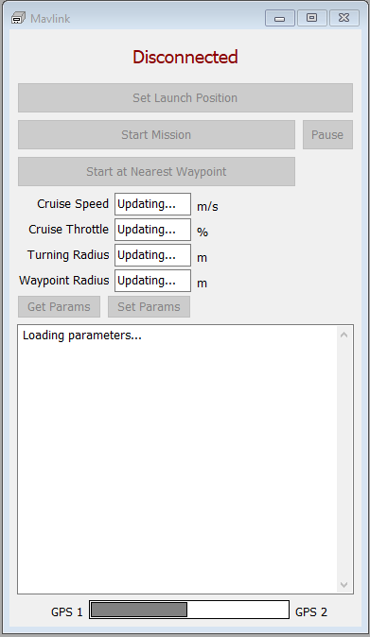
MAVLINK Interface
MAVLink is a very lightweight messaging protocol for communicating with drones (and between onboard drone components).
In HYPACK there is a direct communication between the computer and the autopilot receiving the MAVLink protocol.
The device interface allows the user to take a mission plan and send it to the vehicle.
Parameters can be modified and uploaded back to the vehicle.

Slide 11
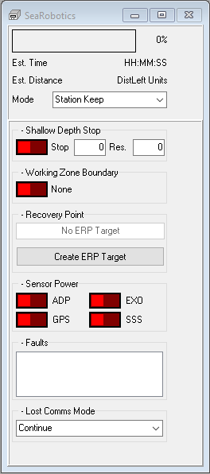
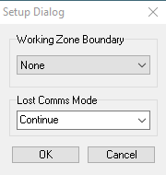
SeaRobotics
The HYCAT uses the SeaRobotics interface. This allows more control over the device including the ability to mark the Emergency Return Point
In the Setup Dialog the driver allows the user to specify a Border as a workplace boundary

Slide 12
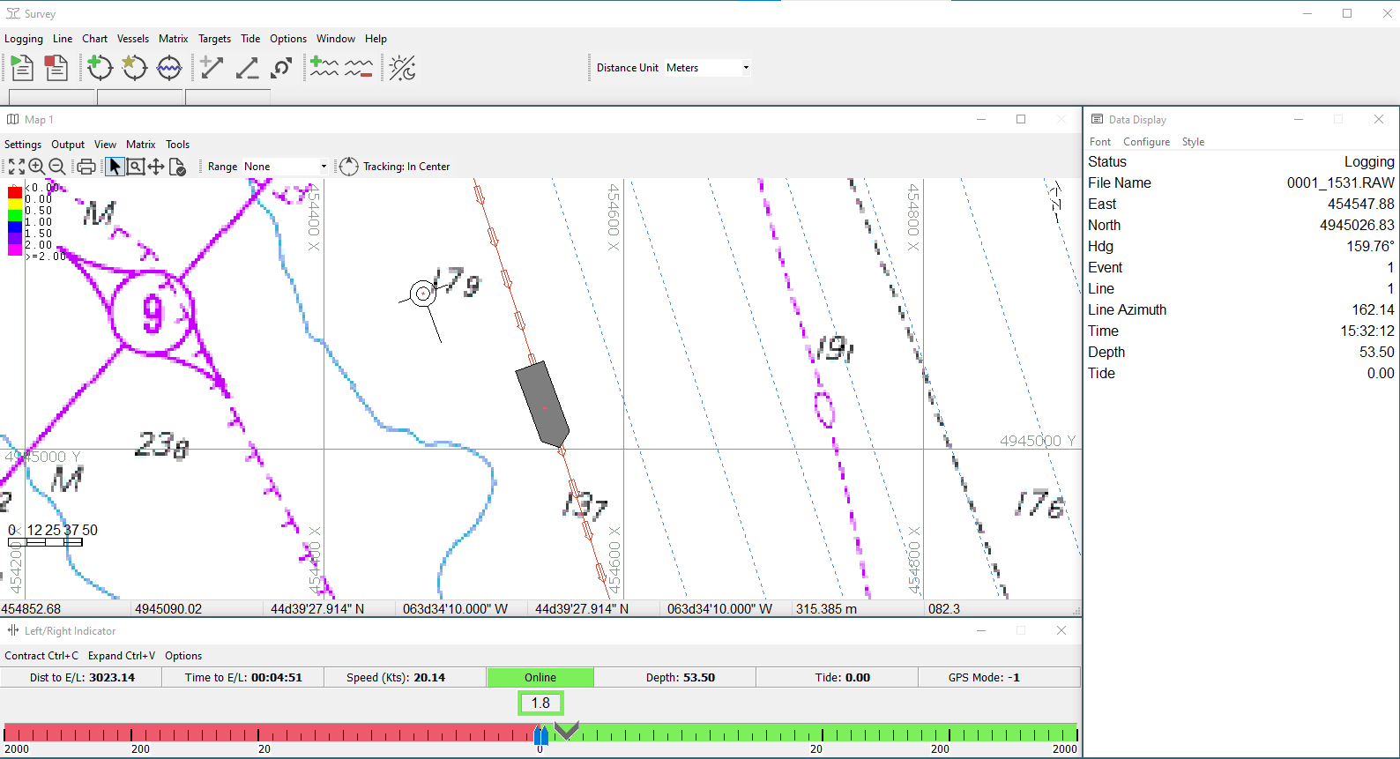
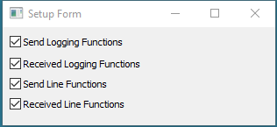
Remote Logging and Line Synchronization
When there are multiple vehicles in a network this driver allows a centralized control of logging functions.

